Slide 1
AstroLab Workshop
Introducing Go Observing and AstroLab software

Slide 2
Agenda:
Logging on to The Schools’ Observatory
Requesting an observation
Searching the archive
Using AstroLab
  Opening an observation
  Adjusting the display contrast
  False colours
  Saving an image
  Measuring size
  Measuring brightness

Slide 3
The Schools’ Observatory
www.schoolsobservatory.org
Top right – Log in

Slide 4
Account Details for The Schools’ Observatory
Username | Password
Wex26Aden | star630
Wex26Akchyata | gravity381
Wex26AntaresHoLong | light622
Wex26Anya | saturn115
Wex26Avesta | venus378
Wex26Beth | radio268
Wex26Bosco | night233
Wex26Carmen | sunrise618
Wex26Evan | sun384
Wex26Galen | sunset243
Username | Password
Wex26Jay | shadow284
Wex26Kae | gammaray145
Wex26Kamsiyochukwu | radio205
Wex26Leon | star281
Wex26Louisa | neptune128
Wex26Louise | cluster394
Wex26Mitch | energy243
Wex26Niesha | venus173
Wex26Sam | blackhole506
Wex26Victor | mercury488

Slide 5
Go Observing Demo –10 mins
Requesting observations from the telescope.
Where to look when the observations are ready.

Slide 6
Go Observing Demo
Click ‘Go Observing’ header
Choose ‘Galaxies’ > ‘Observe a Galaxy’
Select a galaxy and click on its name
Click the green ‘Submit Observation’ button – lower right of screen
Hover over ‘Go Observing’ header and select ‘My Observations’ to see status of observations
Click ‘Go Observing’ header
Choose ‘Stars’ > ‘Observe a Star or Nebulae’
Select an object and submit an observation
Explore Go Observing and submit observations
Notes:
Teacher Notes
Start with a brief introduction of what Go Observing is and how it works. Next, demo each step on the screen at the front so students can follow along.
For Step 3:
Tell students the green ‘i’ button next to the galaxy name will load a webpage with more information about that galaxy
Explain the visibility bars (what colours mean, why observing conditions change, etc.)
Demo clicking ‘Another Date’ button and changing the parameters (e.g. a week instead of a month)
For Step 4:
Talk through information on webpage (instrument, filter, exposure time, etc.)
For Step 5:
Talk through information (ID, status, etc.)
For Step 9 (if time allows):
Can show ‘Advanced Observing’ if time allows

Slide 7
Searching the Archive –
10 mins
Using the basic archive (search by object).
Using the basic archive (search by Observing Programme).
Using the advanced archive.

Slide 8
Searching the Archive
Search by Name:
Hover over ‘Go Observing’ header and select ‘Archive of Observations’
Type the name of an object you requested an observation for (e.g., NGC 5895)
Click ‘Search the Archive’ – lower right of screen
Click the ‘Code’ number to see a preview of the data
Notes:
Teacher Notes
Start with a brief introduction the archive (data, basic vs advanced, etc.). We can search by name if we want data of a specific object. Next, demo each step on the screen at the front so students can follow along.
For Step 3:
Explain other parameters (however, searching by ‘Observing Programme’ is next task)
Webpage might display ‘Too Many Observations’ at top – this means too much data is available to show all of it, so only 5 pages of the most recent data is shown instead
For Step 4:
Talk through other information (instrument, exposure time, filter, etc.)
Students can either right-click and open data in a new tab or just click back to navigate to archive results again
Tell student not to click on ‘View Image’ as this will be done in the last task of the Searching the Archive activity.

Slide 9
Searching the Archive
Search by Observing Programme:
Hover over ‘Go Observing’ header and select ‘Archive of Observations’
Click on the drop-down menu next to ‘Taken for this Observing Programme’
Select an Observing Programme (e.g. ‘3-colour galaxy’)
Click ‘Search the Archive’ – lower right of screen
Click the ‘Code’ number to see a preview of the data
Notes:
Teacher Notes
If we want data of a specific type of object (e.g. galaxies, nebulae), but don’t know any specific names, then we can search by ‘Observing Programme’. This is also useful to get similar data for multiple targets at once.
Demo each step on the screen at the front so students can follow along.
For Step 3:
Explain to students you can also search a specific target within an observing programme
For Step 5:
Students can either right-click and open data in a new tab or just click back to navigate to archive results again
Tell student not to click on ‘View Image’ as this will be done in the last task of the Searching the Archive activity.

Slide 10
Searching the Archive
Advanced Seach Form:
Hover over ‘Go Observing’ header and select ‘Archive of Observations’
Click on ‘Advanced Search Form’ at the bottom of webpage
Type the name of an object and/or select an ‘Observing Programme’
Choose the options you want
Click ‘Search the Archive’ – lower right of screen
Click the ‘Code’ number to see a preview of the data
Notes:
Teacher Notes
If we want more specific data (e.g. certain filter, instrument, exposure time), we can use the ‘Advanced Search Form’.
Demo each step on the screen at the front so students can follow along.
For Step 4:
Talk through information with students. – however, some options chosen together will yield no results (e.g. IO:O and a telescope other than Liverpool Telescope, as only Liverpool Telescope has this instrument. See next slide for details of which instrument is used on each telescope)
For Step 5:
Students can either right-click and open data in a new tab or just click back to navigate to archive results again
Tell students they will be opening their image with AstroLab for the next task.

Slide 11
Telescope | Instrument | Filters
Liverpool Telescope | IO:O RATCam (not since 2014) | B and V u’, g’, r’, i’, and zs’ Ha
‘________’ 2 metre Faulkes Telescope | MuSCAT Fast | u’, g’, r’, i’, and zs’ g’ narrow, r’ narrow, i’ narrow, and zs’ narrow
‘________’ 1 metre Telescope | Sinistro Sinistro Centre | U, B, and V u’, g’, r’, i’, and zs’
‘________’ 0.4 metre Telescope | QHY600 QHY600 Centre | B and V u’, g’, r’, i, and zs’
Notes:
Teacher Notes
‘_____________’ refers to the location of the telescope (e.g. Haleakala 2 metre Faulkes Telescope)
Each telescope has a specific instrument with its own filters and field of views (FoVs). H alpha observations submitted via Go Observing are all currently completed on Liverpool Telescope, though 0.4 metre telescopes have the filter available.
For Liverpool Telescope:
RATCam replaced IO:O in approx. Feb 2014 - both are optical CCD cameras
RATCam FOV is 4.6 x 4.6 arcminutes
IO:O FoV is 10 x 10 arcminutes
For 2 metre Faulkes Telescope:
MuSCAT FoV is 9.1 x 9.1 arcminutes
For 1 metre Telescope:
There is no U data on archive
There is no zs’ data on archive
Sinistro FoV is 26 x 26 arcminutes
Sinistro Centre FoV is 13 x 13 arcminutes
For 0.4 metre Telescope:
QHY600 Centre is used as default in Go Observing – there’s only 3 sets of data for QHY600
There is no u’, g’, i’ or zs’ data on archive
QHY 600 FoV is 1.9 x 1.2 degrees
QHY600 Centre FoV is 30 x 30 arcminutes

Slide 12
Using AstroLab –
30 mins
Opening images
Changing the display settings
Playing with false colours
Saving an image
Measuring the size of an object
Measuring the brightness of an object

Slide 13
Using AstroLab
From the Archive:
Choose an object from the search results and click on the image to open it in AstroLab
Go to ‘Display’ > ‘Scaling’
Lower the ‘Maximum value’ to display more detail – use the sliders or type in a number
Increase the ‘Minimum value’ to reduce fuzziness of image – typing in a number works best
Notes:
Teacher Notes
Demo each step on the screen at the front so students can follow along.
Explain why we need to scale images.

Slide 14
Download the FITS files from Teams
Presentations
  > 2 Tuesday
    > FITS Files (Exploring AstroLab)
Save them in your documents!

Slide 15
Tinyurl.com/wexexplore
https://tinyurl.com/fv5y4xey - Evan
https://tinyurl.com/j7xp3y4u - Galen
https://tinyurl.com/y665bppt - Kae
https://tinyurl.com/32bhydzs - Bosco
https://tinyurl.com/23thmwum - Aden
https://tinyurl.com/3hkr3te8 - Avesta
Notes:
Files are uploaded here as a back-up option if any students have issues accessing Teams

Slide 16
Using AstroLab
From the website:
Hover over ‘Get Started’ header
Go to ‘View your images’ > ‘AstroLab’
Click the ‘Open AstroLab’ button
Go to ‘File’ > ‘Open an image’
Navigate to the downloaded files and select ‘Whirlpool Galaxy.fits’
Click upload
Go to ‘Display’ > ‘Scaling’
Lower the ‘Maximum value’ to display more detail – use the sliders or type in a number
Increase the ‘Minimum value’ to reduce fuzziness of image – typing in a number works best
Notes:
Teacher Notes
Demo each step on the screen at the front so students can follow along.
Explain why we need to scale images.

Slide 17
Using AstroLab
False Colours:
Go to ‘Colour’ > ‘False Colours’
Select a colour scheme
Create a Colour Scheme:
Go to ‘Colour’ > ‘Make Your Own’
Follow the guidance
Save an Image:
Go to ‘File’ > ‘Download Picture’
Move file from downloads into your own documents
Rename (e.g. Whirpool Galaxy – False Colours 1)
You can also upload your images to:
General > AstroLab Pictures
Just make sure to put your name in the image name!
Notes:
Teacher Notes
Demo each step on the screen at the front so students can follow along.
Explain why false colours can be useful in astronomy.

Slide 18
Using AstroLab
Opening Multiple Files:
Click on the grey ‘+’ arrow on the right of the screen
Select which file to upload
Change display settings to view image
Switch between image data by clicking the image boxes on the right
To delete an image file, press the white ‘x’ button, check the image name in the pop-up menu and then click ‘OK’
Notes:
Teacher Notes
Demo each step on the screen at the front so students can follow along.
For Step 5:
The white ‘x’ button may be located either at the top or bottom of the image box – this might be dependent on which web browser is used
Let students open different files and experiment with false colours.

Slide 19
Using AstroLab
Measuring Size:
Open the ‘Jupiter.fits’ file
Zoom in – use mouse or ‘Display’ > ‘Zoom in’
Centre Jupiter – hold down the left clicker button and move the image
Go to ‘Astro’ > ‘Measure Size’
Click ‘Add Line’
Rotate line and stretch across the middle of the planet
Calculate diameter by multiplying the line length and the value given for each pixel
Repeat for ‘Saturn.fits’ file – don’t include the rings in your measurement
Notes:
Teacher Notes
Demo each step on the screen at the front so students can follow along. We don’t need to scale because Jupiter (a planet) is much brighter than other objects since it’s closer to us.
Explain the difficulty in defining edge of object – use the ‘zoomed in view’ box on the left (can zoom in more or less with small + and – buttons in the zoomed view box)
Diameter of Jupiter = 139 820 km (139.82 thousand km)
Diameter of Saturn = 116 464 km (116.464 thousand km)

Slide 20
Using AstroLab
Measuring Size:
Open the ‘M1 Nebula.fits’ file
Change display settings to view image
Go to ‘Astro’ > ‘Measure Size’
Click ‘Add Line’
Rotate line and stretch across the middle of the object
Multiply the line length by the value given for each pixel
Notes:
Teacher Notes
Demo each step on the screen at the front so students can follow along.
Explain the difficulty in defining edge of object – false colours can help highlight this.
Talk about the scale being compared to Jupiter – AU (define this unit) vs thousand km. Astronomical objects are a various range of sizes, so astronomers use many different units. Another example is light years.
Answer: approx. 70 000 AU

Slide 21
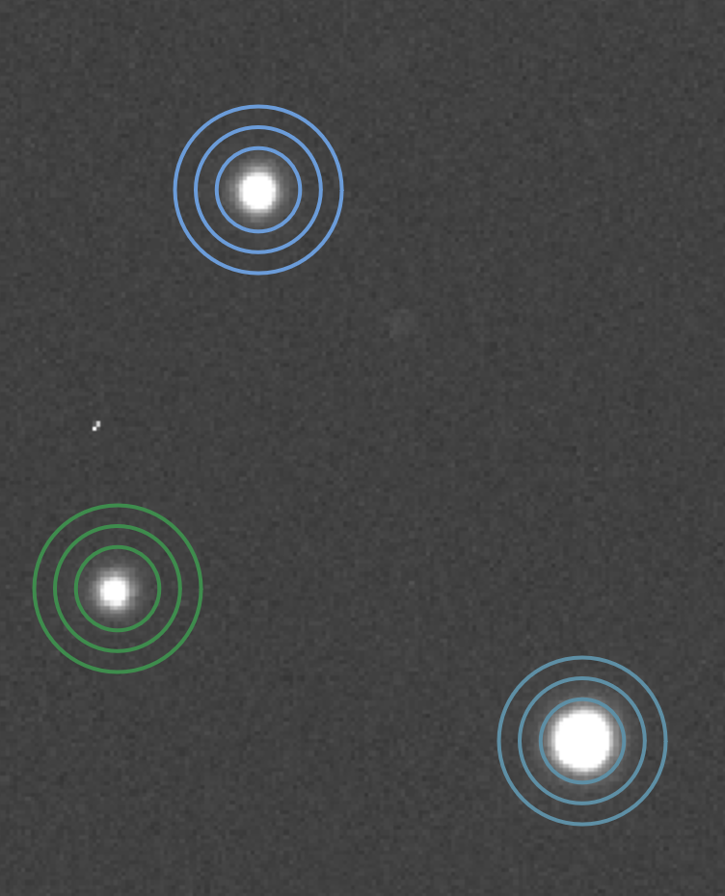
Photometry
Photometry: measuring the brightness of astronomical objects. Done using tools in software (like AstroLab).
Gives a value of the light intensity, known as counts – the number of photons collected by the telescope.
To compare the brightness of astronomical objects, counts are converted to flux or magnitudes (calculated from flux). Flux is the rate of flow per unit area.
Notes:
Teacher Notes
Photons are packets of light (light as a particle). Students may know this from their A-Level studies.
Brightness in counts can be affected by the detector, atmospheric conditions (e.g. seeing), and exposure time. Converting to flux accounts for this, effectively calibrating the data so comparisons can be made.
Students may know about magnetic flux density (from GCSE and A-Level), so may already have an awareness of what flux means. ‘Rate of’ means per unit time.
Magnitudes show relative brightness. It is a logarithmic scale. A difference of 5 magnitudes = a factor of 100 flux. A smaller (including negative) magnitude means a brighter object.

Slide 22
Uses of Photometry
Analyse brightness changes in an object e.g., variable stars, eclipsing binaries, supernovae
Determining temperatures and chemical compositions (including metallicities)
Creating colour-magnitude diagrams (CMDs)
  Stars
  Star Clusters
  Galaxies
Notes:
Teacher Notes
Changes in brightness can used to create a light curve. Different types have variable stars have different shaped light curves. Light curves can also tell us about a star’s size and orbital period. Supernovae light curves can determine the type of supernova.
Temperature is related to colour; higher is bluer, lower is redder. Comparing an object in different filters shows how brightness changes. A colour index is the difference in the brightness of an object between two different filters. It can be used to help determine the temperature of a star.
In astronomy, metals are defined as elements heavier than hydrogen and helium.
CMDs of stars can help us understand how stars evolve over time. The features relate to stages in the life cycle of star. This will be covered in more detail in the ‘Intro to Stars’ workshop.
CMDs of star clusters can help determine age, distance, and metallicity.
CMDs of galaxies can help us understand the types of galaxies and how galaxies evolve over time. Students will now plot some galaxies on a CMD and look for features.

Slide 23
Download the FITS files and EXCEL sheet from Teams
Presentations
  > 2 Tuesday
    > FITS Files (Galaxy CMD)
> AstroLab Galaxy CMD – Student Worksheet (blank)
Save them in your documents!
Rename EXCEL sheet: ‘AstroLab Galaxy CMD – Student Worksheet (Your Name)’

Slide 24
astro.ljmu.ac.uk/~amn/WexWeek/CMD/

Slide 25
Using AstroLab
Open the ‘M59 – B.fits’ file
Change display settings to view image
Go to ‘Astro’ > ‘Measure Brightness’
Click ‘Add Target’
Adjust radius so the inner circle completely surrounds the galaxy
Adjust radii of inner and outer rings if needed
Click on ‘Results’ header to view results
Copy the value into the EXCEL sheet – ‘Counts’ > ‘B’
Open the ‘V’ data for the galaxy
Measure the brightness and input the value into the EXCEL sheet
Repeat for all galaxies
Notes:
Teacher Notes
Demo each step on the screen at the front so students can follow along.
Show students that more targets can be added (and what the results look like – this data can be exported). This is useful for getting magnitudes of lots of objects in the image at once (e.g. CMD of cluster).

