Slide 1

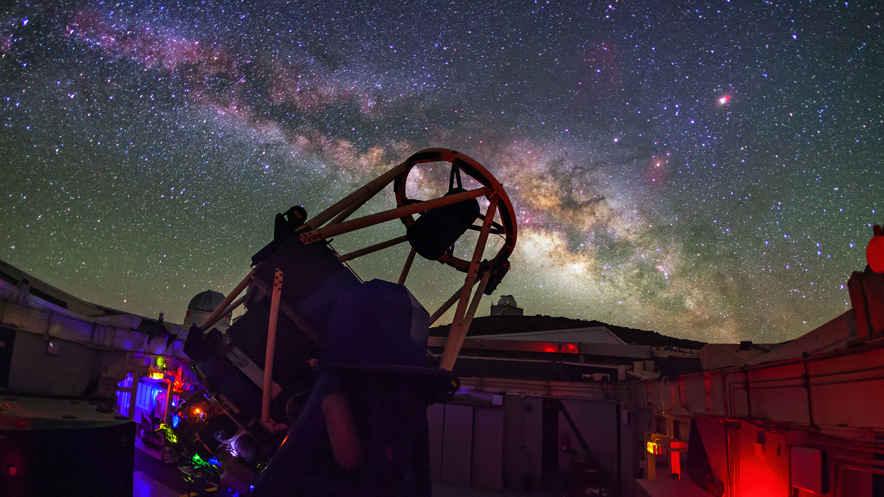

Careers in Physics
The Schools’ Observatory
Picture credit: Daniel López - IAC

Slide 2
Graduate Market:
1. How many students graduated in 2024?
555,835
2. How many graduated with a physics degree?
~7,000
Psychology: 44,900
Biological and Sports Science: 38,045
Business and management: 243,295
Geography, Earth and Environmental Studies: 11,380
Notes:
From HESA

Slide 3

Quick quiz!
How many people in the UK work in industries powered by physics?
A. 500,000
B. 1.2 million
C. 2.7 million
Notes:
~10% of all UK employment

Slide 4

Quick quiz!
From 2021 to 2022, the workforce of the UK Space industry has…?
A. Grown 2.8%
B. Grown 6.7%
C. Shrunk by 5%
Notes:
From ‘Size and Health of the UK Space Agency 2023’:
Direct employment constituted an estimated 52,000 Full Time Equivalents (FTEs), representing 6.7% growth versus 2020/21’s 48,800 FTEs. This is equivalent to 0.16% of the total UK workforce, with a further 76,500 indirectly supported jobs across the supply chain giving a total of 128,500 jobs supported – this number is not directly comparable to 2020/21.

Slide 5
Quick quiz!
How many people have a STEM job across all industries in the UK?
A. 3.7 million
B. 6.2 million
C. 9.4 million
Notes:
From ‘Supply of skills for jobs in science and technology’:
This publication assesses STEM workers across the whole economy, accepting the relevance of STEM jobs both in science and technology industries and in non-science and technology industries.

Slide 6
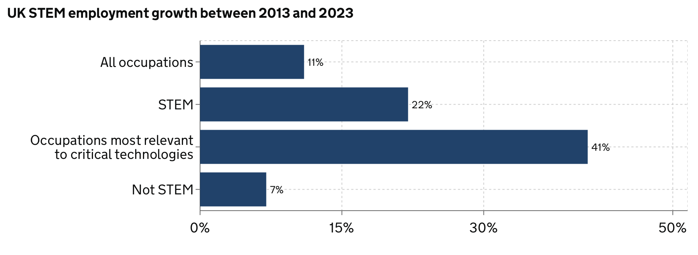
STEM Workforce
Source: Supply of skills for jobs in science and technology
Notes:
Occupations most relevant to critical technologies:
Artificial Intelligence (AI) – machines that perform tasks normally performed by human intelligence, especially when the machines learn from data how to do those tasks.
Engineering biology – the application of rigorous engineering principles to the design of biological systems.
Future telecommunications - evolutions of the infrastructure for digitised data and communications.
Semiconductors – a class of electronic materials with unique properties that sit at the heart of the devices and technology we use every day.
Quantum technologies – devices and systems which rely on quantum mechanics, to provide capabilities that ‘classical’ machines cannot.

Slide 7
Where do Physics graduates go?
Physics-based UK businesses contribute £230bn to the economy
(2021/22 graduates)
Notes:
https://www.prospects.ac.uk/careers-advice/what-can-i-do-with-my-degree/physics

Slide 8
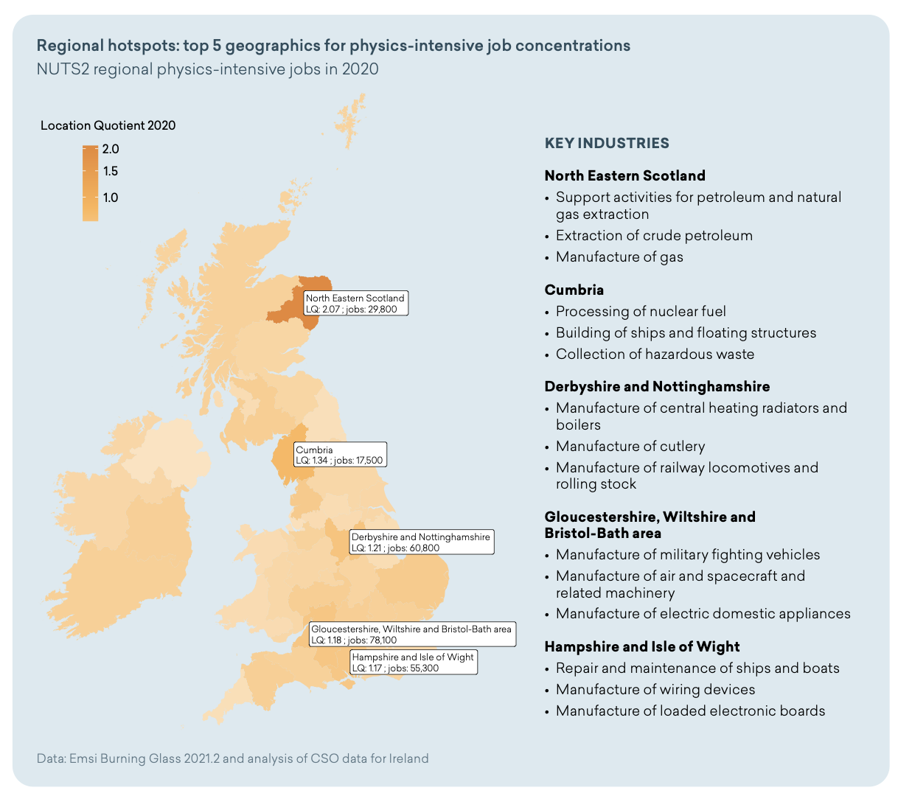

Slide 9

Employment
Notes:
https://www.prospects.ac.uk/careers-advice/what-can-i-do-with-my-degree/physics

Slide 10
Earnings
What is the annual starting salary for a physical scientist graduate?
£29,000
Veterinary: £33,000
Medicine and dentistry: £35,000
Business and management: £27,000
Architecture, building and planning: £25,000
Law: £24,000
Notes:
https://www.savethestudent.org/student-jobs/whats-the-expected-salary-for-your-degree.html
This is an average starting salary – amount will vary depending on location, job sector, etc.

Slide 11
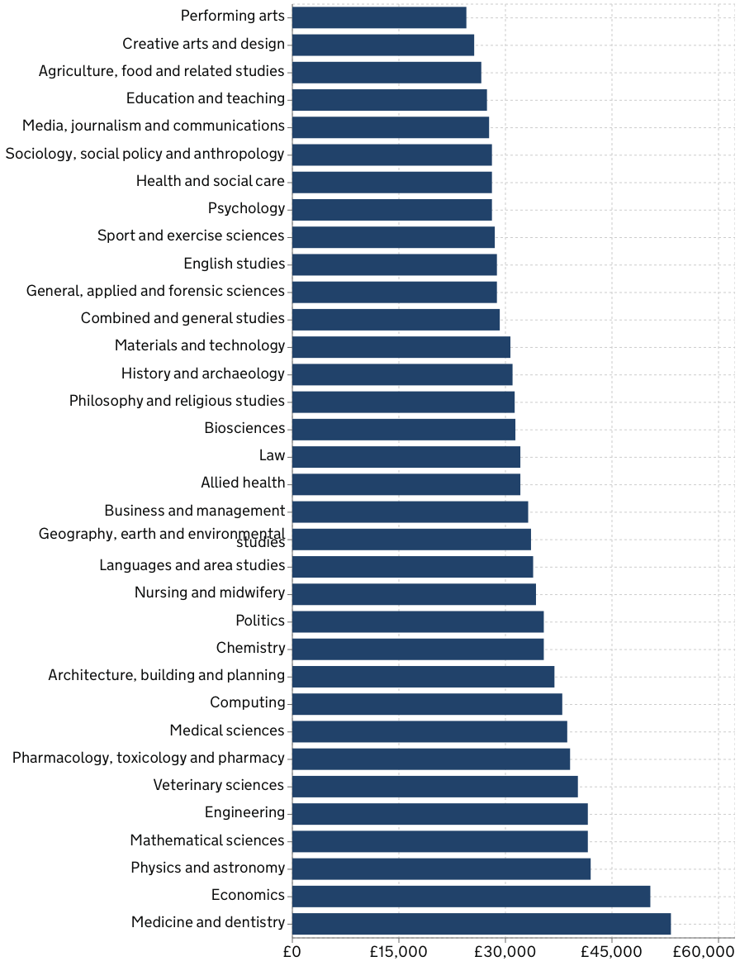
Median Earnings of Graduates 5 years after Graduation
(Tax Year 2022/23)
Source: Outcomes and earnings data
Notes:
From gov.uk ‘LEO Graduate outcomes provider level data’
Note: graduates may not be working in purely physics and astronomy areas, but the skills are highly sought after and transferrable to several other careers.

Slide 12
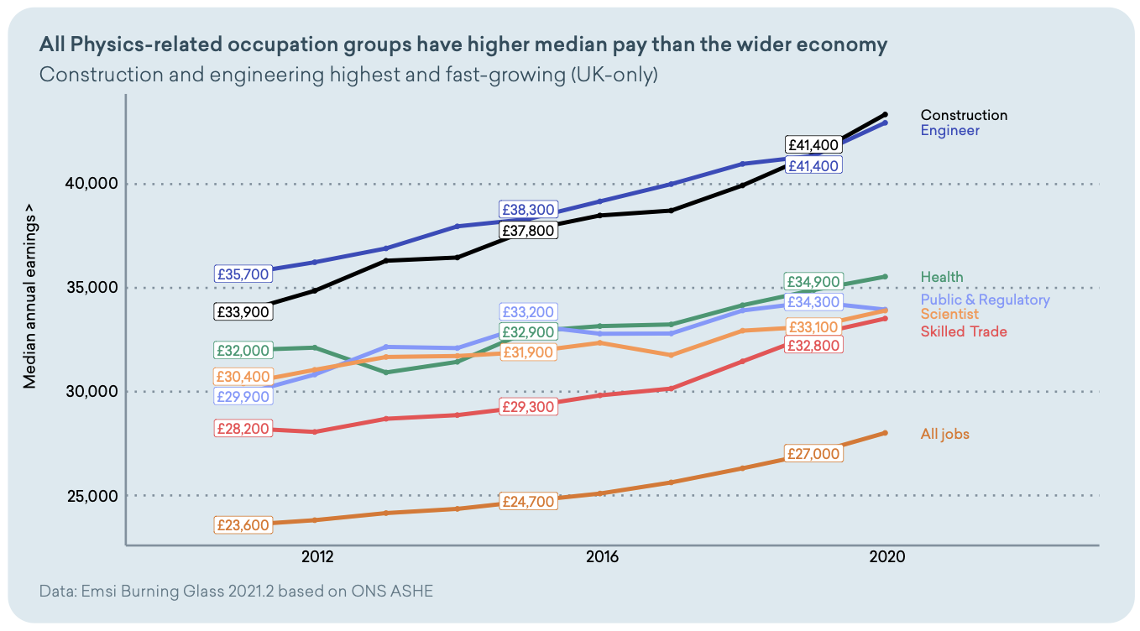
Notes:
From IOP report ‘Physics in Demand’:
Airline pilots and flight engineers are the highest paid – median salary of £97 ,400 – followed by electrical engineers (£52,200), construction managers (£48,600) and research and development managers (£46,700).

Slide 13
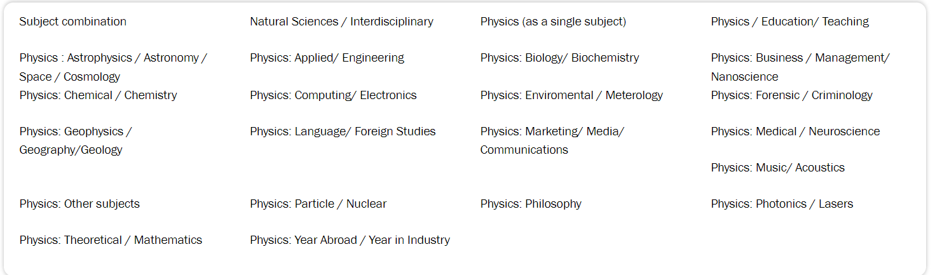
Physics Degrees
What do you enjoy most about physics?
Do you want to combine physics with another subject?
Do you want a year abroad or in industry?
Where would you be happy to live for 3+ years?
Is the degree course IOP accredited?
Notes:
Wide variety of degrees available in many locations.
Choose a degree course that you feel best suits you - if you change your mind, most universities allow switching between courses in the 1st year because modules at this time between physics course are similarly building core knowledge, so tend to overlap.
Ultimately, where you decide to study doesn’t matter too much, but IOP has a register of accredited courses that are academically ‘sound’.
https://www.ucas.com/explore/subjects/physics-and-astronomy

Slide 14

Grade Requirements
Vary with each institution
  110 – 160 UCAS points
  A-Levels: A* = 56, A = 48, B = 40, C = 32, D = 24, E = 16
Average A-Level Grades: AAB – ABB
  MUST include Maths and Physics
Some degrees offer Foundation Years for those with lower grades
BSc and MPhys may have different requirements
ucas.com/ucas/tariff-calculator
Notes:
Not many people wanting to do undergraduate physics, so best grades will only be needed for the most competitive universities.
As well as foundation years, you can also apply for a physics degree through clearing if you don’t get accepted at your choices.
https://www.ucas.com/explore/subjects/physics-and-astronomy

Slide 15
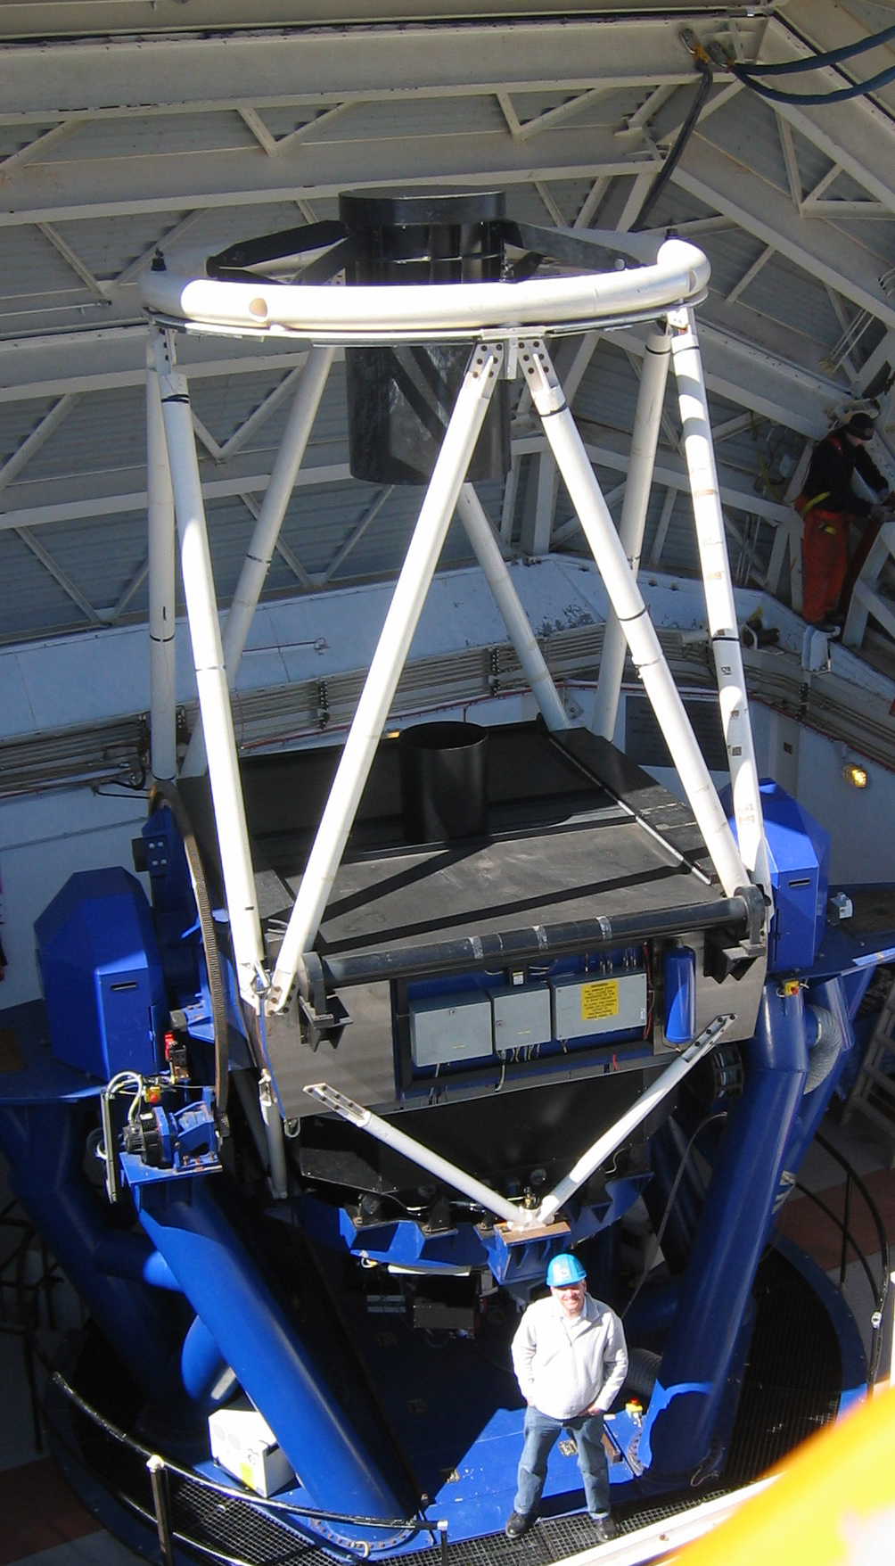
Astrophysics in Liverpool
A-Levels: A* = 56, A = 48, B = 40, C = 32, D = 24, E = 16
Physical Science Foundation Year:
  Typical offer is 80 UCAS points (CDD at A-Level)
Physics with Astronomy BSc (Hons)/Astrophysics MPhys:
  128 UCAS points (ABB at A-Level)
  must include Maths and Physics.
Accredited, and offering study abroad opportunities
Opportunity for observing experience:
  Use of the Liverpool Telescope for final year projects
  Undergraduate Field Trip to Tenerife (summer of 2nd Year)

Slide 16
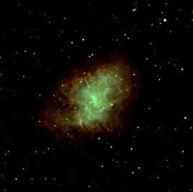
What is Astrophysics?
Physics
Maths
Chemistry
Computing
Astronomy
Communication
Combination of skills
Highly transferable skill set
Open many doors to an interesting career

Slide 17

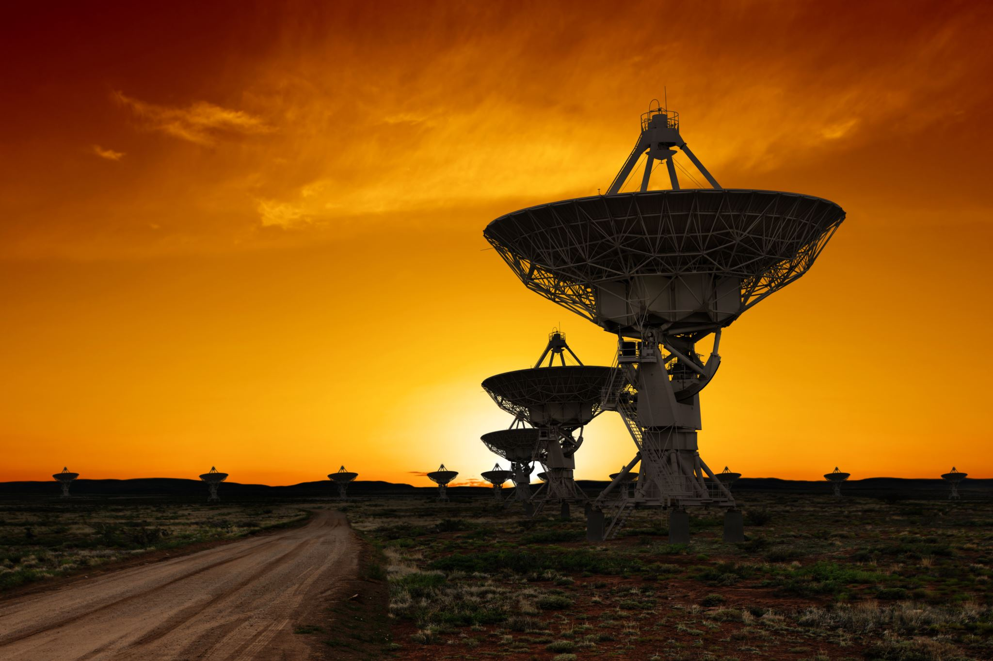




Physics & Astrophysics
What you might do…
Where you might work…
Conduct research and test theories
Collect and analyse data
Use, maintain and develop equipment
Develop software
Create computer models
Write papers and attend conferences
In laboratories
In observatories
In universities
In museums
In planetaria
Notes:
Data – using telescopes or spacecraft
Equipment – telescopes, supercomputers

Slide 18
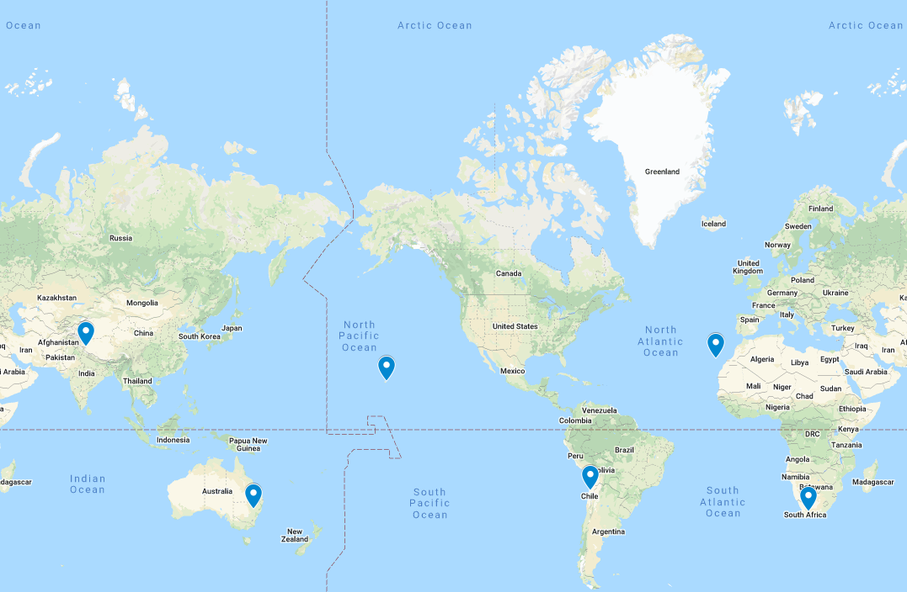
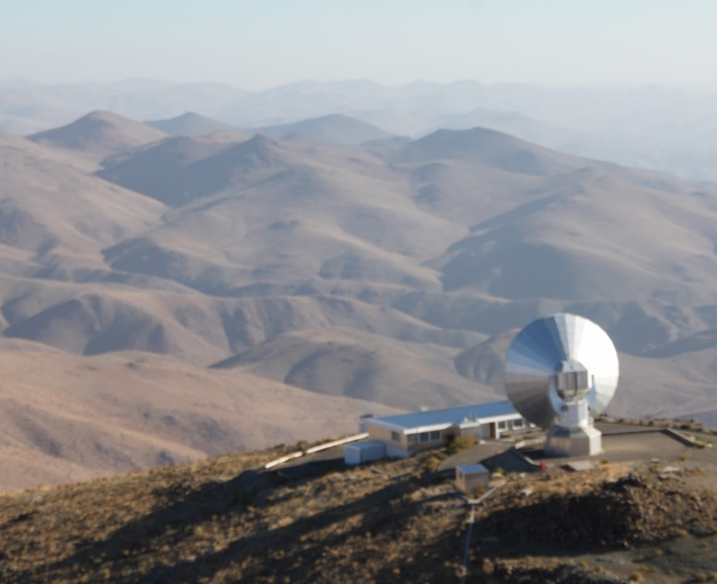

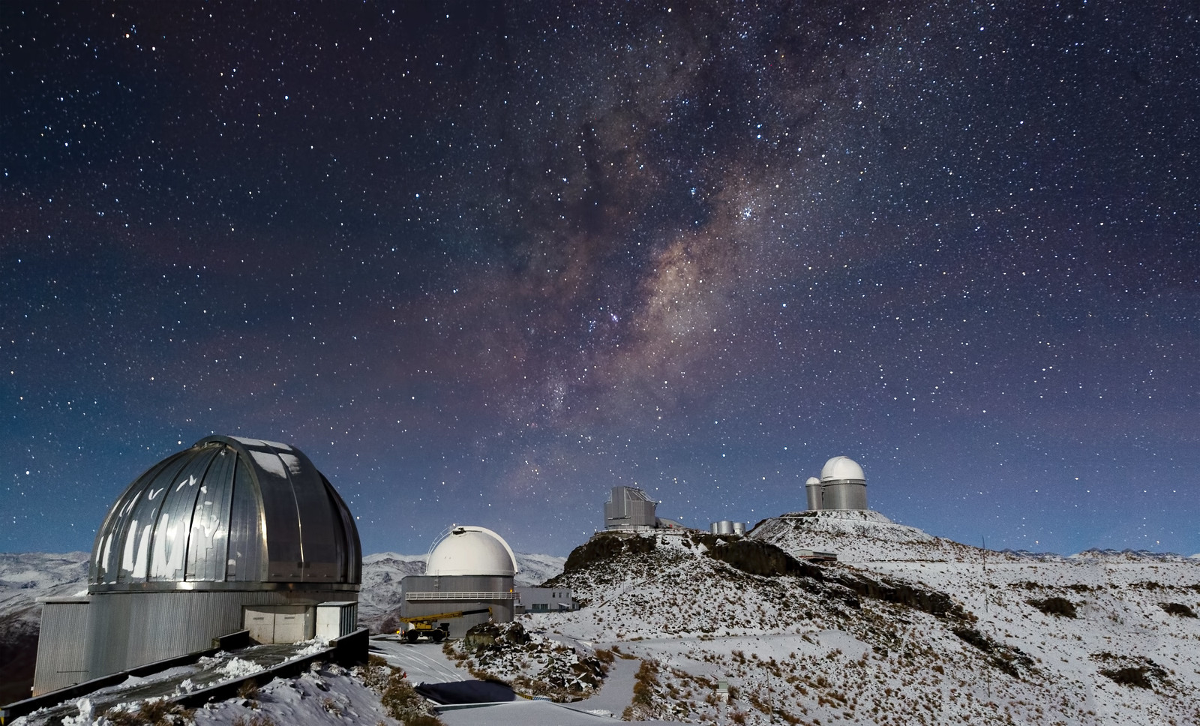
Travel the World!
Notes:
Travel the world to use observatories
https://en.wikipedia.org/wiki/File:Hawaii_SunSet2111111.jpg
https://pixabay.com/photos/summit-la-palma-canary-islands-2871545/
https://www.flickr.com/photos/esoastronomy/8733985135

Slide 19
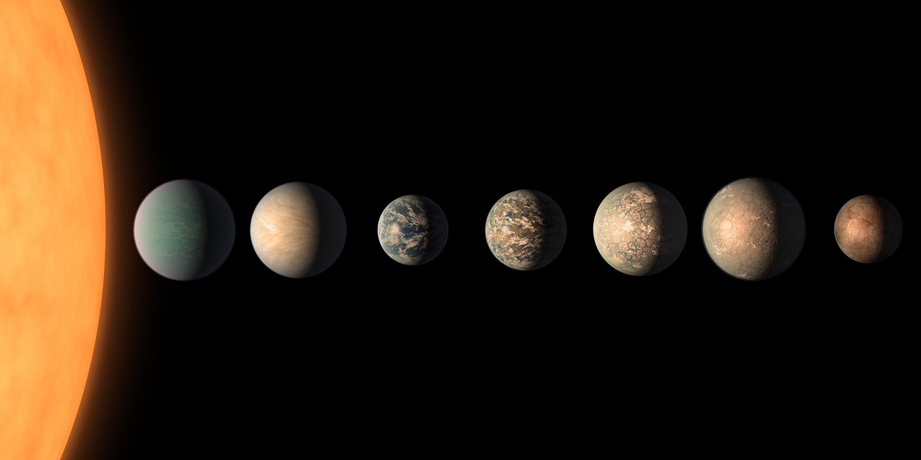
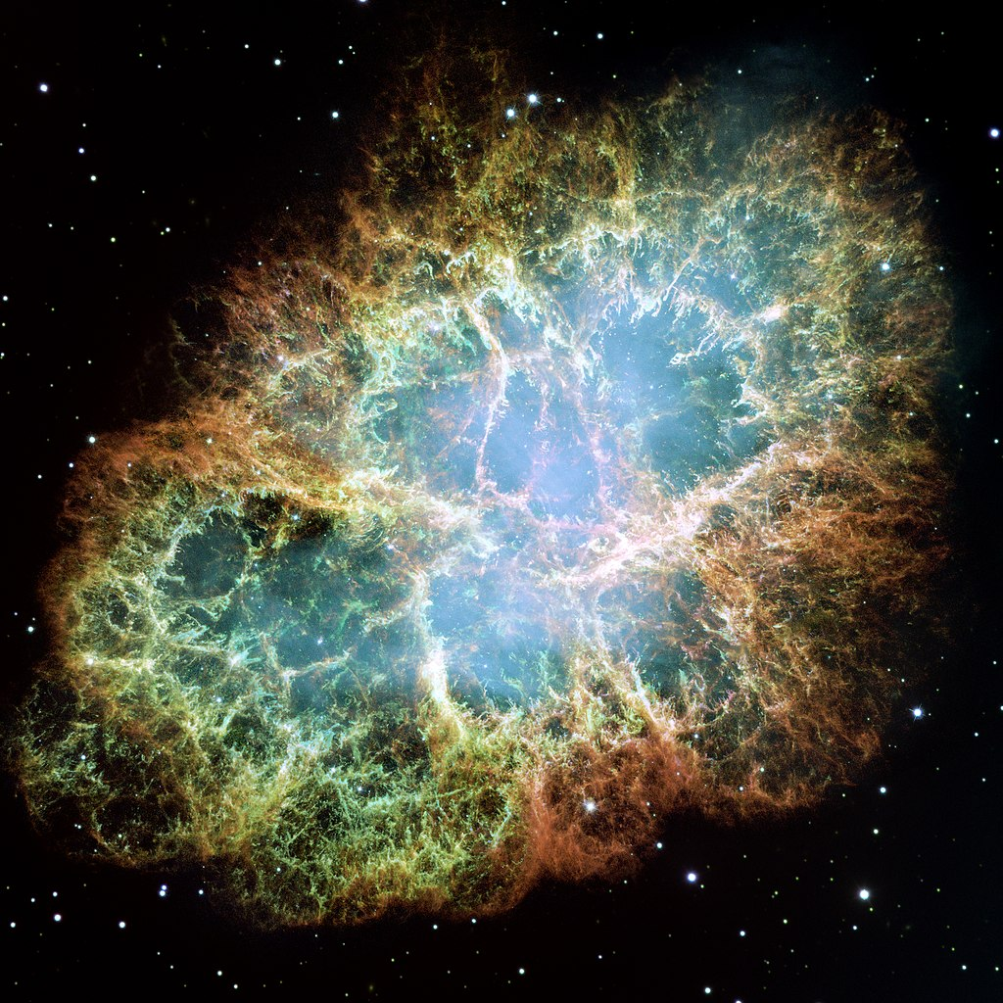
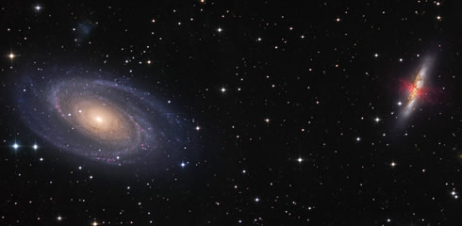
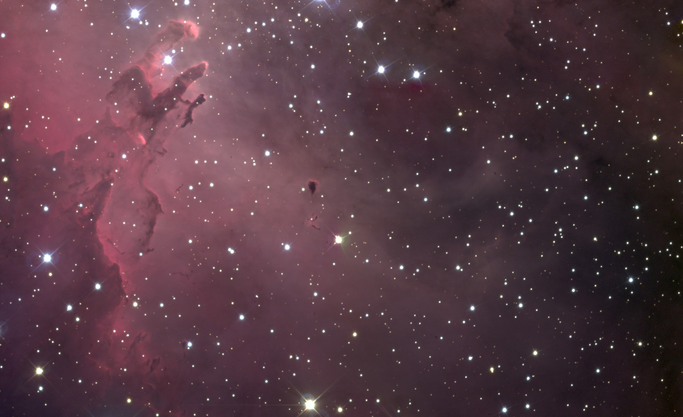
Study the Universe

Slide 20
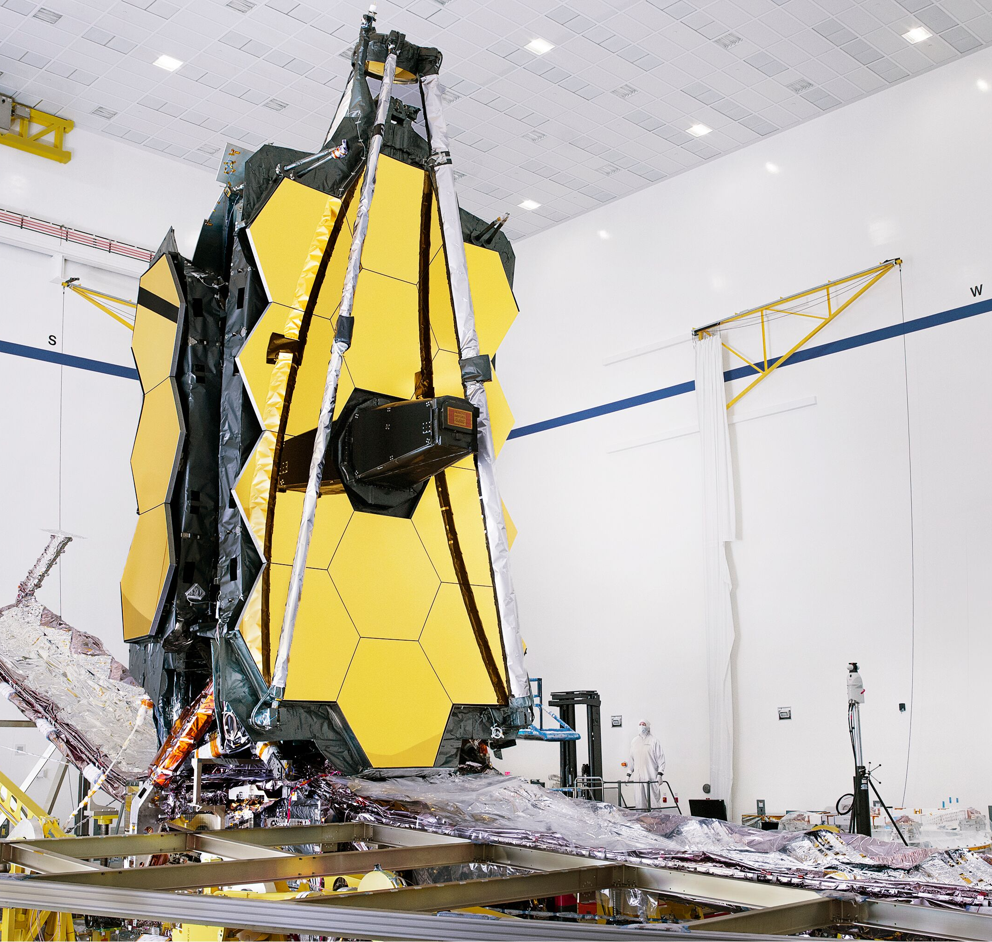
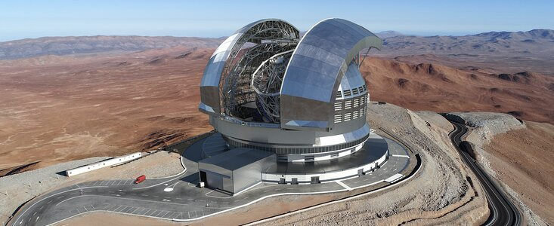
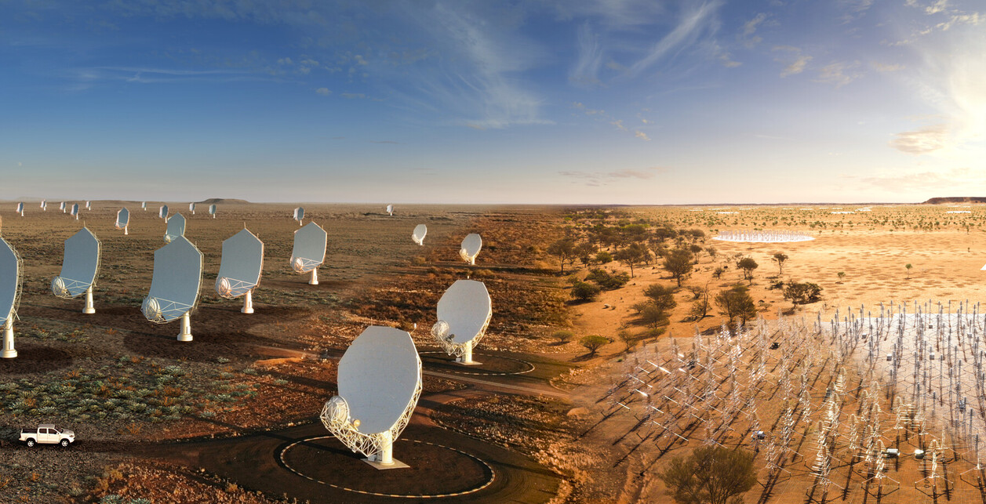
Drive forward technology
Notes:
Work with data collected in space
Use the next generation of space telescopes

Slide 21

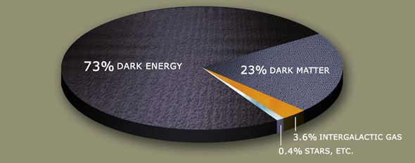
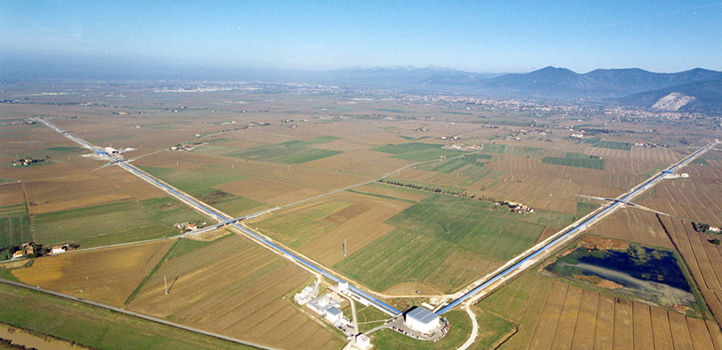
Answer the BIG Questions!

Slide 22

And much more!

Slide 23







Any questions?

Slide 24
Physics & Astrophysics
WHAT IS PHYSICS?
WHY IS IT IMPORTANT?
Part of science
Mechanics, heat, light, sound, electricity, magnetism, atoms
The study of how the Universe behaves, from the smallest particles to clusters of galaxies
For other sciences
To improve lives
Tackle challenges the world faces

Slide 25
What is Astrophysics?
WHY IS IT IMPORTANT?
Discover how the Universe works, explore how it began and evolved, and search for life on planets around other stars.
-NASA’s Goal in Astrophysics

Slide 26

Apprenticeships

Slide 27
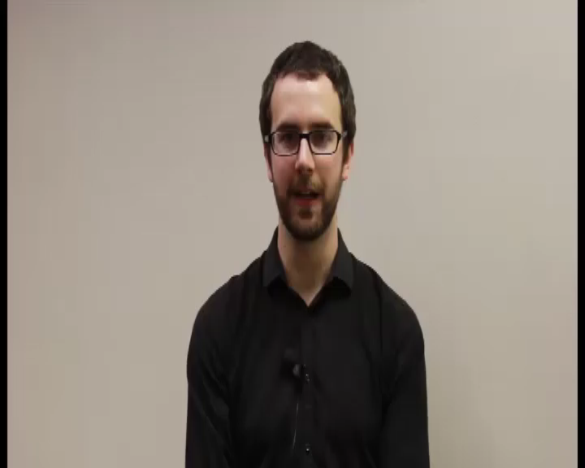
Mike’s Story

Slide 28
What is Astrophysics?
“The branch of astronomy concerned with the physical nature of stars and other celestial bodies, and the application of the laws and theories of physics to the interpretation of astronomical observations”
- Oxford Languages

