Slide 1
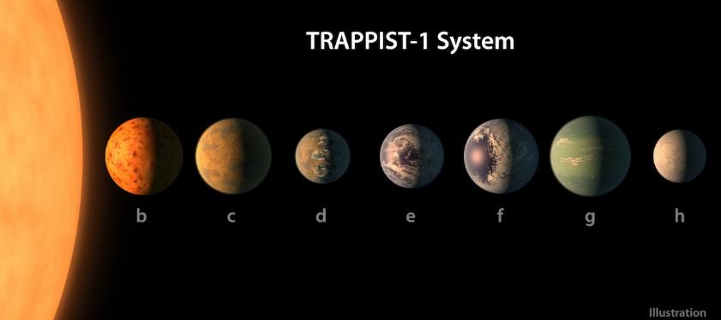
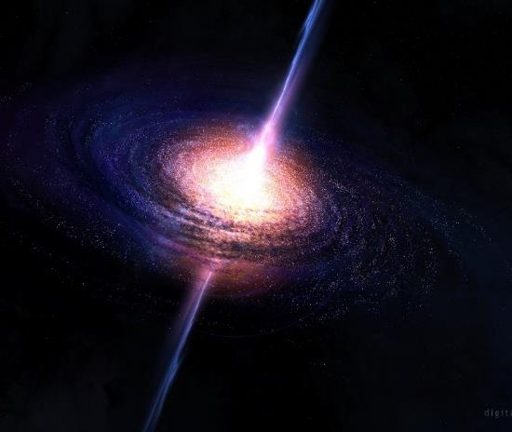
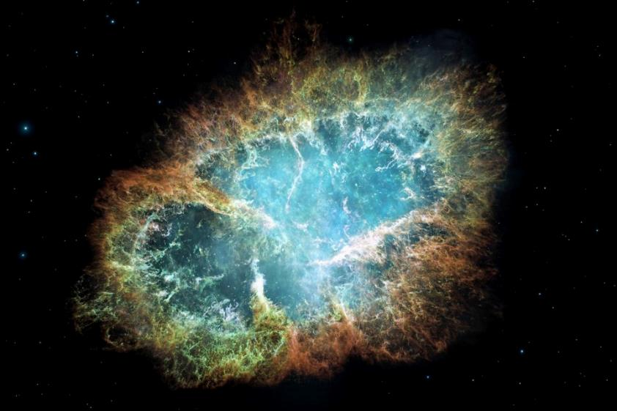


COMMUNICATING YOUR SCIENCE
The What, Why and the How!
Notes:
Important info, overview of the week, today’s timetable
Introduce university and people you’ll be working with
Briefly describe what we do here
But first….

Slide 2
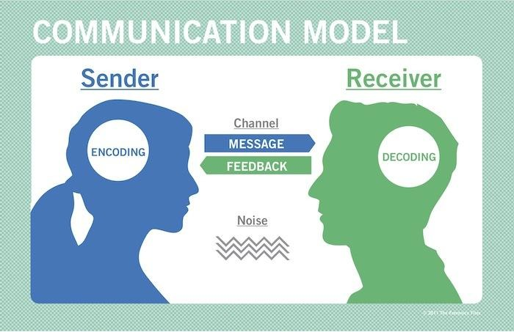
WHAT IS A SCIENCE COMMUNICATION?
Scientist
Science Communicator
You

Slide 3
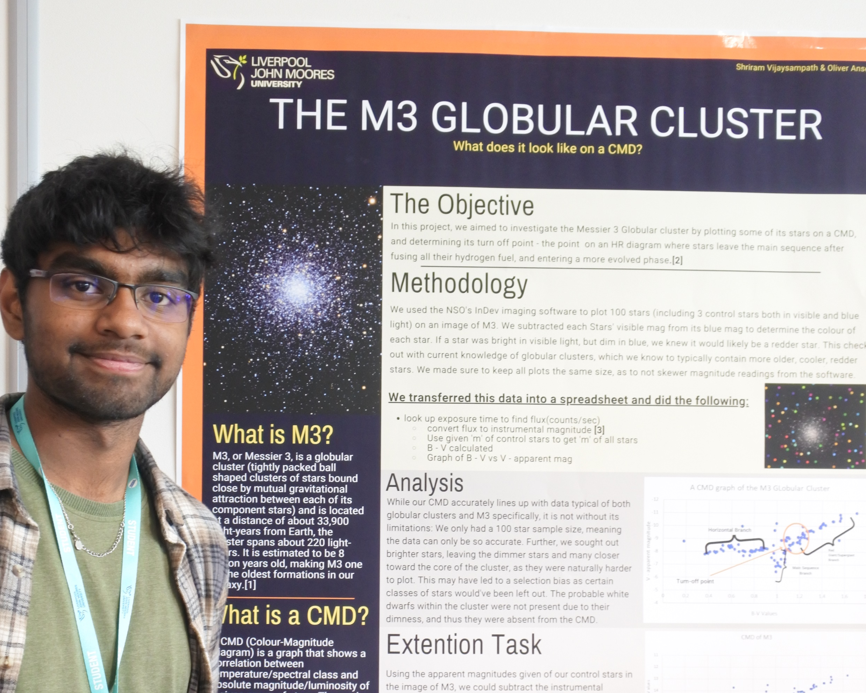

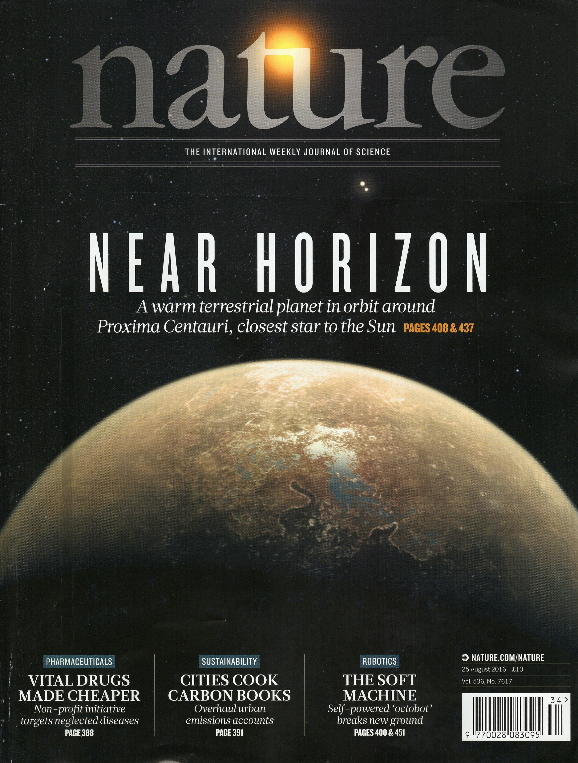
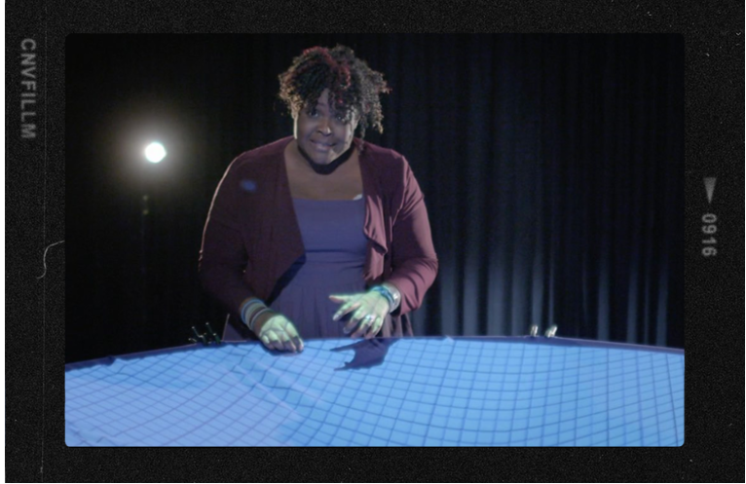
SCIENCE COMMUNICATION CHANNELS
Public talks
School workshops
Science Festivals
TV/Radio
Writing blogs
Social media
Magazines/newspapers
Conferences (Posters)
Art exhibition
Notes:
Nature - By ESO/M. Kornmesser (photo displayed on the magazine cover) - https://www.eso.org/public/images/ann16056a/ (photo displayed on the magazine cover), CC BY 4.0, https://commons.wikimedia.org/w/index.php?curid=50998461
Maggie - https://www.bbc.co.uk/programmes/p03qt9yh
Poster – NSO
Lecture – canva
Classroom - canva

Slide 4
WHAT IS A SCIENCE COMMUNICATION?
The Public

Slide 5
WHO ARE THE PUBLIC?
There isn’t one!
Community groups
Academia
Social groups
Age groups
Genders
Ethnicities
Education
Geographical
Policy makers
Industries
Schools

Slide 6



WHY SHOULD I BOTHER TALKING ABOUT MY SCIENCE?
Audience
Institution
You

Slide 7
1. STAND UP FOR SCIENCE
Fighting back against the dangerous tide of misinformation
Raising awareness about the global challenges
Regaining trust in science (from being role models or people experiencing STEM in a positive way)
2. LET’S TALK
Helping the public feel confident
Empowering the public to join in conversations
Listen and Incorporate their thoughts
3. SHARE THE BEAUTY OF THE WORLD
Making someone’s day by learning something new about the universe

Slide 8
4. WHERE DID MY DOSH GO?
Public funding: let the public know how you're spending their money
Private funding: report back on what sci comm you've done
5. DO YOU RESONATE WITH THEIR 'WHY
It could be civic responsibility, widen participation, or reaching potential industry partners or collaborators
6. RESEACH EXCELLENCE FRAMEWORK (R.E.F)
If you are at a university in the UK, then your sci comm work will help with the university ranking and income

Slide 9
7. POP YOUR BUBBLE
Hear what strangers think of your work might even lead you to seeing your own science in a different light or new ideas
8. SCI COMM WITH BENEFITS
Could improve your profile to attract more job or funding opportunities
Develop new skills
Networking
9. FUN
It can be just for fun
It gives a sense of purpose, personal fulfilment

Slide 10

HOW TO COMMUNICATE SCIENCE?
Understanding your audience
How to do TV interview?
Writing a news piece
Public speaking
Working with young audience
Crafting a message
Applying for grants
Many more…

Slide 11

SCIENCE POSTERS
An attractive summary of the research
Presented at conferences
Attendees view the posters and authors answer any questions and discuss their work
A mix of brief text and tables/graphs/graphics
Hardest part is keeping is concise – not overcrowding the page

Slide 12
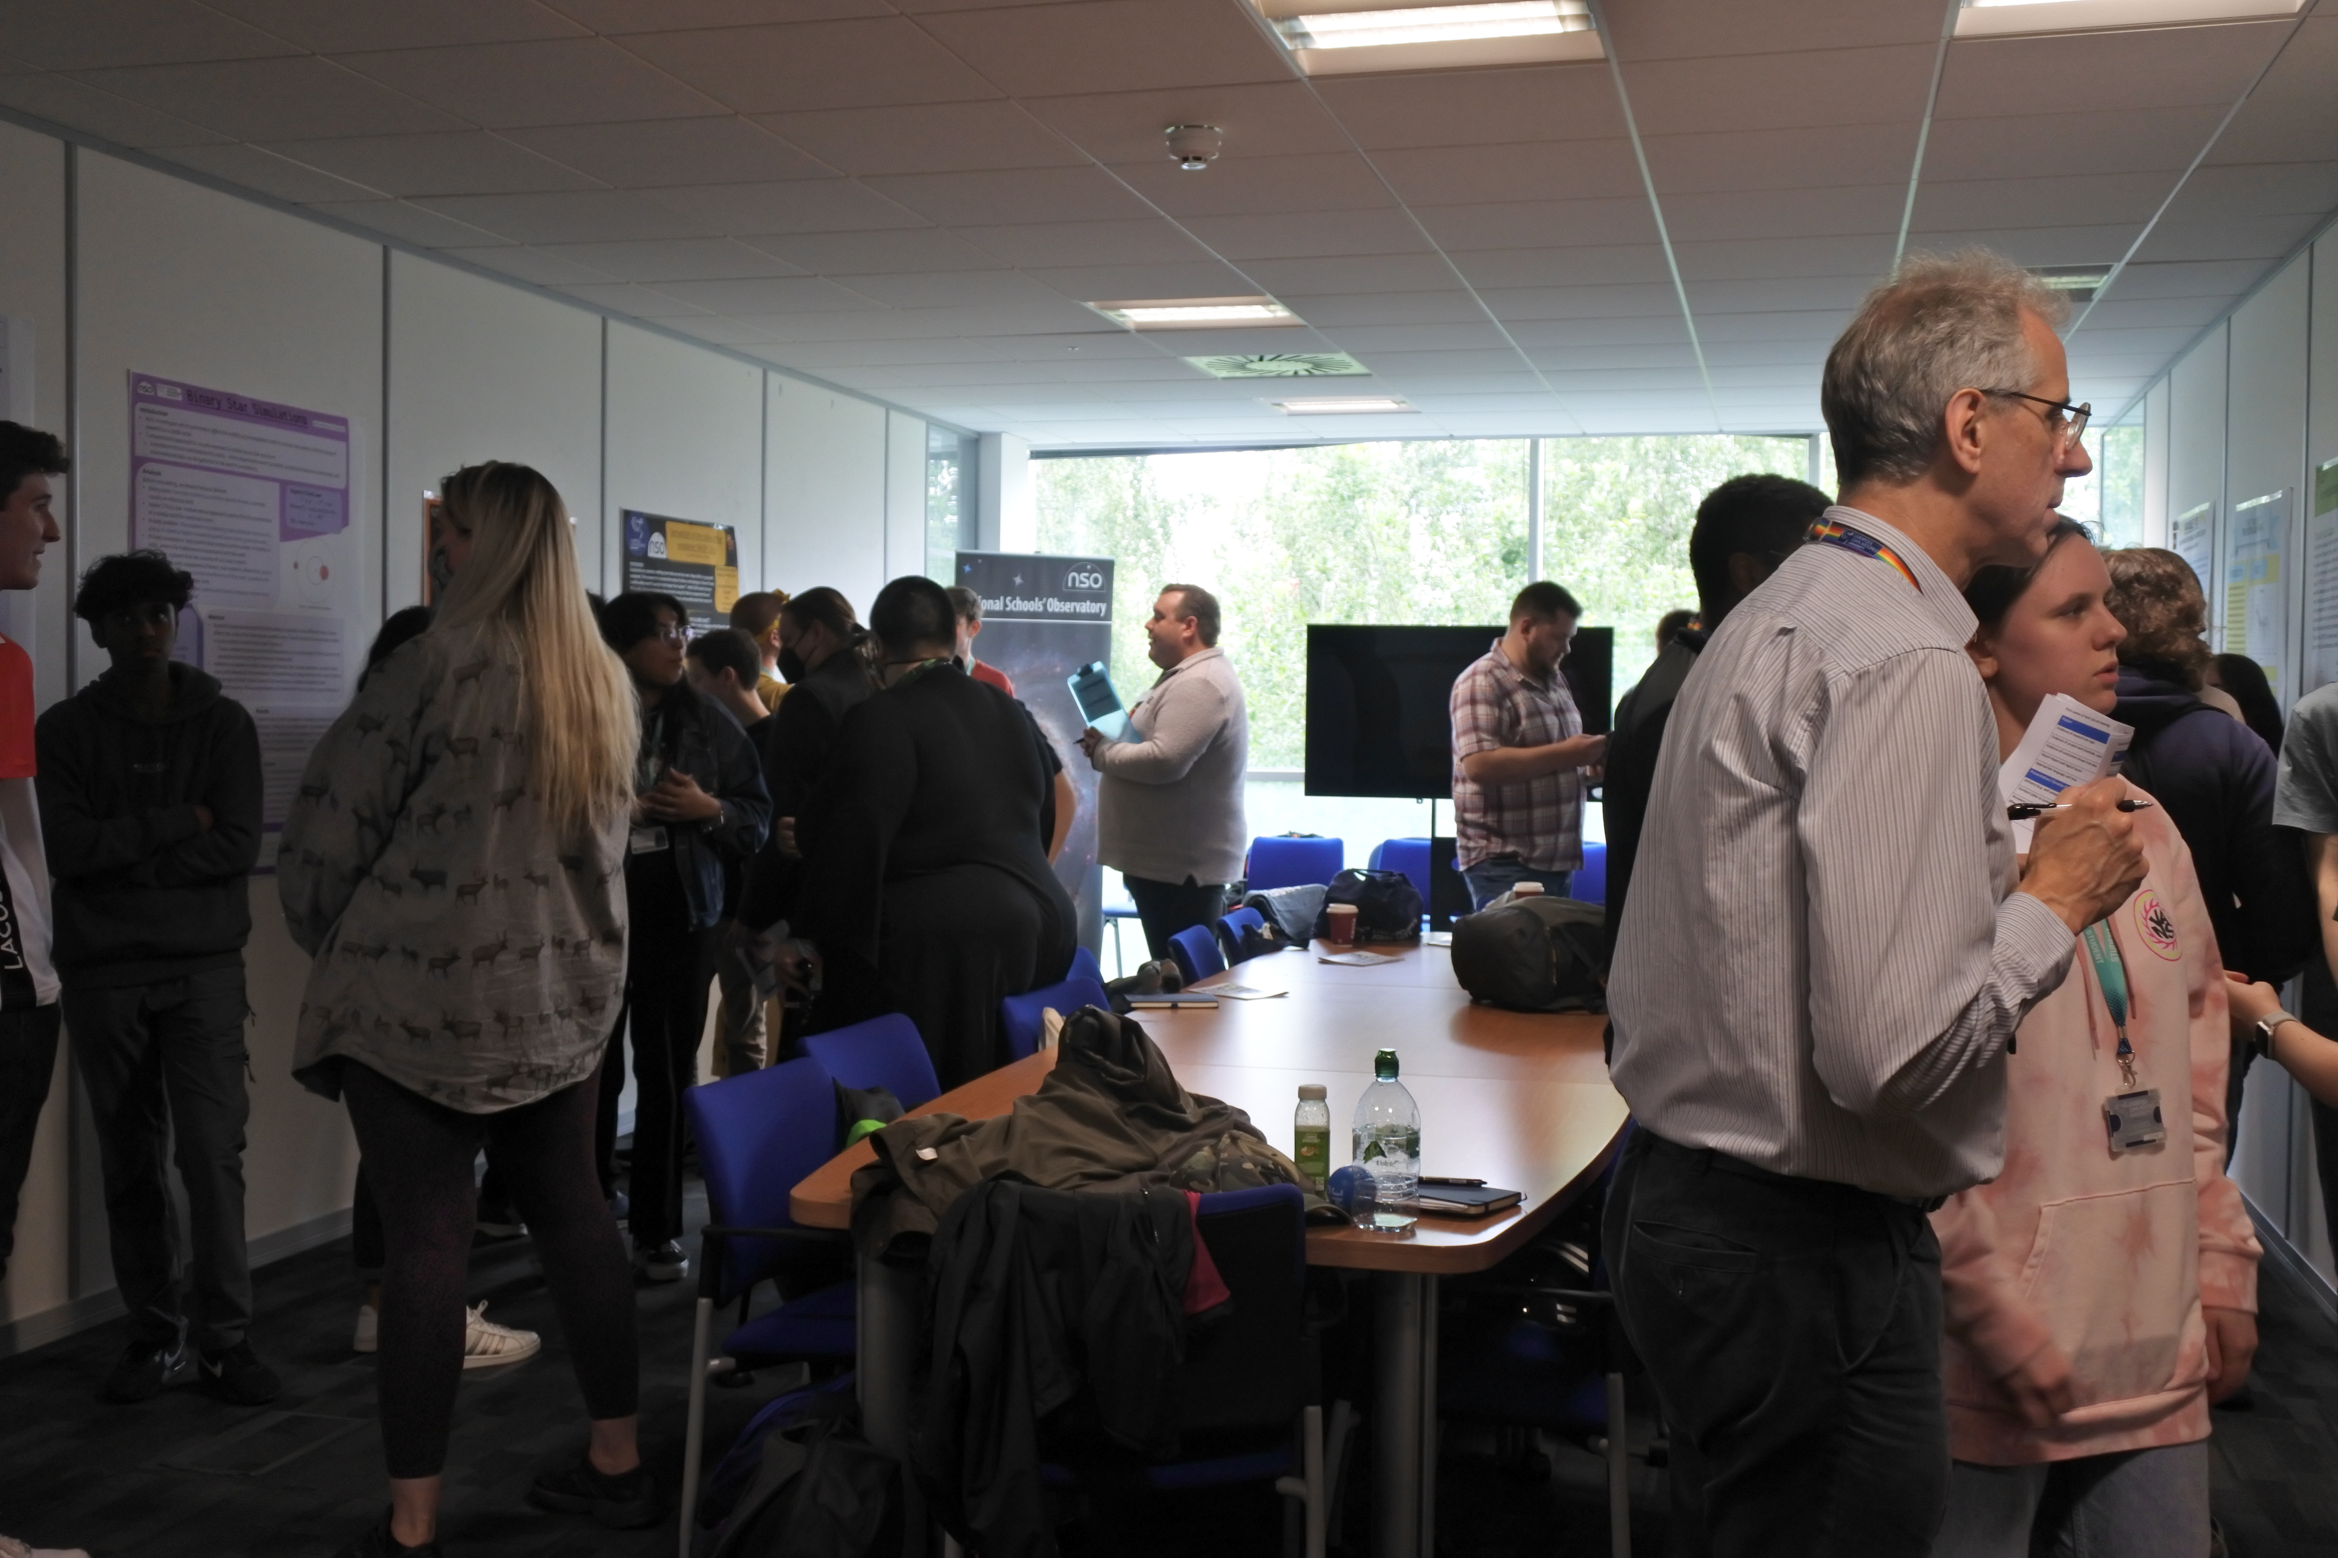
POSTER SESSION

Slide 13
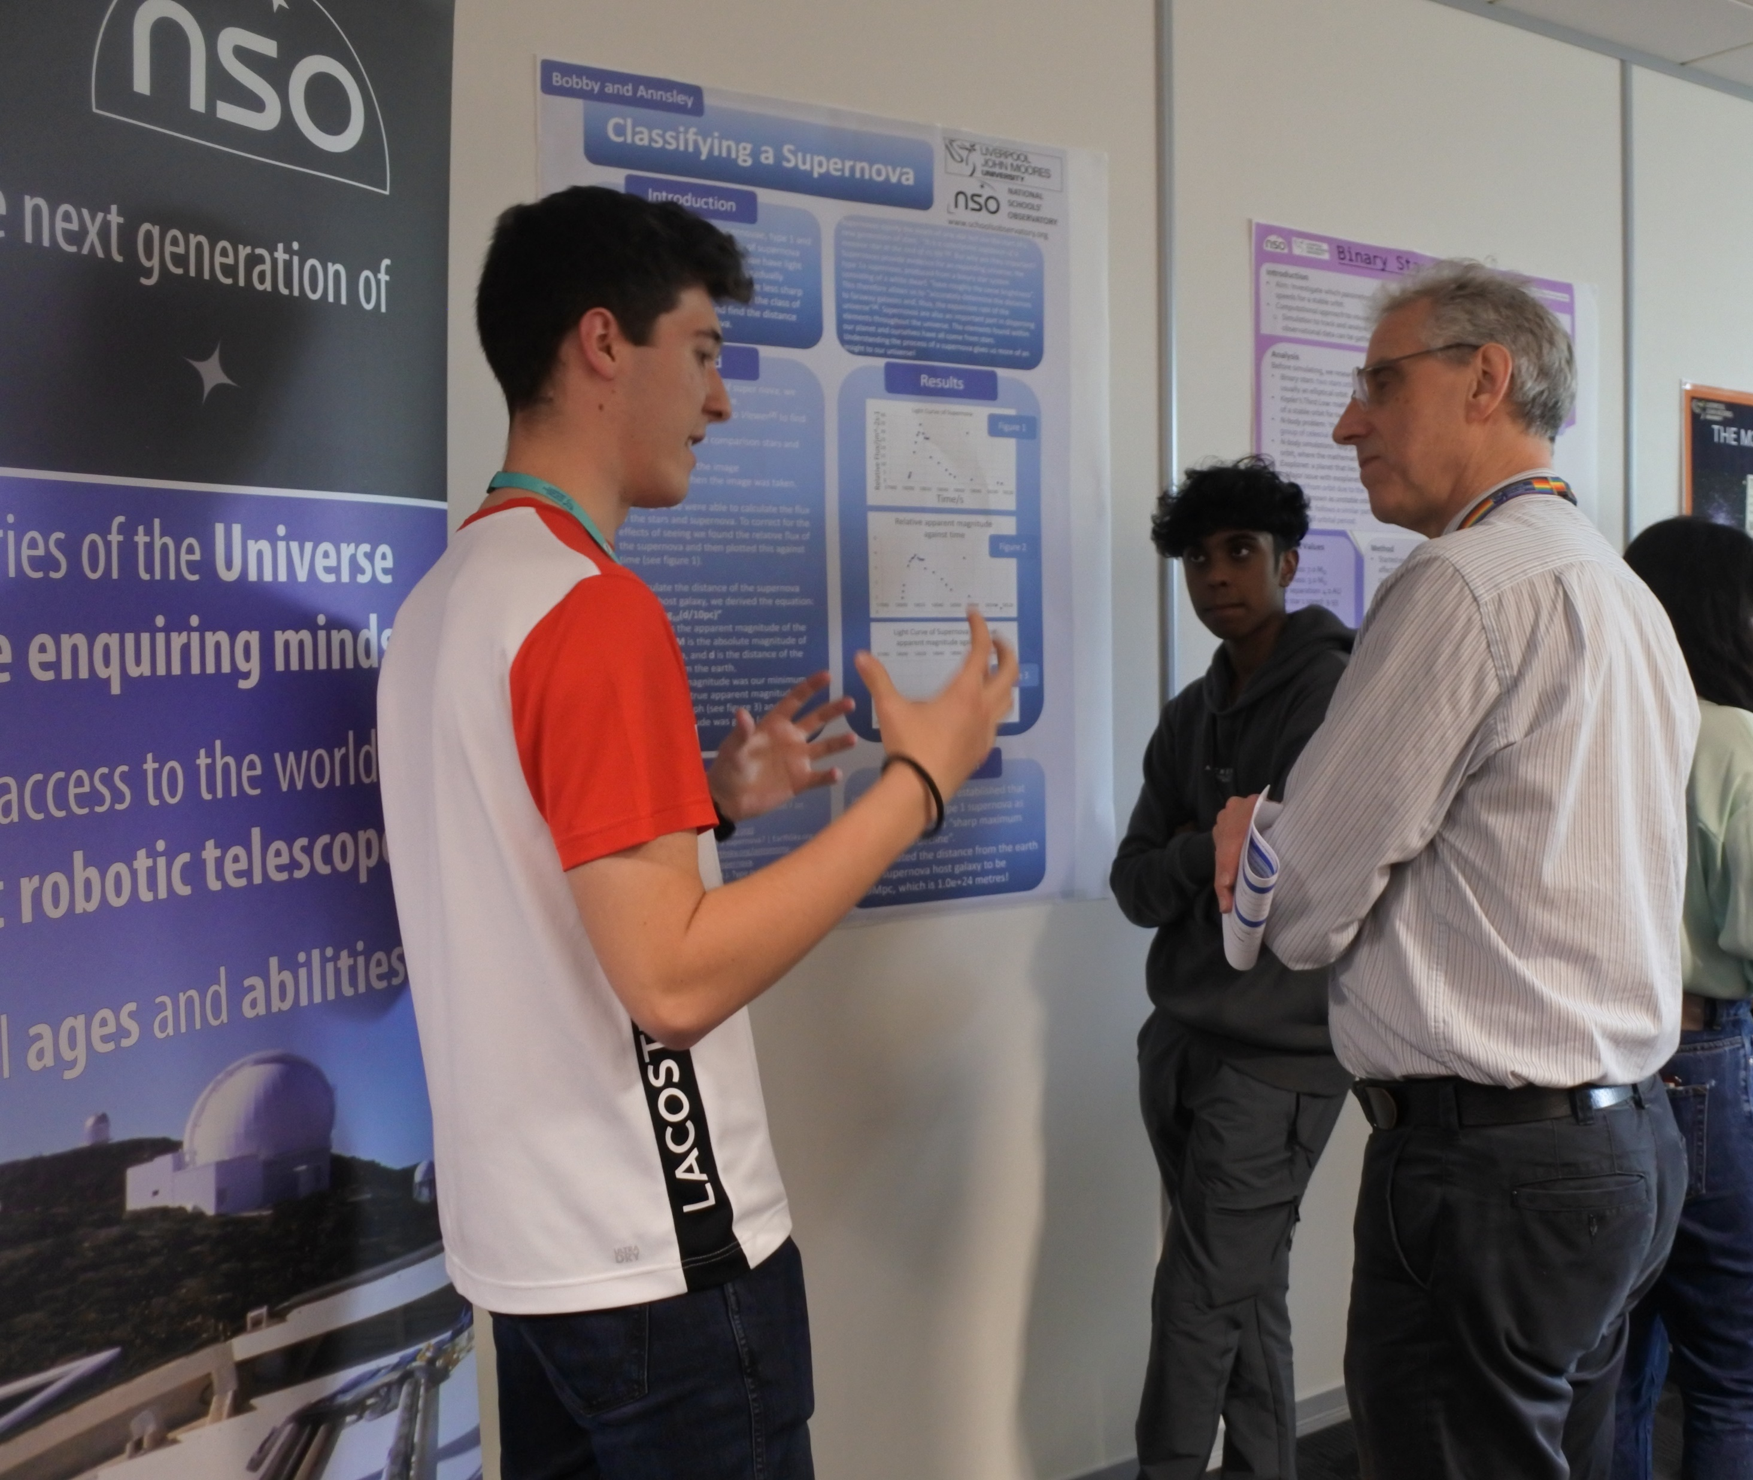
PRESENTING YOUR POSTER
It’s your opportunity to show off your research and talk to students and academics about your topic.
Did you enjoy your project? Show us. Bring your personality to the pitch. You can also talk about the challenges.
Remember, the people you talk to might not be experts on your topic!
Practice! (there is time on Friday morning)
  Think about the questions you might be asked
  How will you use the poster to highlight what you are saying?
  What will be your opening pitch?
We want to hear about your work. Even if you feel nervous, be confident that we are interested!

Slide 14

PREPARE AN ELEVATOR PITCH
Focus on the key findings.
For example:
30 seconds: Introduce yourself & your topic.
45 seconds: Give us an overview of your methods and results – what did you do, and what are your graphs and images telling us?
45 seconds: Summarise your discussion & conclusion - What is the big message coming out of your analysis?
Notes:
2 minutes role play to show them the concept.

Slide 15
COMMUNICATION CHALLENGE
Get into pairs
Look at the word you have been given
Explain the word to your partner without using any of the words on the card
Notes:
5 mins

Slide 16
COMMON MISTAKES
Underestimating your knowledge
Overestimating the audience’s knowledge
Not explaining technical language
Giving very long answers to questions
Focusing on the how rather than the why

Slide 17
How to make a GREAT science poster!

Slide 18
WHAT MAKES A GOOD POSTER?
Have a look at the posters in the room
Think about what you like, what you would change
Share ideas
You might have noticed…
Simple colour scheme
Graphics, graphs, charts
Subheadings
Suitable sized text
One or two fonts
Bullet points
Breathing room
Logical reading order
Labels

Slide 19
A TERRIBLE POSTER

Slide 20
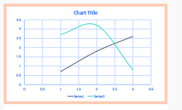
WHAT SHOULD YOUR POSTER CONTAIN?
Tip! You can rearrange the components. Put the most important stuff near the top!
Short, interesting title.
Title
Authors
Introduction
Names of the people who did the work.
A brief summary of the topic. What was the question you were trying to answer?
Results
Your data and what it tells you, presented in a nice visual way.
What you used, what you did, and how you did it.
What your data means. Have you answered your question?
Methods
Conclusion
Ask your supervisor about how to format references.
The people or organizations who helped you do the research.
References
Acknowledgements

Slide 21
TIPS ON DESIGNING A GREAT POSTER
Think of the poster as a visual summary of your work. You don’t need to include every detail!
Check any requirements that you have been asked to use.
  (e.g., orientation, size, format)
Short interesting title.
Bullet points rather than paragraphs.
Clear logical layout.
Reading order; left to right, top to bottom.
Pick a simple colour scheme.
Pick one or two fonts.
You will read this last.
You will read this first
Then you will read this.
Then this.

Slide 22
TIPS ON DESIGNING A GREAT POSTER
Make it look appealing! You want to attract people’s attention
Software – use what works for you!
  Powerpoint/Open Office
  Canva.com
  Adobe Illustrator/InDesign
  Inkscape
Negative space is your friend. Leave lots of ‘breathing room’ around your text & images.
Use subheadings & labels.
Graphics and charts will help draw attention to your poster and make it stand out!

Slide 23
WHERE DO WE START?
Answer these three questions…
What is the most important, or interesting, thing I’ve learned from the research project?
How can I visually share my research? Can I use charts, graphs, photos, and images?
What kind of information can I include in my talk that will complement my poster?
Think about narrative. You want to tell a story!

Slide 24
THE RULES
Deadline: 4:30PM Thursday
Submission
  Save as a pdf
  Save in the submission folder in Teams
  Use this type of file name
  “Project Name - Your names.pdf”
  E.g., “Exoplanets – Alison Jenny.pdf”
Layout
  Portrait
  A1 (594 mm wide x 841 mm high)
Visuals
  Sensible font size (24 – 36 pt for body text, larger for headings)
  No gifs or videos
Referencing
  You must reference ALL external sources of information

Slide 25
FRIDAY’S POSTER SESSION
On Friday, it’s your opportunity to show off your research.
Your posters will be displayed at the ARI. Staff and students will come along to see the posters and hear from teams about their research.
All pairs will stand by their poster and chat with people as they make their way around the room. You don’t have to present to everyone at once! But you will have to talk to lots of different people.
It lasts an hour – there will be refreshments.
There are prizes to be won!
Enjoy it!

Slide 26


