Slide 1
Intro to Data
Using Microsoft EXCEL

Slide 2
Agenda:
Finishing photometry from AstroLab workshop
Creating a Galaxy CMD
Using EXCEL to manipulate astronomical equations

Slide 3

MS EXCEL
Key Info
Projects will involve collecting, manipulating, analysing, and presenting data using MS Excel.
Key points covered today can be accessed at any time in the ‘Workshops’ folder.
Ask for help if you’re not sure about something or experiencing a problem.

Slide 4

Be a Good Scientist
Save work regularly!!
Organise files into folders and give everything useful names.
Add titles and labels to charts, diagrams, tables.
Make notes as you go – if you came back in a year, could you do it again?
If you make an assumption or spot a potential source of error, make a note of it and include it when you present your results.

Slide 5
Finish Photometry
Open the ‘M59 – B.fits’ file
Change display settings to view image
Go to ‘Astro’ > ‘Measure Brightness’
Click ‘Add Target’
Adjust radius so the inner circle completely surrounds the galaxy
Adjust radii of inner and outer rings if needed
Click on ‘Results’ header to view results
Copy the value into the EXCEL sheet – ‘Counts’ > ‘B’
Open the ‘V’ data for the galaxy
Measure the brightness and input the value into the EXCEL sheet
Repeat for all galaxies

Slide 6
Calculating an Approximate Flux
Flux is the rate of flow of a quantity per unit area.
For simplicity, we are going to calculate an approximate flux that is just the rate of energy – in this case, the number of photons (counts) per second.
Each galaxy’s exposure time is given in the table on the EXCEL sheet.
Notes:
Teacher Notes
An actual flux needs to take into account the area of the aperture (as the galaxies are different sizes) as well as the instrument used, seeing conditions, etc. Technically this means we shouldn’t compare data for the galaxies, but this exercise is just to introduce students to using EXCEL.
Instead, ask students to keep this mind when analysing their results at the end – this is also good practice for when they do their projects. They should note any potential assumptions or causes of error as they go along.
Demo calculating the B flux (Equation: = D4/B21). Show students what happens when you click and drag to apply to all cells in the column. The formula copies the action, with ‘D4’ and ‘B21’ being replaced with cells below them in the column, and each subsequent cell doing the same. Doing this gives errors in the rest of the cells. Explain the errors – F5 is because it’s being divided by the cell with the galaxy names, the others are being divided by zero.
To rectify, keep the B21 cell constant (Equation: = D4/$B$21). Now all cells will show numbers. However, this is using an exposure time of 60 for all. Go along the column and change the letter to match the correct exposure time (B=60, C=90, D=120). A ‘!’ in a triangle might pop up when the first cell is changed. It’s good practice for the students to check any potential errors, so click on it to show them – it’s just that this formula is the only one different (yet) to the rest, so we can ignore the message because we want it to be different.
Once you’ve completed changing the formulas, show students that (now the correct cell for the exposure time will stay constant), they can just drag and apply the formulas from the F cells into G, and the ‘D’ in the formula will automatically change ‘E’ which is one cell over. Demo the first cell (G4) and then give students a few minutes to complete before you do the same.

Slide 7
Magnitude
Magnitudes measure the relative brightness (on a logarithmic scale).
Defined by filter – e.g., V = 11 means the object has a magnitude of 11 in the green (V) filter.
There are 2 main types: apparent and absolute.
A smaller magnitude means a brighter object. This also includes negative magnitudes!
Notes:
Teacher Notes
A difference of 5 magnitudes = a factor of 100 flux.
The apparent magnitude of an object is how bright that objects appears to look from our viewpoint on Earth. This means it is affected by distance (among other things). The absolute magnitude of an object is how bright that objects appears to look at a specific distance (10 parsecs/32.6 light years) from Earth. Because it isn’t affected by distance, absolute magnitude is a measure of the object’s luminosity (or reflected light for non-luminous objects e.g. planets).
The Sun has an apparent magnitude (V filter) of around -27. Sirius, the brightest star in the sky, has an apparent magnitude (V filter) of -1.46. Naked eye observations, in ideal dark conditions, can see objects with apparent magnitudes (V filter) as faint as around +6.5.

Slide 8

Calculating Instrumental Magnitude
For simplicity, we are going to calculate the instrumental magnitudes of the galaxies in the B and V filters.
This is the uncalibrated apparent magnitude of an object.
$$m=−2.5\log_{10}\left(f\right)$$
m is the instrumental magnitude
f is the flux, which we measured in counts/second
Notes:
Teacher Notes
Explain to students that instrumental magnitudes are only really used to compare objects within the same image when the same size aperture has been used. Technically this means we shouldn’t compare data for the galaxies, but this exercise is just to introduce students to using EXCEL. Ask students to keep this mind when analysing their results at the end – this is also good practice for when they do their projects. They should note any potential assumptions or causes of error as they go along.
Demo writing the formula (=-2.5LOG10(F4)) for the first cell and applying it the rest. Give students a few minutes to complete the other column before you do the same.

Slide 9
Calculating Colour Index
A colour index is the difference in brightness of an object between two different filters.
We are going to calculate the B – V colour index for each galaxy.
Bluer objects have a low value. Redder objects have a larger value.
Notes:
Teacher Notes
A star’s colour index can help determine the temperature and spectral type. Star colour indexes are also used in HR diagrams, which can help us understand stellar evolution.
A galaxy’s colour index (along with other properties) can help determine its classification. It also helps us understand a galaxy’s star formation rate and the age of its stellar population. Galaxy colour indexes are used in CMDs, which can provide clues about galaxy formation and evolution.
Explain the colour index values. Blue objects are bright in the B filter – therefore, they have a smaller value for their B magnitude, leading to a smaller value when calculated. Redder objects are bright in V filter – therefore, they have a smaller value for their V magnitude, leading to a larger value when calculated.
Demo writing the formula in the first cell and ask students to apply this to the rest. Give them a few minutes to complete before doing the same.

Slide 10
Creating a Colour-Magnitude Diagram
We will plot the B – V colour index (x axis) against the instrumental B magnitude (y axis). We can then look for any patterns or features.
Insert a scatter graph
Add data to the graph
Add labels and a title
Alter the value range of the x-axis and y-axis to fit your results
Add data labels
Notes:
Teacher Notes
Demo each step on the front screen so students can follow along. The final result will not show any obvious features as the dataset isn’t large enough (and hasn’t been corrected), however students might find that the elliptical galaxies give a higher B – V (redder) value than the spiral galaxies and have a higher instrument B magnitude.
Click ‘Insert’ header
Click on the scatter graph icon
Select the first graph in the ‘Scatter’ section (with the small dots and squares, no lines)
Click ‘Select Data’
Click the ‘+’ button under the ‘Legend entries (Series)’ box
Click in the blank ‘X values:’ box
Select all the B – V data from column J
Delete the text in the ‘Y values:’ box
Select all the Instrumental B Magnitude data from column H
Click ‘OK’
Click the ‘Add Chart Element’ button from the top menu and select ‘Axis Titles’ and then ‘Primary Horizontal’
Edit to ‘B – V Colour Index’. Select ‘Home’ header, click on axis title and increase the font size.
Click ‘Chart Design’ header. Click the ‘Add Chart Element’ button from the top menu and select ‘Axis Titles’ and then ‘Primary Vertical’
Edit to ‘Instrumental B Magnitude’. Select ‘Home’ header, click on axis title and increase the font size (to the same as the other axis title).
Double-click the values of the y-axis to open the format axis panel at the side (alternatively, right-click the y axis and select ‘Format Axis…’)
Under the ‘Bounds’ heading, change the ‘Minimum’ to -14 and ‘Maximum’ to -9 to better fit the range of values. Note: students may need to use slightly different values to fit the range of their individual results
Click ‘Home’ header and increase the font size of the numbers.
Double-click the values of the x-axis to open the format axis panel at the side (alternatively, right-click the y axis and select ‘Format Axis…’)
Change the range if needed (but probably not necessary). Then click ‘Labels’ and change ‘Label Position’ to ‘Low’.
Increase the font size of the numbers (to the same as the other axis).
Edit ‘Chart Title’ to ‘Galaxy Colour-Magnitude Diagram’ (if there isn’t a chart title there, select ‘Add Chart Element’ button, then ‘Chart Title’, then ‘Above Chart’)
Increase font size of title (larger than axis titles). Stretch graph to a larger size if needed.
Go to ‘Chart Design’, ‘Add Chart Element’, ‘Data Labels’, then select ‘Below’
Double-click the data labels to open the format data labels panel at the side (alternatively, right-click the data labels and select ‘Format Data Labels…’)
Tick ‘Value From Cells’ and select the galaxy names from column B. Click ‘OK’
Untick ‘Y Value’ and ‘Show Leader Lines’
Increase font size of labels
Move any labels that overlap into another space
Ask students to compare the galaxy name to its type
Ask students if there’s a pattern to the redder galaxies – they should find these are mostly ellipticals

Slide 11
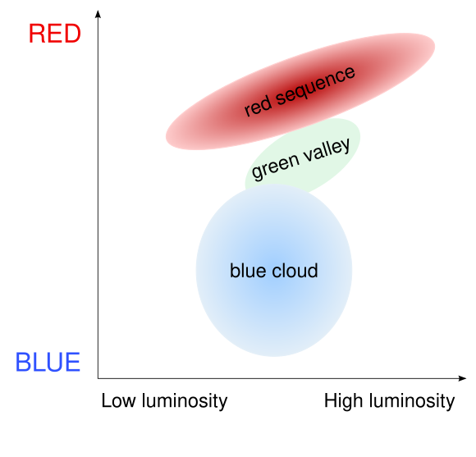
Galaxy Colour-Magnitude Diagram
Key Features:
Red Sequence
  Generally elliptical galaxies
Green Valley
  Galaxies with declining star formation
Blue Cloud
  Generally spiral galaxies
Image: Joshua Schroeder/M0tty
Notes:
Teacher Notes
Green valley may be composed of late galaxies that are running out of gas for star formation and early galaxies where gas. has been destroyed very quickly (e.g. through mergers, AGN).
To see these features, we’d need data from thousands of galaxies.

Slide 12
Extension Activity
Calculating Absolute Magnitude

Slide 13
Download the EXCEL sheet from Teams
Presentations
  > 2 Tuesday
> Extension_Calculating Absolute Magnitude – Student Worksheet (blank)
Save them in your documents!
Rename file with your name on the end.

Slide 14
Calculating Absolute Magnitude
The absolute magnitude of an object is how bright that objects appears to look at a specific distance – 10 parsecs (32.6 light years) from Earth.
Because it is unaffected by distance, astronomers can use the absolute magnitudes of objects to compare their luminosities, which is a measure of the radiated/emitted power.
To calculate absolute magnitudes for the galaxies in our data set, we need to know the distance of each galaxy…
Notes:
Teacher Notes
Luminosity is the total amount of electromagnetic energy emitted per unit of time. The units of measurement are Watts, W - which is the same as Joules per second, J/s. In astronomy, luminosity is often given in terms of the Sun’s luminosity (with 1 L⊙ = luminosity of the Sun).
Measuring distance in astronomy is important but can also be difficult. One tool that astronomers use is redshift.

Slide 15

Using Astronomical Equations
We will use some astronomical equations to calculate the absolute magnitudes for the galaxies in our data set.
The distance modulus equation relates apparent magnitude, absolute magnitude, and distance:
$$m −M=5\log\left(d\right)−5$$
m is the apparent magnitude
M is the absolute magnitude
d is the distance measured in parsecs, pc
Notes:
Teacher Notes
The absolute magnitude of an object is how bright that objects appears to look at a specific distance (10 parsecs/32.6 light years) from Earth.
Because it is unaffected by distance, astronomers can use the absolute magnitudes of objects to compare their luminosities, which is a measure of the radiated/emitted power. Luminosity is the total amount of electromagnetic energy emitted per unit of time. The units of measurement are Watts, W - which is the same as Joules per second, J/s. In astronomy, luminosity is often given in terms of the Sun’s luminosity (with 1 L⊙ = luminosity of the Sun).
m – M is the distance modulus. It expresses distances on a logarithmic scale.
To calculate absolute magnitudes for the galaxies in our data set, we need to know the distance of each galaxy. Measuring distance in astronomy is important but can also be difficult. One tool that astronomers use is redshift.

Slide 16
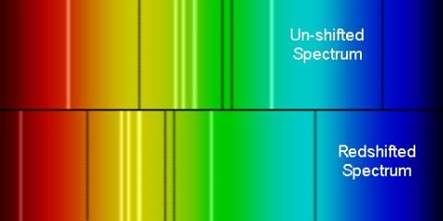
Redshift
Most galaxies are moving away from us, so the wavelengths of emitted light get ‘stretched’ and move towards the redder part of the electromagnetic spectrum.
This is known as redshift.
Astronomers can use redshift to work out the distance to a galaxy.
Image: TSO
Notes:
Teacher Notes
Students may know about redshift from GCSE/A-Level.
Between one wave and the next being emitted, the galaxy has moved backwards. This increases the distance between the waves – and, so, the wavelength. A longer wavelength shifts the light into the redder part of the spectrum. This can be viewed by comparing emission/absorption lines.
It can be compared to sound waves; as a siren (e.g. on an ambulance, fire engine) approaches, you notice the pitch become higher, and it gets lower when the siren is moving away. Pitch is related to frequency, with lower frequencies resulting in lower pitches. Frequency is related to wavelength – the longer the wavelength, the less waves can pass a point in 1 second, and so the lower the frequency. Lower pitch sounds, therefore, have greater wavelengths.

Slide 17

Calculating Redshift
Redshifted is calculated by comparing wavelengths of light that are observed (by us on Earth) against the wavelengths as they were emitted - i.e., at rest:
$$z= {(λ}_{observed} − λ_{emitted}) ÷ λ_{emitted}$$
z is the redshift
𝜆_{observed} is the observed wavelength
𝜆_{emitted} is the emitted wavelength
Use the wavelength data in the EXCEL sheet to calculate each galaxy’s redshift
Notes:
Teacher Notes
Refer to previous slide – the unshifted spectrum is the emitted and the redshifted spectrum is the observed. The difference between them will give the redshift. Redshift values are usually positive, showing that the observed wavelength is bigger compared to the emitted.
Calculating the redshift a galaxy could be demoed. Alternatively, allow students to attempt and see if any common errors/misunderstandings occur. The most likely mistake will be forgetting to include brackets in the formula. Call students’ attention back to front if whole class feedback is needed at any point.
Once students have attempted, show answers on screen.

Slide 18
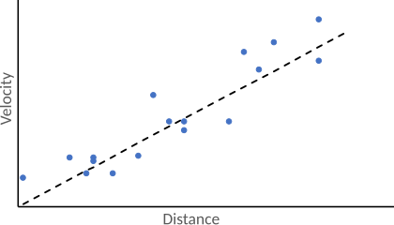
Hubble’s Law
Studies show that more distant galaxies have greater observed redshifts, meaning they must be travelling away from us faster.
It was found that the recessional velocity of a galaxy is roughly proportional to its distance.
The value of this ratio is called the Hubble constant.

Slide 19



Calculating Distance
Hubble’s Law is expressed mathematically as
For small redshifts, we can apply
$$v= H_{0}D$$
$$v=zc$$
$$zc=H_{0}D$$
z is the redshift
c is the speed of light, measured in km/s
H₀ is the Hubble constant, measured in km/s/Mpc
D is the distance, measured in Mpc
Use the data in the EXCEL sheet to calculate each galaxy’s distance
Notes:
Teacher Notes
Students can attempt to rearrange equation themselves. A check could always be made if needed before getting them to start calculations.
Emphasise that the calculated distance will be in megaparsecs and students will need to convert to parsecs – they should be familiar with the conversion from GCSE/A-Level.
Calculating the distance of a galaxy could be demoed. Alternatively, allow students to attempt and see if any common errors/misunderstandings occur. The most likely mistake will be forgetting to include brackets in the formula. Call students’ attention back to front if whole class feedback is needed at any point.
Once students have attempted, show answers on screen.

Slide 20

Calculating Absolute Magnitude
Now that the distance to each galaxy (in parsecs) has been found, we can calculate their absolute magnitudes.
$$m −M=5\log\left(d\right)−5$$
m is the apparent magnitude
M is the absolute magnitude
d is the distance measured in parsecs, pc
Use the data in the EXCEL sheet to calculate each galaxy’s absolute magnitude
Notes:
Teacher Notes
The absolute magnitude of an object is how bright that objects appears to look at a specific distance (10 parsecs/32.6 light years) from Earth.
Because it is unaffected by distance, astronomers can use the absolute magnitudes of objects to compare their luminosities, which is a measure of the radiated/emitted power. Luminosity is the total amount of electromagnetic energy emitted per unit of time. The units of measurement are Watts, W - which is the same as Joules per second, J/s. In astronomy, luminosity is often given in terms of the Sun’s luminosity (with 1 L⊙ = luminosity of the Sun).
m – M is the distance modulus. It expresses distances on a logarithmic scale.

