Slide 1

Introduction to University, UCAS and Finance
Carolyne Berry
Liverpool John Moores University

Slide 2
Reasons to go to university
How to choose a university
Student Finance
Student Life
Applying for university

Slide 3
Why HE?
Opportunity for new experiences
Unlimited academic possibilities
An investment for the future
Potential to have the time of your life!
New friends and great memories
A great graduate job/career
Independence and freedom

Slide 4
Financial advantages
“figures published by Gov.uk show a continued rise in salary, as working-age graduates aged 16-64 earned a median salary of £26,000 in 2023, and earned £6,500 more per year than non-graduates.”
Graduate Labour Market Statistics 2023, Gov.uk
This means graduates earn almost £300,000 more over the course of their career than non graduates!

Slide 5
Why go?
The top reasons for attending university are:​
To earn more money​
To pursue a vocation​
To study a subject you enjoy​
To get more career opportunities​
To move away from home/be more independent

Slide 6
Finding the right course and
THEN choosing the right university
Over 36,000 course combinations listed on ucas.com
Students can choose:
Five courses at five different universities
Five different courses at one university
Or anything in between
However, it must all be done on one application form
(NB Exceptions for Oxbridge and medical-related courses)

Slide 7


Choosing a Course
Everyone will have their own priorities:
Foundation Degree
Undergraduate degree
Study more than one subject
Particular subject / area of interest
Long term career plan
Sandwich Course
Study abroad
WHAT CAN YOU STUDY WITH YOUR CURRENT SUBJECTS?!

Slide 8

What subject is right for me?
It’s important you choose a subject you enjoy and will help you reach your goals.
Think about what you enjoy day-to-day – maybe this could be part of a future job role?
Explore different job sites and graduate career options to look for ideas on what you’d like to do once you've finished your studies.
Take a look at subject guides on Unifrog and Unitaster Days to get an idea of the types of subjects you could study, and the industries graduates go on to work in.
Search for courses by subject on UCAS to see what's available.

Slide 9

Choosing a Course
Some degree courses tend to be very specialised from day one, allowing students to focus on their chosen subject.
However, there are others that allow you more flexibility in what you study.
Make sure you read the course descriptions carefully, and click through to university websites for further information.

Slide 10
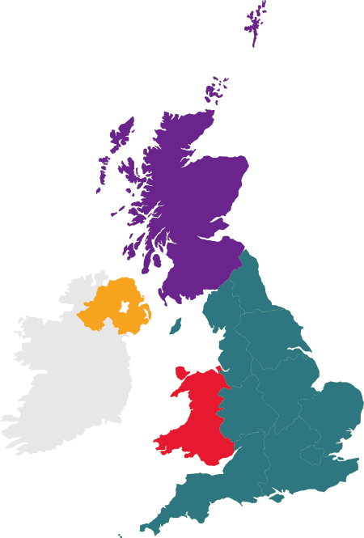
360+ universities and colleges:
  4 in Northern Ireland
  15 in Wales
  18 in Scotland
  316 in England
35,000+ courses available

Slide 11
What to look for in a university?
Accommodation options
Finance – Bursaries & Scholarships
Student advice teams
Academic support
Clubs & Societies
Job opportunities

Slide 12
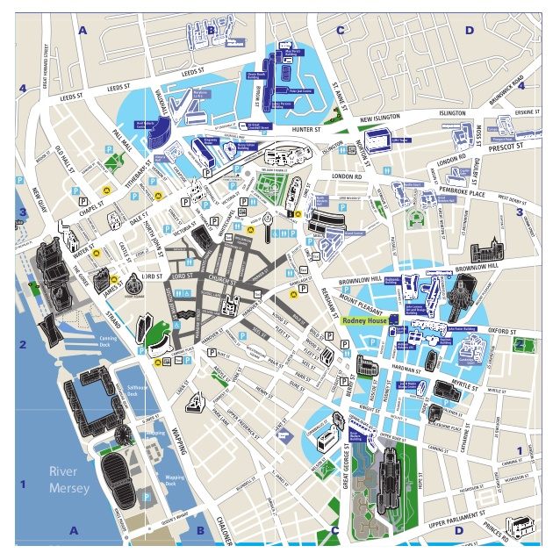
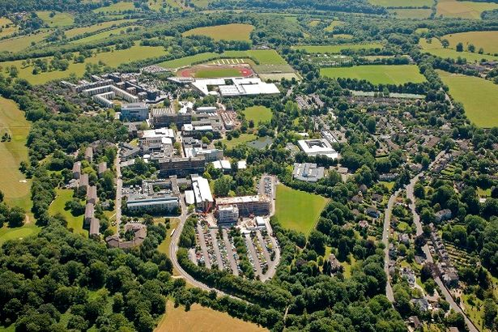
Campus or City University?
University of Bath

Slide 13

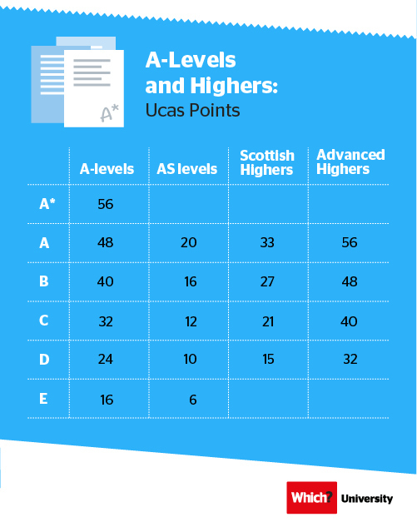
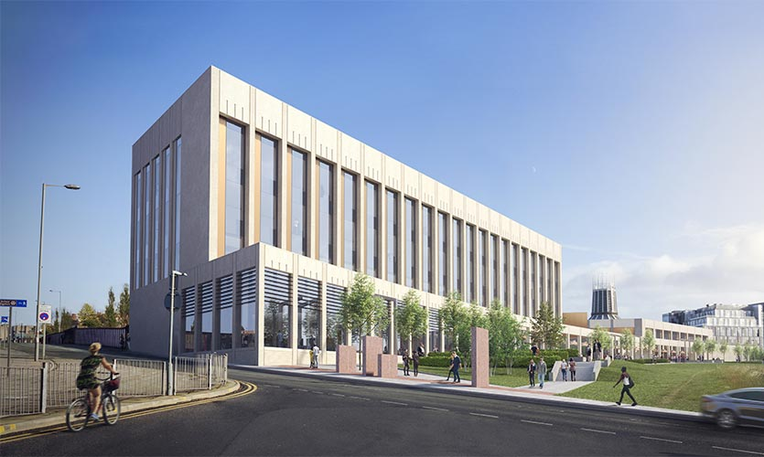

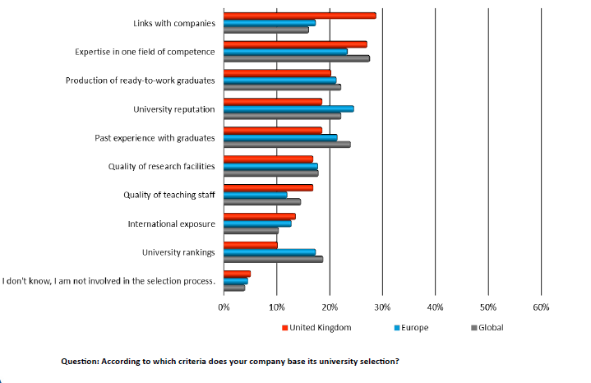
Why people choose their university?
Course Choice
The University Facilities
Entry Requirements
Reputation of the University
Location
Accommodation
Support for Jobs / Careers

Slide 14
Choosing the right university for you
Style – from the traditional, with a focus on subject-based courses and research, to modern universities, with a greater focus on vocational courses.
Location – some are based in large cities, others in smaller towns - a major influence on the environment and lifestyle.
Size – larger universities can have more than 20,000 students, whereas some of the smallest have only a few thousand.
Culture and facilities – influenced by a range of factors, including the diversity of students who attend.
What graduates do – all universities collect destination statistics. It can be interesting to find out the types of jobs or further study students go on to.
Tuition fees – can vary between universities and colleges. Check if there are any scholarships or bursaries available.
Living costs – accommodation, transport, and food can vary enormously.

Slide 15
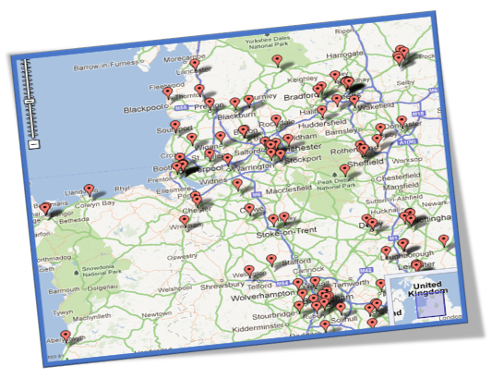
Other things to consider...
These are all the Universities within the North West / Midlands / Yorkshire area.
It's possible to get to the majority of these institutions (uni's) within 2 hours via train or car.

Slide 16


Paying for University
Student Finance overview

Slide 17
What are the main costs of University?
Tuition Fees
Accommodation
Insurance/bills
Food
Going out
Travel
Books

Slide 18
Where does this money come from?
Tuition Fee loan
Cost of Living (maintenance) Loan
Other Bursaries/Support
Scholarships
Part time job

Slide 19
Q: Will I have to pay tuition fees?
A: Yes - but you can take out a tuition fee loan to cover the fees and you don’t start paying this loan back until after graduating and earning over £25,000

Slide 20

Money for living costs
Dependent on Household Income
Dependent on where you studying & living situation
Paid in 3 term instalments directly into the student’s bank account
Maintenance Loan

Slide 21
Loans for students from England: *2026 entry
Household Income | Living at home | Living elsewhere/Halls | Living in London
£25,000 or less | £9,118 | £10,830 | £14,135
£30,000 | £8,354 | £10,058 | £13,349
£40,000 | £6,825 | £8,512 | £11,777
£50,000 | £5,286 | £6,967 | £9,168
£60,000 | £4,013 | £5,421 | £7,637
£65,000 or more | £4,013 | £5,048 | £6,853
*Figures accurate February 2026

Slide 22

How do I repay the loans?

Slide 23
Loan Repayments
All loans added together so you only make one monthly payment
Repayments start after Graduation
Only once you are earning over £25,000 (9% of any income over £25,000k - England threshold)
Deducted at source by your employer like Tax and National Insurance
Any outstanding loan written off after 40 years
Repayment will stop and start if your income goes up and down
& YES you still have to pay your loan back even if you emigrate

Slide 24
If your income falls below £25,000 (e.g. if you go travelling) your loan repayments will automatically stop.
9% of annual salary (over £25,000), divided by 12 monthly payments. For instance £26,000 is £7.50 per month, or £50,000 is £187.50 per month.
After 40 years anything you owe on your student loans is written off.
Annual Salary | Monthly repayment @£25,000k threshold
£25,000 | £0
£26,000 | £7.50
£30,000 | £37.50
£35,000 | £75
£40,000 | £112.50
£50,000 | £187.50
£60,000 | £450.00

Slide 25


Slide 26

Choose from a range of hundreds of courses
Hours per week vary depending course (8-20 contact hours)
Lectures, seminars, tutorials, field trips, practicals and placements
Study when you want to
Support from personal tutors
Two semesters in each year
Long summer

Slide 27


Slide 28


City centre university of 24,000+ students, offering a broad range of 300+ courses
Offering a great student experience and excellent student support
Generous scholarships
Guaranteed city-centre student accommodation within walking distance to university buildings
Study and live in Liverpool, one of world’s most famous cities

Slide 29
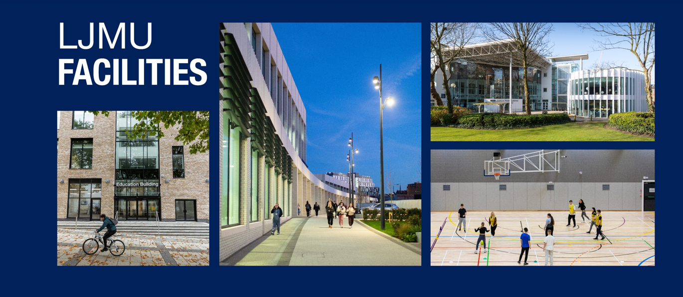

Slide 30
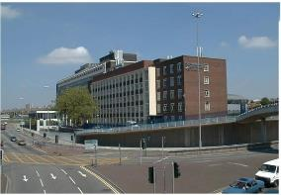
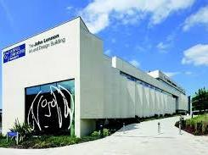
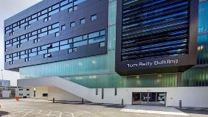
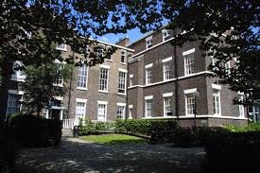
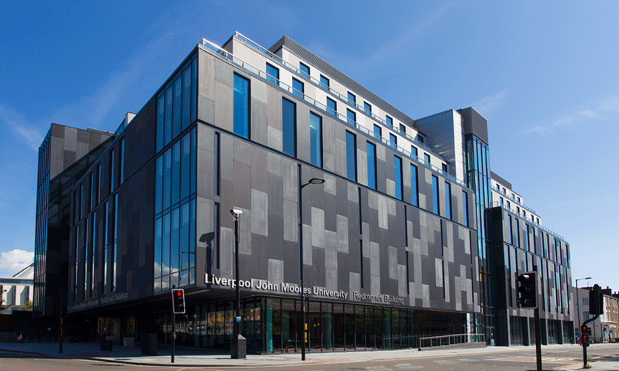
Buildings
Engineering and Technology:
Byrom street - James Parson Building
Arts, Professional and Social Studies: John Lennon Art & Design
Science:
Tom Reilly Building
Arts, Professional and Social Studies: John Foster Building
Arts, Professional and Social Studies: Redmonds Building
University Buildings
Notes:
Facilities – University Buildings
Some faculties mainly operate courses from particular buildings, but they are open to everyone in the university
Explain a little about the facilities in each department/subject
i.e. labs for science, Meeting/conference rooms for business
New facilities have opened including Redmond's building (fairly new build) and £6M spent on engineering facilities
New facilities planned to open come 2018/19
More on next page…

Slide 31
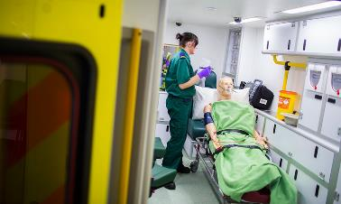
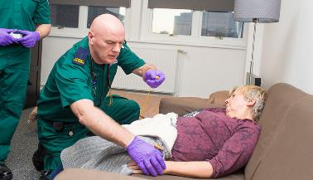
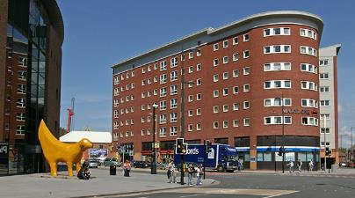
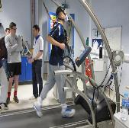

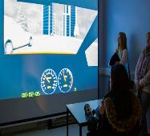

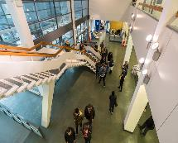
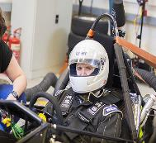
Facilities
Tithebarn Street - Ambulance Room
y
Tithebarn Street – Home Environment Room
Tithebarn Street
Tom Reilly Building
Byrom Street
Course Facilities
Notes:
Faculty of Education, Health and Community
NHS style facilities, Nursing rooms/Paramedic analysis rooms fitted with recording equipment to play back performance
Faculty of Science
Based out of the Tom Reilly building, the faculty of science provides state-of-the-art facilities and equipment all freely accessible during your time at LJMU.
Facilities include:
Labs
Simulation suites
Respiration monitoring equipment
Faculty of Engineering and Technology
Mainly based out of the Byrom street campus building (James Parsons)
Technology Labs
Formula One Car
Social Learning Space

Slide 32
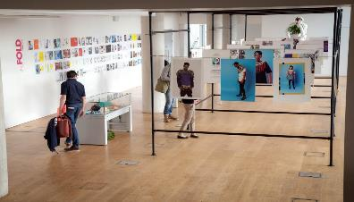
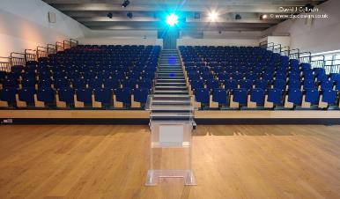
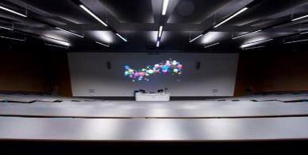
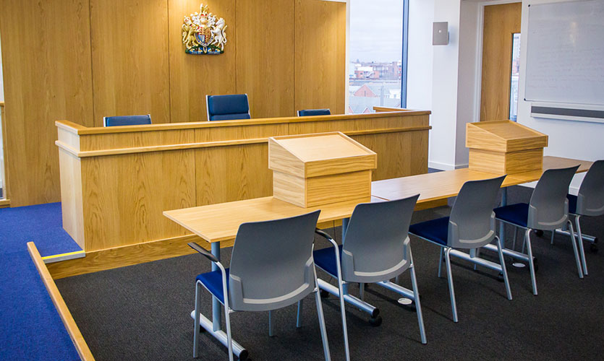

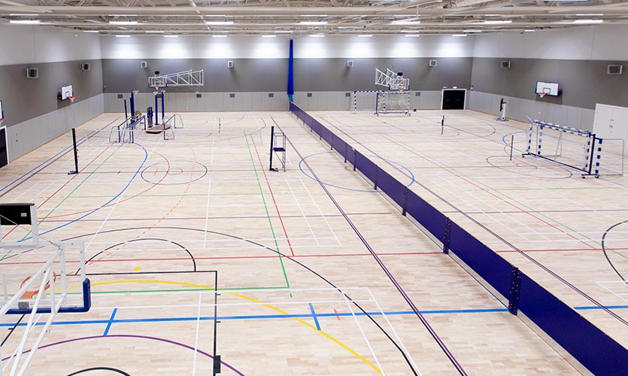
Facilities
Arts, Professional and Social Studies:
JLAD - Art Exhibition
Arts, Professional and Social Studies:
JLAD - Lecture Theatre
Arts, Professional and Social Studies:
Redmonds – Lecture Theatre
Liverpool Business School
Redmonds – Moot Room
Arts, Professional and Social Studies:
Redmonds - TV Studio
Mount Pleasant Campus
Sports Building - 2 Indoor Sports Halls
Course Facilities
Notes:
Facilities – Campus Facilities
A range of sporting facilities (IM Marsh)
Dance Studios
A range of lecture theatres and teaching rooms
Art exhibitions showcased in the John Lennon Art and Design building
Kitchen areas for food & nutrition courses
Sports specific facilities
Football pitches (indoor & outdoor), tracks, dance studios and pools – When you come to Liverpool John Moores University, you know that you’ll have the sports facilities you need.
11 Lifestyle fitness centres across the city
A tennis centre
Eight swimming pools
Grass and all weather pitches
Two golf courses
Dance studios
Squash and badminton courts
Indoor climbing wall
An athletics track
Steam and sauna rooms

Slide 33
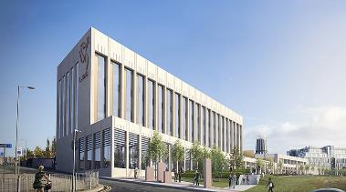
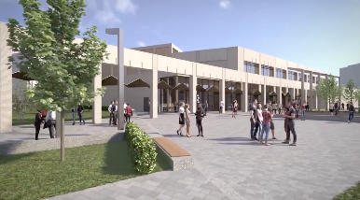
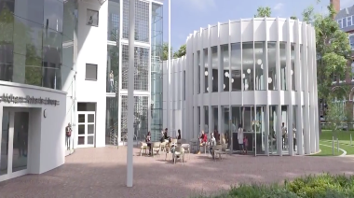
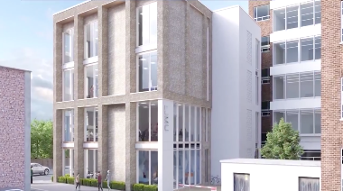
Brand New Facilities!
Liverpool Business School
4-6 Rodney Street
Student Life Building
Copperas Hill
Sports Building
Copperas Hill
LJMU Library Pavilion
Aldham Robarts Library
School of Nursing & Allied Health
Tithebarn Street
Faculty of Education
Maryland Street

Slide 34
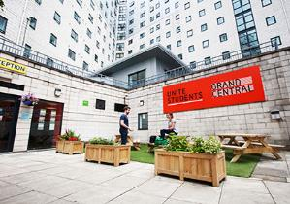
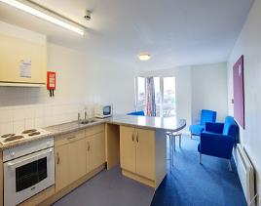
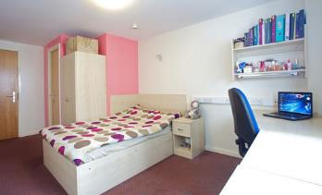
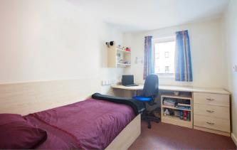
Living In – Mount Pleasant Campus
Grand Central
The Lantern
Student Halls
Notes:
Student Halls
Compare and contrast available halls – i.e. “ You may find Grand central is slightly cheaper but not as high spec” or ‘Willingness to travel i.e. longer walk from accommodation to study building’
Key Points:
City centre living
Close to all facilities
Guaranteed room for first year students
24 hour security
Help reception on-site
Typically close to necessary amenities i.e. Laundrette, Shops, Pub
Many rooms come with en-suite bathrooms (no sharing)
Typically all bills included
Fact - John Moores University Guarantees all new students city centre accommodation typically recommended close to their campus

Slide 35
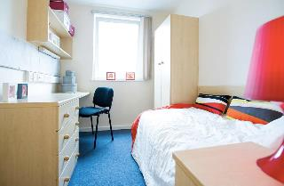
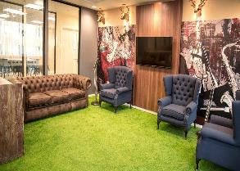
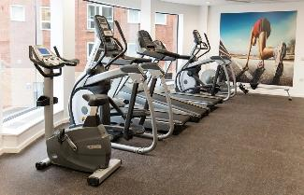
Living In – City Centre Campus
Marybone 1,2 3
Byrom Point
Student Halls
Notes:
Student Halls
Compare and contrast available halls – i.e. “ You may find Grand central is slightly cheaper but not as high spec” or ‘Willingness to travel i.e. longer walk from accommodation to study building’
Key Points:
City centre living
Close to all facilities
Guaranteed room for first year students
24 hour security
Help reception on-site
Typically close to necessary amenities i.e. Laundrette, Shops, Pub
Many rooms come with en-suite bathrooms (no sharing)
Typically all bills included
Fact - John Moores University Guarantees all new students city centre accommodation typically recommended close to their campus

Slide 36


Slide 37

University and Colleges Admissions Services

Slide 38
UCAS – an independent charity
UCAS does:
process applications
provide information, advice, and training
have a Fraud and Verification Team
take part in education sector engagement
UCAS doesn’t:
suggest courses or universities
make decisions or offers
advise on finance, immigration, or visas for individuals

Slide 39

What is UCAS?
The organisation responsible for managing applications to higher education (HE) courses in the UK
The provider of Apply & Track - online tools which make it easier for students, universities & colleges to manage applications and offers
An unbiased guide for students, parents & advisers to help make informed choices about HE and understand the application process

Slide 40
UCAS Timeline
June
UCAS Apply available
6 September
First date for receipt of applications by UCAS
15 October
Deadline for receipt of applications to Oxford or Cambridge, and all with choices to Medicine, Dentistry and Veterinary Science to be guaranteed equal consideration.

Slide 41
UCAS Timeline
15th October 2026
Deadline for receipt of applications to Oxford or Cambridge, and all with choices to Medicine, Dentistry and Veterinary Science to be guaranteed equal consideration.
13th January 2026
Closing date for most applications (but your college will set their own deadline)
Forms received after this date are stamped "late" and considered only at the discretion of the institutions
Respect the internal deadline set by your College - normally November / December
30th June 2027 (Late Applicants)
End of applications before Clearing
NB UCAS deadlines are 6.00pm

Slide 42
What happens next?
Invite for interview/audition
or
Receive an offer decision :-
Conditional: BBB (120 points), DMM (112)
Unconditional: already achieved grades / no grades needed
Reject: No offer of a place
Receive invite to departmental applicant day – your chance to interview the university. Always attend these!!

Slide 43
Before you start…
Make sure you have researched your course/university choices thoroughly
Visited universities
Speak to uni’s about what they are looking for in a candidate – especially key for competitive subjects. Is there anything you should include?

Slide 44
Is the Personal Statement that important?
For some students, this is the ONLY chance to tell us about themselves and why we should make them an offer. For every student, it is the first impression we get of you!
Notes:
Depends on admissions tutor’s preference, the course, how competitive it is… Sometimes it is crucial, sometimes not that significant – but you never know, so better safe than sorry!!

Slide 45
Work Experience
Think about how your work experience has helped you to be a more suitable candidate for your chosen course.
Practical experience which may have confirmed your interest in a particular subject.
What type of skills did you gain, i.e. team work, computer literacy, communication skills.

Slide 46

Next Steps
Research universities and courses
Think about what you want to study, why is this your favourite subject
Build some experiences to develop new skills and discuss in your personal statement
Take on a part time job or a voluntary position linked to your subject
What extracurricular experience do you have? Could you start a new hobby to improve your application?

Slide 47





Find out more from UCAS
@ucas_online
www.yougo.co.uk
www.facebook.com/ucasonline
http://ucas.faq-help.com
www.youtube.com/ucasonline

Slide 48

outreach@ljmu.ac.uk
ljmu.ac.uk

