Slide 1
Use this optional Slide to add some information about you
Notes:
Quick intro: name, job, what you work on, and one “fun fact” about your work.

Slide 2
Welcome to the Mission
Can We Get Human to Mars?
Notes:
Welcome, explorers! Today marks the beginning of an exciting journey. You’re going to help plan one of the biggest missions in human history: getting people to Mars.

Slide 3
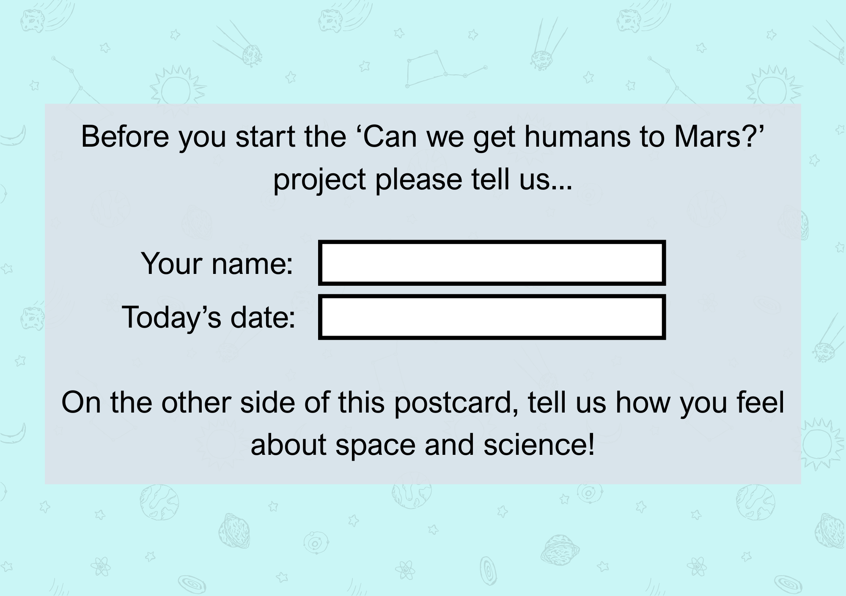
Evaluation Postcards
Notes:
Before we start the project, we’d like to know how you feel about science and space. There are no right or wrong answers — choose what is true for you. Ask pupils to write name + today’s date.

Slide 4
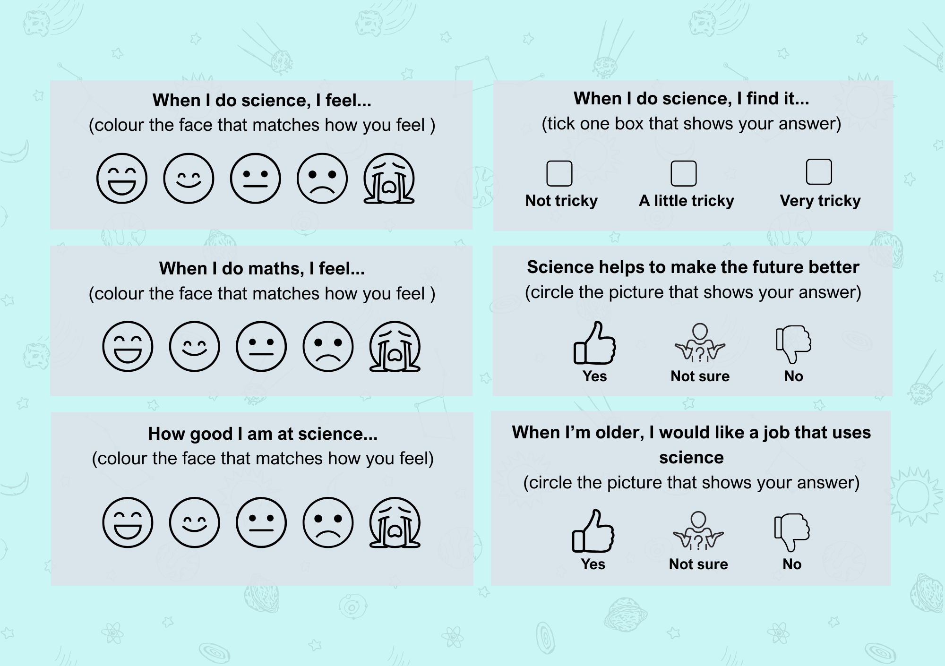
Evaluation Postcards
Notes:
Guide pupils through each box together: Feelings: colour one face
Tricky question: tick one box
Yes/Not sure/No: circle one picture
Give quiet time to complete, then collect in. Reminder: teacher has opt-out list — those pupils don’t complete a postcard.

Slide 5
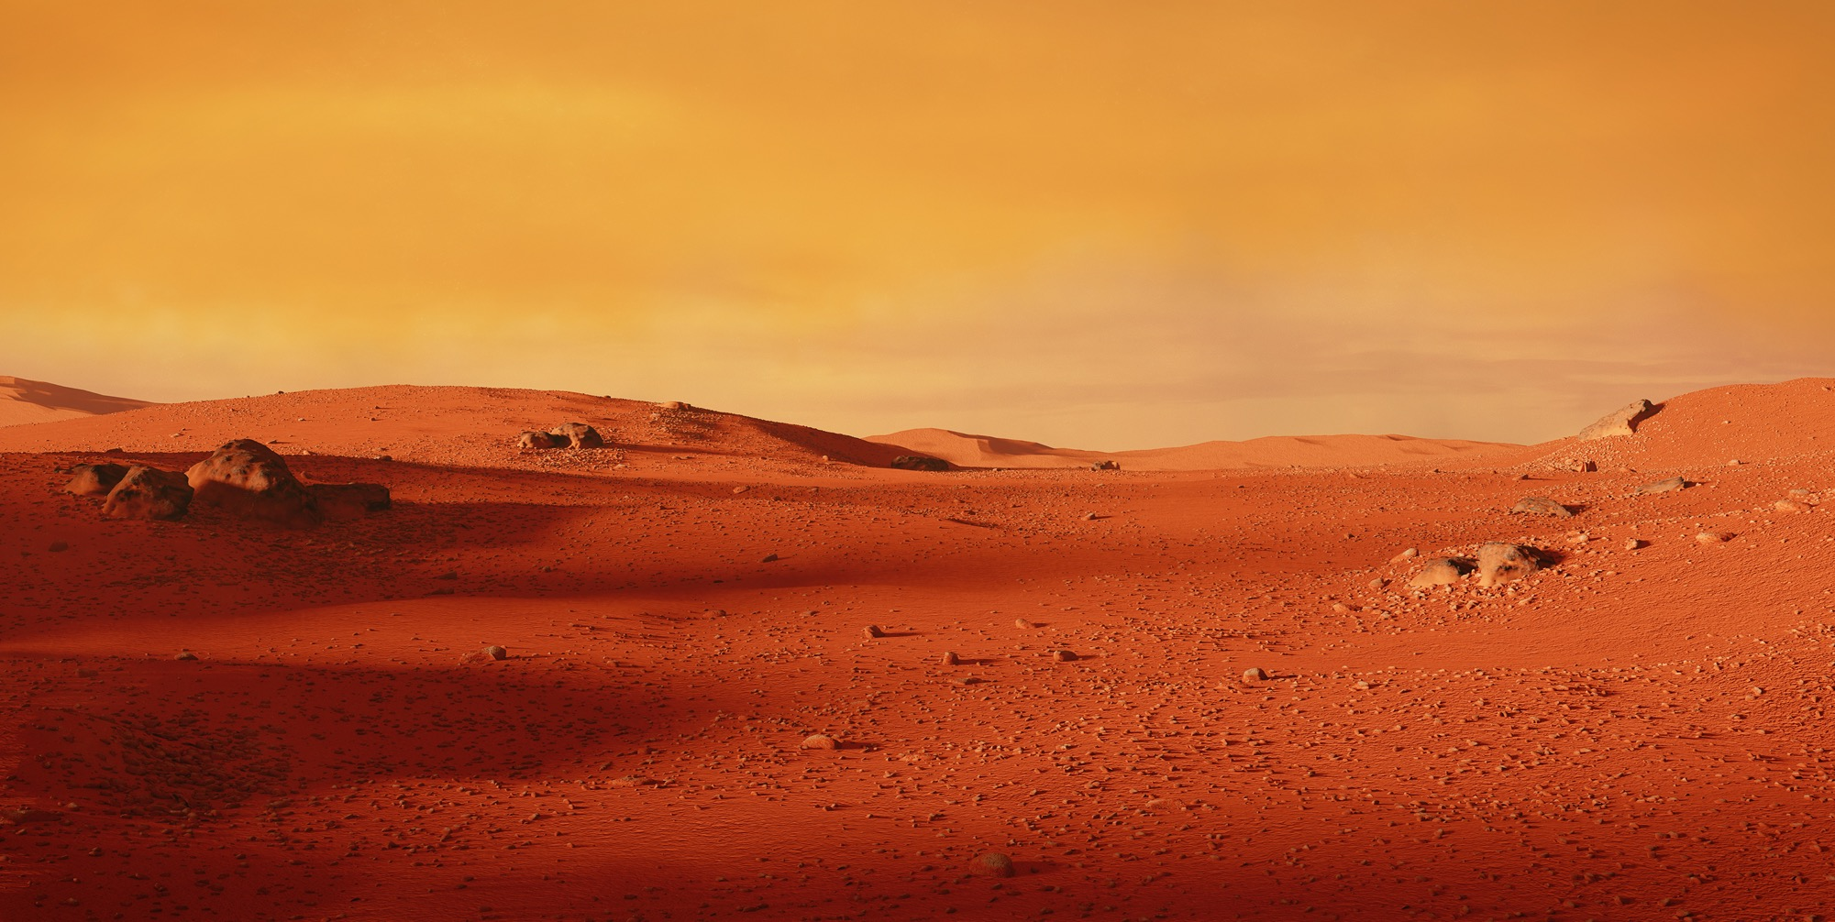
Which of the 8 planets in our Solar System is this?
Notes:
Answer, Mars.
Ask children what they know about Mars – quick 1 min

Slide 6
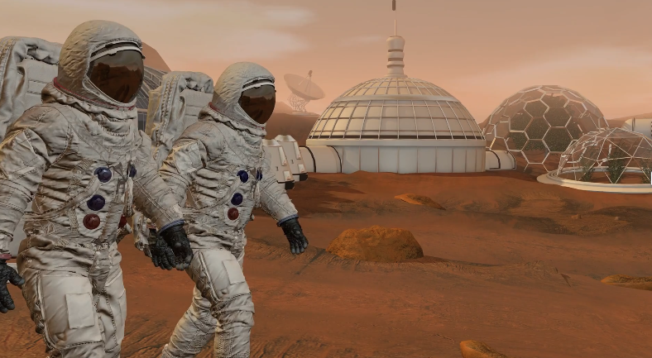
Why go to Mars?
Mars is the most Earth-like planet nearby
We want to search for signs of life
Help us in protecting our planet
Space missions inspire new inventions!
Notes:
Mars is the most Earth-like planet nearby
It has days (a Martian day, known as a Sol, is only 36 minutes longer than on Earth), seasons, and polar ice caps.
We want to search for signs of life
Liquid water is vital for life on Earth, so we consider it when looking for life elsewhere – scientists believe Mars once had lots of liquid water on the surface in lakes, rivers, and possibly oceans.
However, this was probably billions of years ago when the Martian atmosphere was thicker and able to ‘trap’ more heat.
Help us in protecting our planet
Living on Mars could teach us how to survive in extreme conditions, which is especially important when considering the effects of climate change.
Also, if humans can recycle air, water, and grow food on Mars, we can use the same innovations to live more sustainably on Earth.
Space missions inspire new inventions
Technology developed for space often helps Earth (e.g., water filters, solar panels, medical imaging). If we can survive in a place with no air, no water, and freezing temperatures — imagine what we can invent for people here at home.
Big missions also inspire new generations and global cooperation.

Slide 7
How Many people have been to Mars?
A. 0
B. 2
C. 12
Notes:
Tell students you’ll read out the options, and they’ll vote by raising their hands (e.g. ‘Who thinks the answer is A? What about B? And C?’).
The correct answer is A. 0 – no humans have gone there. You could explain that pupils will explore what it would take to send humans to Mars safely and the first humans to go could be children in schools today.

Slide 8
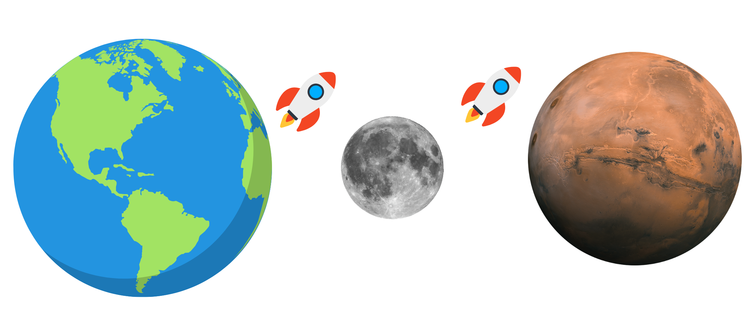
What’s the Challenge?
?
Notes:
Explain that getting to Mars is not as simple as building a rocket, pressing launch, and landing. A journey to Mars would take months, and space (and Mars) is a very different environment to Earth. Humans have not travelled beyond low Earth orbit for many years, so there would be many unknowns if we tried to send people to Mars right now.
Explain that there are several steps we need to solve first. Through this project, pupils will explore each step.
Explain that before we can safely go to Mars, we need to learn how humans can live somewhere other than Earth. There is a closer place we can visit to practise this.
Ask pupils to guess what it is (again, encourage thinking time and no shouting out). Confirm that it is the Moon and explain that it will be an important stepping stone on the journey to Mars. Today’s investigation is about studying the Moon’s surface and choosing a suitable landing/base site.

Slide 9


The 6 Investigations
Where Should We Build a Moon Base?
What Do Humans Need to Survive?
How Do You Control a Robot Rover?
How Do We Stay Healthy in Space?
Why Does Mars Change Size?
When Should We Launch to Mars?
Notes:
Briefly outline the 6 project steps (keep each one to a single sentence):
Step 1: Study the Moon and choose a safe place to land and build.
Step 2: Plan how humans could live on the Moon (shelter, food, water, energy).
Step 3: Learn how to control robotic rovers using coding, to explore before humans arrive.
Step 4: Explore how space affects the human body and how to stay healthy.
Step 5: Investigate how far away Mars is and what that means for travel.
Step 6: Plan the best launch window for a safe journey to Mars.
Conclude by explaining that across the 6 investigations, pupils will work through these steps to build up a realistic plan for getting humans to Mars.

Slide 10



Meet the Crew – That’s You!
You’ll become:
🪨 Geologists – Study rocks and search for a landing site
🛠️ Engineers – Design and build space technology
💻 Coders – Control robots and program space missions
💪 Medics & Physical Trainers – Keep astronauts healthy in space
🔭 Astronomers – Observe space and collect telescope data
➗ Mathematicians – Calculate distance, speed, and launch timing
Notes:
Every successful space mission needs an amazing team — not just astronauts. We need geologists to understand rocks and pick safe landing spots. Engineers to build things that survive space. Coders to program our robots and get them where they need to go. We’ll need medics and trainers to keep astronauts healthy in low gravity. Astronomers to use telescopes and study the Moon and planets. And of course, mathematicians — because without maths, we can’t even launch a rocket. You’re going to play all these roles across the project — how exciting is that?

Slide 11
Investigation 1
Where should we build a Moon base?

Slide 12
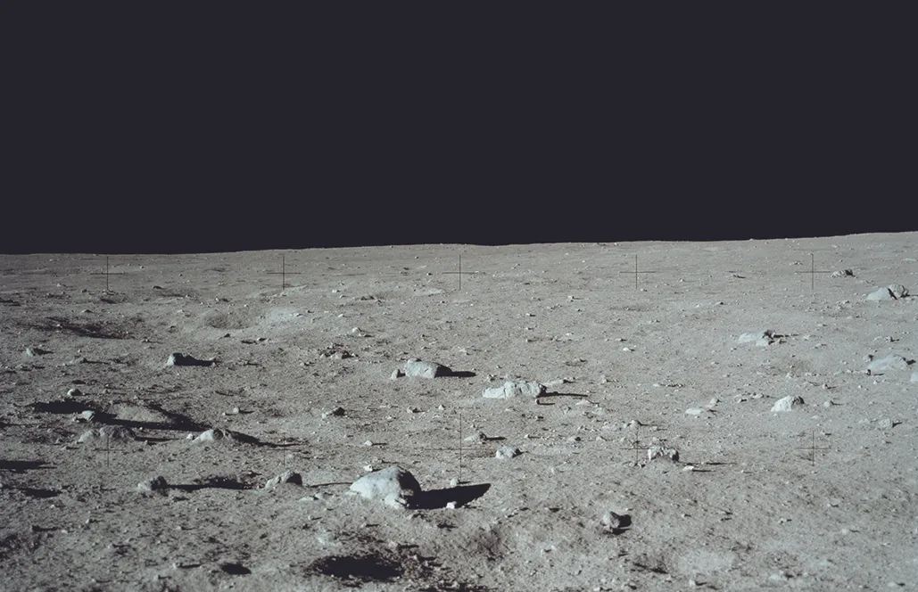
How Many people have been to the Moon?
A. 0
B. 2
C. 12
Notes:
12 astronauts have walked on the Moon
Other information you could add:
First: Neil Armstrong & Buzz Aldrin (1969).
Last: Gene Cernan & Harrison Schmitt (1972).
The Apollo 11 landing site was the Sea of Tranquillity.
Astronauts brought back 382 kg of Moon rocks and soil.

Slide 13
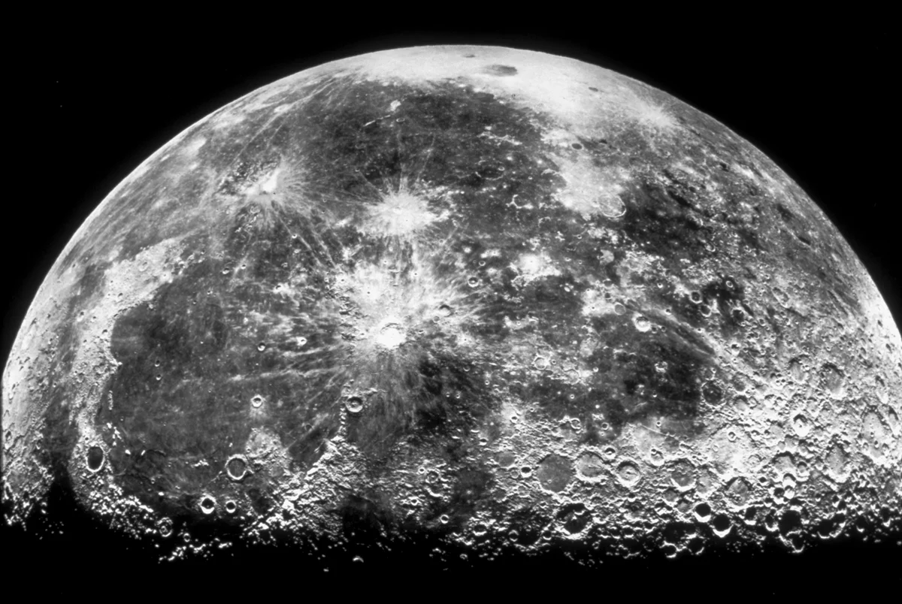
Investigation 1 brief:
Your team will become Geologists and your mission is to explore the moon to choose the best place to build a base on the Moon.
Notes:
Welcome to your first mission! You're now lunar scientists, and you’ve been asked to help space agencies choose the perfect spot to build the first Moon base. This base will help us practise living off Earth and prepare to go to Mars. Let’s find out how we’ll do that.

Slide 14
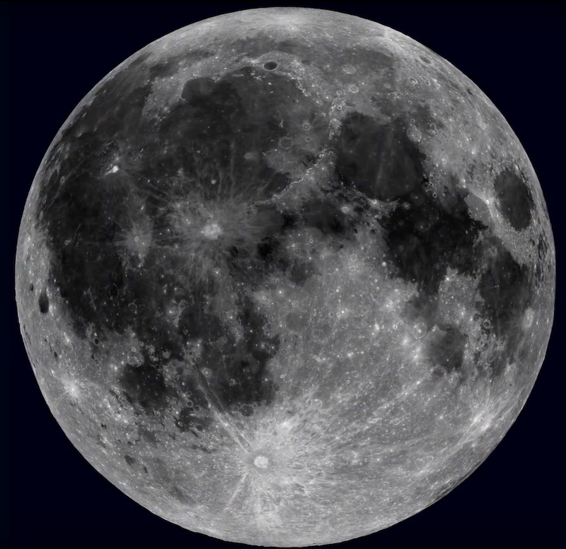
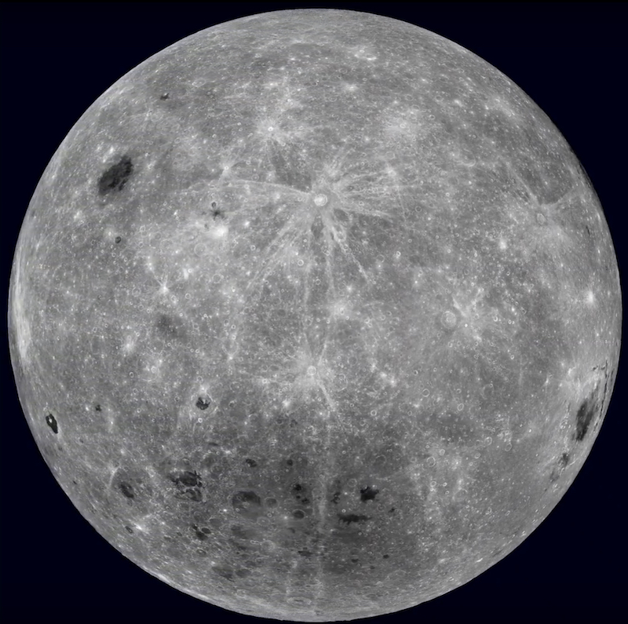
Activity: Explore the Moon’s Surface
Notes:
In front of you is a huge printed map of the Moon — just like the ones real scientists use to plan missions. Your task is to investigate this surface and label key features. Let’s find out what to look for

Slide 15
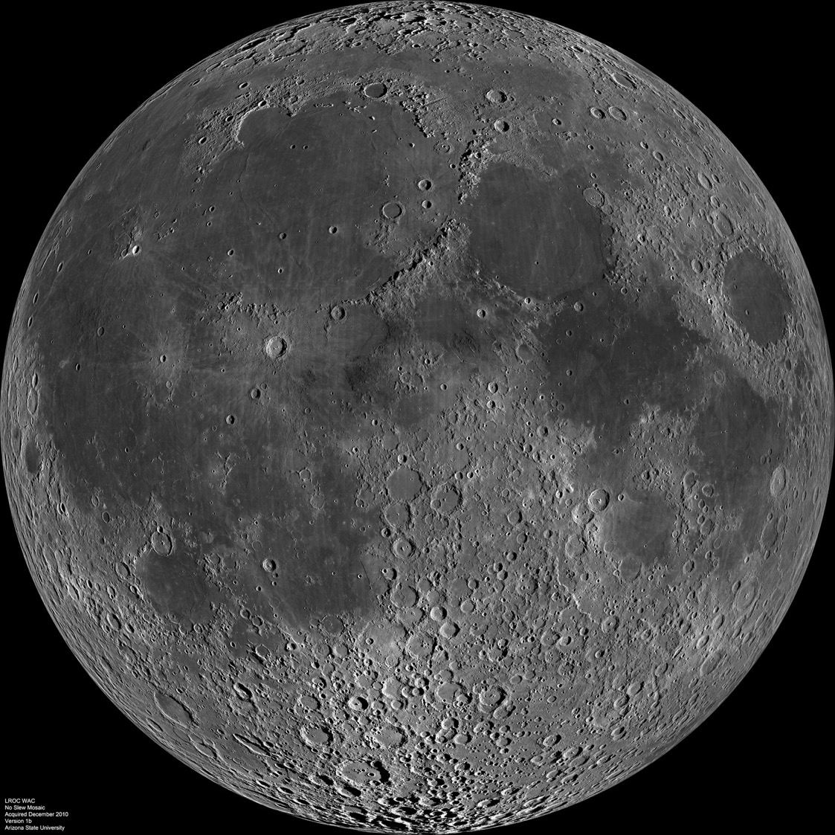
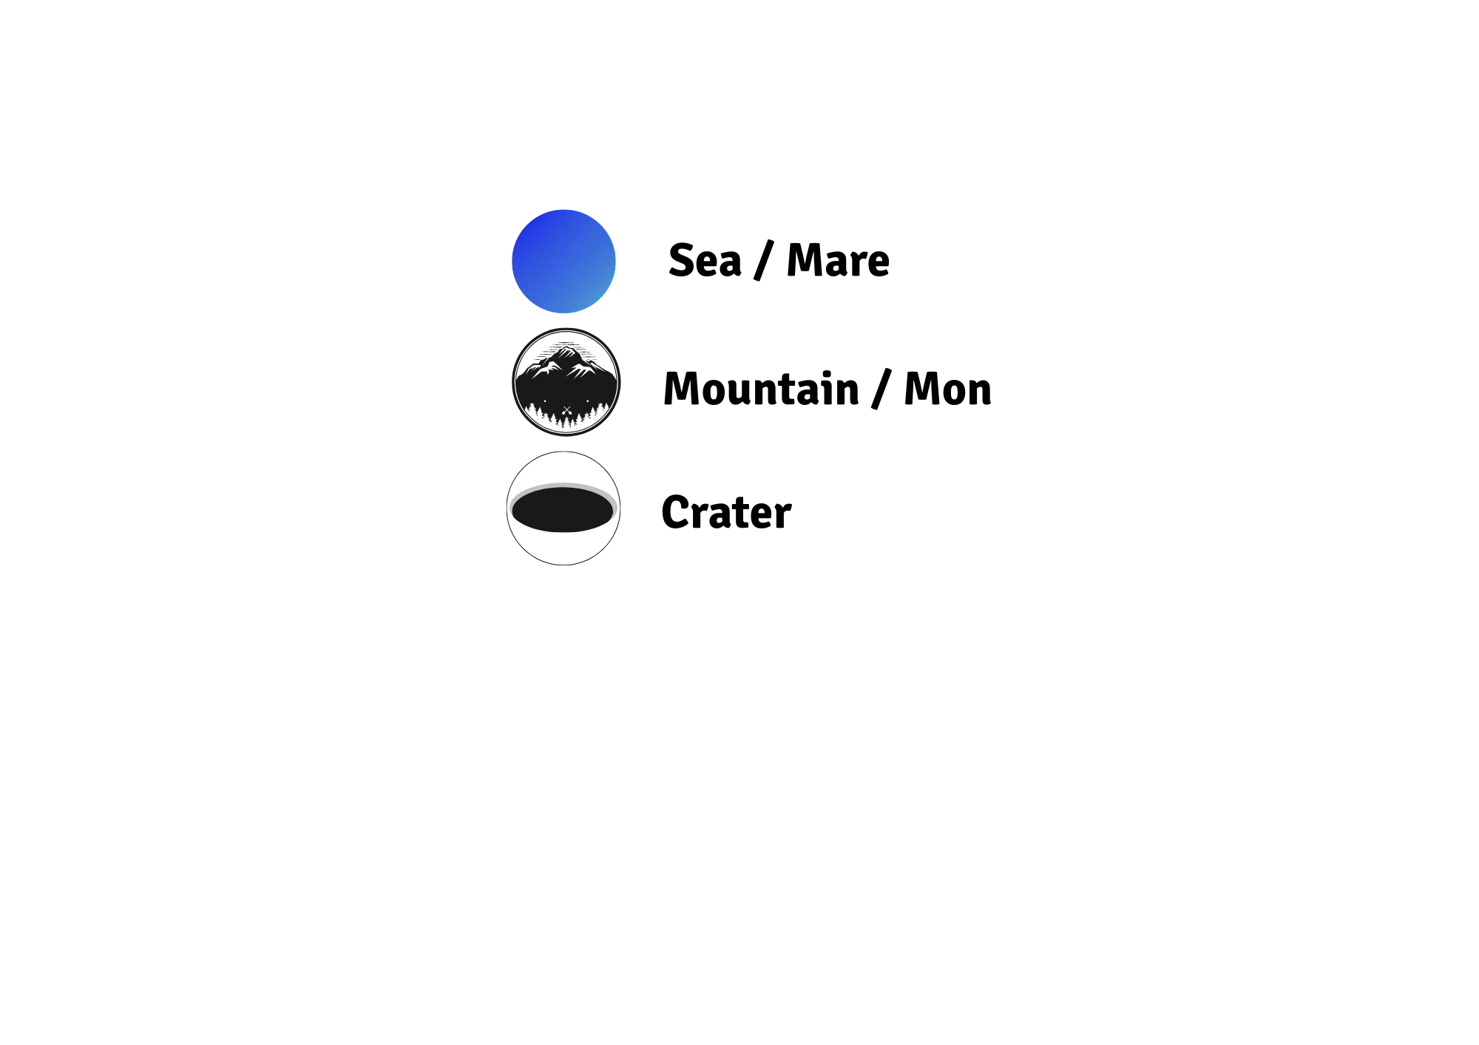
What to Look For
This Photo by Unknown Author is licensed under CC BY-SA

Slide 16
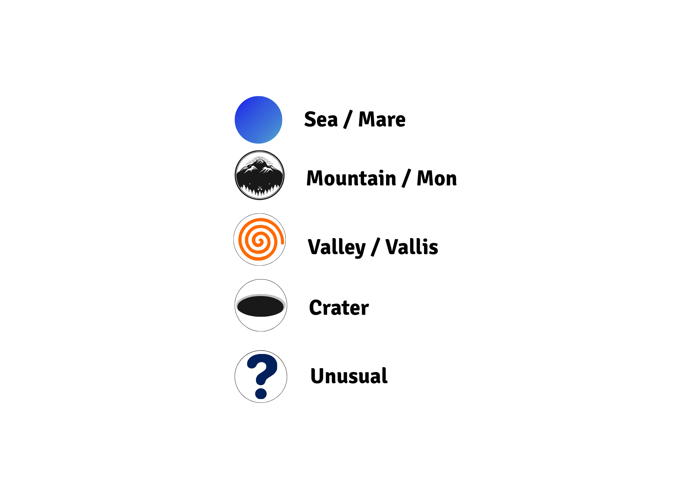
Seas (maria)
How to spot them:
If it’s dark and smooth patch, it’s probably a mare
This Photo by Unknown Author is licensed under CC BY-SA
Notes:
Key Facts:
Large, dark plains made of basalt (lava rock).
Formed by lava flooding giant impact basins billions of years ago.
Ancient astronomers thought they were oceans; hence they called it “mare” (Latin: sea).
Cover ~16% of the Moon’s surface.

Slide 17
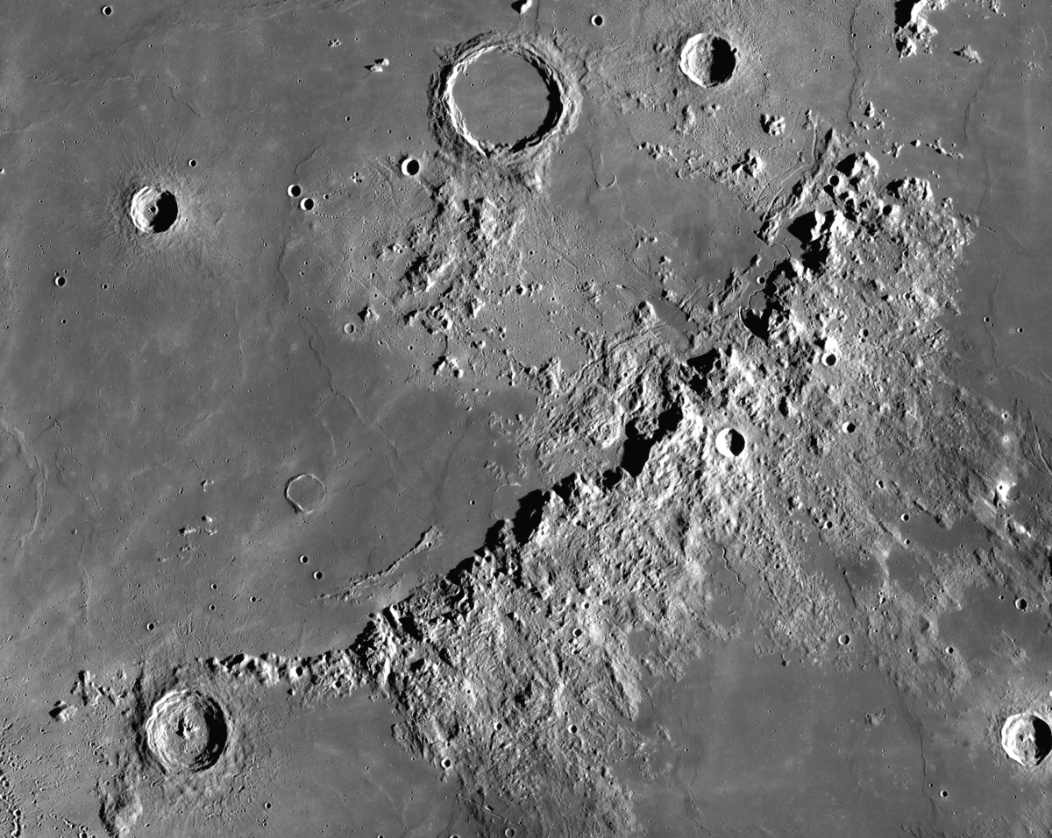
Mountains (mons)
How to spot:
Bright patches near shadows, bumpy or raised areas.
Notes:
Key Facts:
Bright, high areas often marking the rims of ancient impact basins.
Some peaks are 3 – 4 km high.
Older rock than the maria (seas); heavily cratered.

Slide 18
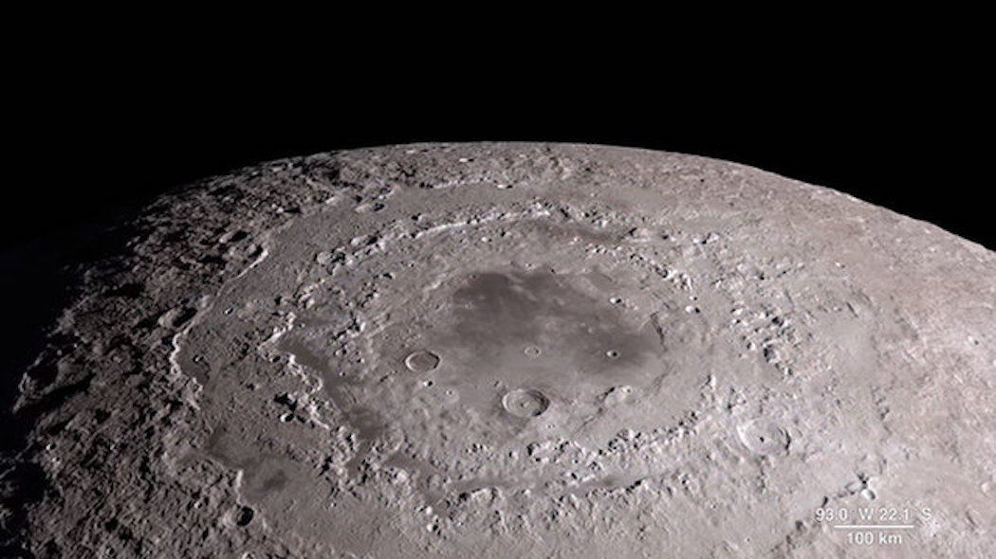
Craters
Hot to spot them:
Round shapes with a rim/wall.
Notes:
Key Facts:
Created by asteroid/comet impacts.
Can be huge (hundreds of km).
Bright rays sometimes spread from them – caused by ejected debris.
With no atmosphere, craters remain unchanged for billions of years.

Slide 19
Explore the Moon’s Surface
Find the best example of each feature on your Moon section. Put the correct sticker next to each one.
Choose a feature and write a short description about how it looks.
Student Workbook: page 4

Slide 20
Activity: Choose a Moon Base Site

Slide 21
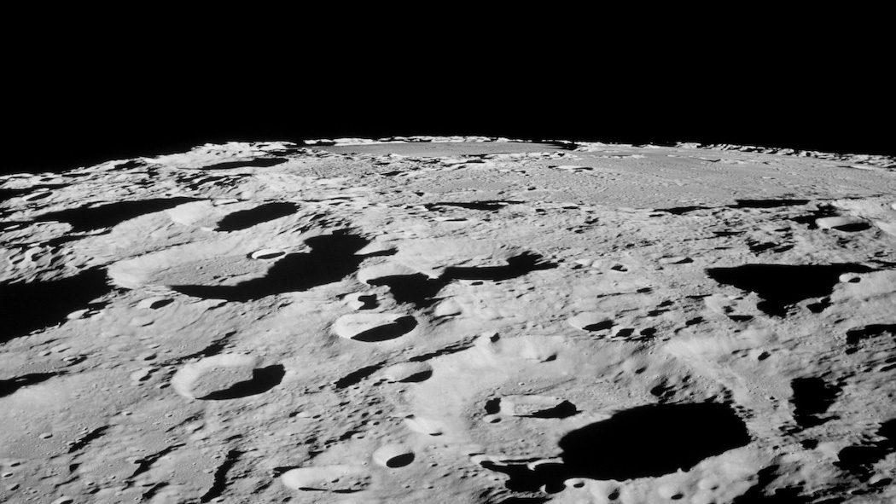
What Makes a Good Base Site?
Sunlight for energy
Easy to reach (flat ground)
Safe from space hazards
Near useful features like craters or lava tubes
Notes:
Ask students ‘What make a good base site?’. Select some to share with the class before showing the answers
Prompts that students might consider:
Whether there’s sunlight or shadows (as solar power will be useful to power our Moon Base)
Safety issues (e.g. avoid deep craters)
How easy building and landing will be (flat land would be best)
Access to resources (e.g. rocks, possible ice)
The proximity of interesting places (e.g. craters, lave tubes – they might even hold water)
Good sites might include flat sea/mare areas near crater edges (solar energy + flat land + access to rocks).
Poor sites might include deep craters (hard to land + very cold + long shadows).

Slide 22
Choose a Moon Base Site
Look at the Moon image on page 6.
Circle/Draw an arrow towards the place where you will put your Moon base.
Select words from the box on page 7 to explain why you chose that site.
Student Workbook: page 6 – 7

Slide 23
Activity: Taking a Moon observation
Notes:
This activity is all about using real data, just like professional astronomers. You’ll be requesting an image of the Moon using a robotic telescope in places like the Canary Islands or Hawaii.

Slide 24
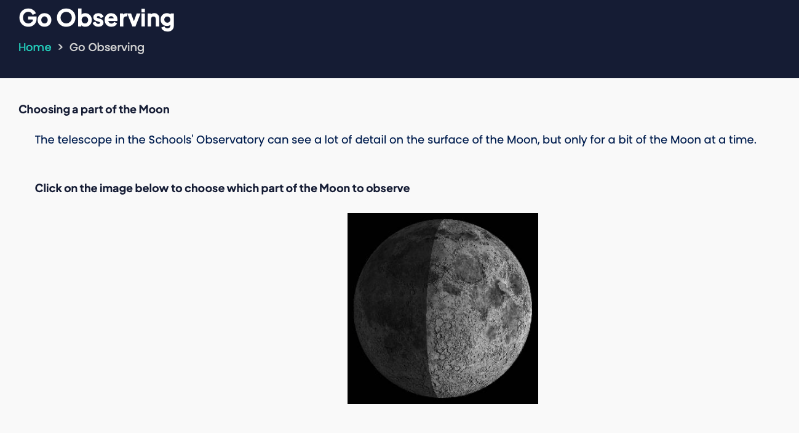
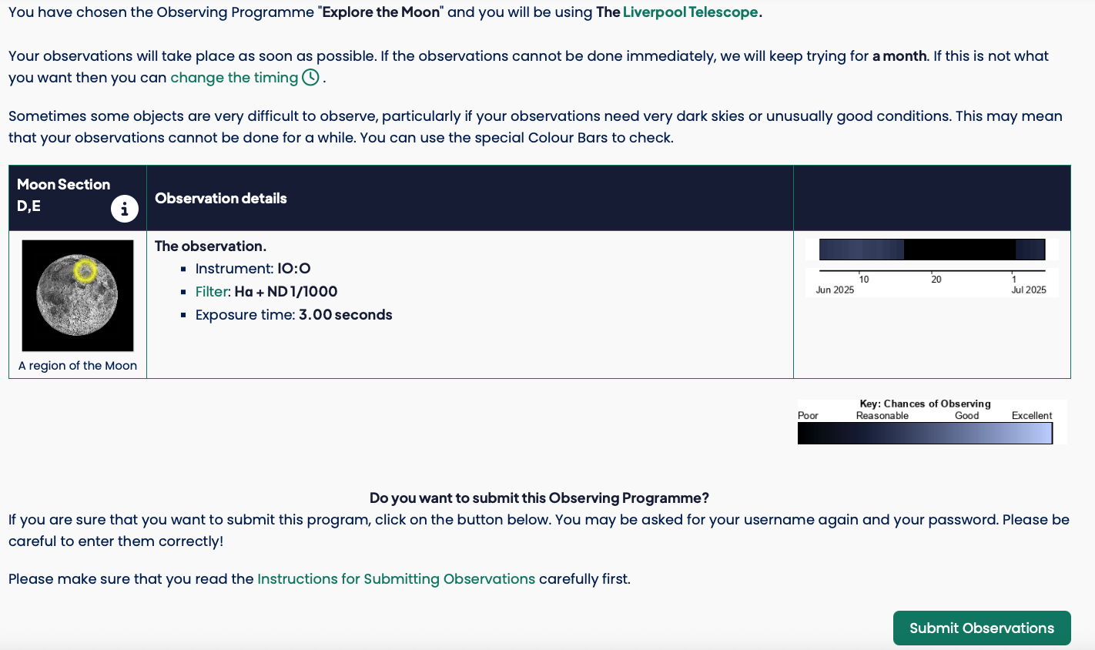
What Do You Need to Do?
Log into your student account
Go to Go Observing
Choose Observe the Moon
Pick your site region
Submit your request!
Write the Moon section name in the box
Student Workbook: page 7
Notes:
Each student will log into their Schools’ Observatory account. Once inside, you’ll go to the Go Observing section and choose to observe the Moon. Then, select the part of the Moon your team is investigating. Once you’re happy with your choice — hit submit! It may take a little time for the telescope to return your image. You can use our Archive which is full of real observations. Your can show the students similar photos of their sites from the archive.

Slide 25

Next Investigation…
Now that you have selected a site for your Moon Base, the next investigation will explore how to design it.
You’ll learn about what resources humans need for survival and how we can get these on Earth and in space!

