Slide 1

Investigation 3
How do you control a robot rover?
Career Link:
Engineer/Computer programmer

Slide 2
Introduction to your investigation
Last time, you designed a Moon Base.
Today, we take the next step towards exploring Mars.
Before we can send humans to Mars, we must send robotic rovers first to learn more about Mars.
Your team will become Engineers and Programmers, coding rovers to complete missions on Mars.
Notes:
Begin by reminding the students about the previous investigation.
“Last time, you all worked as mission planners and designed your own base camp on the Moon. Can anyone remind us why we started with the Moon before Mars?” (Encourage students to share: e.g. practising living off Earth, easier travel, safe testing site).
Then link to today: “Now that we’ve built our Moon base, we’re ready to take the next step towards exploring Mars! But Mars is far away and much harder to reach. Instead of sending people straight away, we send robots first. These robots are called rovers, and they help us learn what Mars is like
Today, you will become engineers and computer programmers. You’ll code your own robotic rovers and send them on scientific missions to explore the Martian surface. The data you collect will help us understand what humans will need to survive there
Remember, this mission builds on what you’ve already done. Every investigation brings us one step closer to getting humans to Mars!

Slide 3
Why Explore Mars with Rovers?
Mars is far away and too risky for humans right now
Rovers act like scientists on wheels
Robots are safer and cheaper than sending people
Exploring Mars prepares us for the future
Notes:
Ask ‘’ Why Explore Mars with Rovers first before sending human? – let the student share their thoughts – Don’t spend too much time on this
Mars is far away and too risky for humans right now
It takes months to travel there and we don’t yet have the technology to keep humans safe for the whole trip.
So we send robots first to test the conditions.
Rovers act like scientists on wheels
They can study rocks, soil, and weather.
They collect data about the planet that we couldn’t get otherwise.
Robots are safer and cheaper than sending people
If a robot fails, we can build another.
Humans need food, water, and oxygen – robots do not.
Exploring Mars prepares us for the future
Each mission teaches us more, so we can plan for when humans might one day live there.

Slide 4
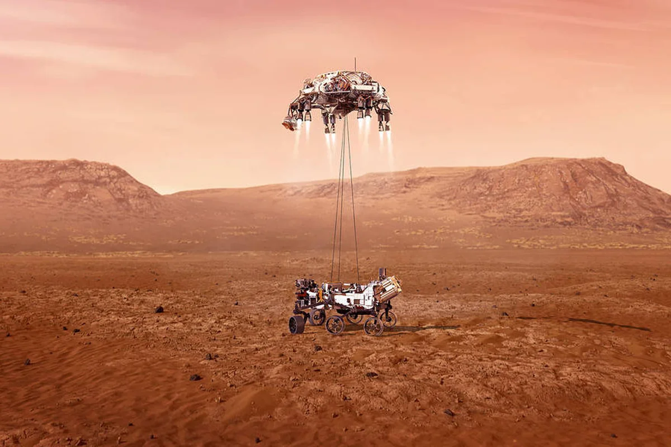
How many rovers have landed on Mars?
A. 6
B. 22
C. 0
Notes:
Answer: 6 rovers have landed safely on Mars. Only 2 of them are still alive today.
Different countries like America, Europe including the UK, China, India, Japan, and the UAE have been sending spacecraft to Mars for nearly 60 years! Each mission taught us something new.
Over 50 missions have tried… many failed at first but more succeed now! Tell the students that even failures help scientists and engineers learn for the next mission.

Slide 5

Now it’s your turn…

Slide 6

Introduction to Programming
Programming is like giving instructions to a robot or computer.
The robot only does exactly what you tell it to do.
Notes:
Ask for a volunteer to come to the front.
Give them instructions like:
“Take 3 steps forward.”
“Turn one step right.”
“If you are close to the desk, turn left.”
Point out that this is just like coding — we give clear, step-by-step rules.
Remind them: computers are not clever by themselves, we make them clever with instructions.
if our code has mistakes, the robot will not behave as expected. This is called debugging.

Slide 7
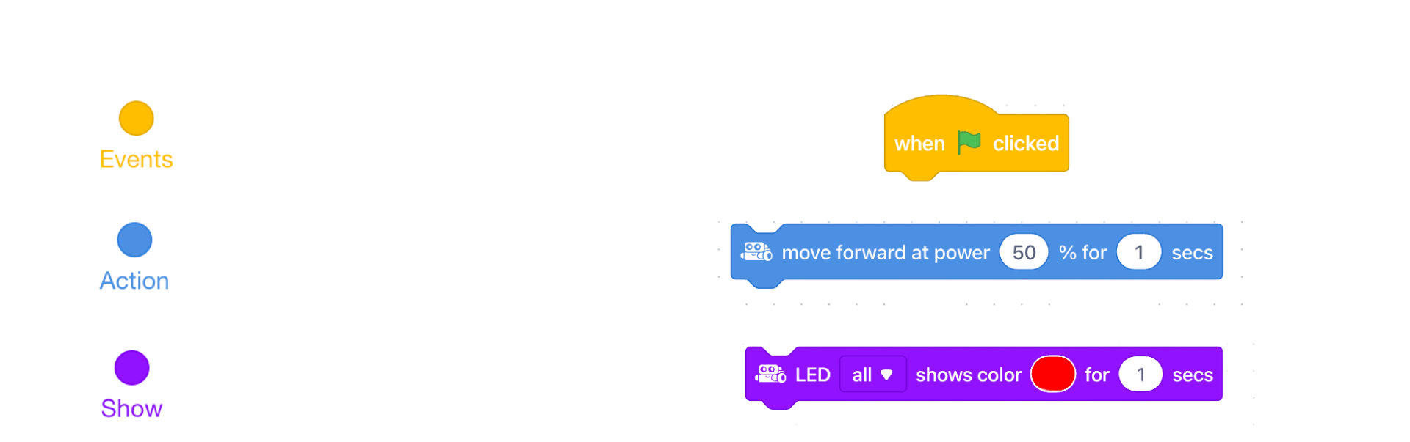
Coding Blocks
Start the program
Move the robot
Change how the robot looks or acts
Notes:
Introduce the mBot rover. Explain that it is a small programmable robot that will represent a Mars rover in today’s missions.
Next, introduce the Makeblock (mBlock) coding platform. Pupils will control the rover using coding blocks. This software is similar to Scratch, which students likely have used before
Explain each block quickly:
🟦 Events – Start the program.
Example: “When green flag clicked.”
Think of this like saying “Go!” to the robot.
🟩 Action (Motion) – Move the robot.
Example: “Move forward for 3 seconds” or “Turn right.”
This tells the robot where to go.
🟧 Looks/Show – Change how the robot looks or acts.
Example: “Turn lights red.” ‘’Make a Beeb sound’’
This makes the robot show something.

Slide 8


Demo time
Notes:
Do a short demo:
Drag and click each block
Take one block (e.g., move forward).
Drag it into the coding area, click on it, and show the robot reacting.
Explain: “Every block is an instruction. When you click it, the robot listens.”
Snap blocks together like LEGO
Demonstrate how two blocks can be joined (e.g., when green flag clicked + move forward).
Point out how the shapes only fit in certain places; this helps us know what works together.
Change variables
Show how to change numbers in a block (e.g., “move forward for 1 second” → “move forward for 3 seconds”).Ask: “What will happen if I change it to 5 seconds instead of 1?” Then test it.
How to stop the rover
Pupils can start the program by clicking on the code block, so it is helpful to keep a “stop moving” block ready to click at any time if something goes wrong. They can also use the stop button in the software. Finally, if the rover is not responding, show pupils the on/off switch to reset it and then help them to reconnect it to the software.

Slide 9

Quick tests time
Student Workbook: page 28-29
Notes:
- Split the class into 8 groups and give each group one mBot. It is recommended to ask the class teacher to help with the grouping, as they know which pupils work well together.
- Lay out the 4 Mars canvases on the floor (Place 1 rock model per canvas on A3 square) and add 4 magnetic blocks per canvas on C7 square)
Before pupils begin, remind them to:
handle the rovers carefully and not drop them from a height
keep the rovers on the floor for coding and testing (not on tables)
Test 1: Move forward – make the rover move one square forward
Test 2: Turn 90° – make the rover turn 90° left or 90° right
Test 3: Sound or light signal – make the rover play a sound or show a light

Slide 10
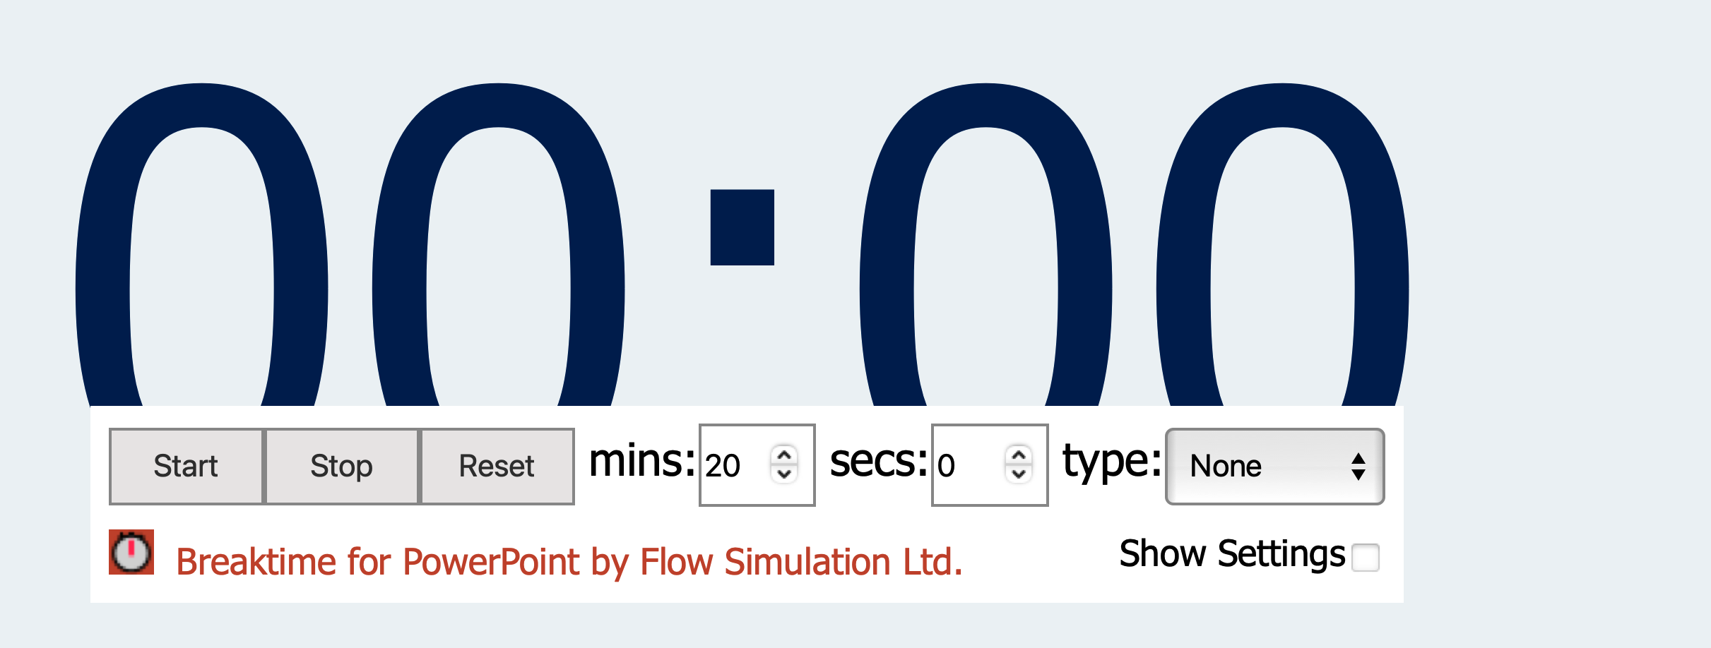
Notes:
You can adjust the time to fit your session. (recommended 10 minutes)

Slide 11

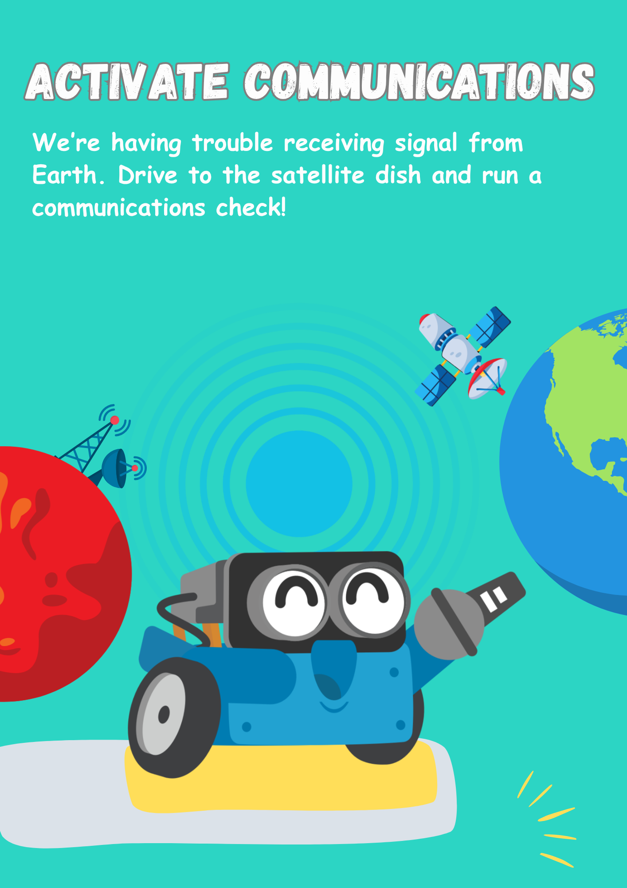
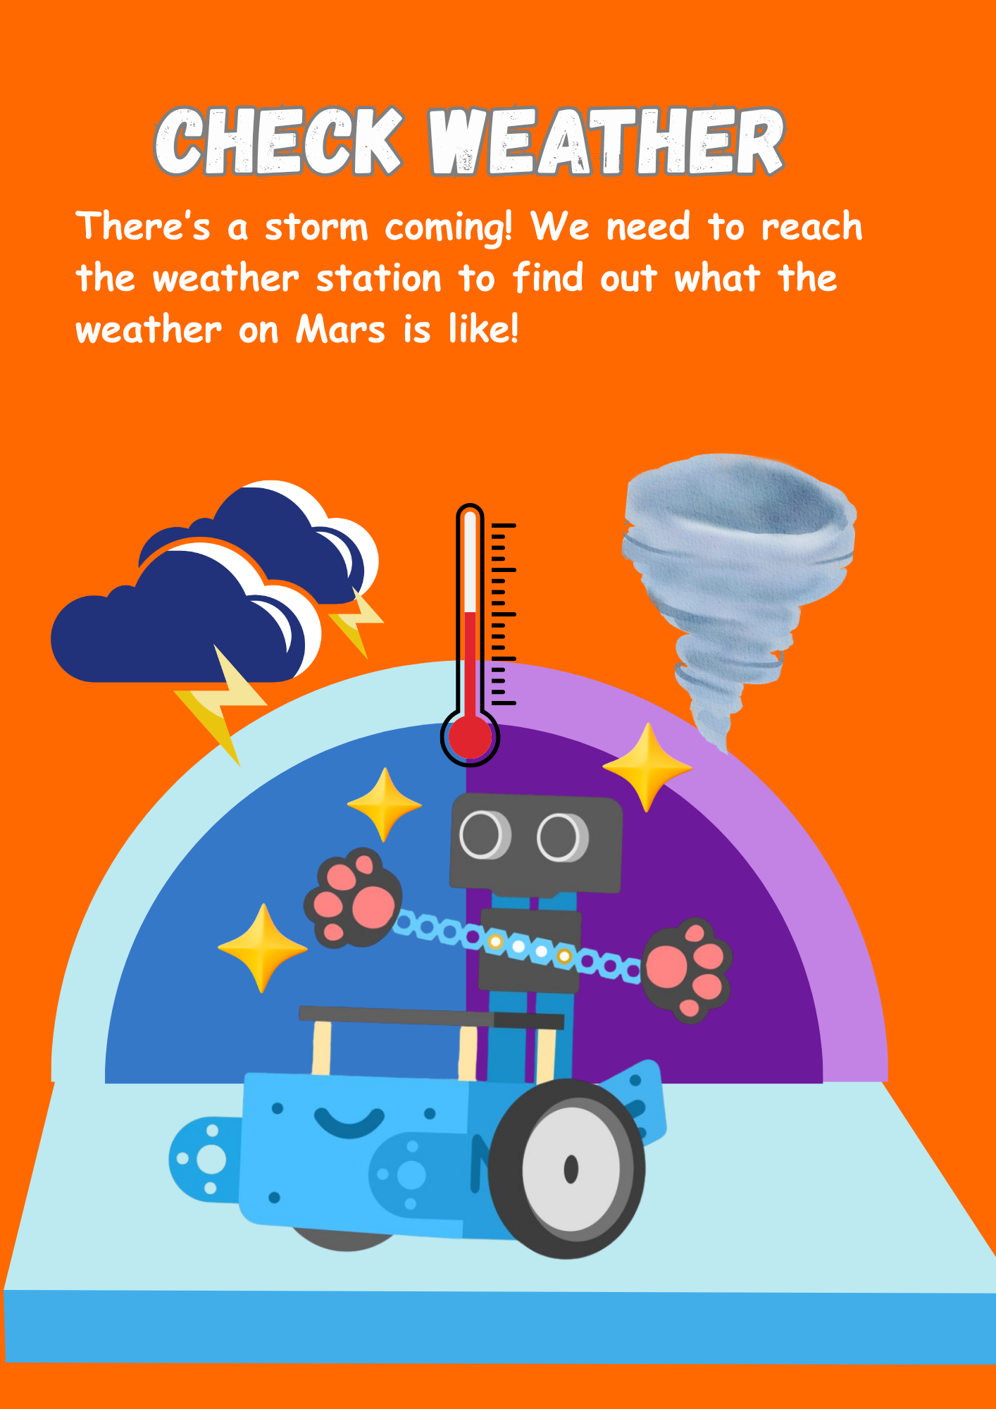
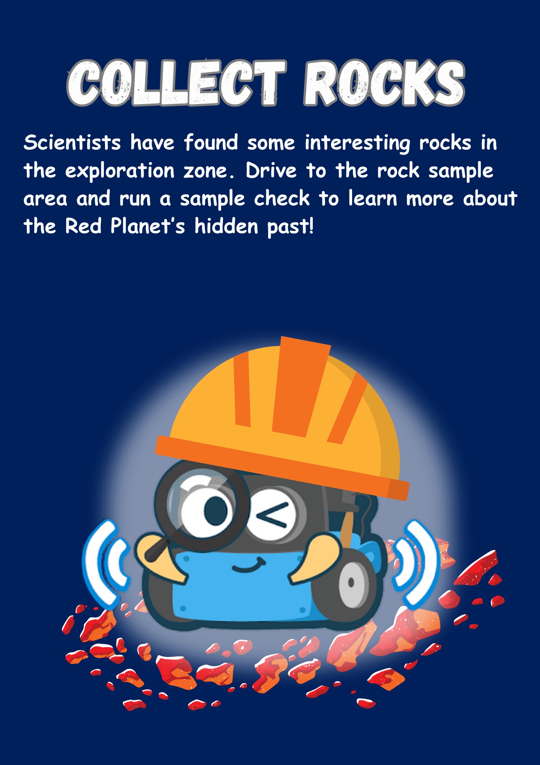
Your Missions
Plotting
Coding
Testing
Recording
Notes:
Hand out the mission cards to each team by canvas:
Canvas 1 and 2
Hand out the following mission cards, one per each team:
Clean Solar Panels
Activate Communications
Canvas 3 and 4
Hand out the following mission cards, one per each team:
Check Weather
Collect Rocks
Briefly explain that each team will follow a simple mission process.

Slide 12
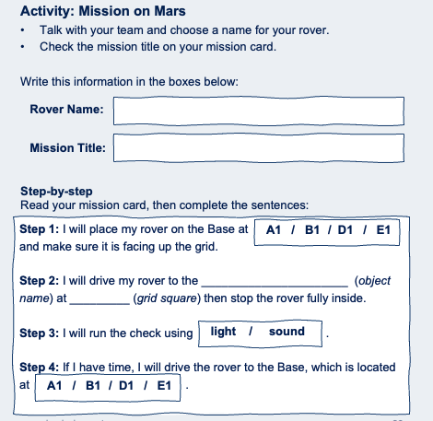
Step 1
Rover and Mission details
Student Workbook: page 29
Notes:
Step 1 – Rover and Mission Details (page 29 in the workbooks)
Ask students to agree on a rover name and write it in the workbook.
They should also write down their mission title (from the mission card).
Pupils read the mission instructions on the back of the card and complete the sentences in their workbook.
Tip: Emphasise collaboration: this step builds team identity and makes them feel like “real engineers.” You could prompt: “What would NASA or ESA name their rover? Can you come up with something inspiring or funny?”

Slide 13
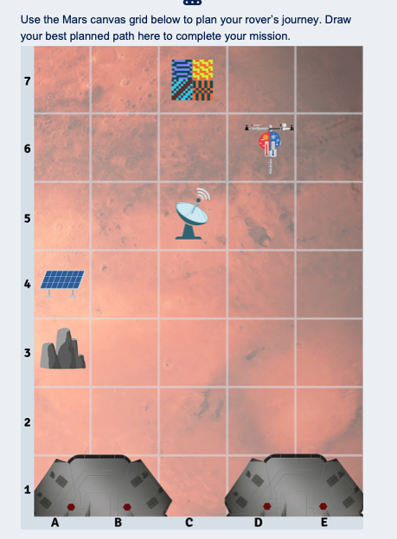
Step 2
Plotting & planning
Student Workbook: page 30
Notes:
Step 2 – Plotting & Planning (page 30 in the workbooks)
Students should trace the safest path to their mission target.
Remind them to think about obstacles (rocks and stations).
Tip: See pages ---- for some ideas on how to complete each mission. Tell them to use arrows or step counts to map moves. This helps avoid errors later. Connect to real science: engineers at NASA also plot rover paths carefully to avoid hazards.

Slide 14
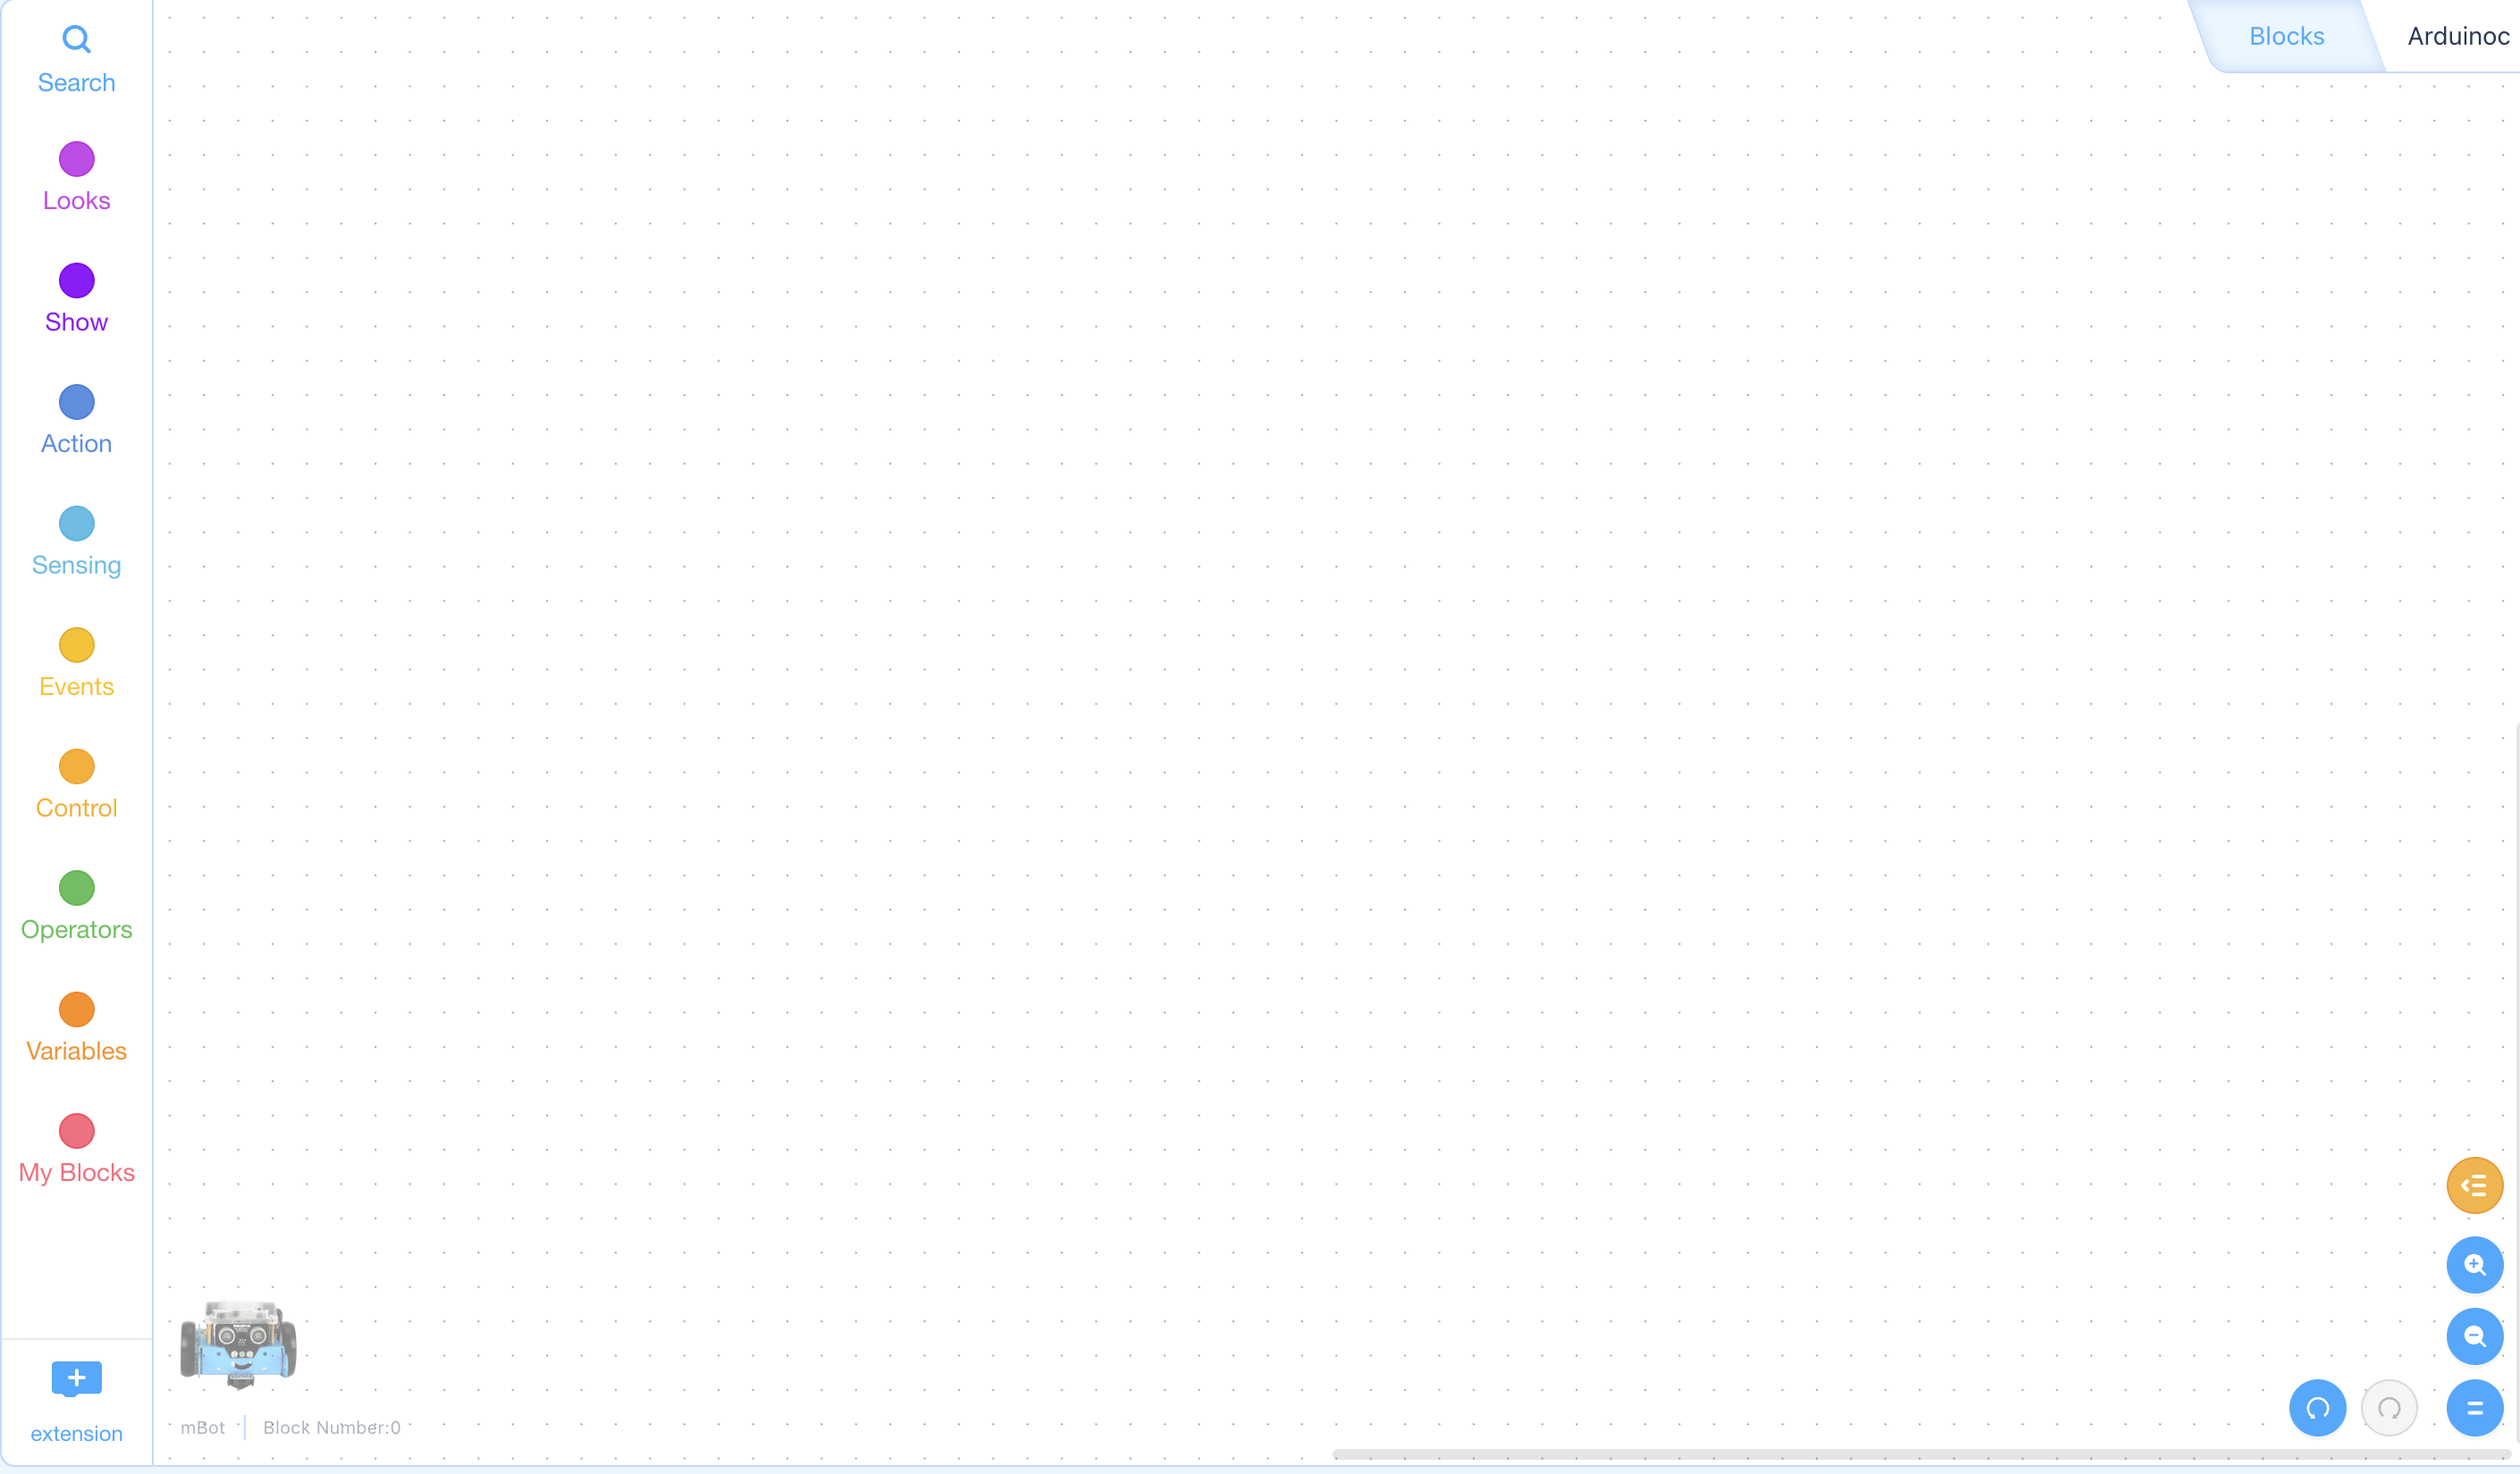
Step 3
Coding
Notes:
Step 3 – Coding
Now, students turn their plotted path into code.
Remind them:
Use the same blocks they practised in the Quick Rover Tests.
Each move or turn should be included as a block in their program. For example, if pupils need the rover to move several squares, they should change the value (or repeat the block), rather than repeatedly clicking a “move one square” block.
Remind pupils that once the rover is placed on the launch base and they press start, they should not touch the code while it is running, the program should be complete before launch.
Tip: Walk around and check that teams’ code matches their planned path.

Slide 15

Step 4
Testing
Notes:
Step 4 – Testing
Pupils test their code on the floor and check whether the rover follows the planned route.
If it doesn’t work first time, reassure them that this is normal, they should adjust the code and try again.
Tip: Highlight that real missions also test multiple times before launch.
Ask: “What worked? What didn’t? How can you improve it?”
Motivate them by saying even NASA engineers face failures before success.

Slide 16
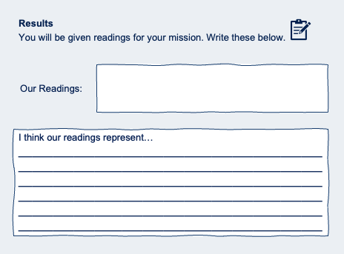
Step 5
Readings
Student Workbook: page 31
Notes:
Step 5 – Readings (page 31 in the workbooks)
When a team completes their mission, they should let you know.
Once they have successfully completed it, give them the relevant mission reading/value to record (as the mission controller).
Pupils record the reading in their workbook and answer the question: “What does your reading represent?”
Allow around 30 minutes for the mission section in total (adjust as needed for your session). If teams finish early, you can offer an extension activity (see page ___).

Slide 17
Notes:
Adjust the time to fit to your session (recommended 30 minutes)

Slide 18
Readings
12.5 minutes
That’s how long a radio message takes to travel from Mars to Earth (one way).
Notes:
Mission 1 – Activate Communications Reading to give pupils: 12.5 minutes
What it represents: That’s how long a radio message takes to travel from Mars to Earth (one way). This is why we can’t control Mars rovers in real time — there is always a delay.

Slide 19

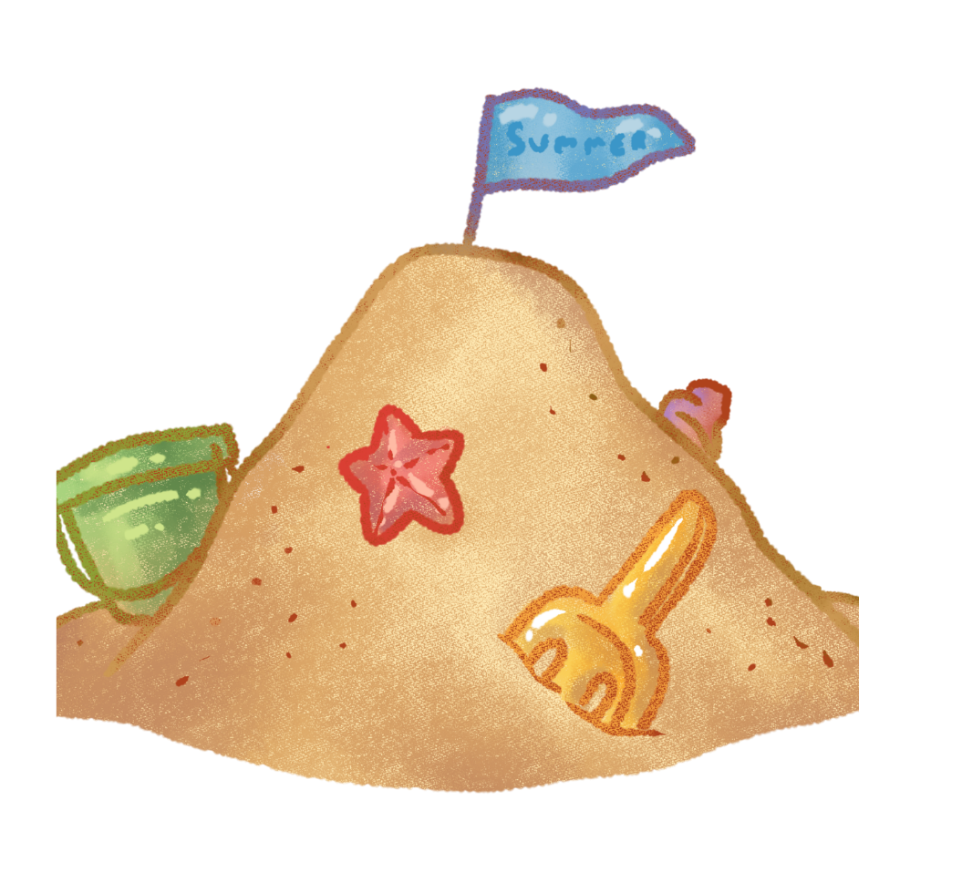


Readings
Rust
(Iron oxide)
Water
minerals
Sand
(Silica)
Volcanic rocks
Notes:
Mission 2 – Collect Rocks Reading to give pupils: Hand the stickers (four icons). Pupils should use the icons to identify and name the 4 rock/mineral types
What it represents: The icons represent four key types of Martian rocks/minerals, which give us clues about Mars’ past:
Rust (iron oxide) → explains why Mars looks red.
Water minerals → suggests water once existed or flowed on Mars.
Silica / sand → found in rocks and dust; can be linked to volcanic activity and past surface processes.
Volcanic rocks → shows Mars was geologically active in the past.

Slide 20
Readings
60 mph (97 km/h)
This is a typical speed for strong Martian dust storms
Notes:
Mission 3 – Check Weather. Reading to give pupils: 60 mph (97 km/h)
What it represents: This is a typical speed for strong Martian dust storms. Dust storms can block sunlight and make it harder to power equipment.

Slide 21
Readings
43%
Mars gets about 43% of the sunlight that Earth receives
Notes:
Mission 4 – Clean Solar Panels Reading to give pupils: 43%
What it represents: Mars gets about 43% of the sunlight that Earth receives, so solar panels on Mars produce less power than the same panels on Earth. Dust on the panels can reduce this even more — which is why cleaning them matters.

Slide 22

Next Investigation
Now we know more about Mars — the rocks, the weather, the temperatures, and how far it is from Earth.
But here’s the big question: if we sent humans there, how could they stay healthy? That’s what you’ll explore in the next investigation!

