Slide 1

Investigation 4
How Do We Stay Healthy in Space?
Career Link: Health Professional

Slide 2
Introduction to your Mission
Now that we know how to create bases beyond Earth and use rovers to help us, we now must understand how our bodies will be affected by travelling to and living on Mars!
In this mission, you will act as health professionals (like medics, nutritionists, physical trainers) to explore how we stay healthy in space.
Notes:
Teacher Notes (see page 61 in the Teacher Handbook for more details)
Link to previous investigation: Students learned how to establish bases beyond Earth and how we can use robot rovers to explore regions far away from bases or too dangerous for humans. So, we have the basic knowledge to survive and work in space.
Link to overall Mars project: We must understand the effects of alien environments on the human body and how to reduce any negative impacts. Astronaut training enables us to stay healthy and work efficiently, increasing the chances of a successful mission.

Slide 3
Some Dangers of Human Space Exploration
Our bodies aren’t made to live in space.
Being in environments different to Earth’s changes how our bodies function.
Astronaut training helps to minimise the risks of these changes.

Slide 4
Travelling in a Rocket
Large forces act on rockets during launches and landings. Astronauts feel a weight pressing into their bodies, and this risks them losing consciousness.
That’s why they train in a big piece of equipment (human centrifuge) which spins them around, so they get used to feeling these forces.

Slide 5
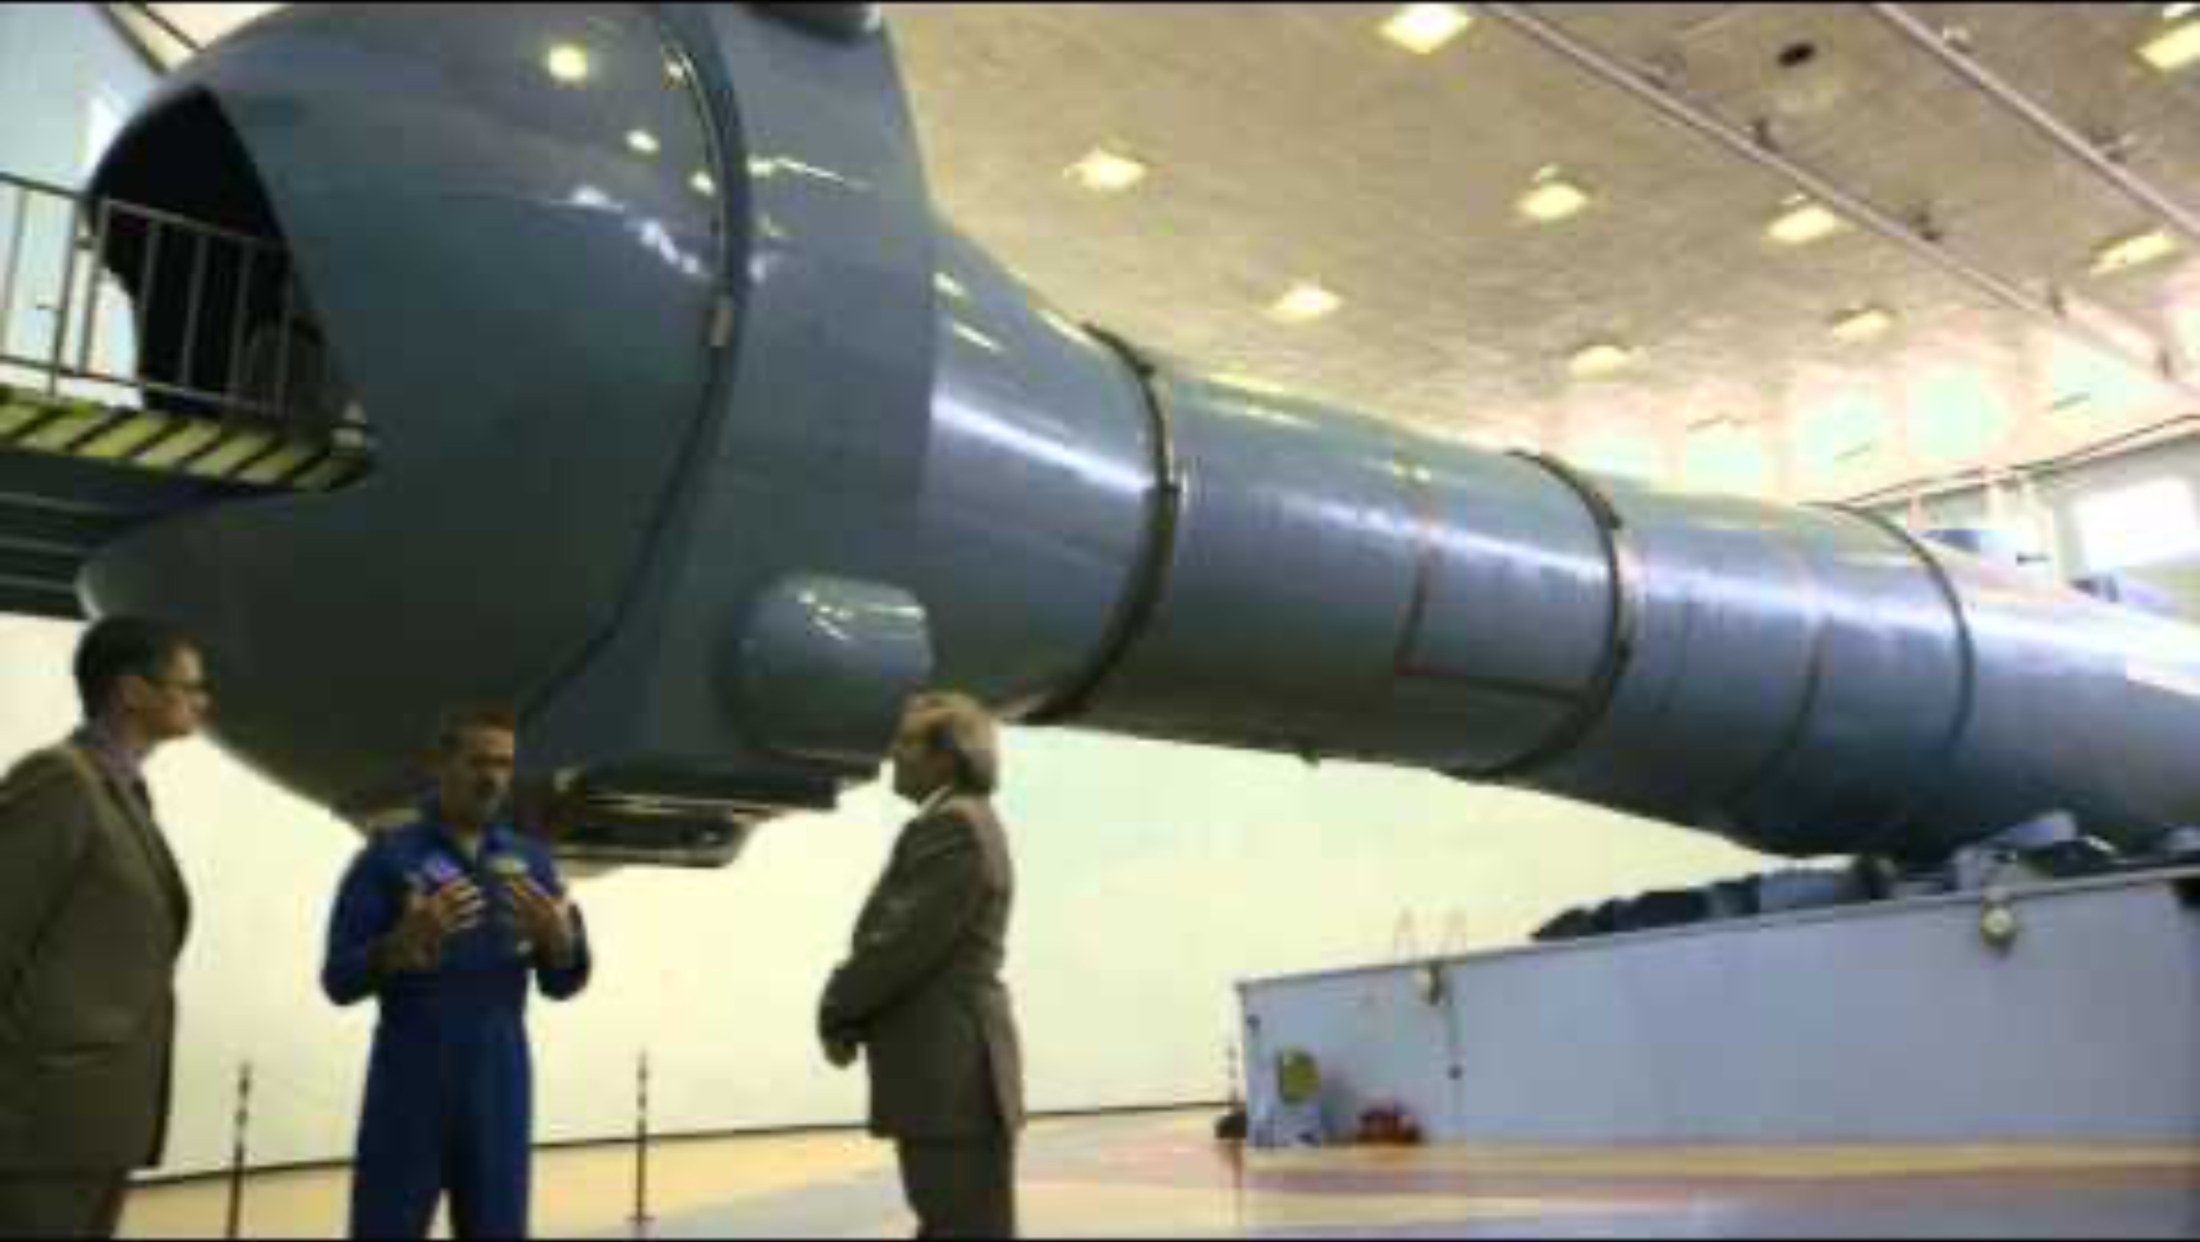
Why Do Astronauts Train in a Centrifuge?
Notes:
1 G = force that a stationary object (like a person standing still) experiences on Earth.
Due to the large accelerations that a rocket undergoes, large forces act on it and the astronauts inside. This means astronaut's experience forces much larger than Earth’s gravity.

Slide 6
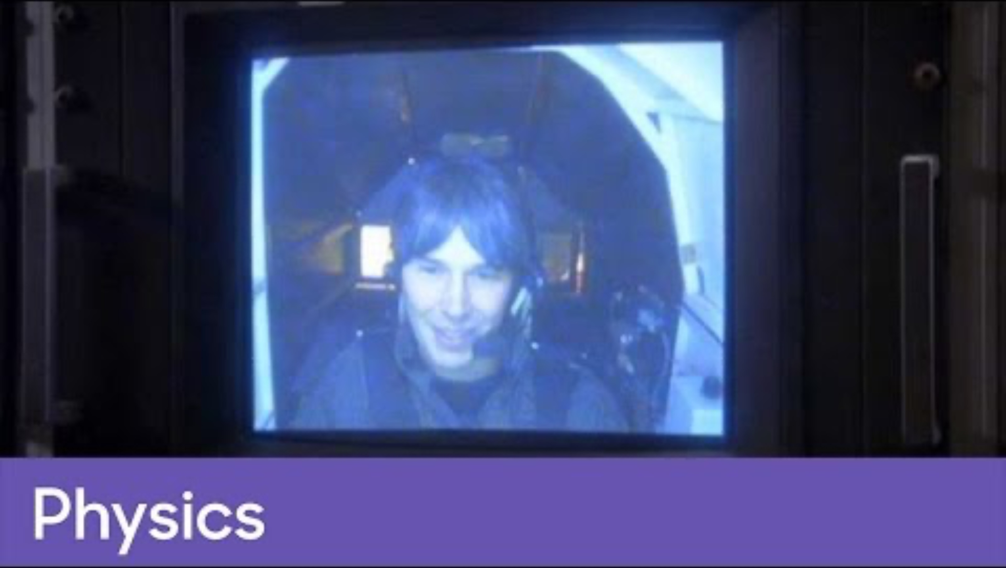
Effects of G-force
Notes:
1 G = force that a stationary object (like a person standing still) experiences on Earth.
Brain Cox describes how his body feels as he experiences higher and higher G-forces (up to 5-G). Though he links the G-forces to the gravitational strength of other planets (e.g. Jupiter’s gravity being just over two times stronger than Earth’s, so equal to around 2-G), astronauts experience high G-forces due to the large accelerations that a rocket undergoes. You can make this link with your students instead.

Slide 7
Low Gravity
Our bodies always work against gravity. If there’s less gravity, less force pulls down on the body. Bones and muscles lose strength over time.
Astronauts spend hours exercising each day. Cycling and running on treadmills keep bones strong, and weight-lifting is good for muscles.

Slide 8
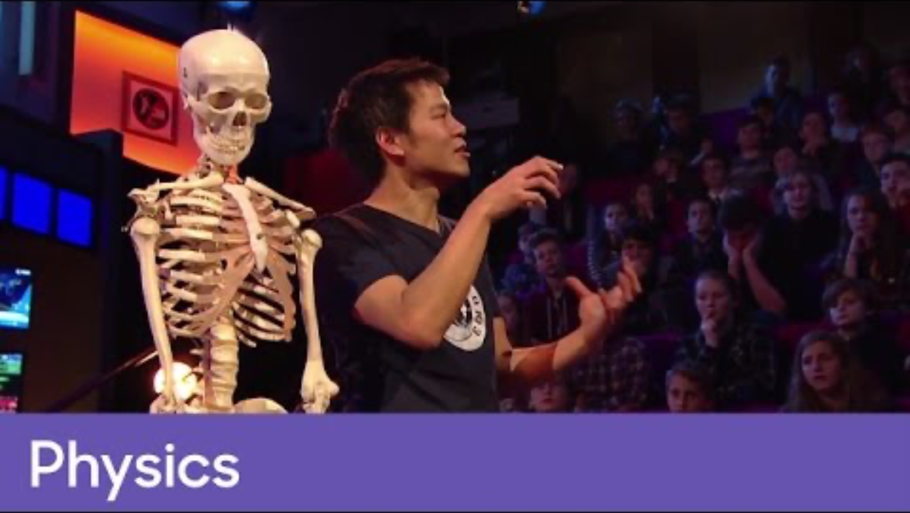
Why are bones weaker in orbit?

Slide 9
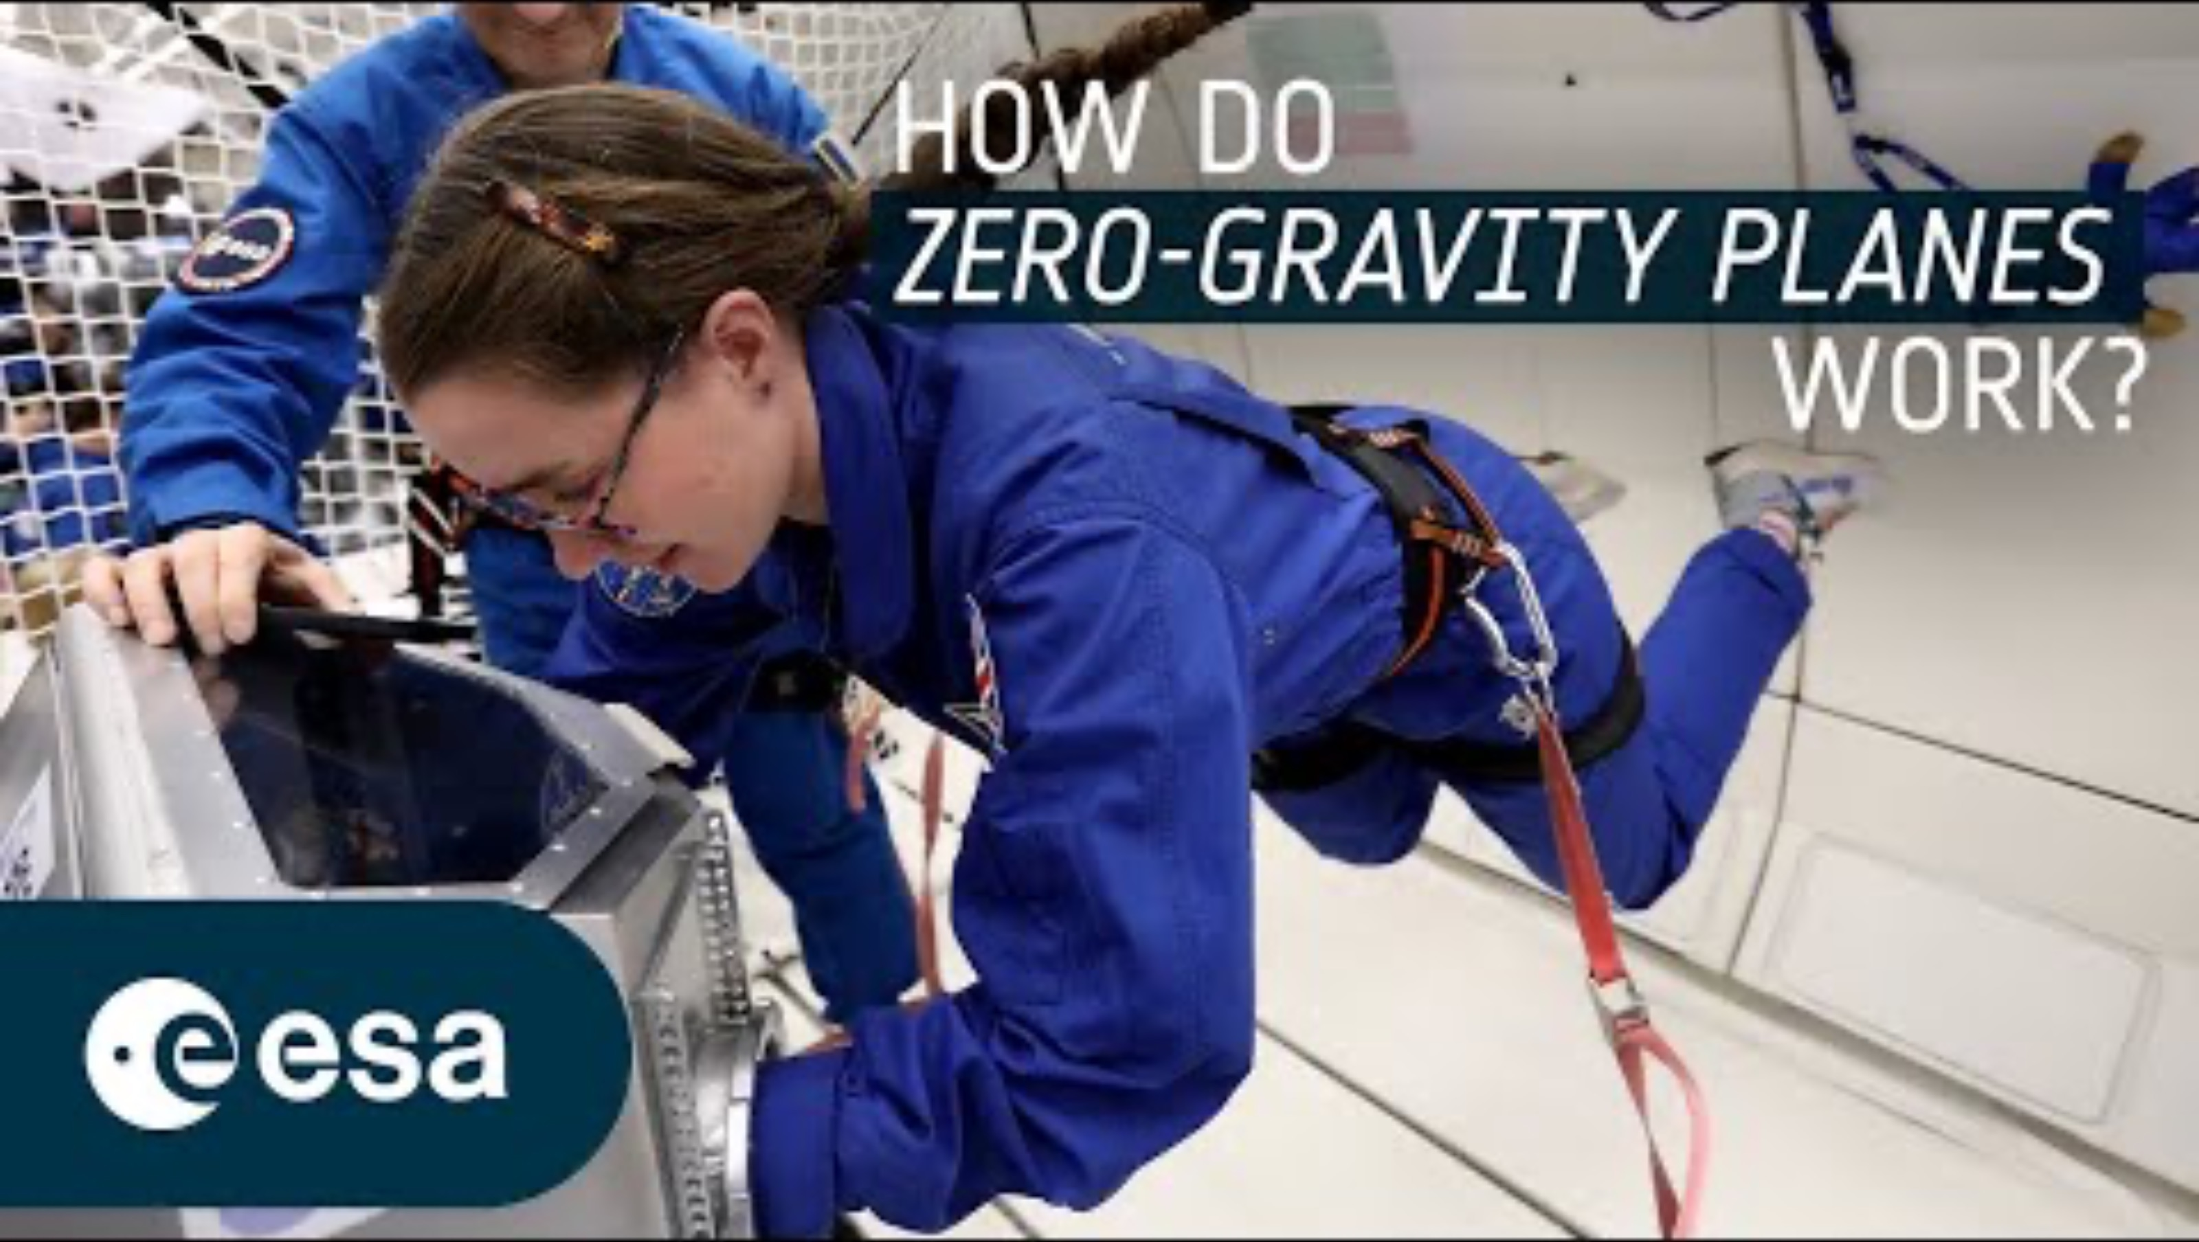
Experiencing zero-G on Earth
Notes:
This training helps future astronauts adapt to moving, working, and even jumping in zero gravity.
When travelling to Mars, astronauts would experience microgravity for most of the duration. They would then need to adapt to Mars’ gravity, which is around 40% the strength of Earth’s gravity.

Slide 10
Space Environment
There’s no air to breathe in space, and it can be extremely hot when facing the Sun and freezing cold in the shade.
Spacesuits protect astronauts. But they’re big and thickly padded, so limit movement. Astronauts train and perform drills in spacesuits to get used to moving around in them.

Slide 11
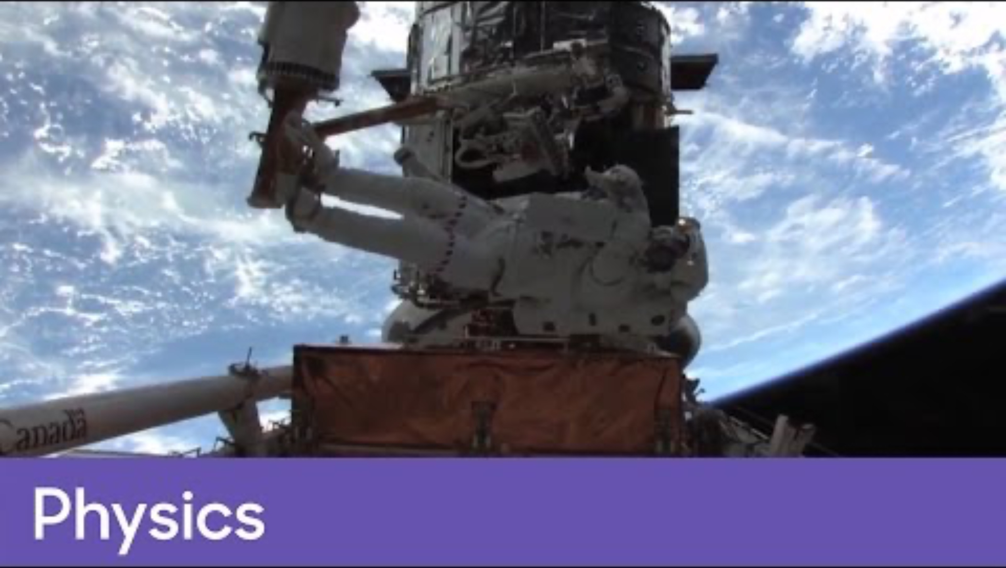
How Do Spacesuits Protect Astronauts?
Notes:
The air particles on Earth press down on our bodies. This is called air pressure.
We have pressure inside our bodies that pushes outward as well. This from internal fluids (like blood and water) and any air inside of us (like in the lungs). The pressure pushing outwards from our bodies is equal to the pressure pushing down from the air surrounding us. This makes the forces balanced.
Space is a vacuum – there is no air. It doesn’t have an atmosphere like on Earth. So, there is no external pressure pushing down on us. Spacesuits provide this pressure instead. Without it, our bodies would expand, and we’d only survive for around 15 seconds.

Slide 12
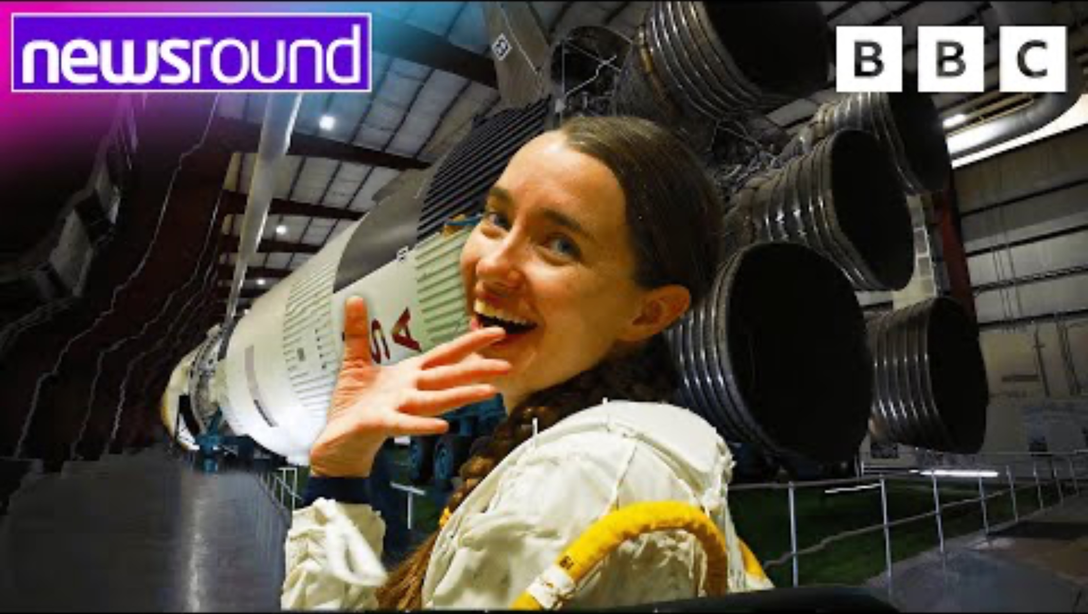
Spacewalk Training
Notes:
Spacewalk trainings take place in a pool to simulate the weightlessness astronauts experience in space.
Note: There is still gravity in space! However, because the International Space Station is in orbit around the Earth, it’s in freefall. It essentially just keeps missing the Earth. Therefore, astronauts on the International Space Station (whether inside or attached outside on a spacewalk) feel weightless.

