Slide 1

Investigation 6
When should we launch to Mars?
Career Link:
Mathematician
Notes:
Welcome, explorers! Today marks the beginning of an exciting journey. You’re going to help plan one of the biggest missions in human history: getting people to Mars. Over the next few weeks, you’ll think like scientists, design like engineers, and code like space explorers. Ready for launch?

Slide 2

Introduction to your Mission
This is our final investigation of the project…
We need to select our launch date!
Now we know more about how to get to Mars and stay safe when we arrive, we’re ready to figure out when to go – but remember, the planets are always moving – we need to time the journey just right!
Notes:
Reiterate what the students have already learnt about their mission planning.

Slide 3
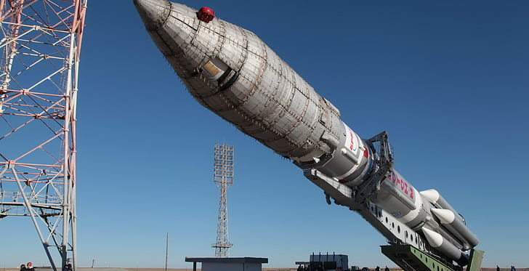
Activity 1: Travelling to Mars

Slide 4
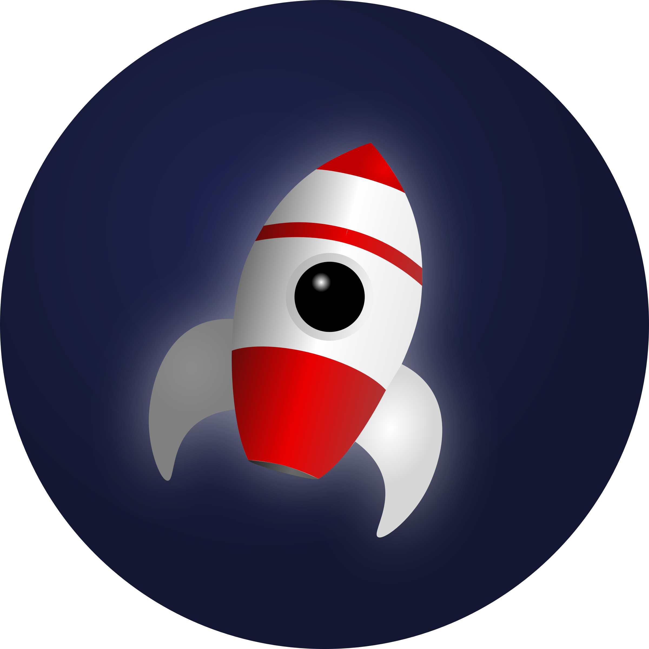
Travelling to Mars
How long would it take to get to Mars in a spacecraft?
Write your guess in your workbooks
Notes:
Remind the students that in the last investigation, they learnt that even though Mars is next to us in the Solar System, it is still REALLY far away.
Get them to write in their workbooks how long they think it would take to get to Mars by spacecraft – even if it was at its closest to us– bring them together and take a selection of their answers – you can play higher/lower for this – have they gone for days/weeks/months/years.

Slide 5
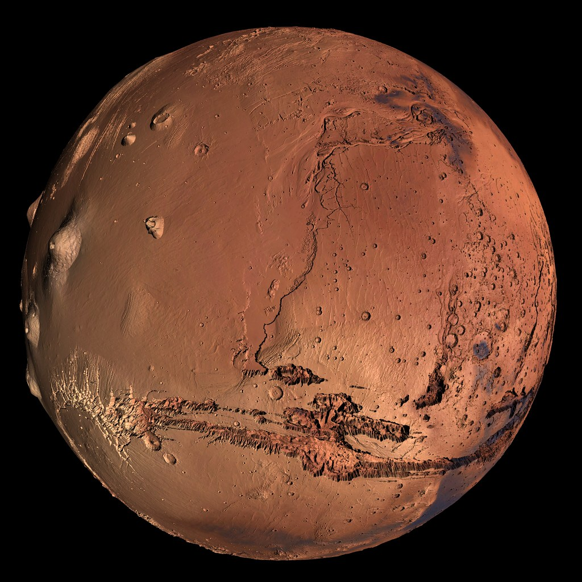
Travelling to Mars
Even at its closest approach, Mars is still about 56 million km from Earth
Spacecraft carrying people to Mars also need to carry enough food, water, oxygen and other supplies to keep the crew alive!
It would generally take about 250 days to get to Mars
Notes:
Reemphasise the distances involved here = 56 million km is equivalent to going to the Moon and back more than 70 times.
If we drove at over 100 km/h it would still take almost 65 years to cover this distance!
Get the students to write down in their workbooks the answer of 250 days (this is a rough estimate – values typically span 210-270 days with the most fuel-efficient path and a good launch window.
Get the students to work out how long this is in months and years in their workbooks.
It’s important to pick the right launch window so that we know the astronauts will have enough supplies to last the journey – and to make sure the journey is as short as possible.

Slide 6
Travelling to Mars
It would generally take about 250 days to get to Mars
That’s the same as:
250 ÷ 30 = 8.33 months
Or
250 ÷ 365.25 = 0.68 years

Slide 7
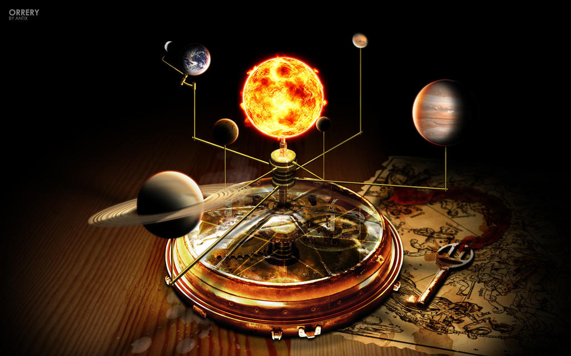
Activity 2: Electric Orrery
This Photo by Unknown Author is licensed under CC BY-NC-ND

Slide 8
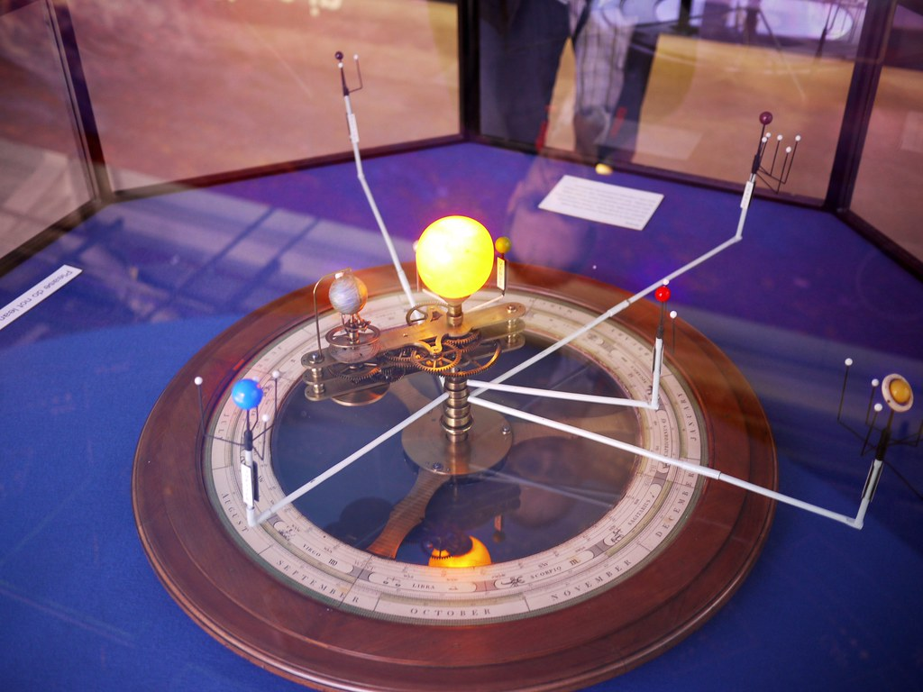
Orrery
An orrery is a model of the Solar System which shows where the planets are at any point in time.
They have been made for hundreds of years using clock mechanisms
Head to the Schools’ Observatory website to see an electronic version of this:
www.schoolsobservatory.org
Notes:
Give the students a quick definition of what an orrery is – models of the Solar System which map the actual positions of all of the planets in our Solar System, including the speed of their movement and their positions relative to each other at an exact time.
Get the students on to their computers/tablets/devices working in pairs and get them to go to The Schools’ Observatory website.
Demo how to get to the orrery by opening and sharing the screen on the class computer.

Slide 9
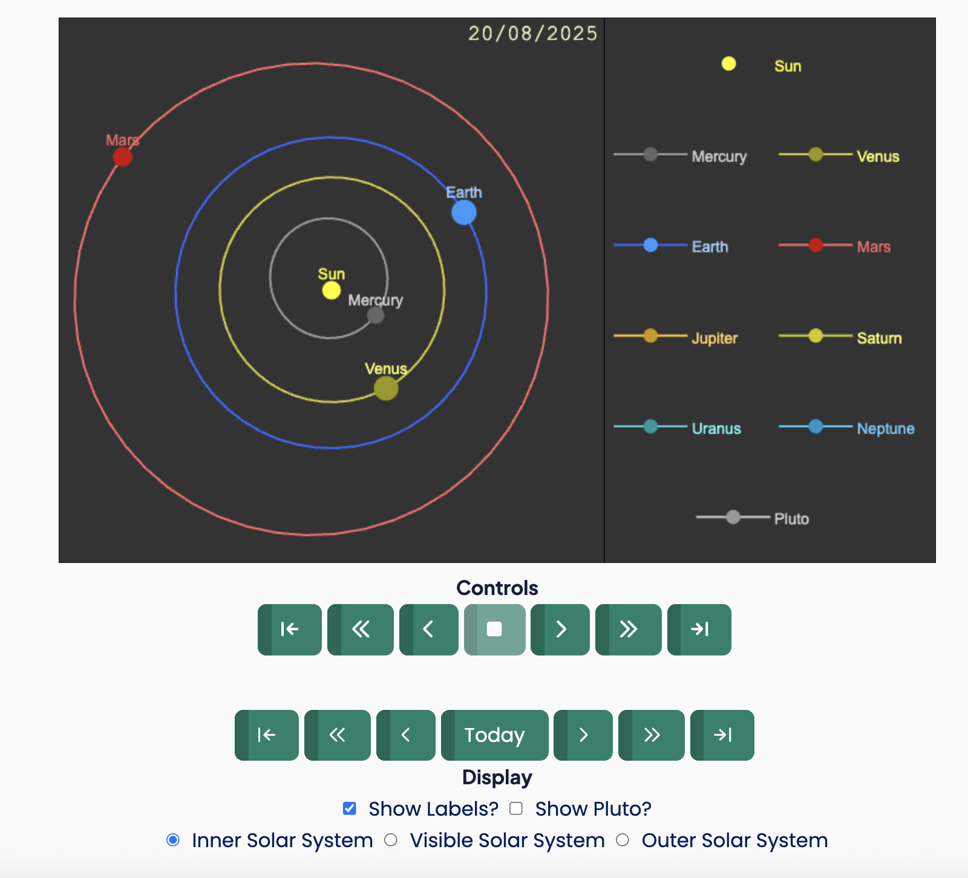
Demonstrate the electric orrery
Go to: www.schoolsobservatory.org
Open the search box
Type in “orrery” and click on Electric Orrery
Scroll down the page to the section called Start Exploring!
Notes:
Follow the steps above, but on a browser screen to get the students to the right place – you don’t need to be logged in for this.
Demonstrate on the browser how to play the orrery in timestamps of a day, month or year using the top Controls
Then show how they can move the orrery step by step by coming back to today on the bottom controls and using the arrows there to move forward by a day, month or year without it playing as an animation.
Make sure on the display that they only show the inner Solar System – you can show them the visible (what we can see with our eyes) or outer Solar System, and even include Pluto – but if they do that, they won’t be able to see Mars and Earth.

Slide 10
When are Mars and Earth next close together?
Starting from today move through the orrery month by month and fill in the table in your workbook:
Are the planets on the same side of the Sun?
Do they appear close together?
Mark the approximate date the planets next look at their closest.
If you have time, move day by day and decide on the exact date of the next close approach.
Notes:
Get the students to work in their pairs, moving through month-by-month to work out the next time of closest approach.
Get them to fill in the table in their workbooks.
If they have time, they can move day by day to get a more exact answer.
The correct next date of closest approach is: 19th February 2027 – hopefully, they get something close to this – it doesn't matter if they get the exact answer.

Slide 11
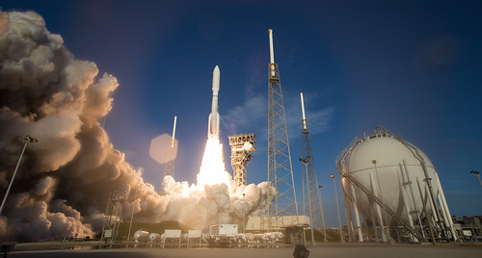
Activity 3: The Launch Date
This Photo by Unknown Author is licensed under CC BY-NC-ND

Slide 12
In your student workbooks:
Calculate your launch date by taking the travel time to get to Mars away from the date of closest approach.
You can use the maths to step through the problem OR get a calendar and count the days backwards!
Remember to start from the date of closest approach which will be part way through a month!
Notes:
The students should have approximately the 19th February as the next date of closest approach – they should start here and then count backwards by 250 days (the travel time you gave them) to get to the launch date.
They will know the number of days in each month and there’s a table in their workbooks to figure this out. They basically need to work backwards adding up the days until they reach 250 and write down the date they get to.
See the teacher book for the maths if you’re unsure.

Slide 13
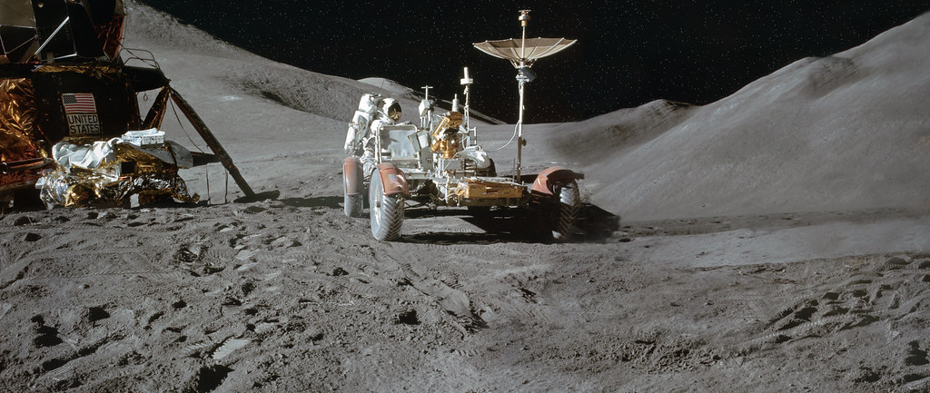
Activity 4: First Words
This Photo by Unknown Author is licensed under CC BY

Slide 14
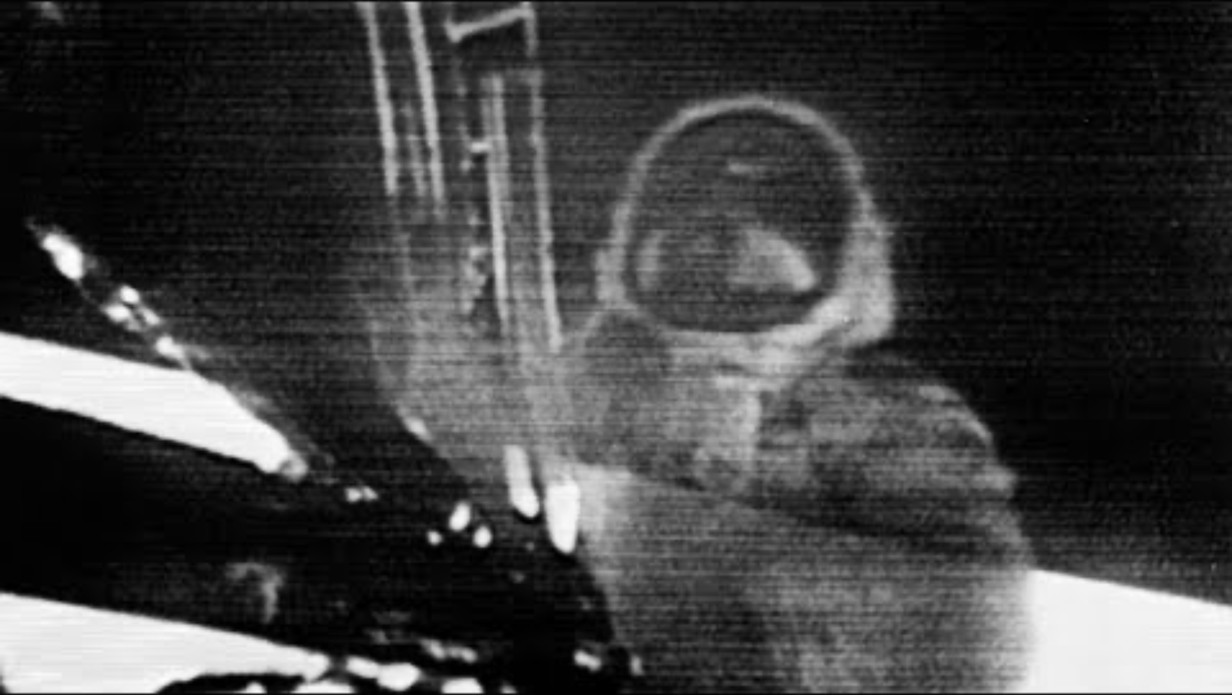
First words are important and last the test of time…
In your student workbooks, write down what you would say as the first person to step onto the surface of Mars.
Notes:
Talk briefly about the importance of the first words spoken from the Moon’s surface.
Neil Armstrong and NASA prepared these words long in advance of the flight.
Around 650 million people around the world tuned in live to see the first steps taken on the Moon – and most of us still know these words today.
Play the video (sound on)
Now they need to think about what they would say as the first person to step onto Mars.
Given them a few minutes to think about this and get them to write the words down in their workbooks.

Slide 15

Activity 5: Postcards
Notes:
Hand out the evaluation postcards to the class, with one per person. Ask them to spend 5 minutes quietly filling in the postcard with how they’ve found the project overall. Collect these back in at the end of the session.

Slide 16
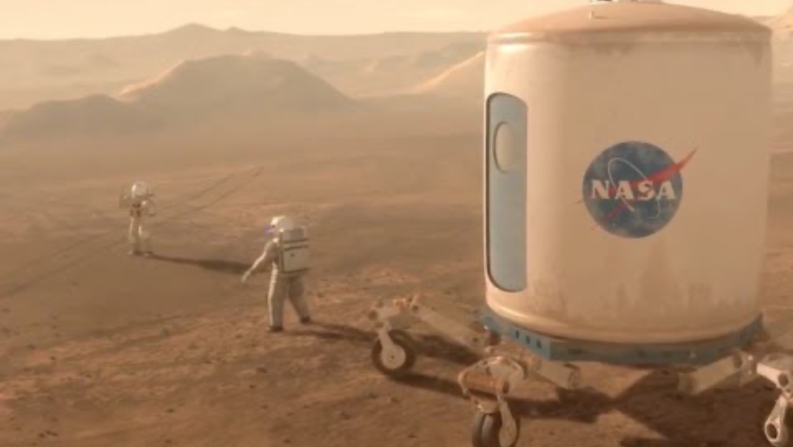
In your lifetime
Notes:
Spend the last part of the session expressing how you’ve found working with the class.
ENSURE THE VIDEO IS ON MUTE
Show the video and explain that future Missions to Mars are already being planned to launch as early as the 2030s.
Advanced missions to land back on the Moon are planned for 2027.
These will happen during the students' lifetime – might they be part of one?
Get the students to put their hands up if they’d like to be a part of a Mission to Mars – whether that’s as an astronaut or part of the ground crew.

Slide 17

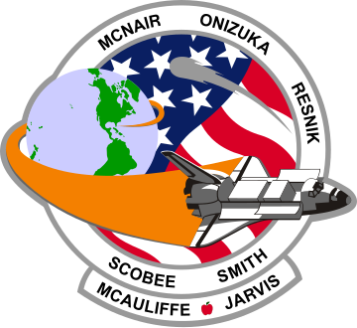



Extension Activities – Take It Further!
Try one (or more!) of these bonus challenges:
Design a mission patch for your Mars exploration!
Notes:
If they want to plan further, they can look at designing a mission patch for the astronaut suits. These are created for every space mission and usually have the crew's names along with some images which explain a little about what the mission is for.

