Slide 1
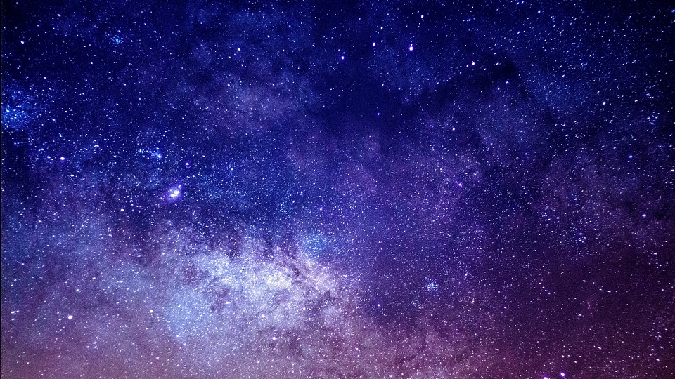
Stars, Galaxies, and You
Work Experience Week
Liverpool, 8 July 2025
Ricardo Schiavon (he/him)

Slide 2
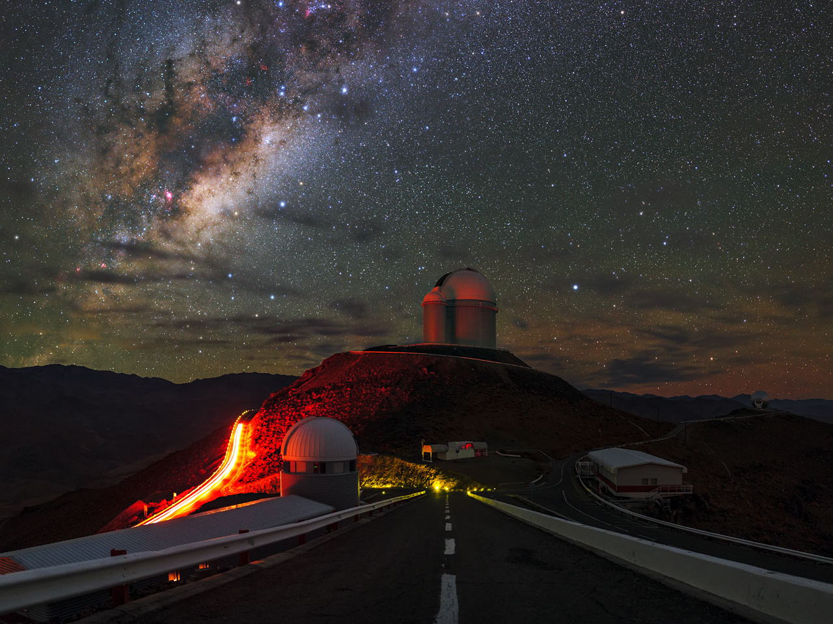
Why Stars?

Slide 3
Why Stars?
The nitrogen in our DNA, the calcium in our teeth, the iron in our blood, the carbon in our apple pies were made in the interiors of collapsing stars. We are made of star stuff.
-- Carl Sagan

Slide 4
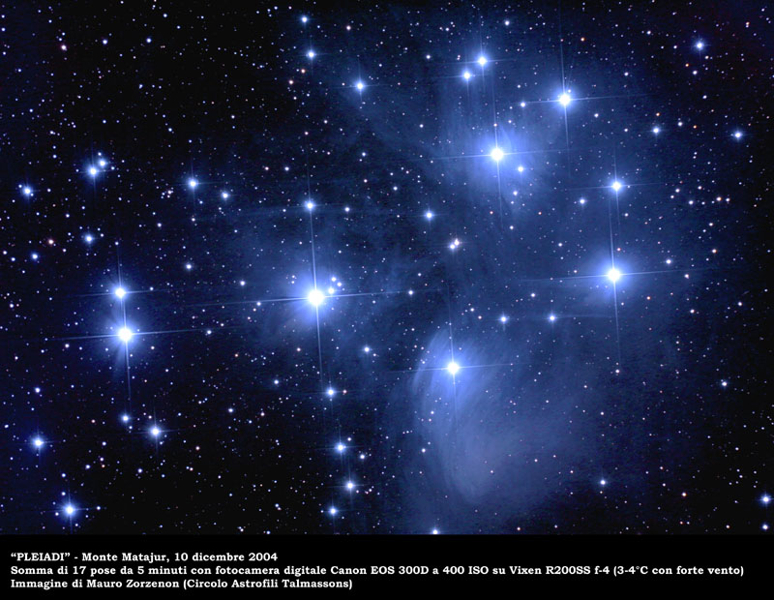
Stars have different brightnesses
The bright blue stars in this picture are all at the same distance, so we know that their intrinsic brightness must not be the same
The Pleiades cluster
Notes:
Messier, French astronomer from XVIII century

Slide 5
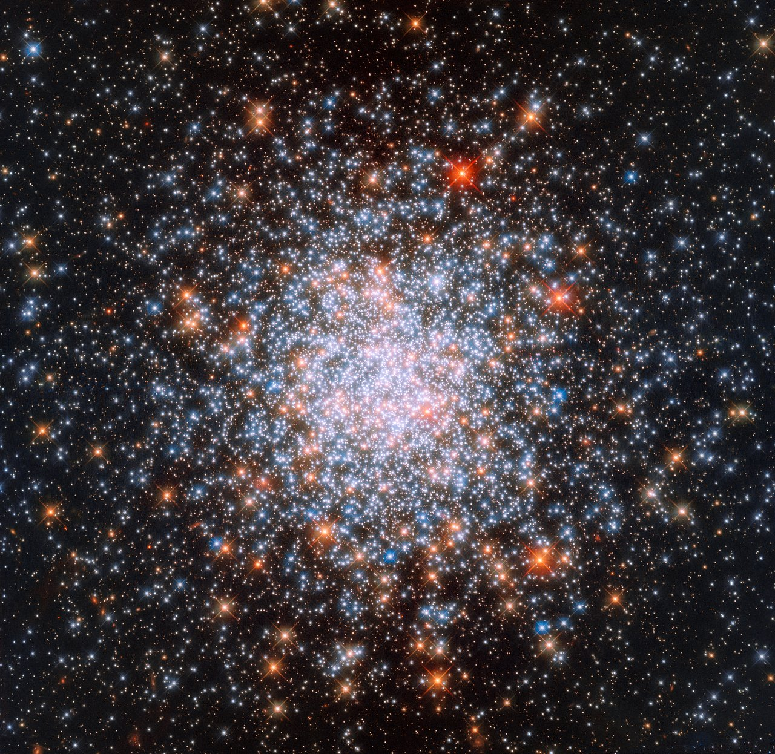
Stars have different colours
This is an image obtained by the Hubble Space Telescope of a globular cluster in the Large Magellanic Clouds
The cluster NGC1866
Notes:
Messier, French astronomer from XVIII century

Slide 6
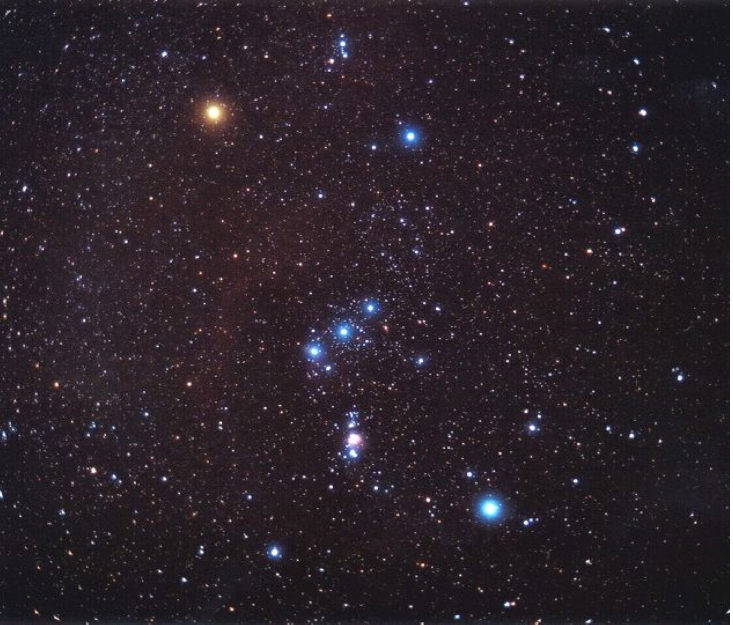
Stars have different colours
An everyday example, the Orion Constellation
Notes:
Messier, French astronomer from XVIII century

Slide 7
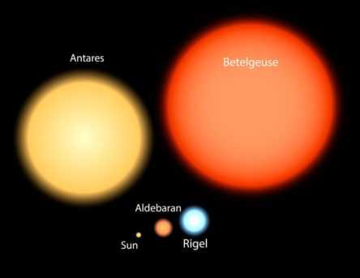
Stars have different sizes
Solar radius: R⊙ = 70 million km
White dwarfs: ～ 0.01 R⊙ (size of the Earth)
Red Supergiants: ～1,000 R⊙ (size of Jupiter’s orbit)
Notes:
Messier, French astronomer from XVIII century

Slide 8
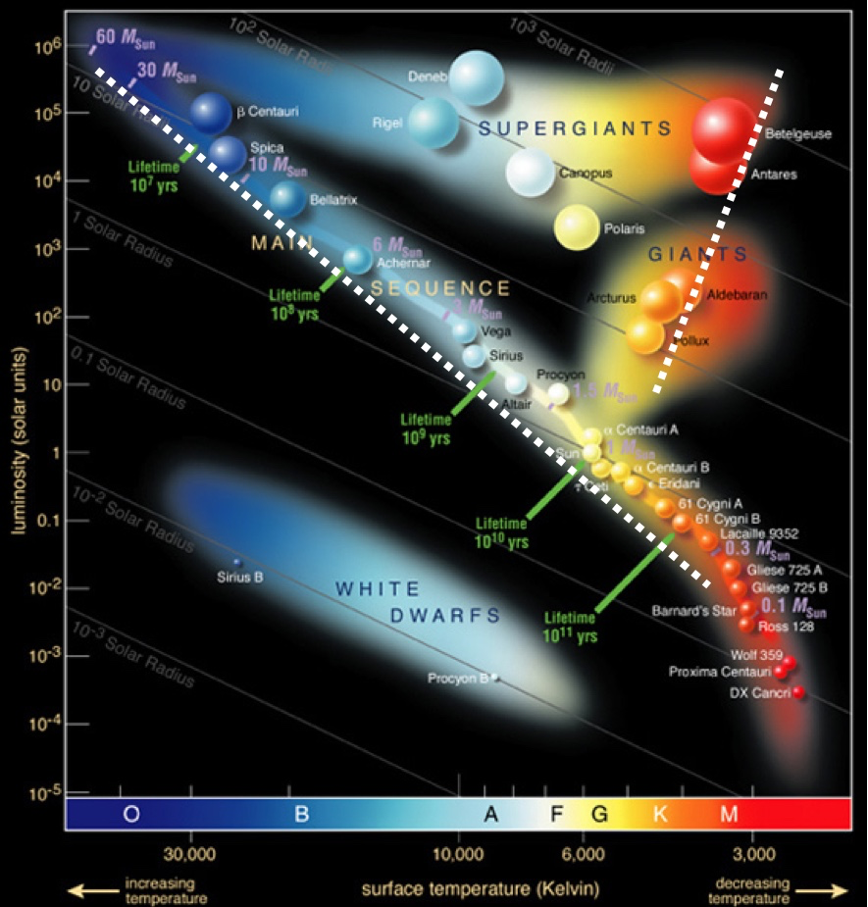
The Hertzprung-Russell (HR) diagram
Bright
Luminosity
Hot
Cool
Faint
Temperature
Notes:
Messier, French astronomer from XVIII century

Slide 9
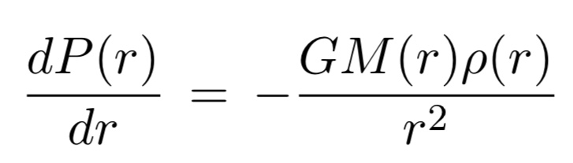
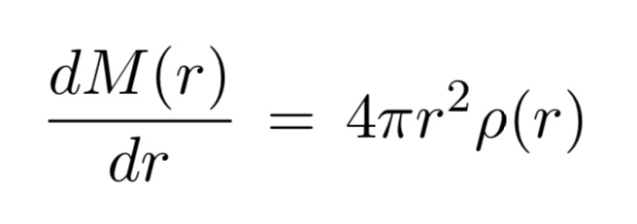
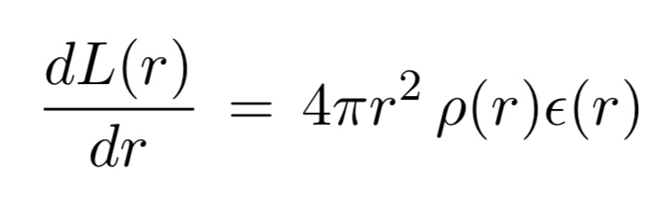
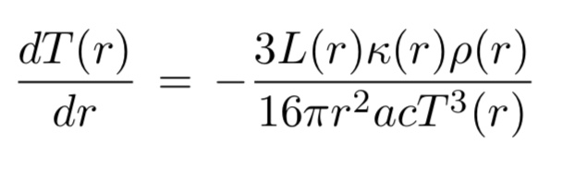
2. Equations of Stellar Structure
Hydrostatic equilibrium
Mass conservation
Energy conservation
Energy transport

Slide 10
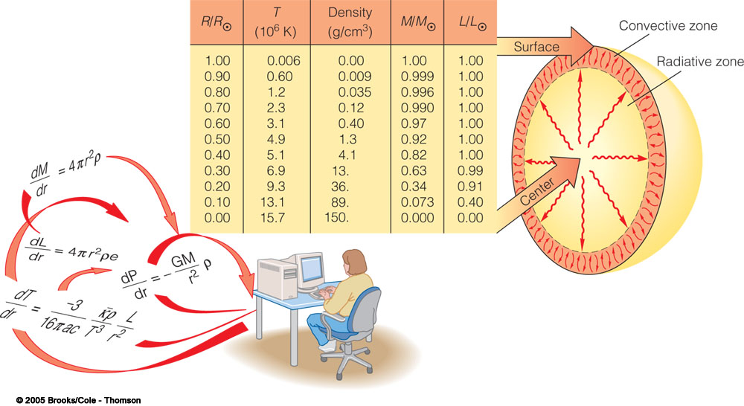
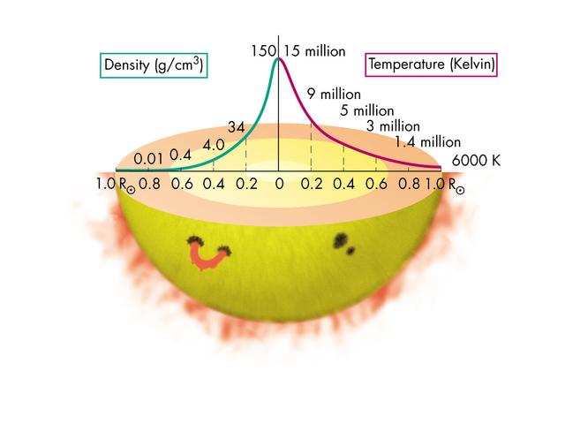
Stellar Models
The equations of stellar structure can only be solved numerically, on the computer
The solution of those equations are what we call a stellar model
Stellar models describe the conditions in the interior of the star
Notes:
Messier, French astronomer from XVIII century

Slide 11
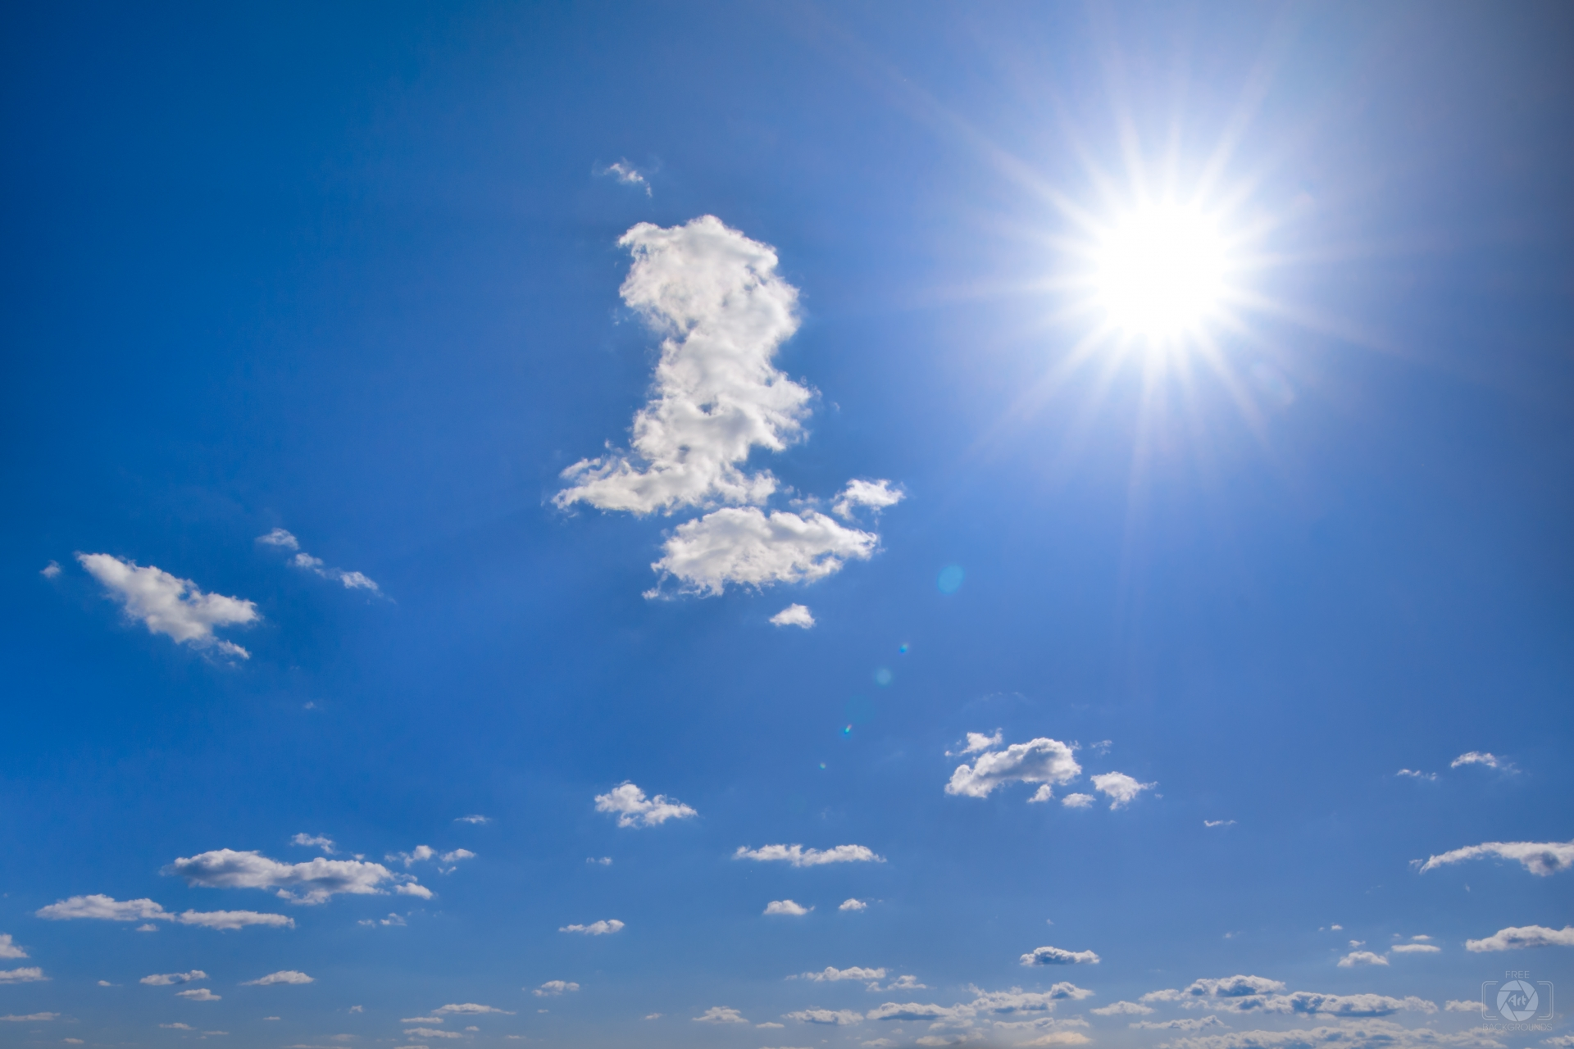
The Sun

Slide 12
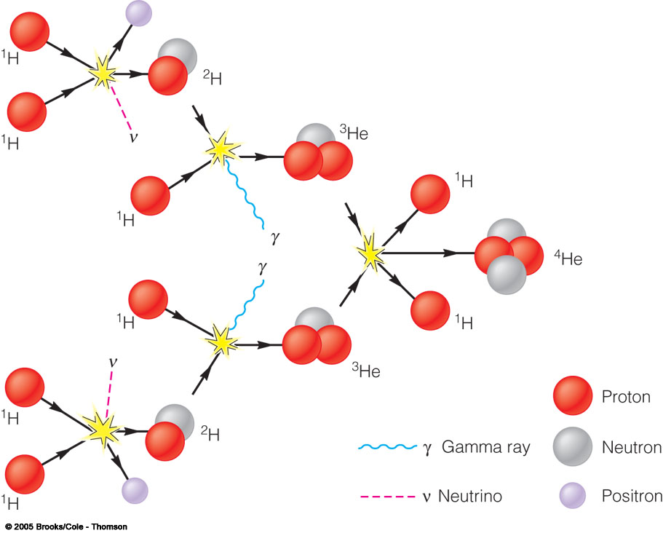
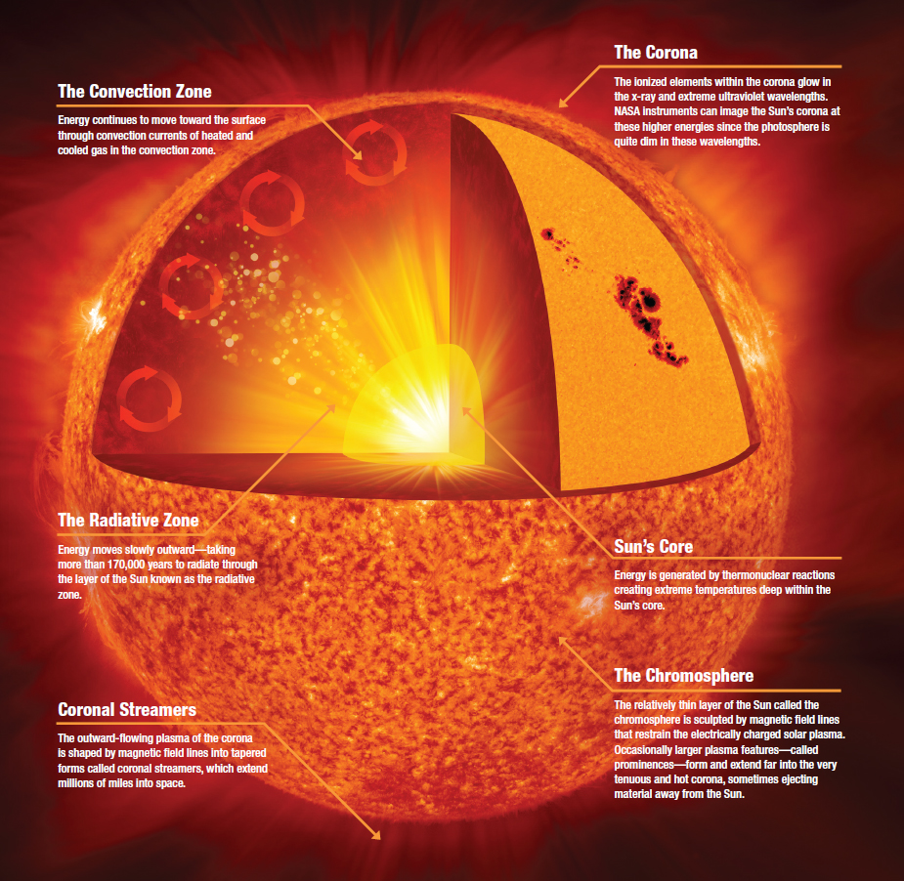
Inside the Sun
E = mc²
The temperature in the solar core is about 15 million K
Hot enough to trigger nuclear reactions, which make the star shine

Slide 13
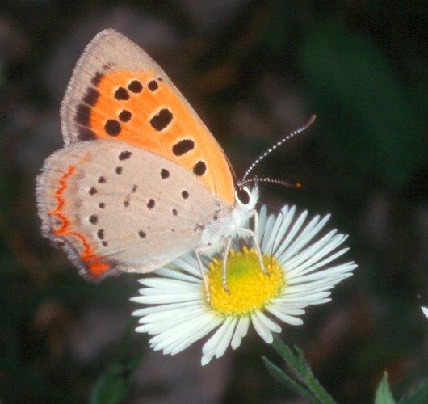
Stars are Simple
This butterfly is more complex than a star.

Slide 14
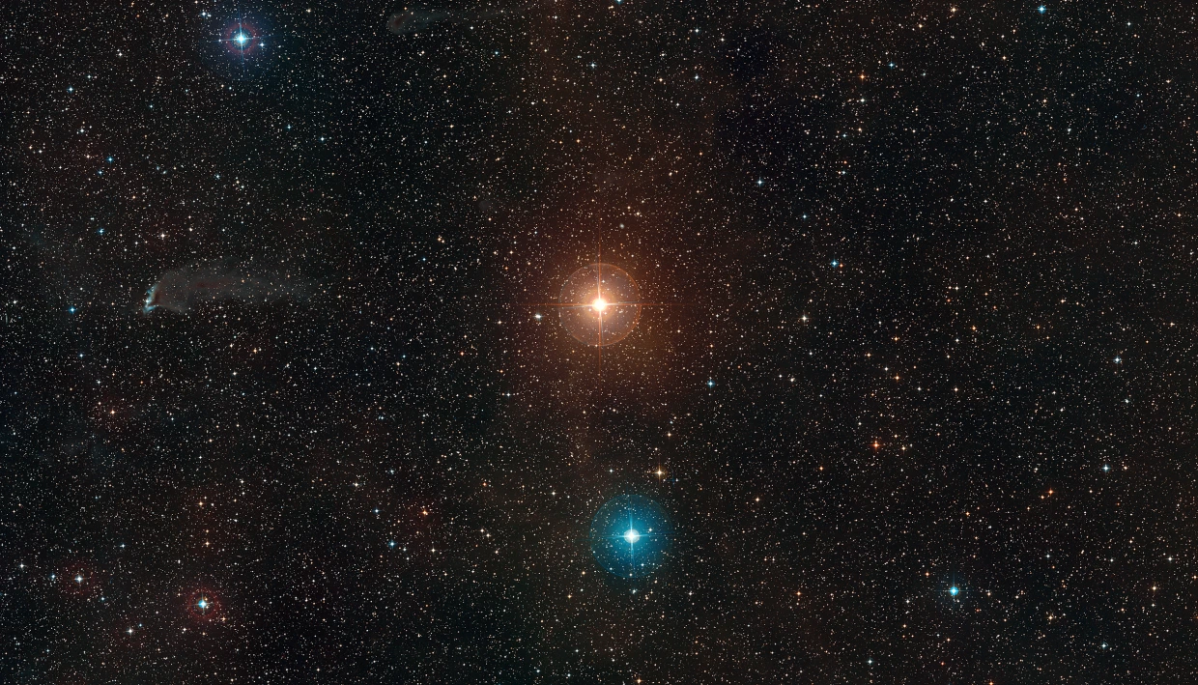
A Star is a self-gravitating thermonuclear reactor

Slide 15
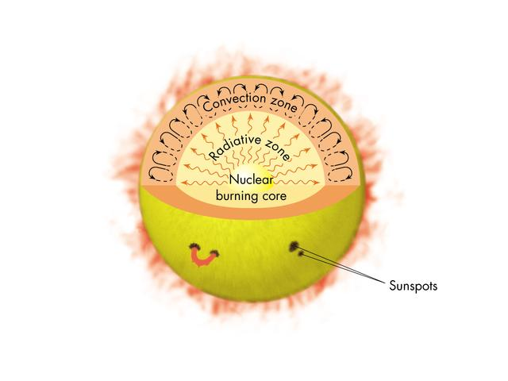
Stellar Models
E = mc²
Notes:
Messier, French astronomer from XVIII century

Slide 16
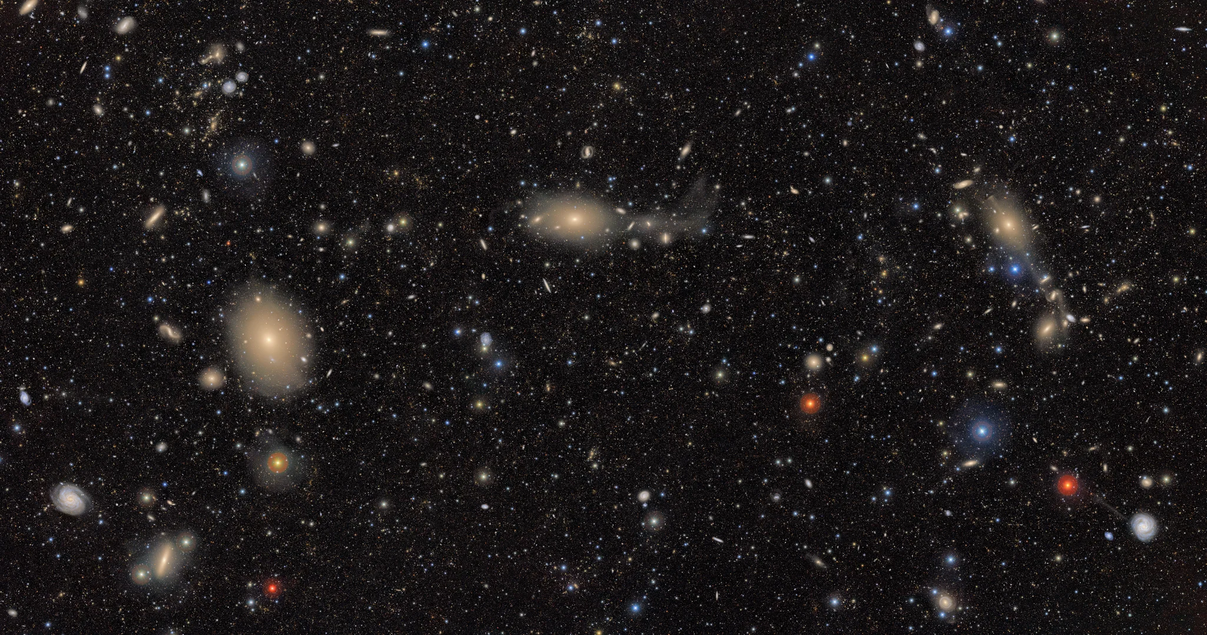
How about galaxies?
Notes:
First light image from Vera Rubin Observatory

Slide 17
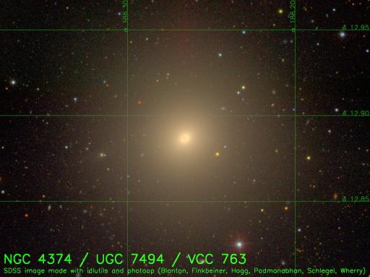
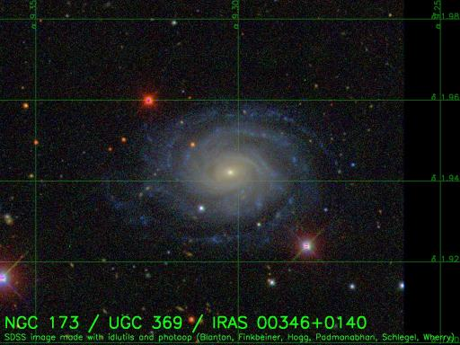
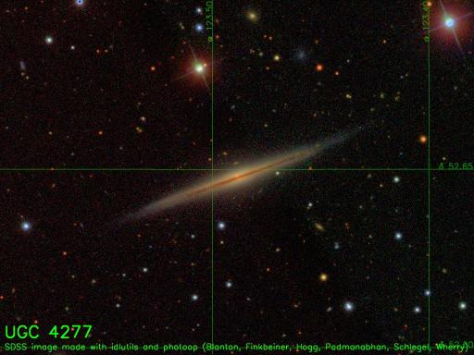
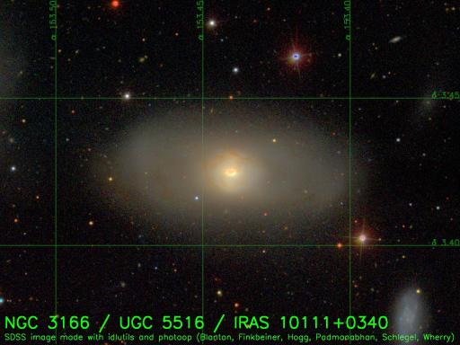
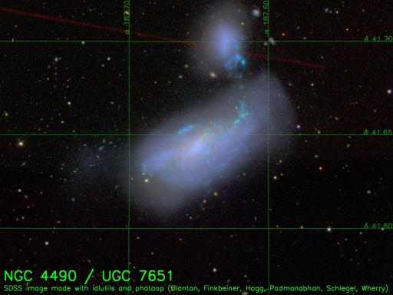
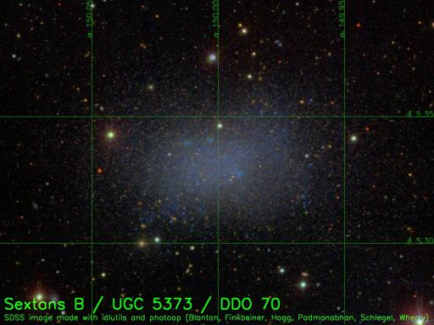
The Galaxy Zoo
Elliptical
Spiral seen face-on
Spiral seen edge-on
Lenticular
Irregular
Dwarf Spheroidal

Slide 18
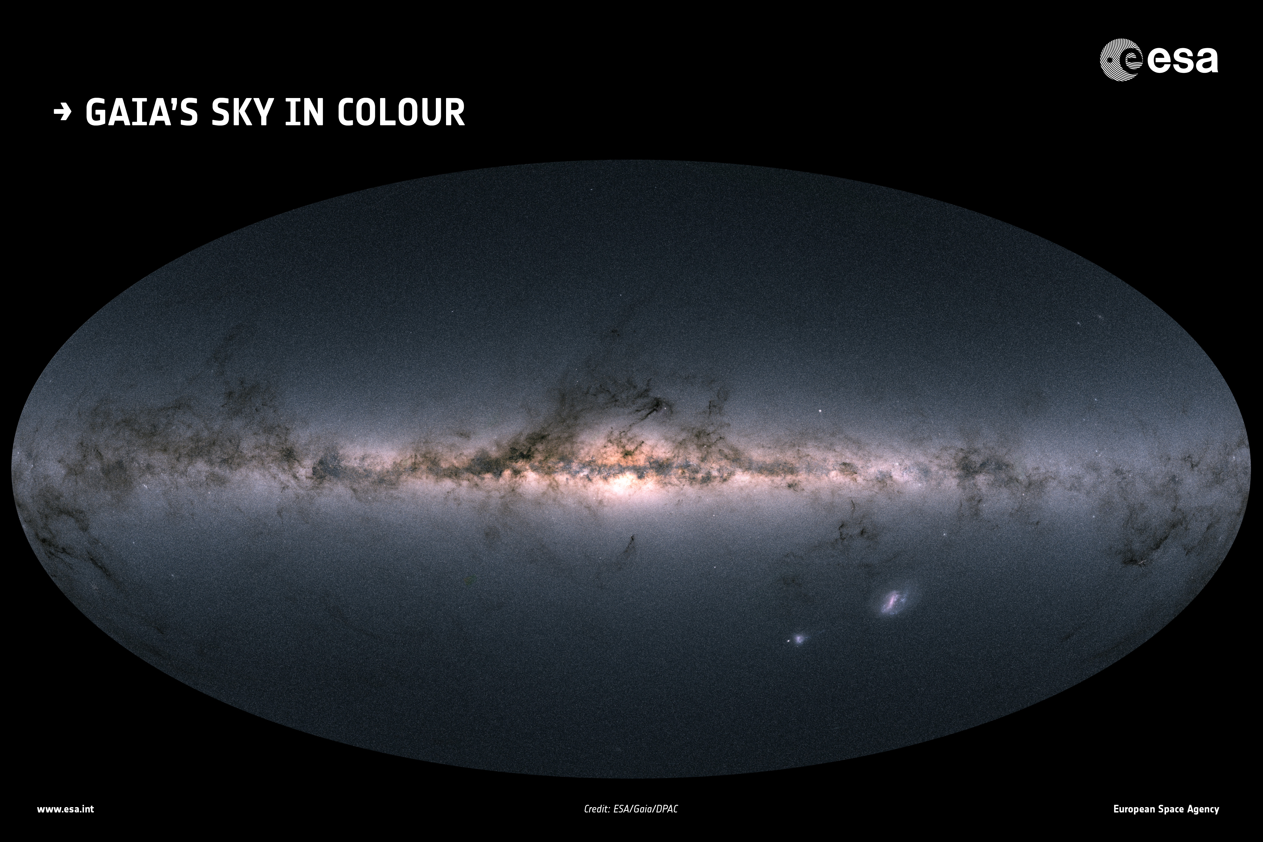
Our Galaxy, the Milky Way

Slide 19
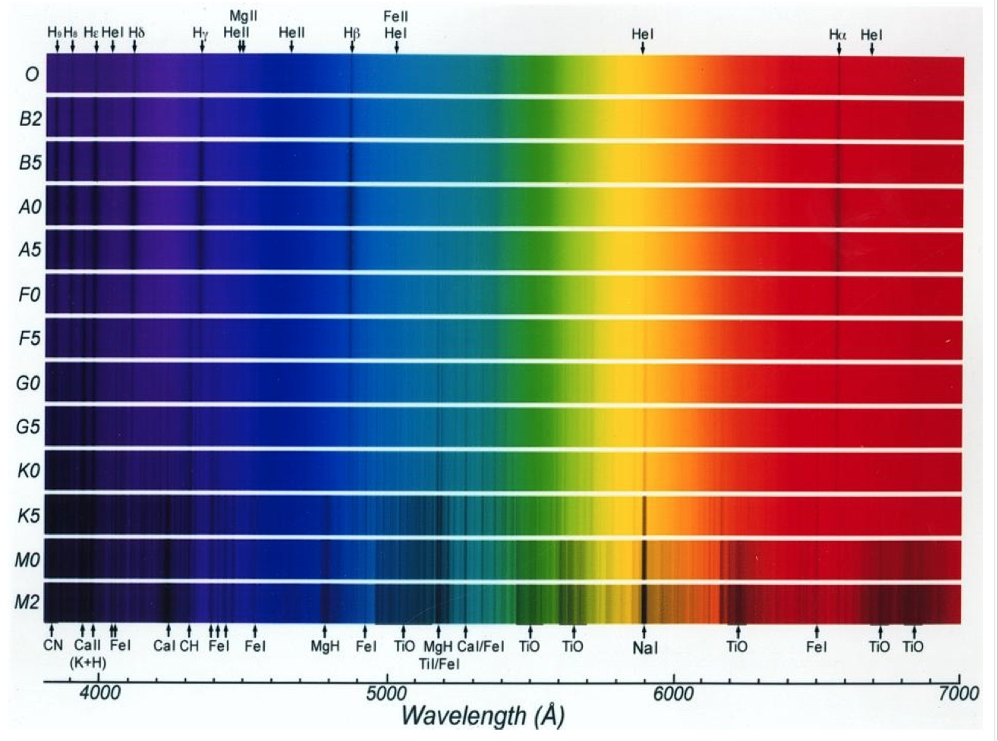
1. Introduction
Stars have different spectra
Attention to varying strength of spectral lines
Notes:
Messier, French astronomer from XVIII century

Slide 20
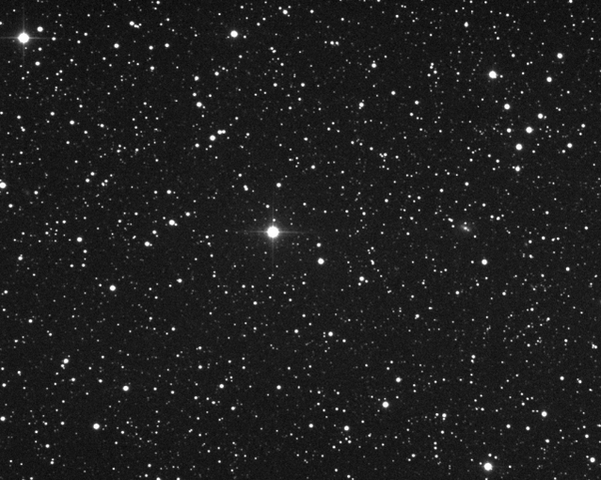
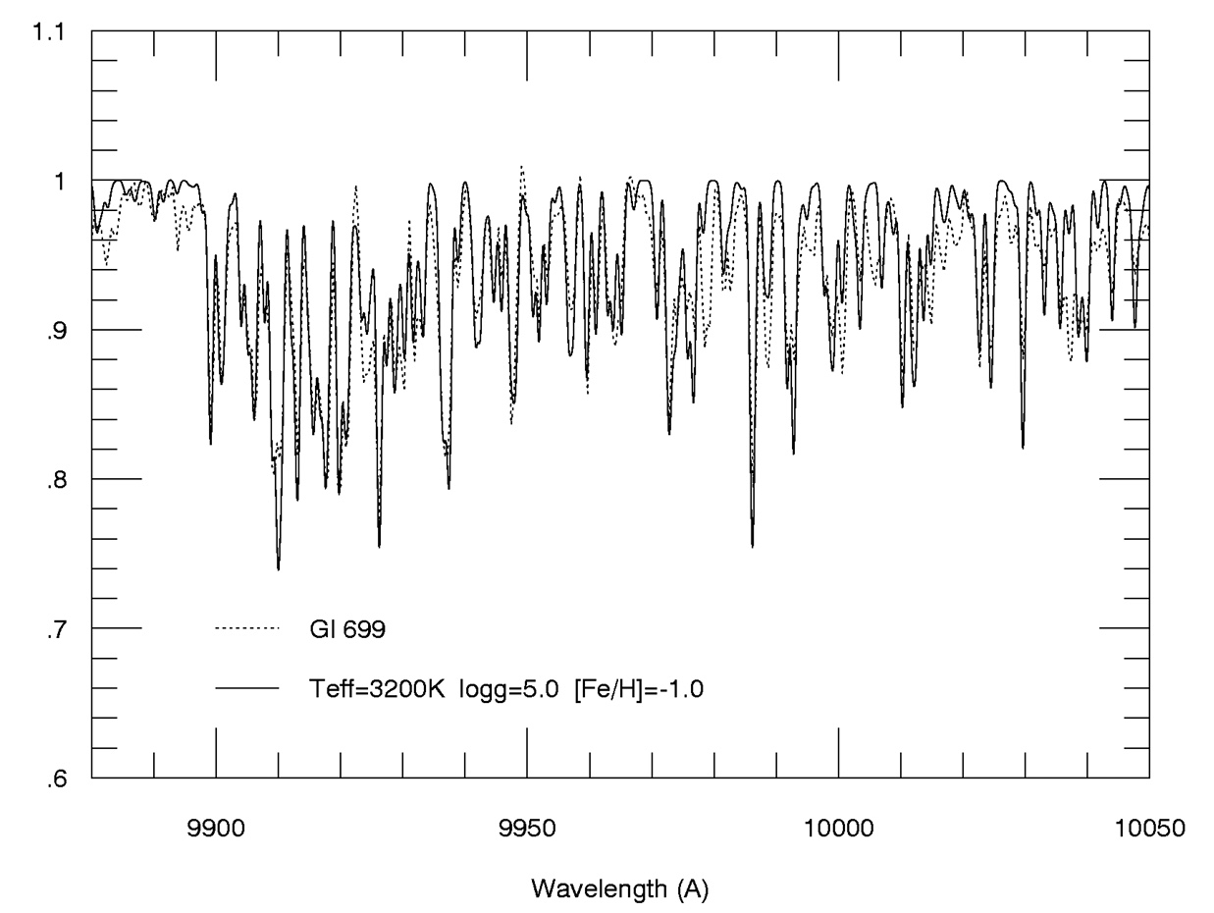
5. Stellar Atmospheres
5.4. Local Thermodynamic Equilibrium
Infrared spectroscopy of Barnard’s star
Schiavon et al. (1997)
A molecular band due to FeH
Dotted line is observed, solid line is synthetic spectrum
Barnard’s star is the second closest star to the solar system. Fastest proper motion.

Slide 21
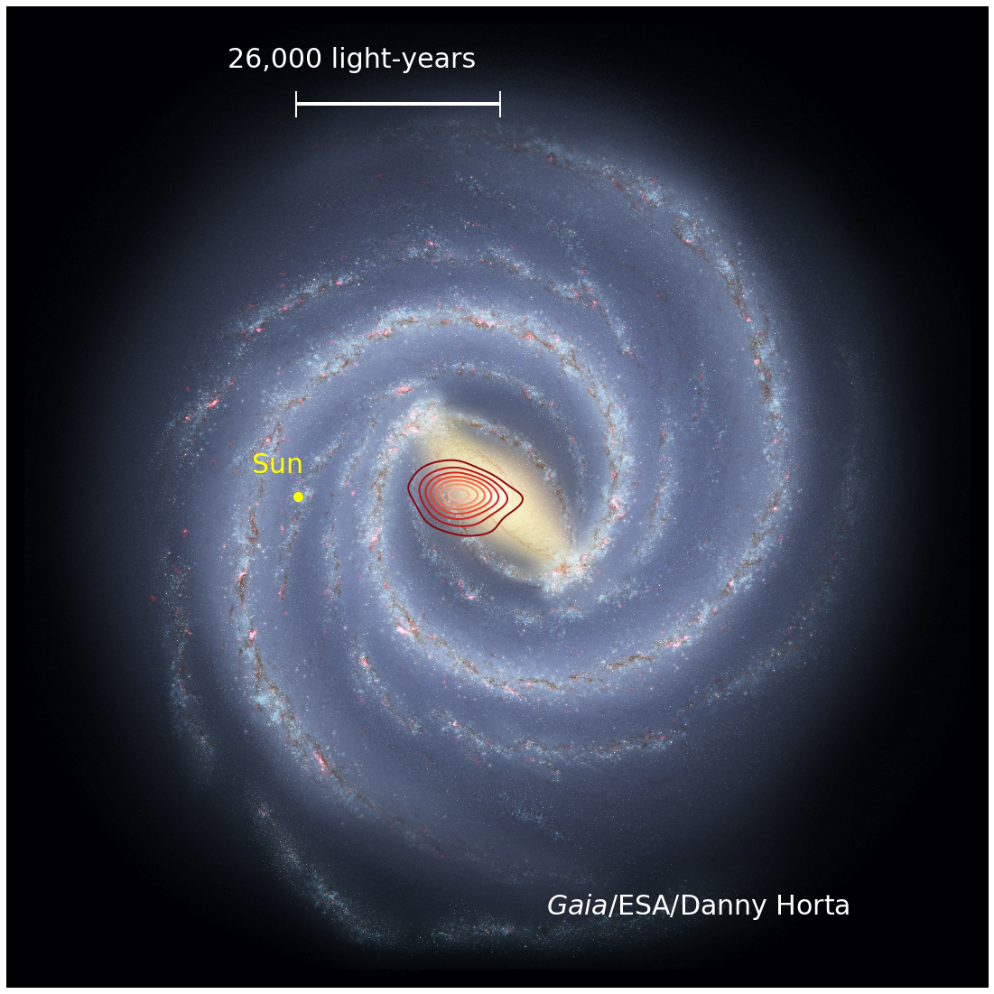

The galaxy within the Galaxy
Liverpool Astronomers discover a small galaxy buried within the heart of the Milky Way
Ricardo Schiavon
MSE2020, 15 Oct 2020
Notes:
Good Afternoon. I’d like to start by thanking the SOC for the opportunity of presenting the work by our Liverpool team today. I will also like to acknowledge the contribution by my collaborators: my former student Ted Mackereth, Liverpool postdoc Joel Pfeffer, and my colleague Rob Crain, and of course the amazing APOGEE team. Today I will be talking about the contribution of GCs and dwarf Galaxies to the stellar content of the MW halo. If anything I hope this talk conveys the notion that the combination of massive Galactic surveys (such as APOGEE and Gaia) with sophisticated numerical simulations is extremely powerful and will play a key role for our understanding of the history of the MW, and galaxy formation in general. We are just scratching the surface.

Slide 22
Why you are here

Slide 23
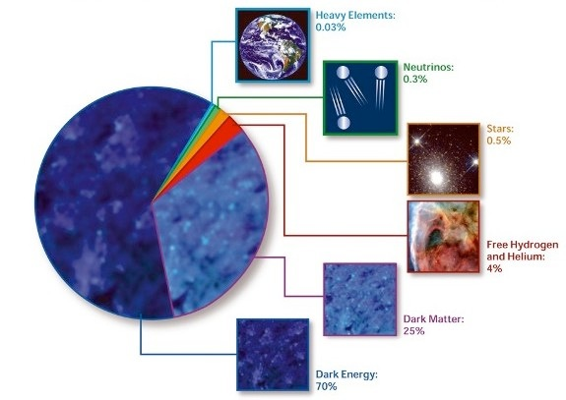
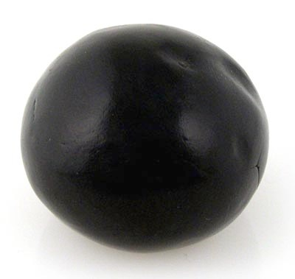
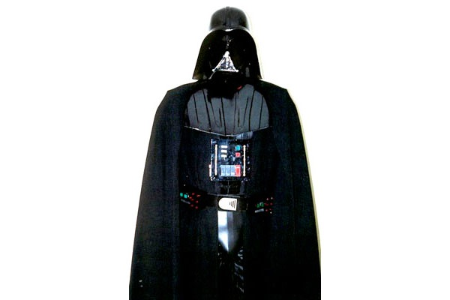
What is the Universe Made of?
5% Matter/Energy as we know it
25% Dark Matter. We don’t know what that is.
70% Dark Energy, responsible for the accelerated expansion of the Universe. We don’t know what that is either.
Notes:
- And just what is the universe is made of?
- It just so happens that we have a very accurate notion of that
- But we don’t know what 95% of the universe is made of!
- Joke: after ~90 years since the discovery of the expansion of the universe, we still know nothing!

Slide 24
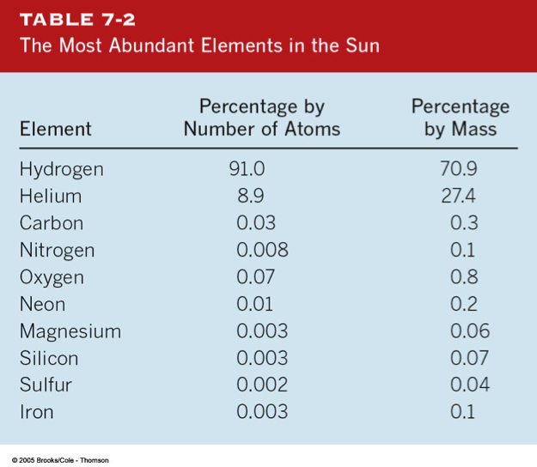
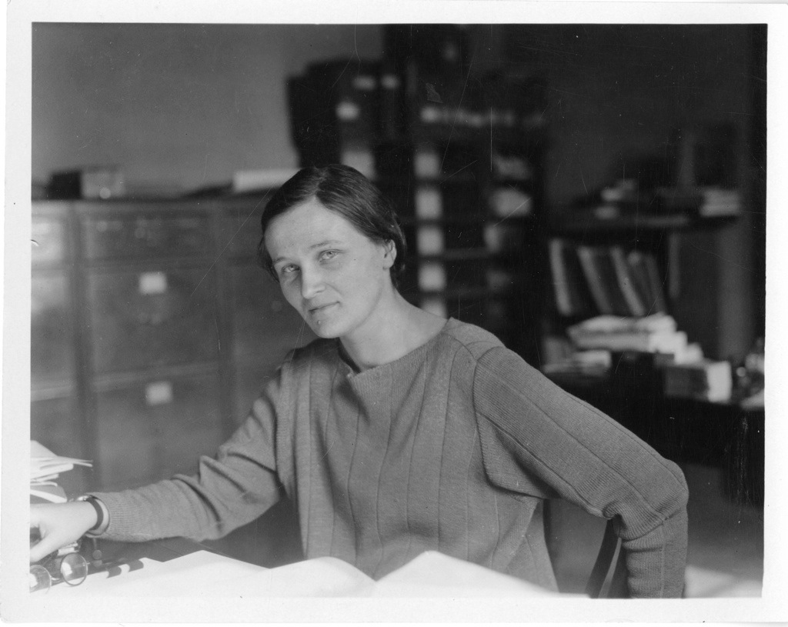
Chemical Composition of the Sun
(and the rest of the universe!)
Cecilia Payne-Gaposhkin (1900-1979)
Stars are 98.3% made of hydrogen and helium. That was first demonstrated by British-American astronomer Cecilia Payne-Gaposhkin.

Slide 25
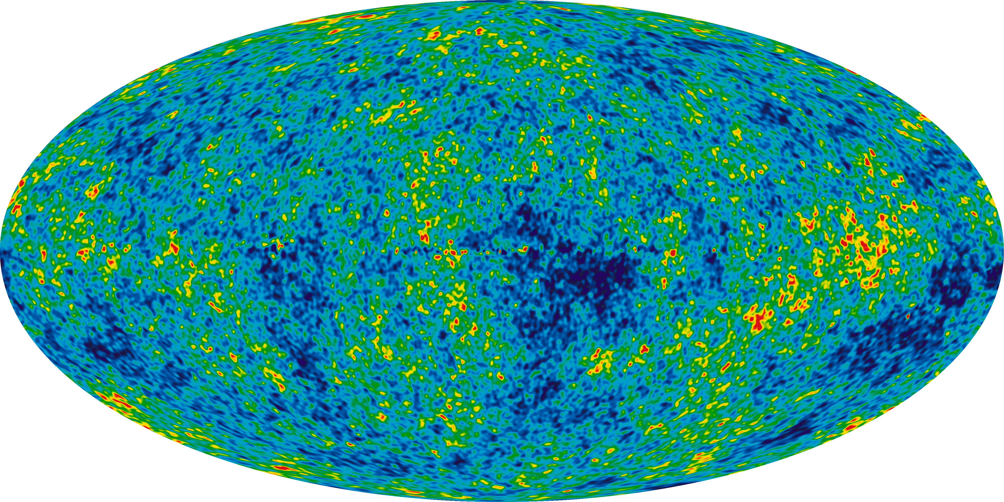
The Cosmic Microwave Background

Slide 26
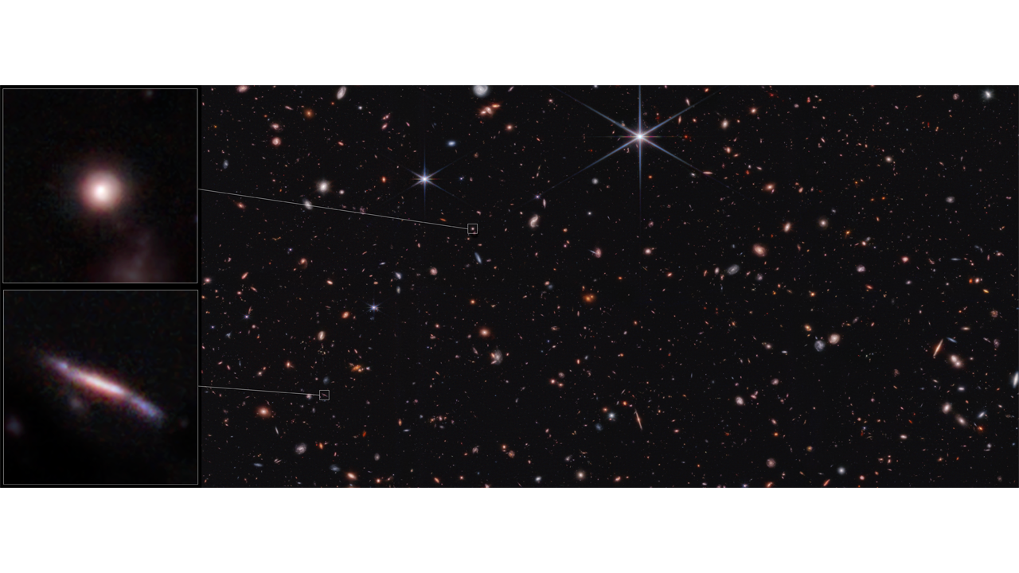
The JWST view of galaxies

Slide 27
Our Galaxy, the Milky Way

Slide 28
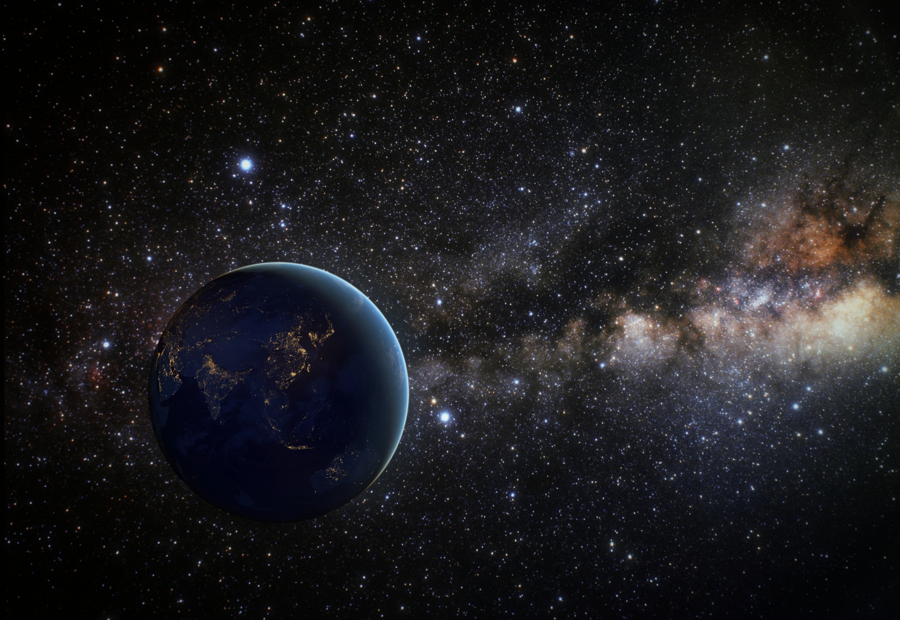
Earth, our home
E

Slide 29
Earth in 1990, seen from outer solar system

Slide 30
A pale blue dot

