Slide 1

Investigation 2
What do humans need to survive?
Career Link:
Engineer/Architect

Slide 2
Introduction to your Mission
Now that we have chosen where our Moon Base will go, we need to know what to include inside of it so humans can live there.
In this mission, you will be an engineer/architect. Your job is to think about the resources humans need to survive and include these in your design of a Moon Base.
Notes:
Teacher Notes (see page 27 in the Teacher Handbook for more details)
Link to previous investigation: Students studied the Moon’s surfaces and identified the observable features, thinking about how these might impact where they build their Moon Base. After selecting a location, an observation was requested with Go Observing. Now, this investigation will explore what needs to be included in their Moon Base so they can survive there.
Link to overall Mars project: A Moon Base could act as a launch site towards Mars. But, more importantly, it will allow us to model building and living in a Base much closer (so, therefore, in safer settings) to Earth. This means the design of the base can be improved before it needs to be built much further away on Mars.

Slide 3
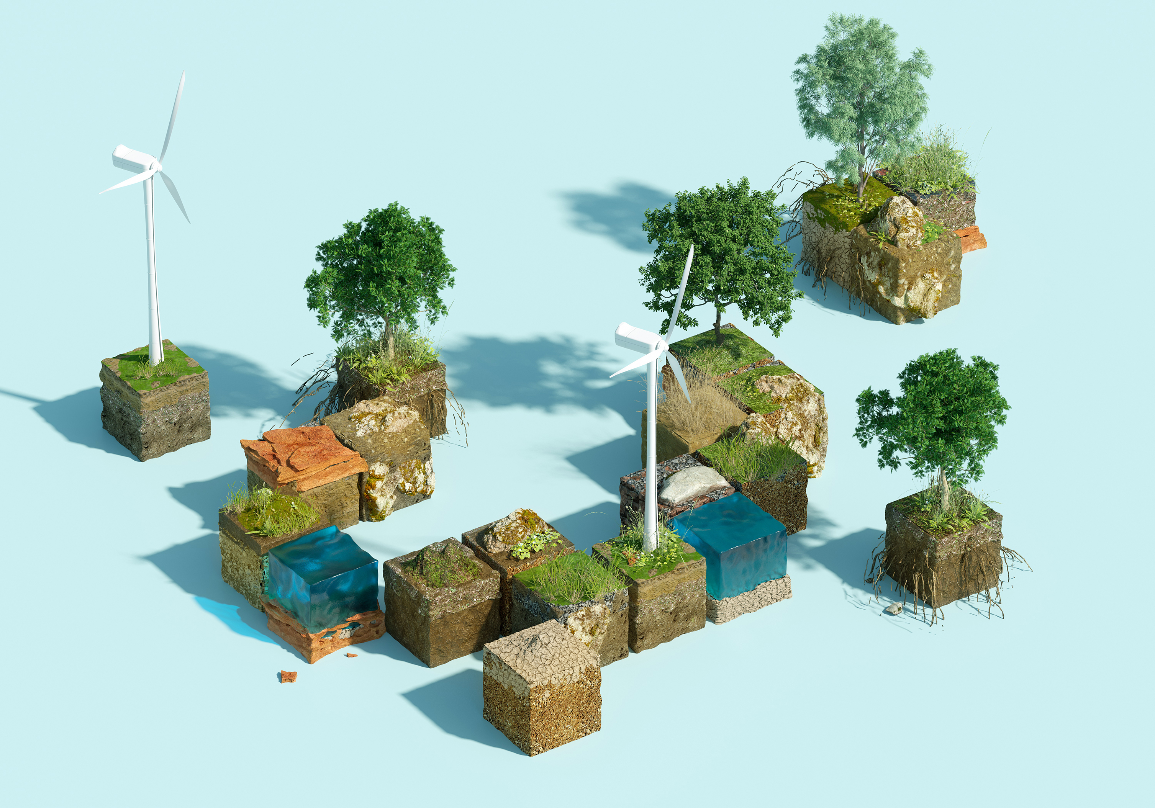
Activity 1: Resources for Survival

Slide 4
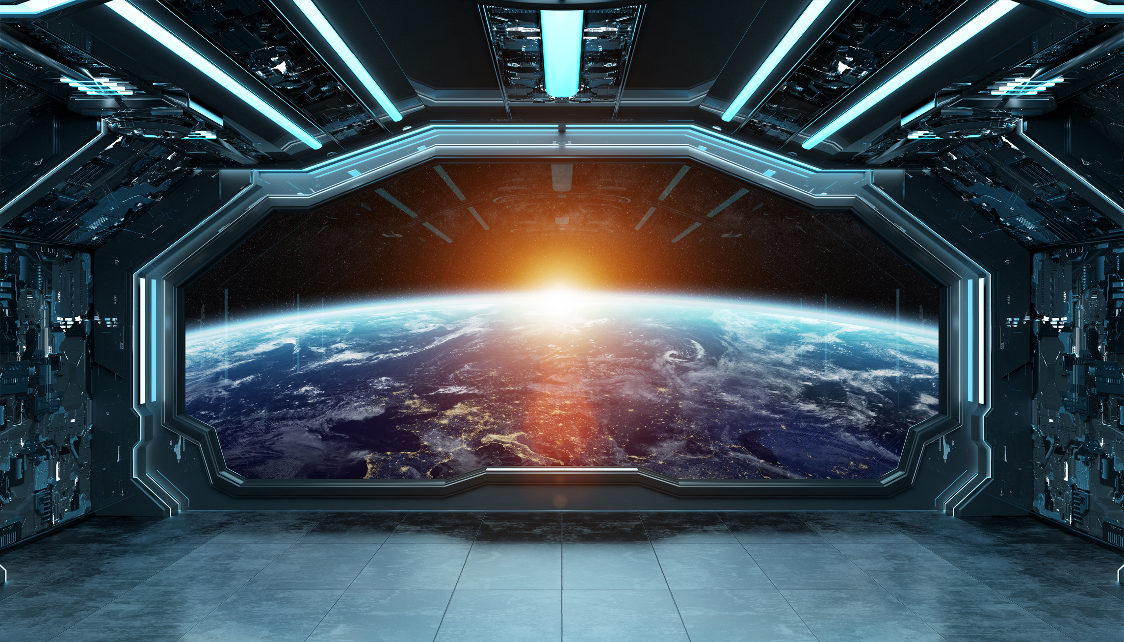
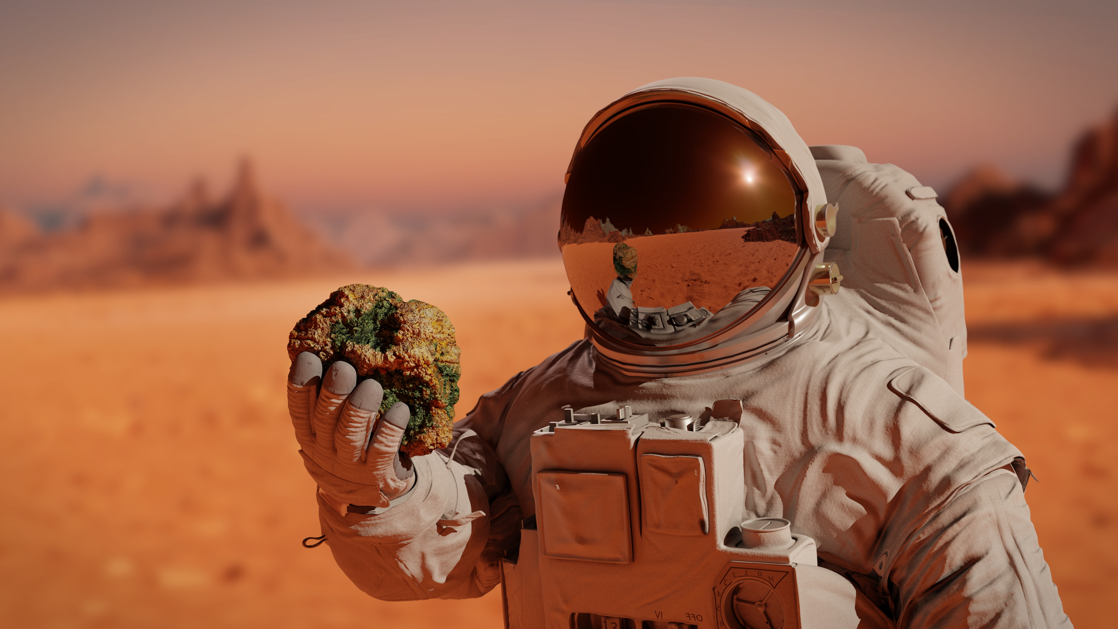
What resources are needed to survive in space?
Student Workbook: page 13
Notes:
Teacher Notes (see pages 28 – 31 in the Teacher Handbook for more details)
You may wish to have a class discussion around this or have students complete independently/in groups and then select some to share their answers. You could also write responses on the whiteboard.
Extension Activity: Students tick which resources are easier to get on Earth vs the Moon or Mars.

Slide 5





What resources are needed to survive in space?
Food
Oxygen
Electricity/Power
Student Workbook: page 13
Water
Shelter
Notes:
Teacher Notes (see pages 28 – 31 in the Teacher Handbook for more details)
These are the basic resources we’d need to survive in space. Students may have mentioned other resources which might be explored in the next section.
Below is more information that you can discuss with your pupils on why humans need these resources:
Food gives us nutrition. We need to eat the right type of foods in the right amount to get the best nutrition for our bodies.
Water keeps us cool, helps to transport nutrients and waste around the body, keeps cells healthy, and helps with chemical reactions inside of us.
Oxygen is used in our cells for many life processes.
Shelter provides protection against the environment and gives us a safe place to sleep and recover which is important for our bodies to grow and heal properly.
Electricity/Power has made it easier to access resources. On a spacecraft or basecamp, we’d need electricity to run the systems that keep us alive.
Extension Activity: All these resources are easier to get on Earth. The different conditions of the Moon and Mars means we would need to bring resources with us from Earth.

Slide 6
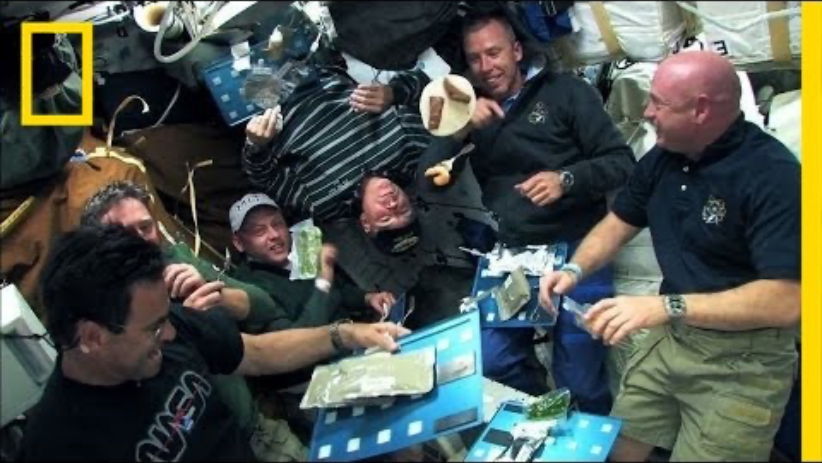
We must think carefully about the resources we send into space…
Notes:
Teacher Notes (see pages 28 – 31 in the Teacher Handbook for more details)
The video contains information about nutrition in food and reducing food mass to cut costs on fuel.
Food on the International Space Station is usually heated and/or rehydrated with water before consumption. Spicy foods are popular. Due to the way scent travels onboard and the effects of microgravity on the body, many astronauts report senses like taste and smell being dulled, which can make food taste bland.

Slide 7

Activity 2: Essential or Extra?

Slide 8
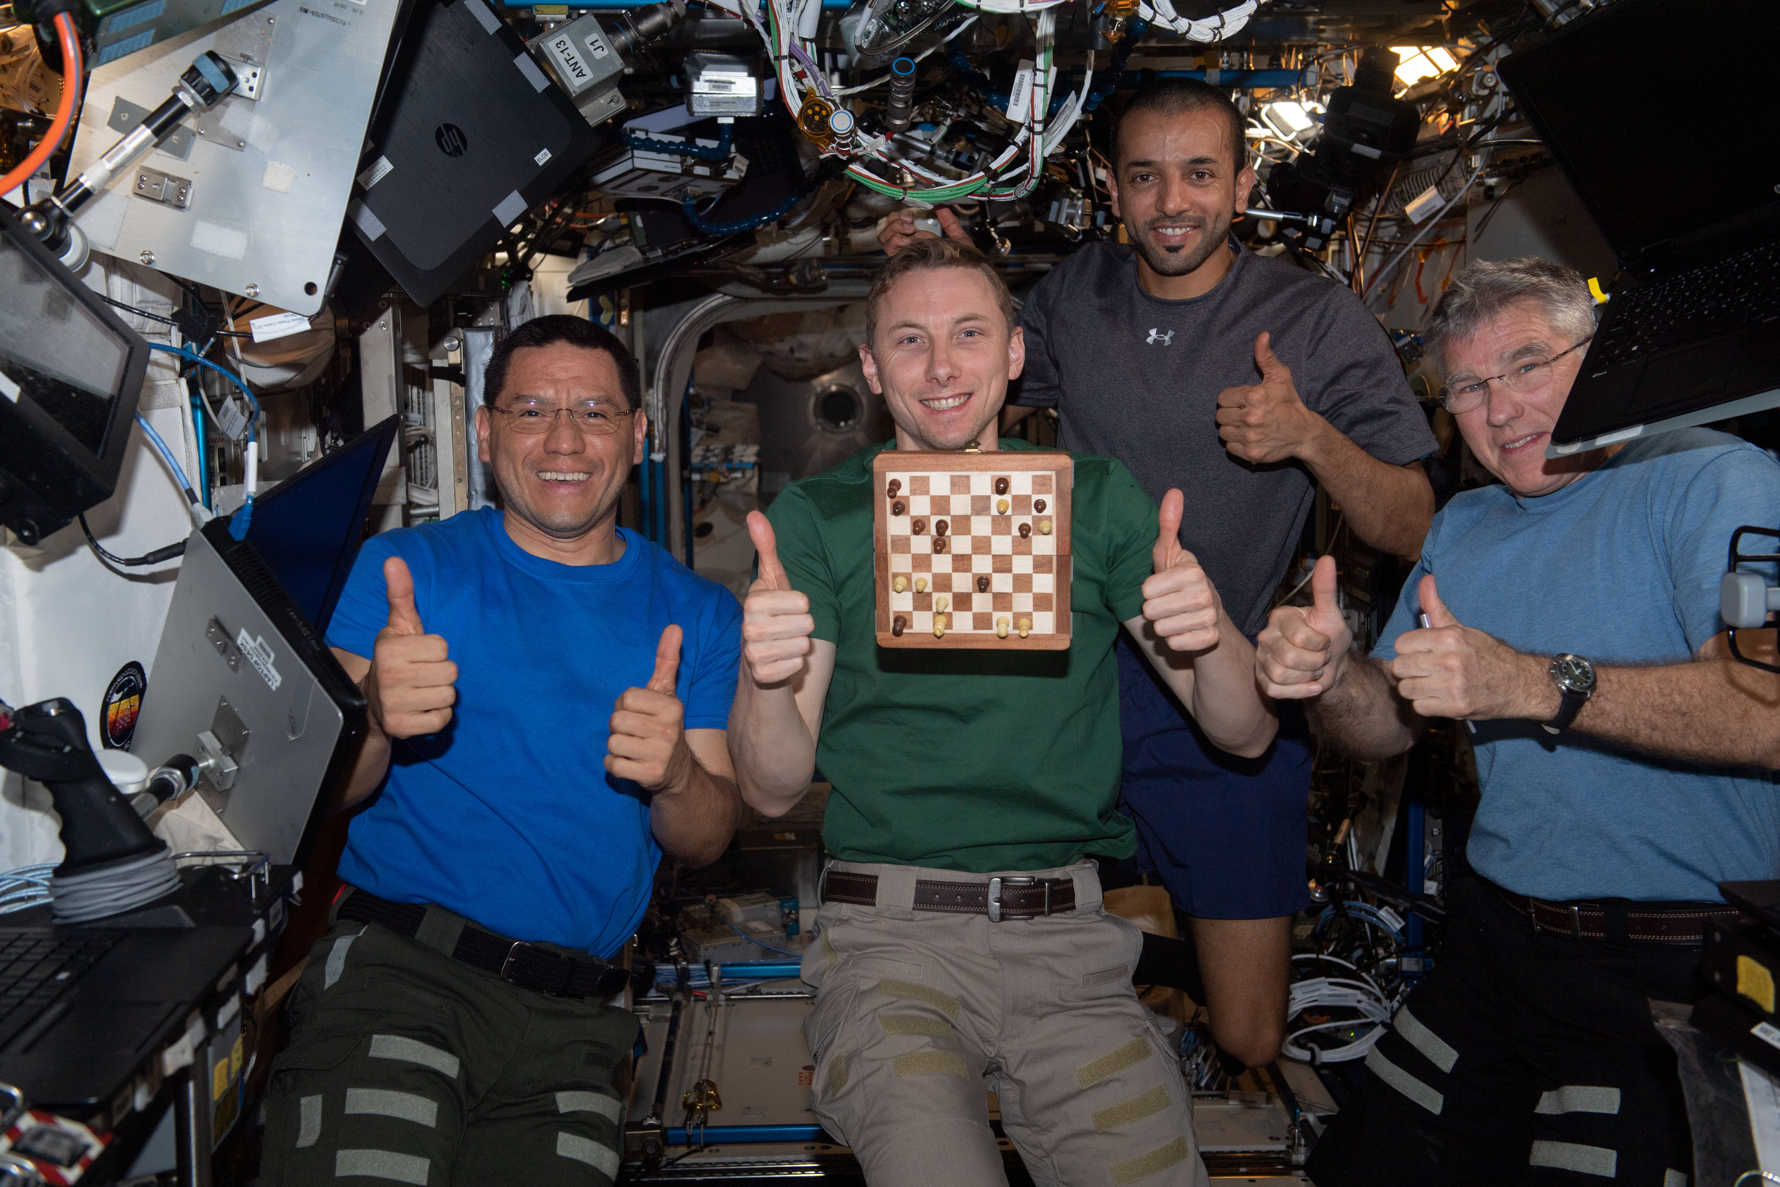
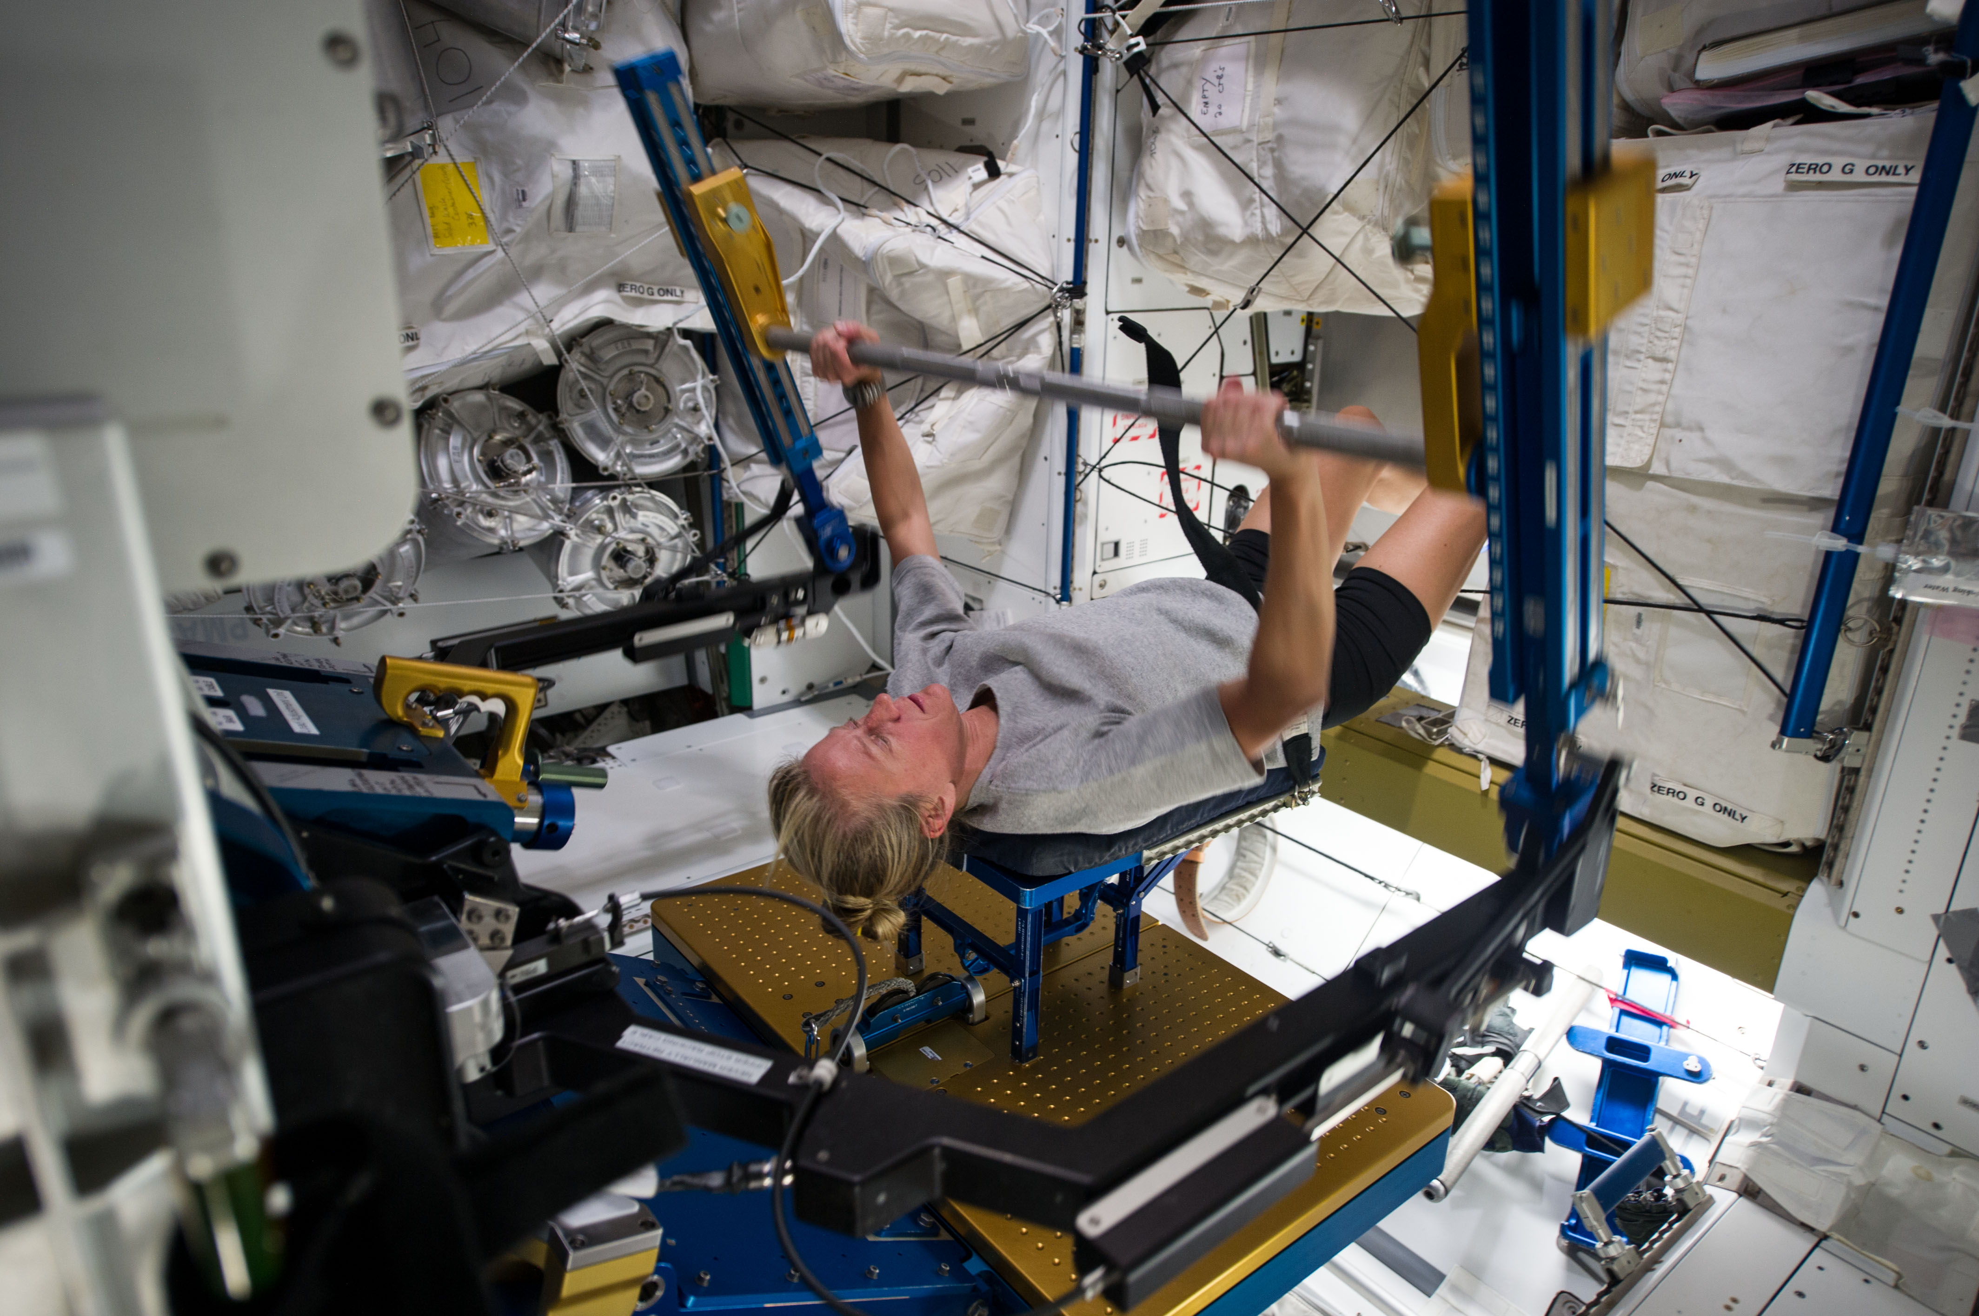

What other resources would make astronauts feel happy, comfortable, and less homesick?
Image: NASA
Image: NASA
Notes:
Teacher Notes (see pages 32 – 34 in the Teacher Handbook for more details)
You may have students write their ideas on mini-whiteboards and then select some to share their answers. You could also lead a class discussion.
Below is more information related to the 3 pictures that you can discuss with students:
Entertainment is a way for us to unwind and reduce stress, which improves our mood and helps physical health. It can boost creativity and imagination.
Communicating with friends and family can help us feel supported and reduce stress, which is good for our mental and physical health. Communication is also important when working as a team.
Exercise is important for us to be healthy and therefore live longer. Different exercises have different effects on the body. We will be exploring the types of exercises astronauts complete in Investigation 4 ‘How do we stay Healthy in Space?’.

Slide 9
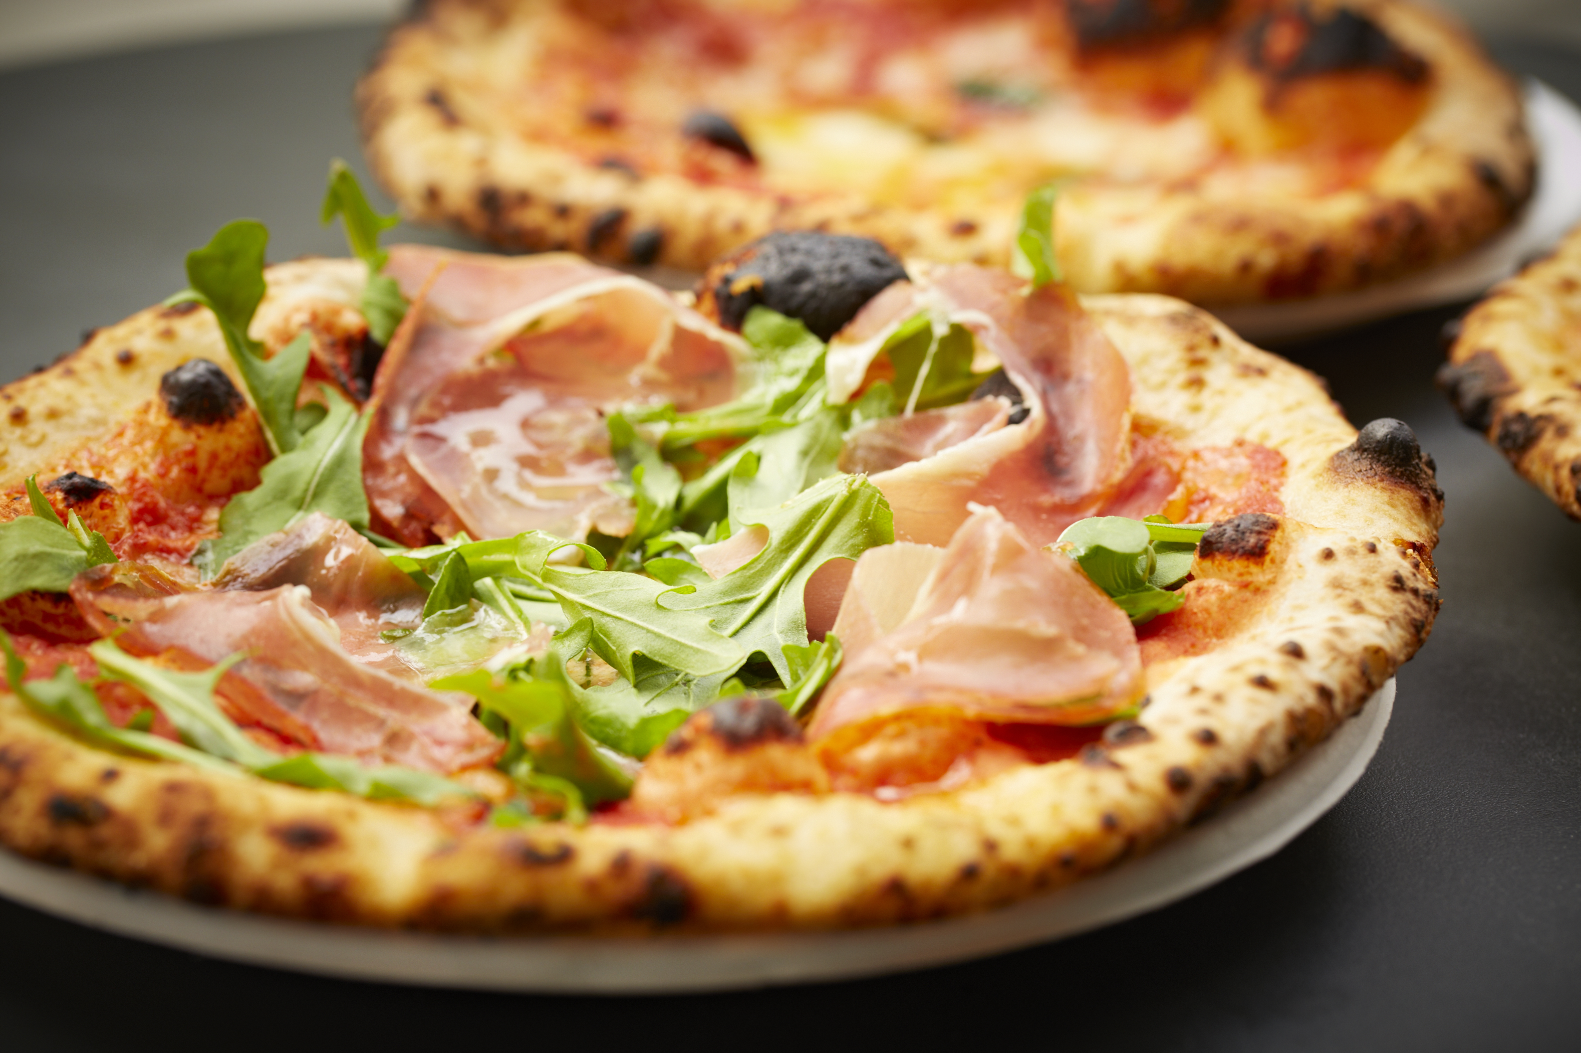
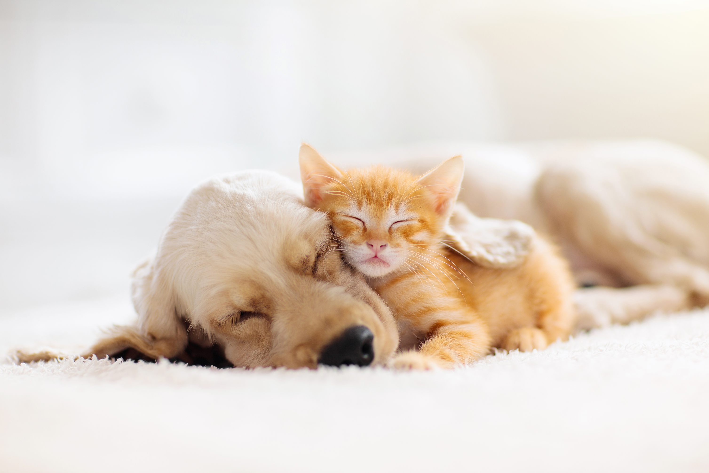
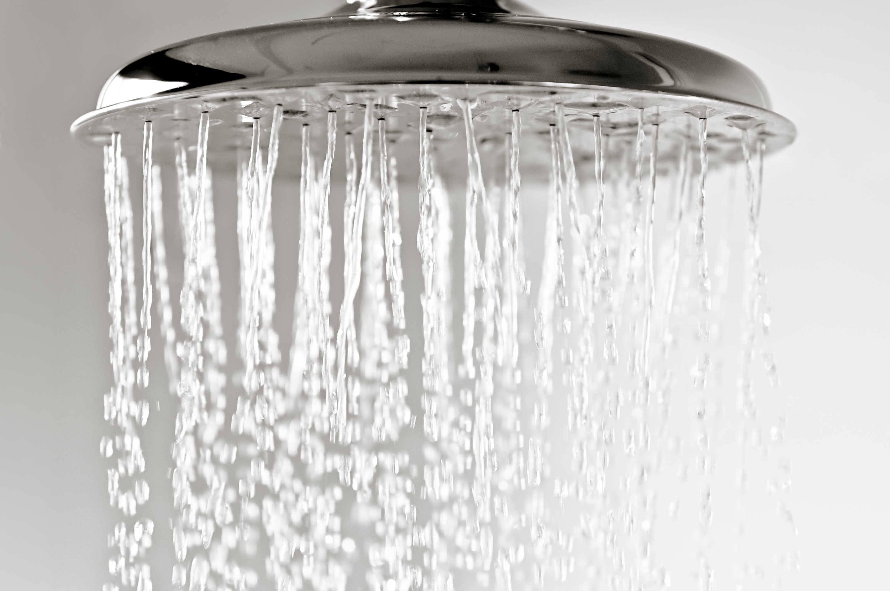
Essential or Extra?
Some essential resources we can’t survive without.
Other extra resources make our lives more comfortable or happier.
Which resources are essential, and which are extra?
Student Workbook: page 13
Notes:
Teacher Notes (see pages 32 – 34 in the Teacher Handbook for more details)
This activity can be done independently or in pairs/groups. Many of the ‘extra’ resources do have benefits that your students may have thought of, so you might want to select some students to explain their answers to understand why they’ve chosen them.
Extension Task: Students add 2 more items to their table and tick whether they think it is an essential or extra resource. Ask them to explain why they chose their answer to check if they have a reasonable justification.

Slide 10
Essential or Extra?
Item | Essential | Extra
Oxygen
Pizza
Pets
Music
Beds
Hot Showers
Plants
Video Games
✓
✓
or
✓
✓
✓
✓
or
✓
✓
Student Workbook: page 13
✓
or
✓
✓
Notes:
Teacher Notes (see pages 32 – 34 in the Teacher Handbook for more details)
Oxygen is an essential resource. It is used by the cells in our body for life processes. We cannot survive without it.
Pizza could be an essential resource as we need food for survival. But other food has better nutritional value, making pizza a treat food and an extra resource instead.
Pets are an extra resource. We don’t need them, even though they can reduce loneliness and stress.
Music is an extra resource, but forms of entertainment are beneficial for us.
Beds could be an extra resource, as they’re not required for sleep. But they do help us rest better. And having something warm to sleep in or with is an essential resource for colder climates.
Hot showers are an extra resource. We can survive with cold showers, though most people prefer the comfort of hot water.
Plants could be an essential resource as some can be used for food, and they give out oxygen. But we might get these resources elsewhere in space, making plants an extra resource.
Video games are an extra resource. but forms of entertainment are beneficial for us.
Extension Task: Ask students to explain why they chose their answer to check if they have a reasonable justification.

Slide 11

Activity 3: Comparing the Earth, Moon, and Mars

Slide 12
Comparing the Earth, Moon, and Mars
Feature | Earth | Moon | Mars
Average Temperature (ºC) | 15 | 127 (day) –173 (night) | -59
Strength of Gravity (g) | 1 | 0.16 | 0.38
Mass of Atmosphere (kg) | 5.15 x 10¹⁸ | 28 000 | 2.5 x 10¹⁶
Gases in Atmosphere | Nitrogen: 78% Oxygen: 21% Others: 1% | Neon: 29% Helium: 26% Hydrogen: 23% Argon: 21% Others: 1% | Carbon Dioxide: 95% Nitrogen: 2.5% Argon: 2% Others: < 1%
Student Workbook: page 14 – 16
1g = force of gravity on Earth
Notes:
Teacher Notes (see pages 35 – 36 in the Teacher Handbook for more details)
Students can use this information to complete the activity in the workbook.
1g = force of gravity on Earth. The strength of gravity on Mars is around two fifths (~40%) of Earth’s. The strength of gravity on the Moon is around a sixth (~16%) of Earth’s.

Slide 13
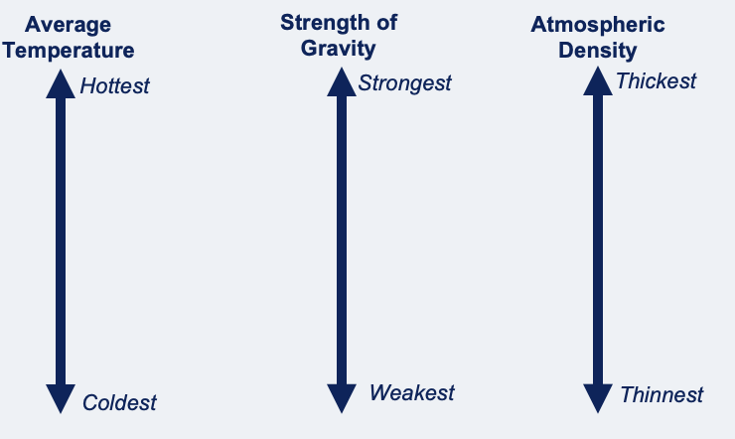
1) Average Temperature
Moon (day)
Earth
Mars
Moon (night)

Slide 14
2) Strength of Gravity
Earth
Mars
Moon

Slide 15
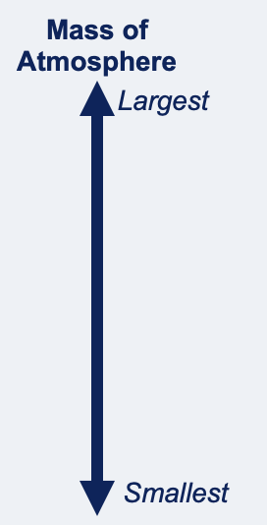
3) Mass of Atmosphere
Earth
Mars
Moon

Slide 16
4) Why can’t humans breathe on the Moon and Mars?
The atmospheres of the Moon and Mars have __________ mass than Earth. This means the air is thinner.
They also contain different _____________. Humans __________ in oxygen. _________ has the most oxygen in its atmosphere. It has around ________ %. The other atmospheres may only have a small amount or even none at all!
gases
Earth
21
breathe
less

Slide 17
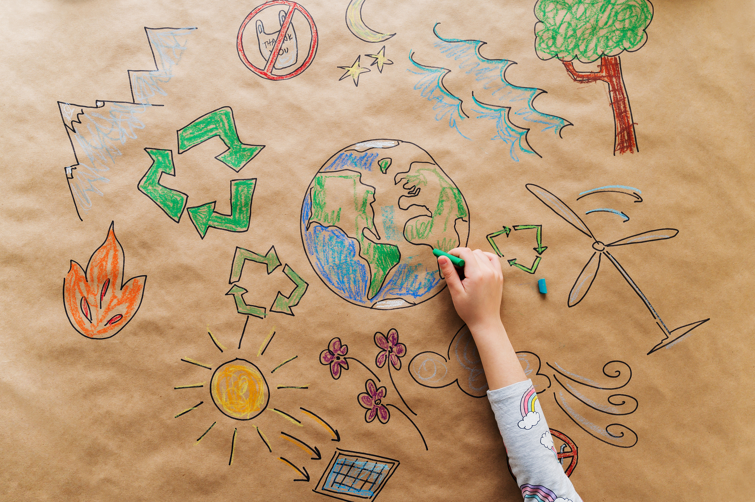
Activity 4: Caring for Planet Earth

Slide 18
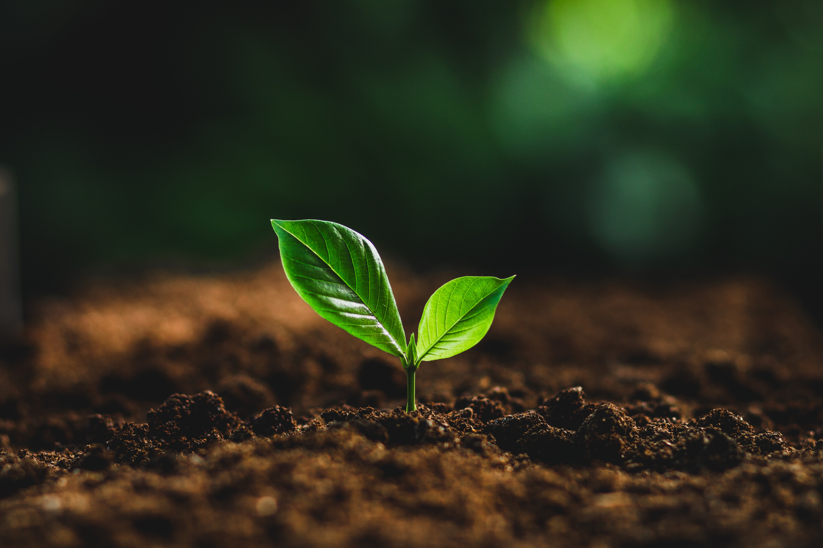
Planet Earth
Our planet is unique because it has everything life needs!
Nowhere else in the Universe has the exact conditions of Earth or all the resources we find here.
But some human activities are damaging our planet…
Notes:
Teacher Notes (see page 37 in the Teacher Handbook for more details)
You should emphasise that it is Earth’s ability to support life that makes it different to all other planets in the Universe. This why why we need to maintain Earth’s conditions exactly as they are. In doing so, we have all the resources needed for survival - but what we do to extract these resources can jeopardise that.

Slide 19
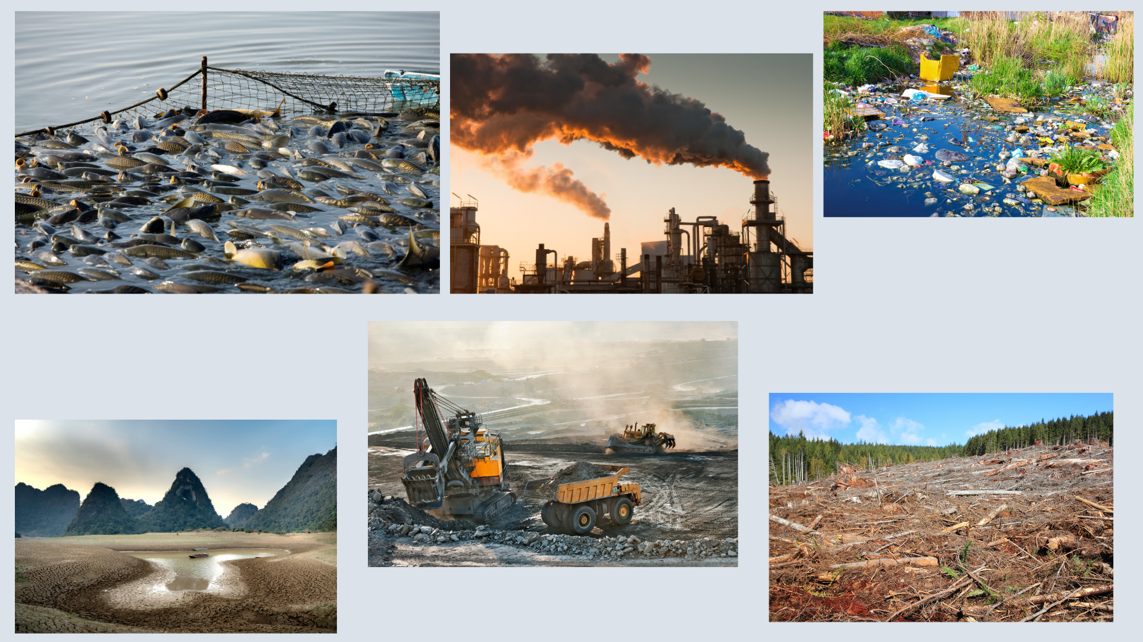
What’s gone wrong?
Notes:
Teacher Notes (see pages 37 – 39 in the Teacher Handbook for more details)
Ask students to reflect on the question and then discuss their answers as a class.
Below is more information related to the pictures that you can discuss with students:
Littering (top-left): This harms the environment e.g. microplastics in water, animals getting sick/dying from ingestion, toxins absorbed into the water/ground.
Lack of water (bottom-left): Man-made dams and reservoirs can limit where water goes. Climate change – caused by global warming - is also increasing the frequency of extreme weather events such as droughts.
Factory (middle-left): This could cause pollution through toxic substances. Emission of carbon dioxide also contributes to global warming and climate change. Large-scale production puts a strain on resources, including an increase on energy demand.
Deforestation (middle-right): The land may be used for farming, building infrastructure, or to extract resources. Species lose their habitats, impacting the ecosystem. Trees store carbon, so cutting them down means carbon dioxide is emitted into the atmosphere.
Overfishing (top-right): This can cause ecosystems to become unbalanced, with a food web collapsing if under too much strain. Fishing can also damage marine habitats and fishing boats may cause pollution through fuel use and plastics.
Digging/Mining (bottom-right): Many resources are extracted from underground. This leads to loss of habitats and sometimes land pollution. It also increases energy demand.

Slide 20
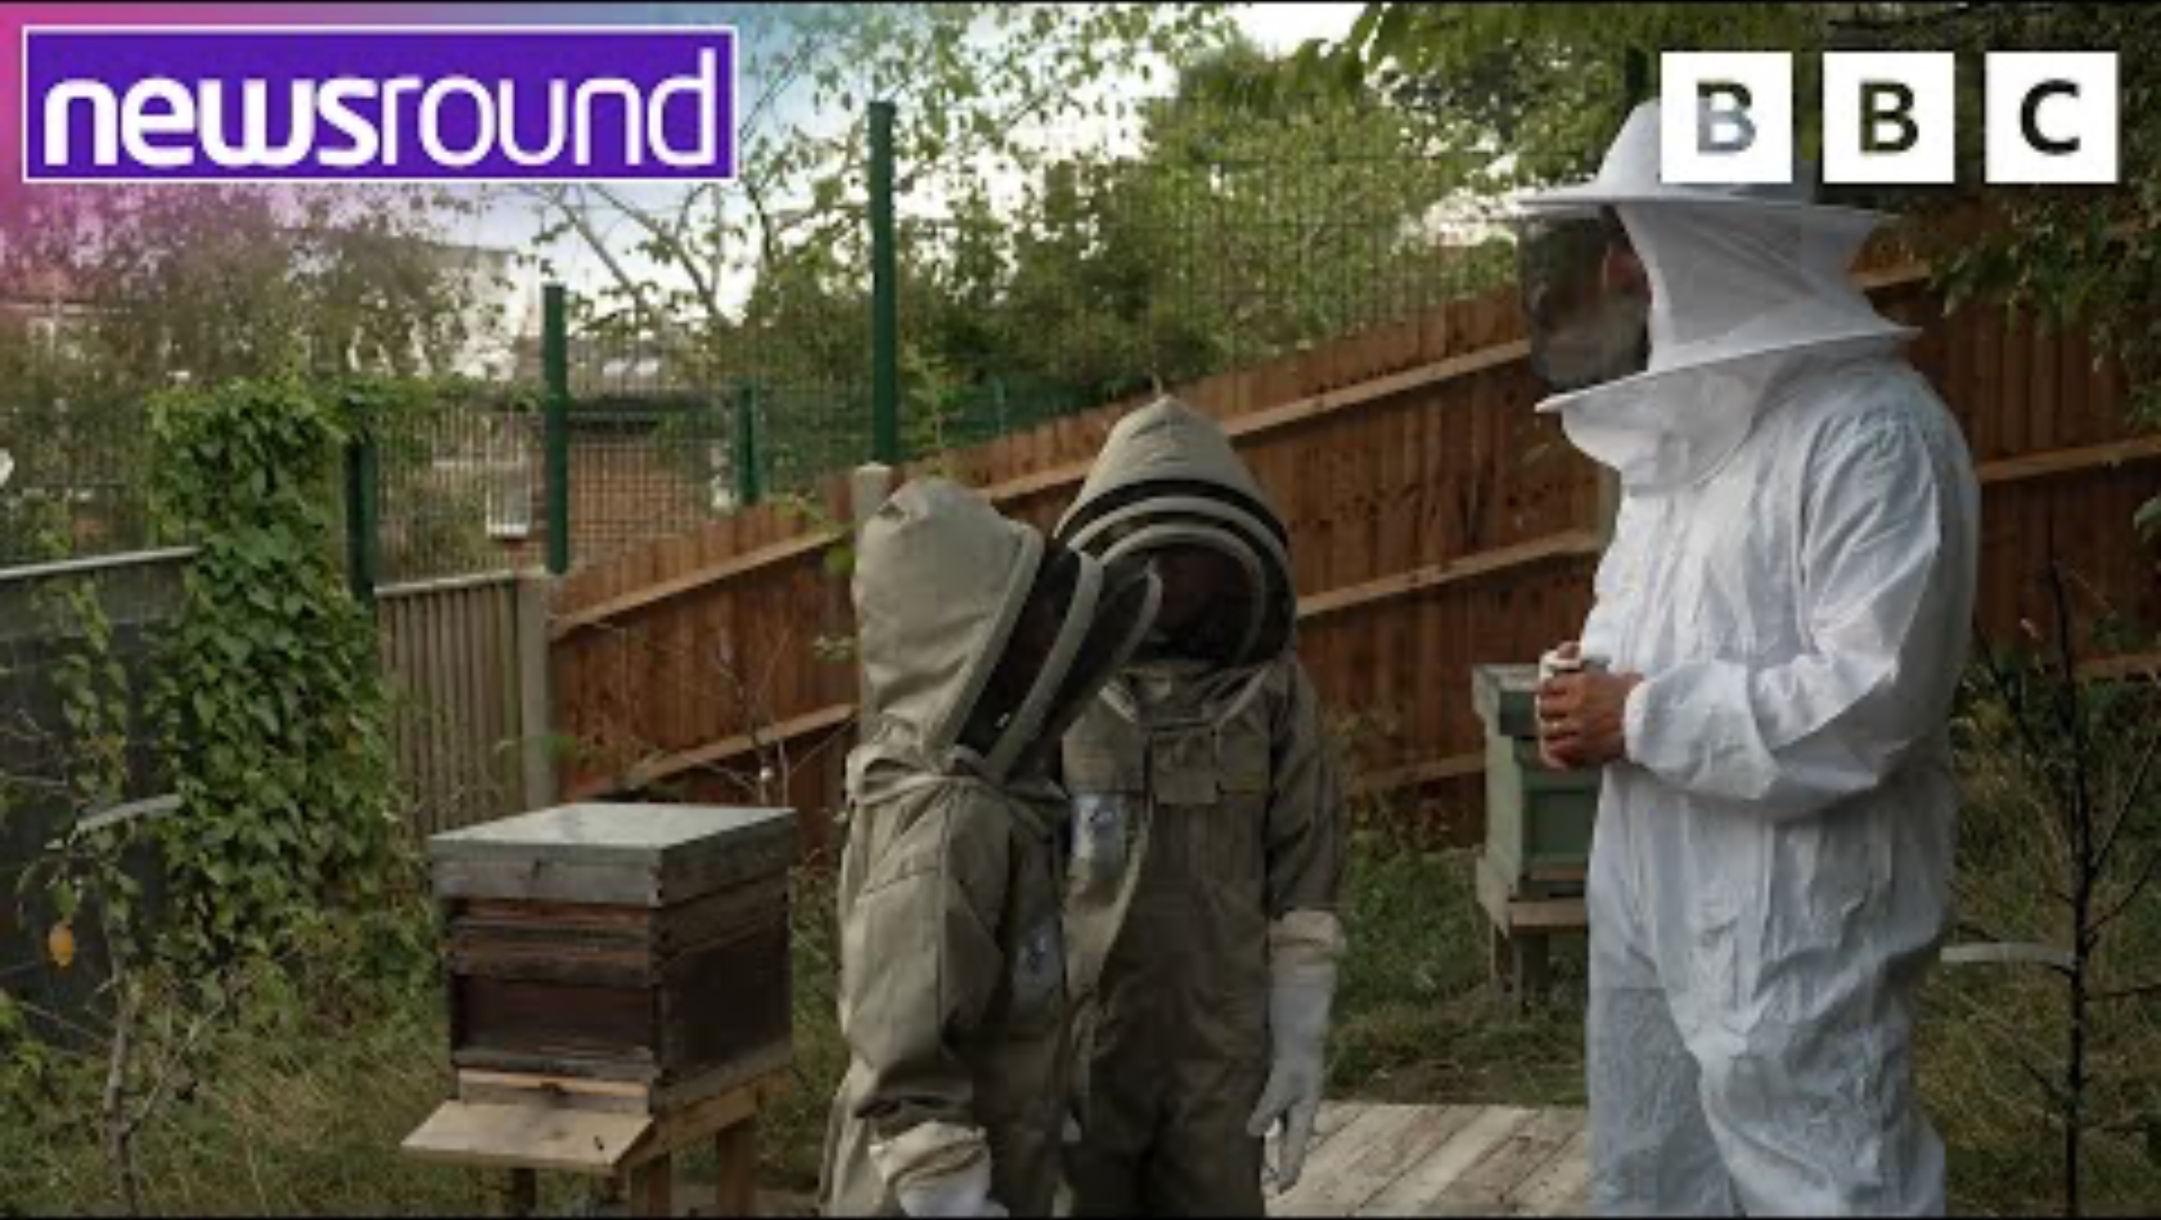
List some ways we can be more sustainable and look after our planet.
Add your own ideas as well!
Student Workbook: page 16
Notes:
Teacher Notes (see page 40 in the Teacher Handbook for more details)
Ask students to write ideas about living more sustainably in their workbooks.
You could discuss with pupils which ideas are the most feasible.

Slide 21
List some ways we can be more sustainable and look after our planet.
Recycle rubbish
Look after wildlife in the local area (e.g. bug hotels)
Reuse items when possible
Compost appropriate waste
Grow fruit and vegetables
Use energy efficient devices
Walk, cycle, or use public transport when possible
Switch off lights and devices when not in use
Notes:
Teacher Notes (see page 40 in the Teacher Handbook for more details)
These are just some ways we can be more sustainable. There are numerous others that you or your students may have thought of.

Slide 22
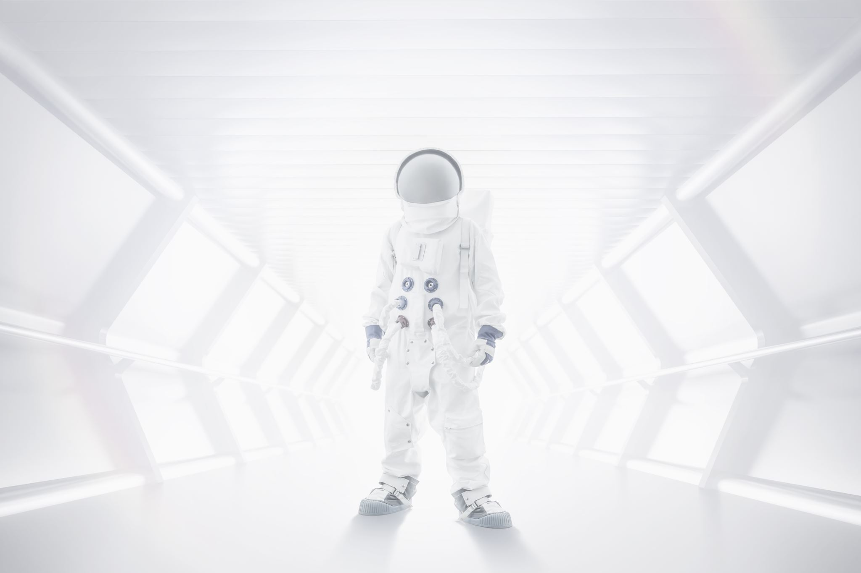
Activity 5: Moon Base Design

Slide 23
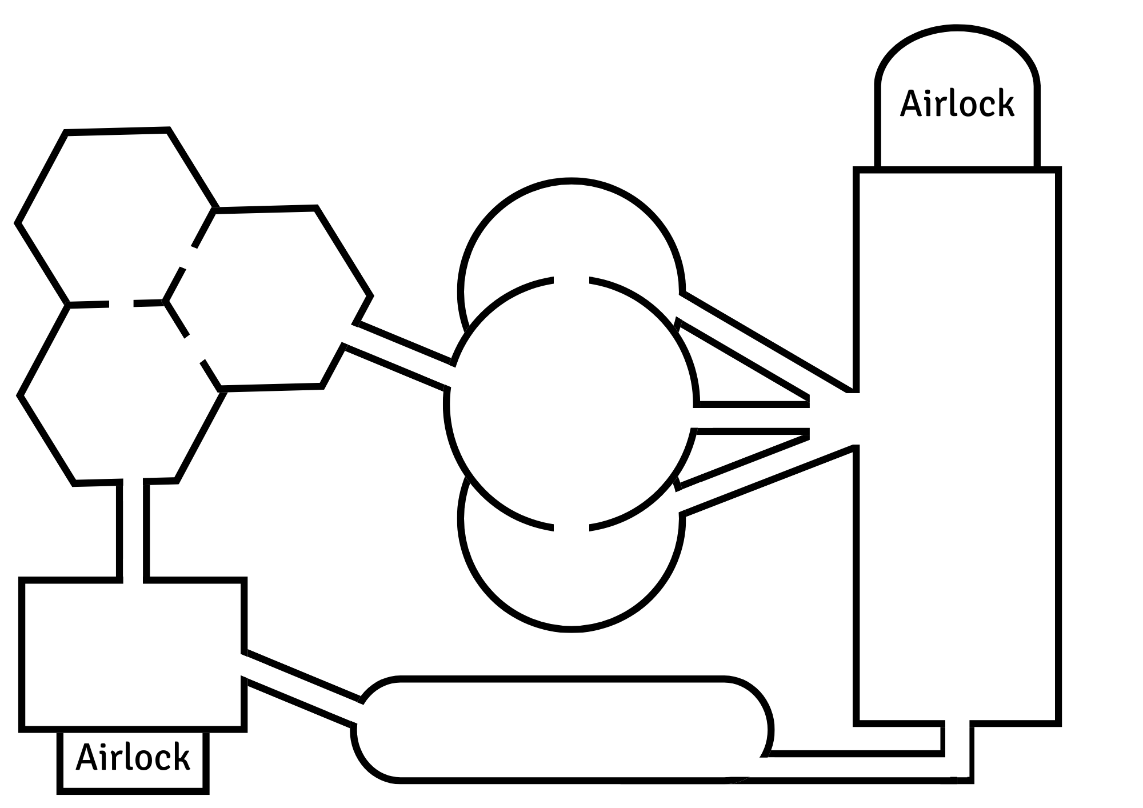
Moon Base
Your base needs to include:
Food Supply Room
Communications Room
Water and Air Filtration Room
Bathroom
Bedroom
Living Quarters with Kitchen
Electricity/Power Supply Room
Medical Room with Gym
Science Lab
1
5
2
3
6
9
7
4
8
Student Workbook: page 17 – 25
Notes:
Teacher Notes (see pages 40 – 45 in the Teacher Handbook for more details)
The template design includes 9 rooms of varying shapes and sizes. The students can decide what each room will be used for and the items they contain. They will have to consider how many people will live at their base and how this affects the facilities needed. They might also think about the proximity of the rooms, as it could be beneficial to place certain rooms close to each other.
In each room on the template design, students will draw the items and add labels where appropriate.
Below is more information you can discuss with your students:
Food Supply Room: The food must be nutritional and not perish quickly. A basic design must include ways to store the food, but students might also add items to grow their own food.
Communications Room: Many communication systems rely on radio waves. Students could include objects such as computers, video cameras, microphones, radio antennae, or even a satellite dish.
Water and Air Filtration Room: Students may want to consider the location of this room (e.g. close the bathroom to collect water faster). Students don’t need to give a lot of detail for the air supply equipment – they just need to demonstrate an understanding that the Moon’s atmosphere is different, and humans cannot breathe unless we bring air like Earth’s.
Bedroom: Students need to think about how many people will live at their base and how they can best feel rested. Astronauts work around the clock, so artificial lighting could be beneficial.
Bathroom: Students could consider how many facilities are required for the people living at their Base. They can also consider the proximity to other rooms.
Living Quarters with Kitchen: This room needs to include forms of entertainment.
Electricity/Power Supply Room: Solar power could be the best way to generate electricity. Excess could also be stored in batteries and used when needed.
Medical Room with Gym: Students should consider which medical items would be most useful and if they could be brought to the Moon. The gym should include equipment that will strengthen bones and muscles.
Science Lab: Ask students to consider what science experiments they might do and what equipment they’ll need.

Slide 24
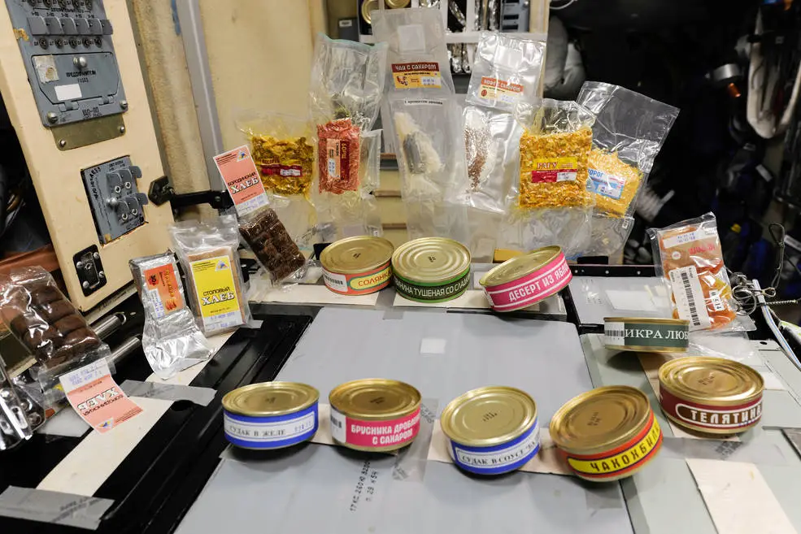
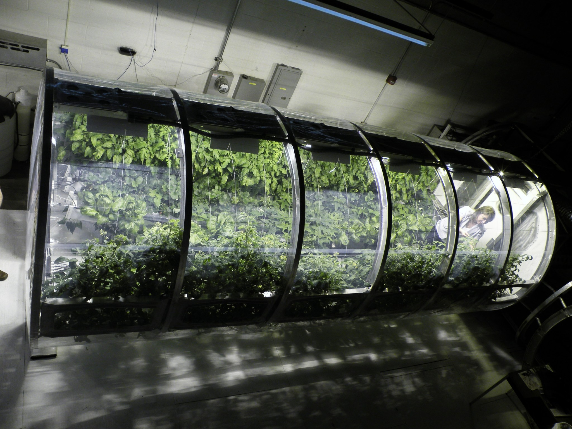
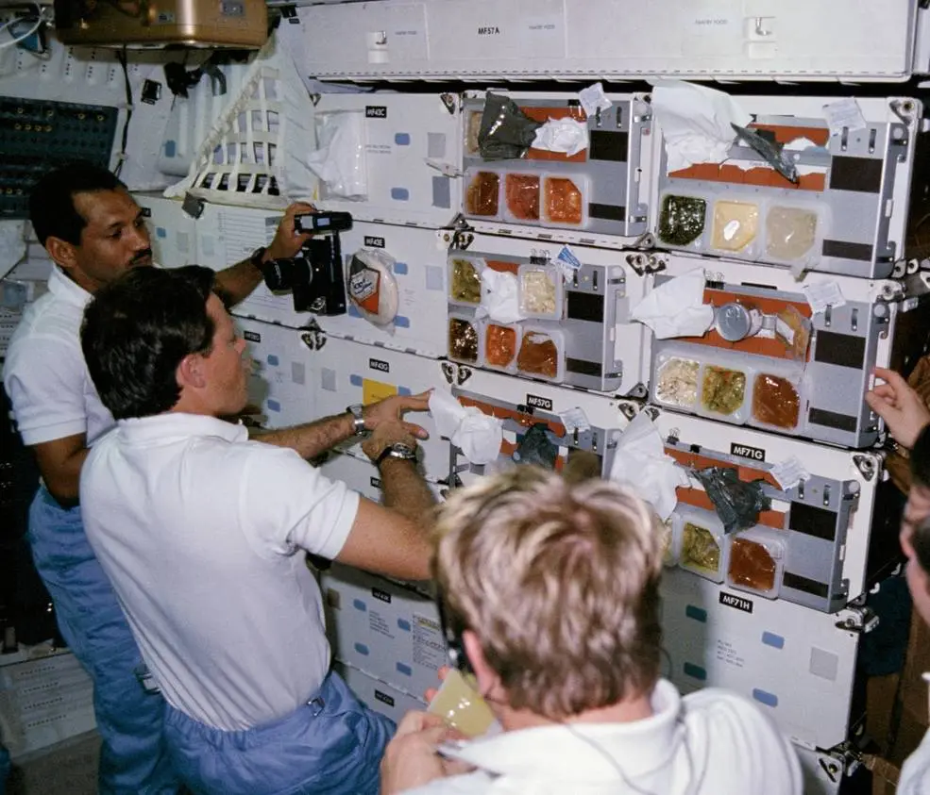
Food Supply Room
Images: NASA
Notes:
Teacher Notes (see page 41 in the Teacher Handbook for more details)
Item prompts in Student Workbook: Food that won’t go mouldy or rot quickly, shelves or cupboards for storing items, crops/plants to eat, equipment to care for plants (like lighting or water sprinklers)

Slide 25
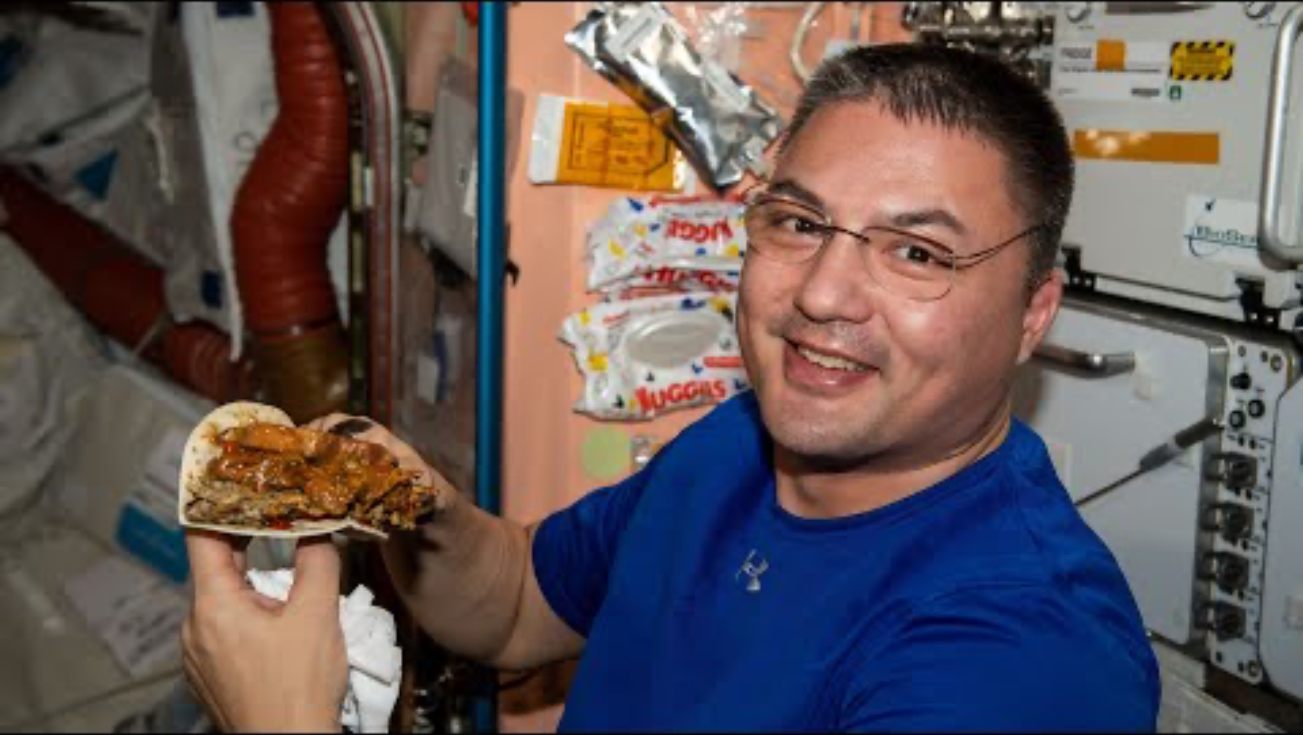
What do astronauts eat in space?

Slide 26
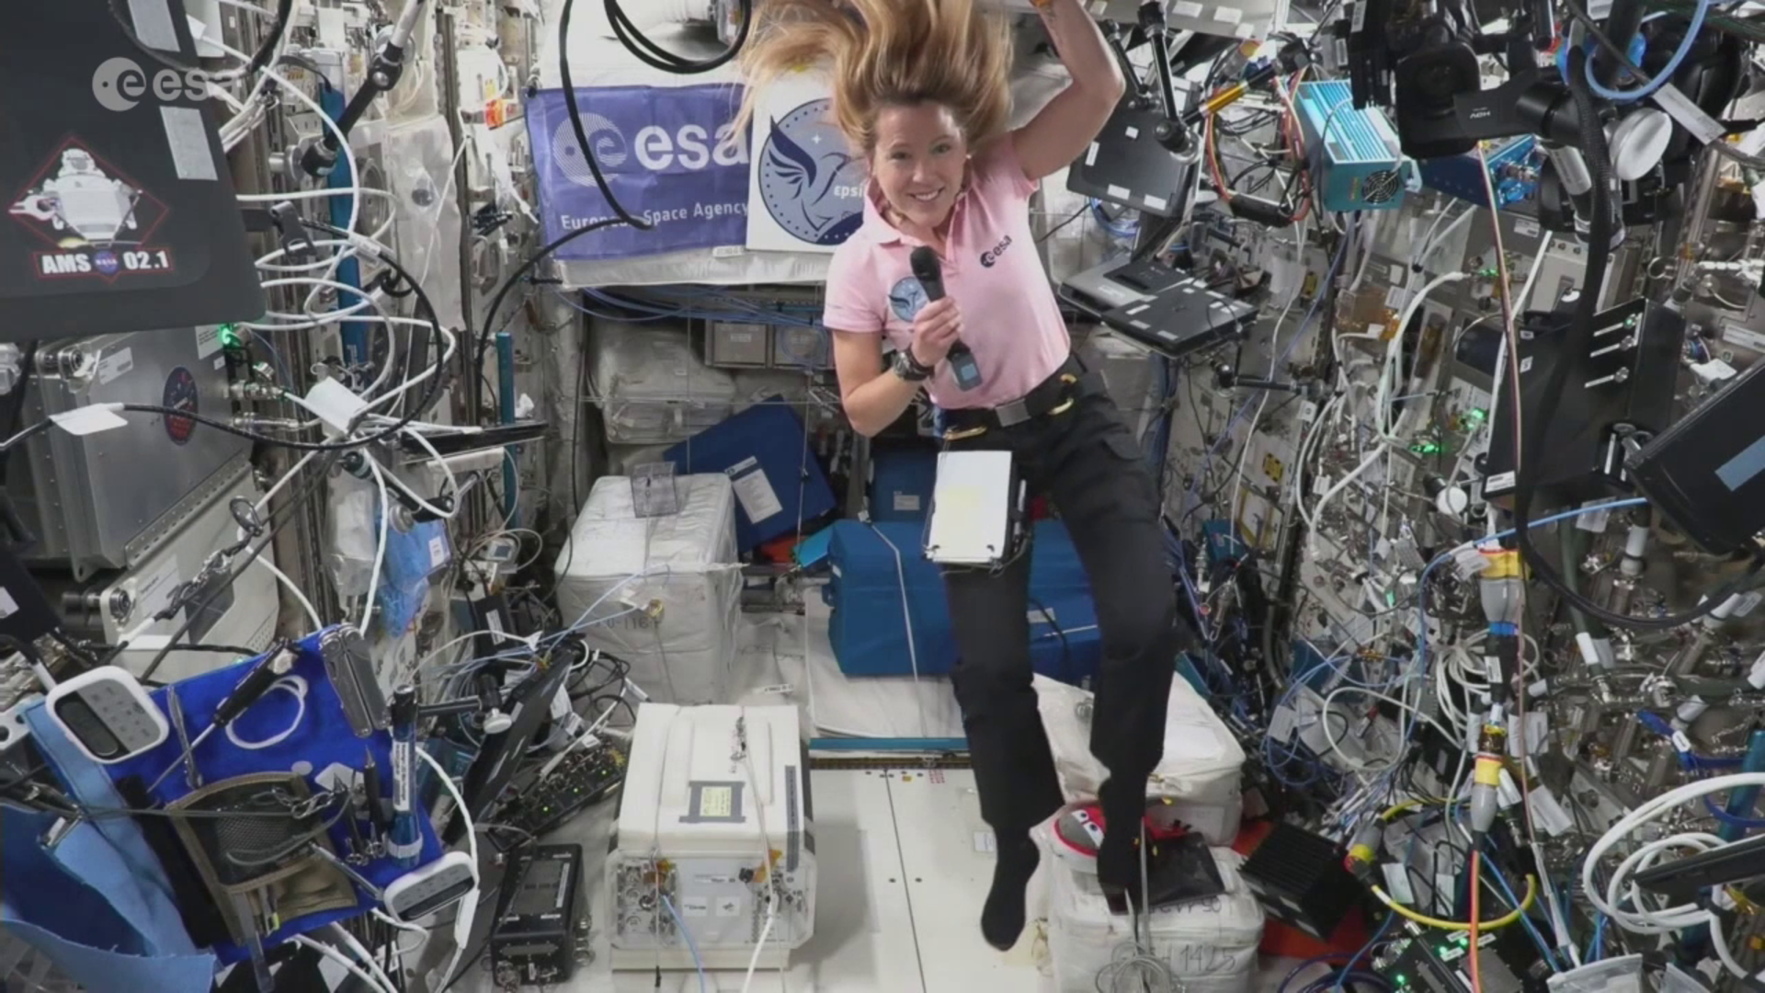
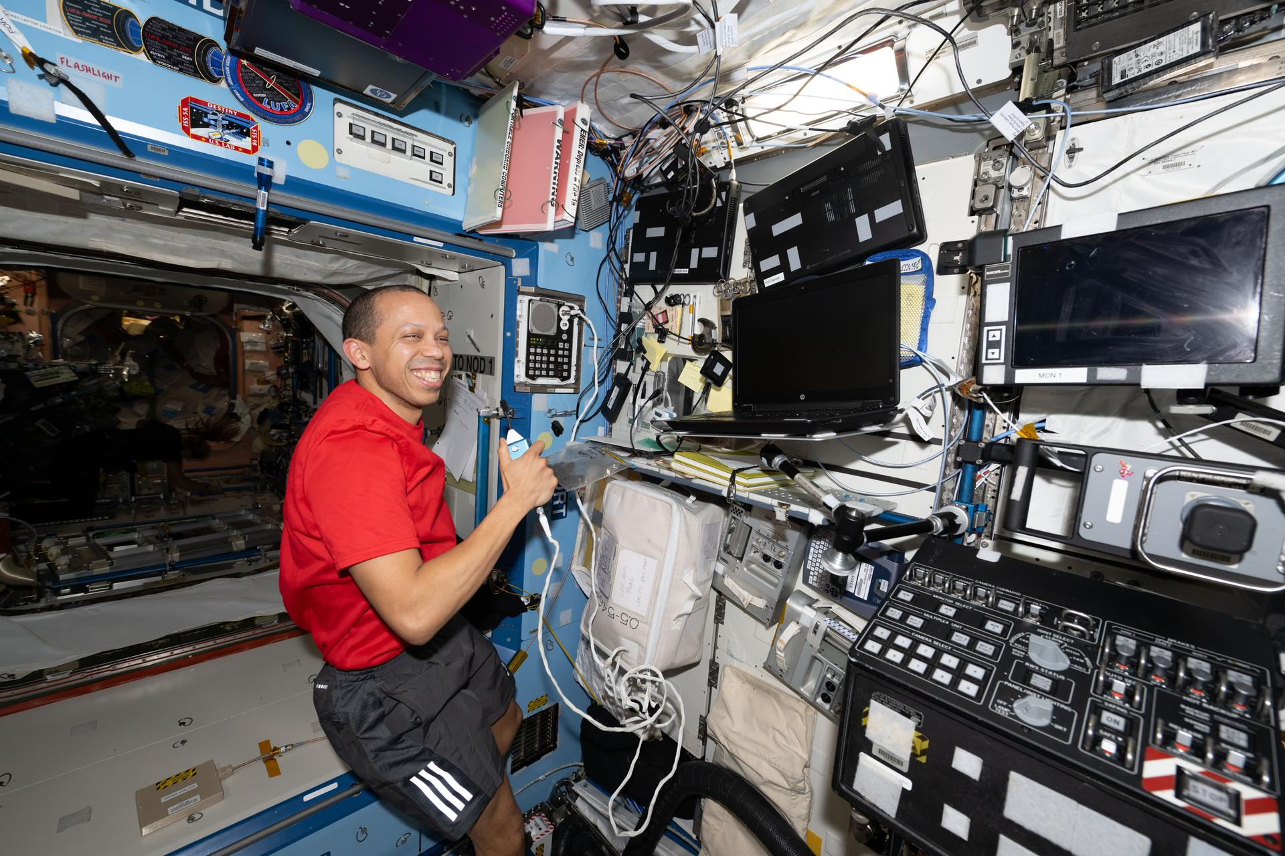
Communications Room
Image: ESA/NASA
Image: NASA
Notes:
Teacher Notes (see page 41 in the Teacher Handbook for more details)
Item prompts in Student Workbook: Computers/Laptops, cameras, microphones, headsets/headphones, satellite dishes, radio antennas

Slide 27
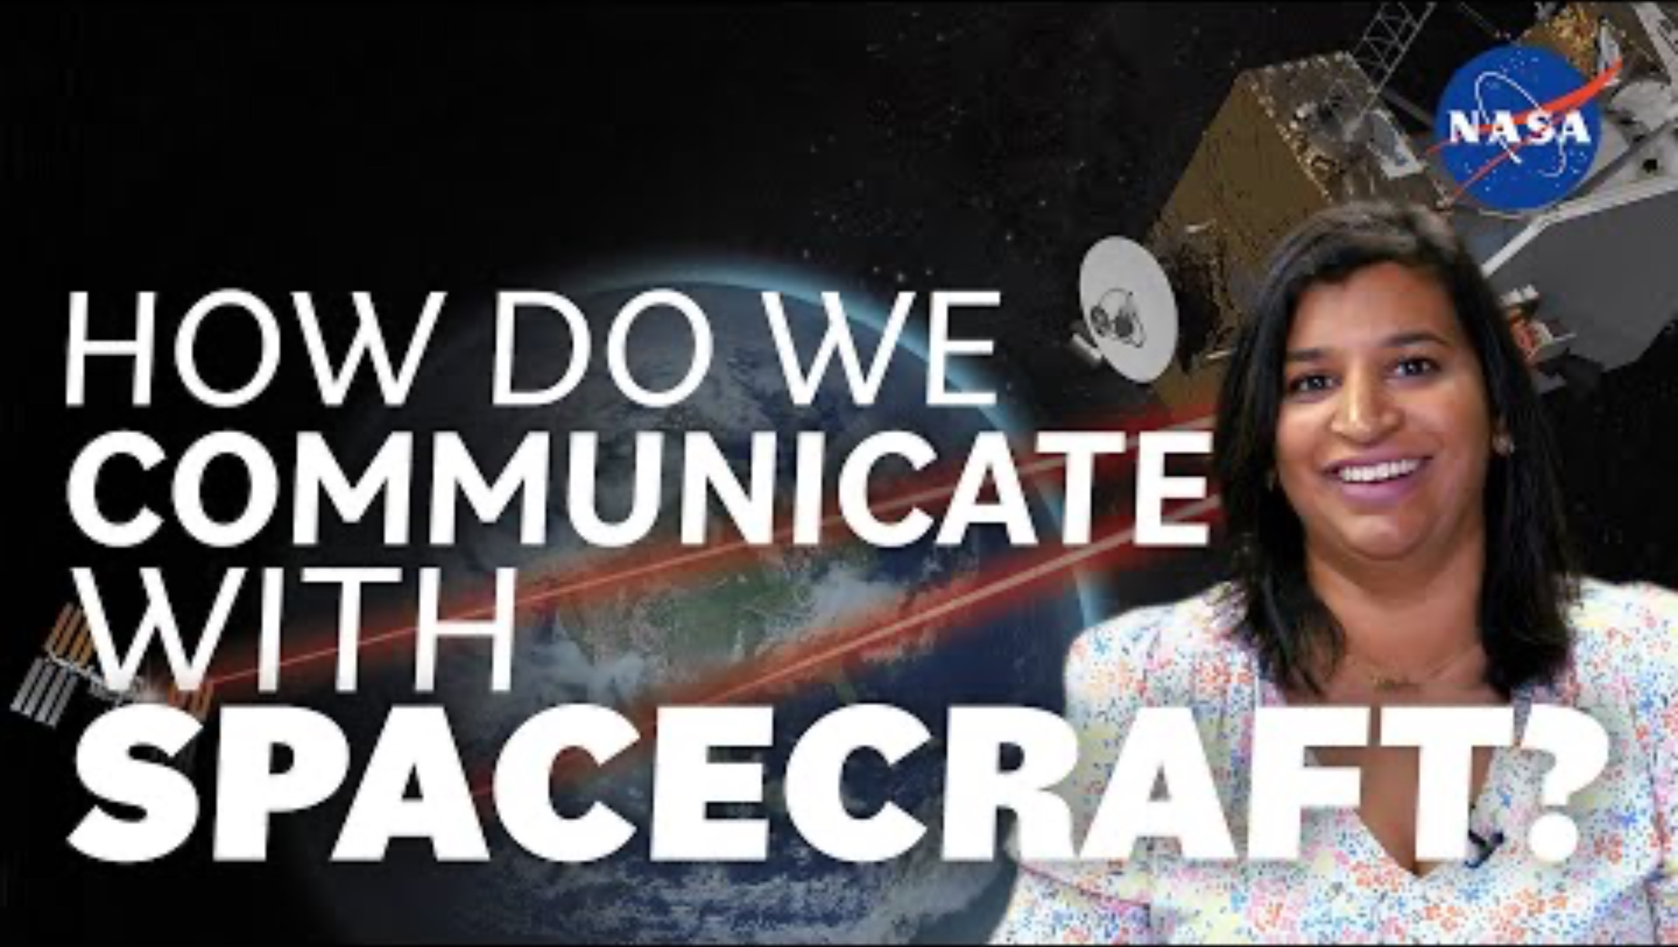
How Do We Communicate With Spacecraft?

Slide 28
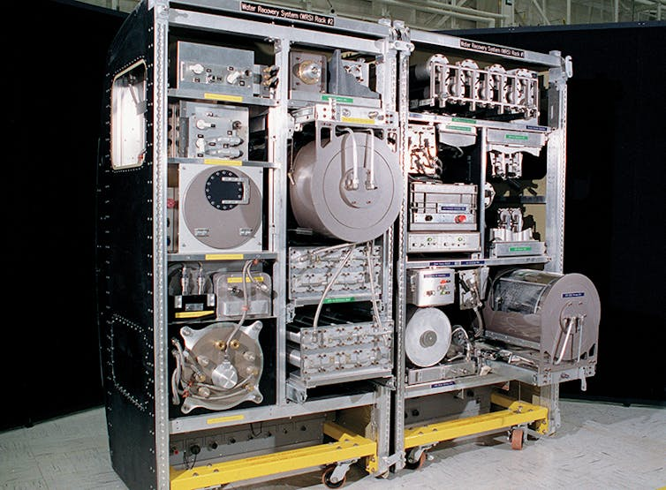
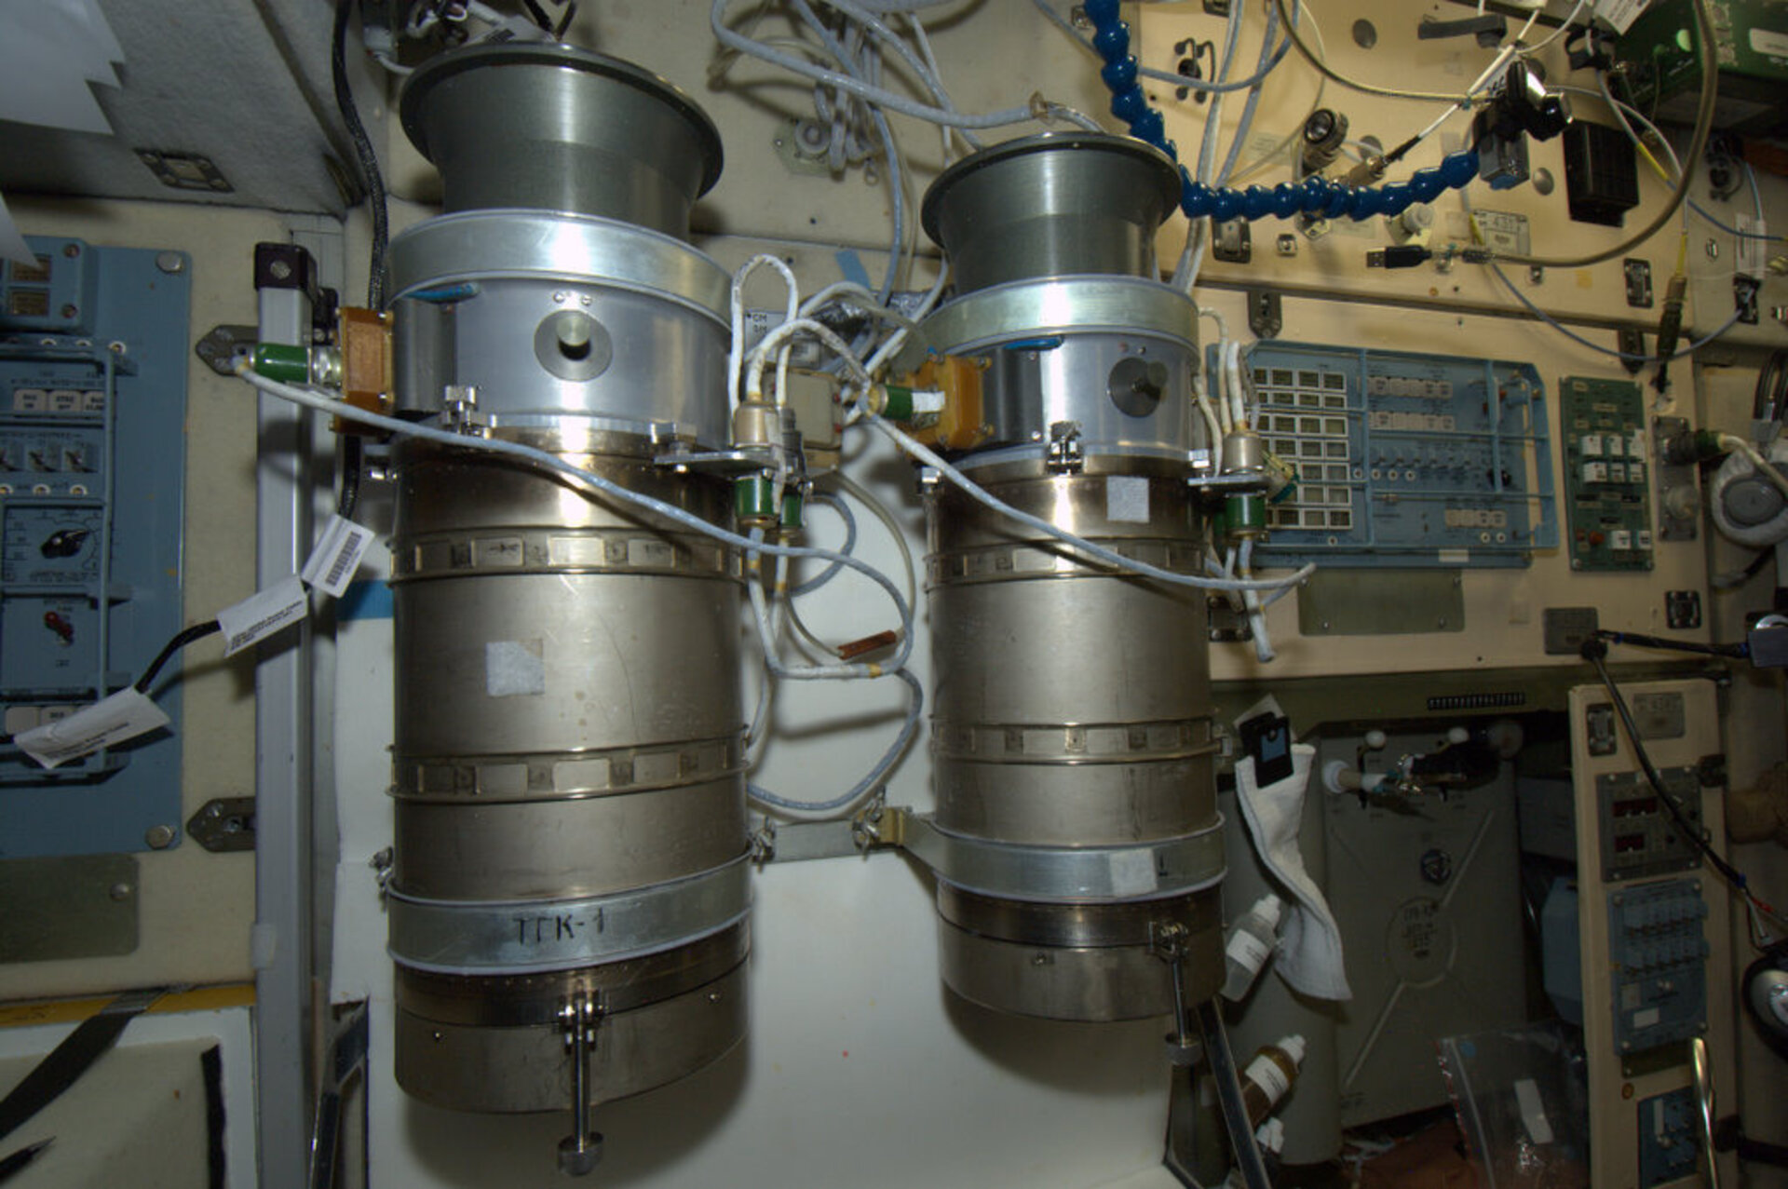
Water and Air Filtration Room
Image: NASA
Image: ESA/NASA
This machine collects water from different places on the International Space Station and makes it clean and safe to drink!
These machines can make oxygen from water!
Notes:
Teacher Notes (see page 42 in the Teacher Handbook for more details)
Item prompts in Student Workbook: Water tanks, water filters (to clean the water), oxygen generators (to turn water into oxygen for breathing), air filters (to clean the air), fans, pipes for moving water and air to different places

Slide 29
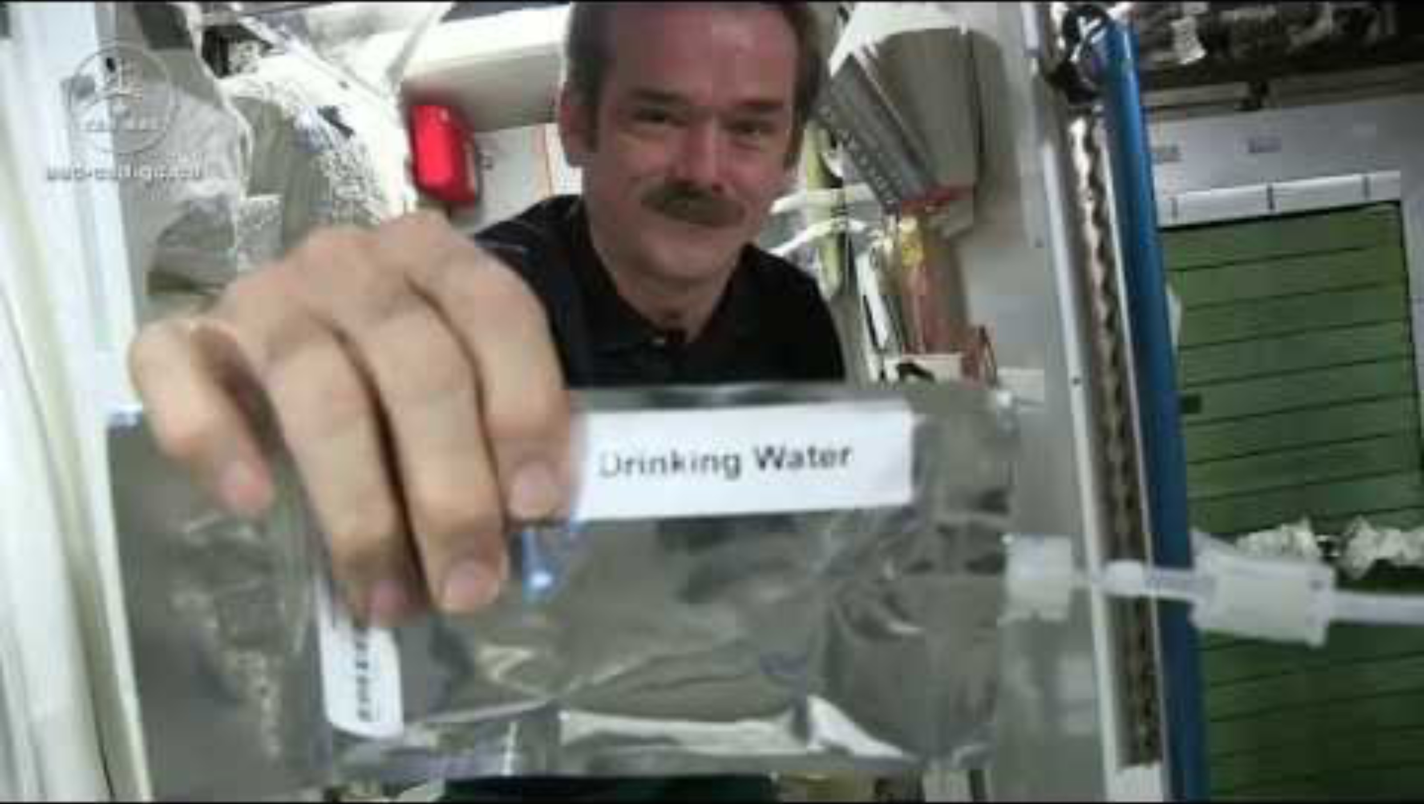
Water Recycling on the International Space Station

Slide 30
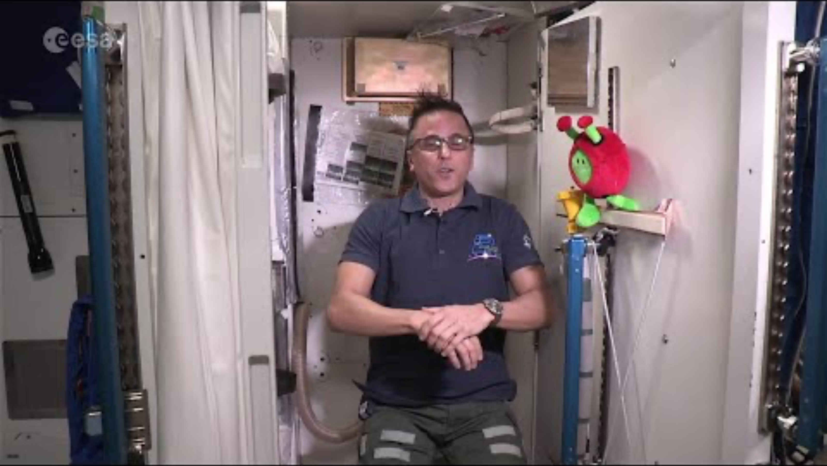
Making oxygen on the ISS
Start video at 4:04 for information about how oxygen is produced and the air is cleaned

Slide 31
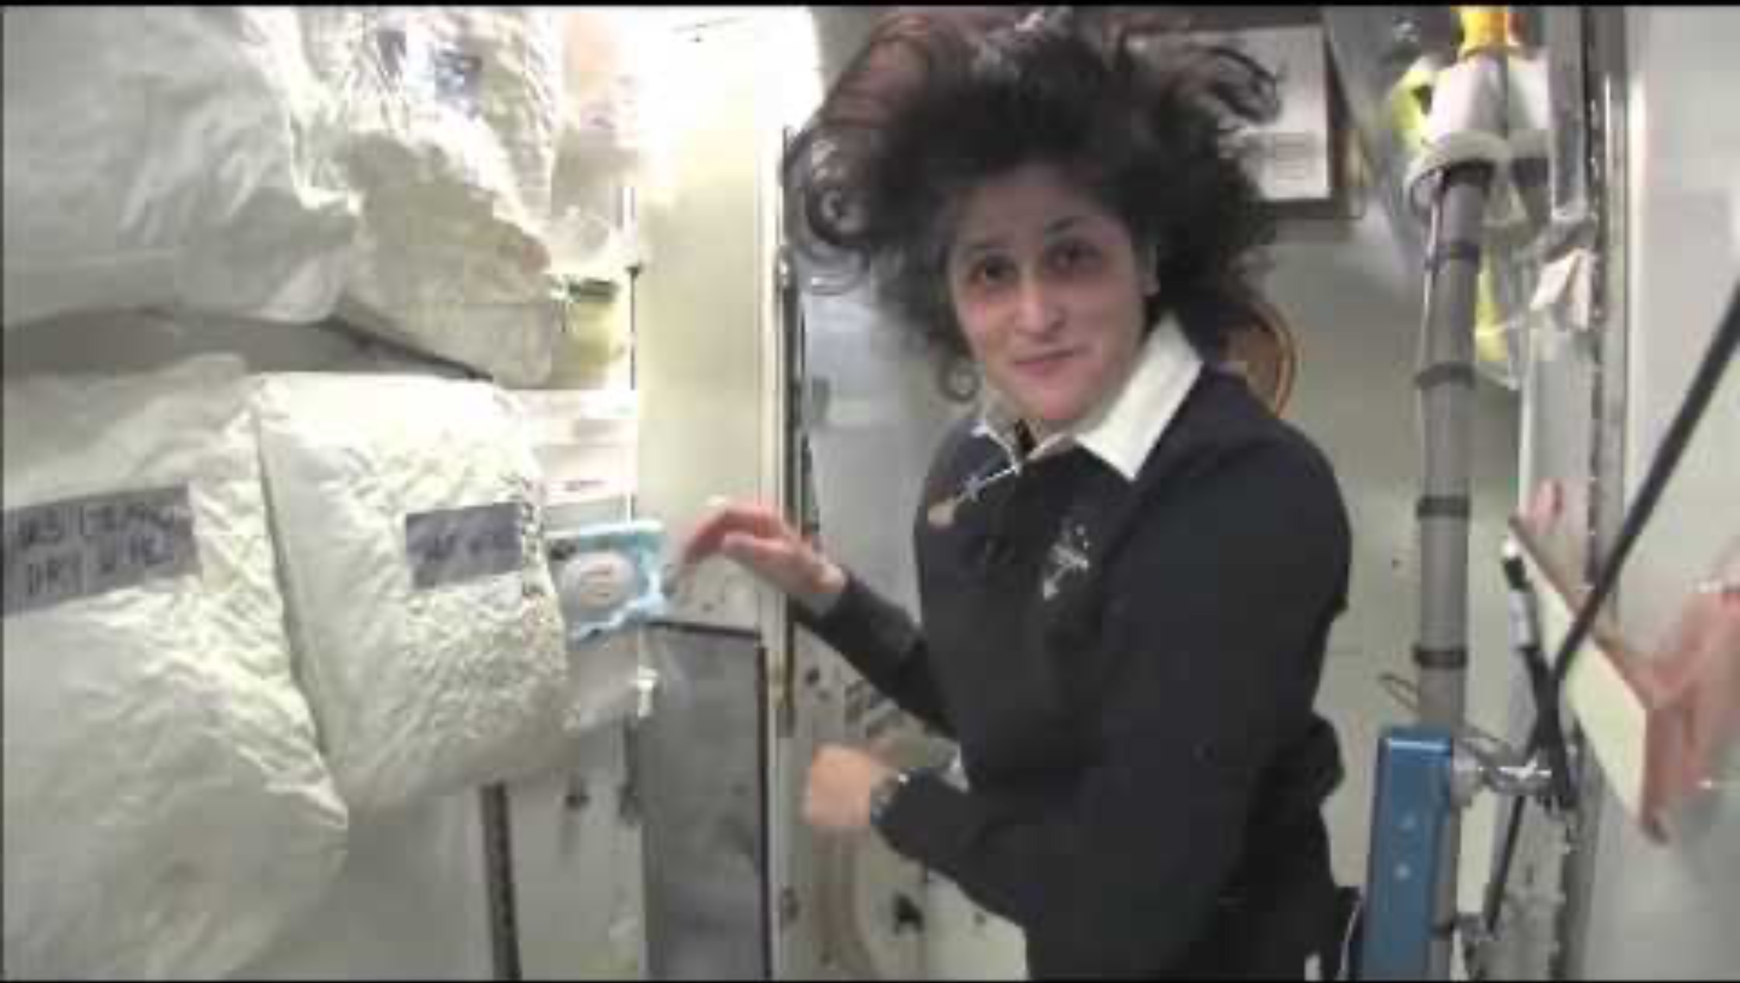
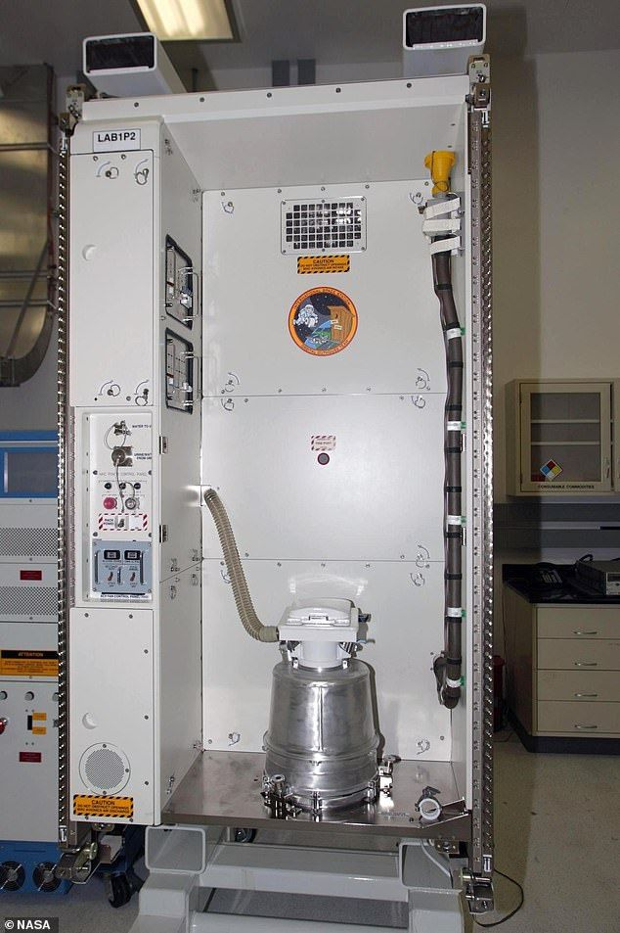
Bathroom
Image: NASA
An example of a toilet on the International Space Station!
Notes:
Teacher Notes (see page 42 in the Teacher Handbook for more details)
Item prompts in Student Workbook: Toilets, showers, sinks

Slide 32
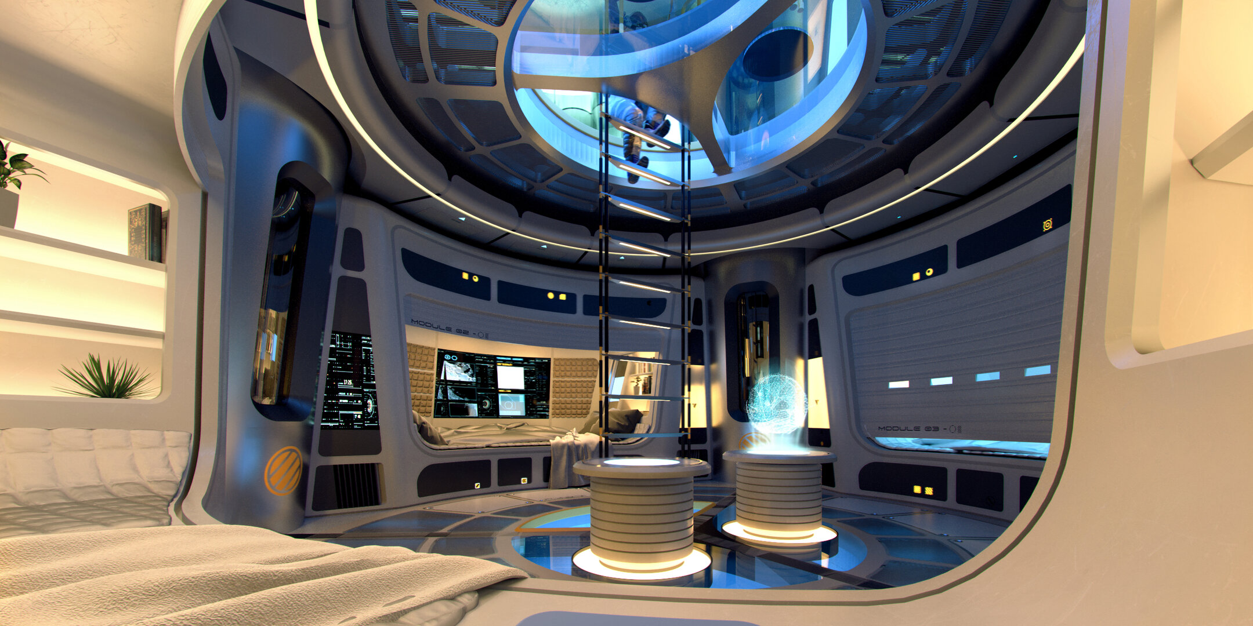
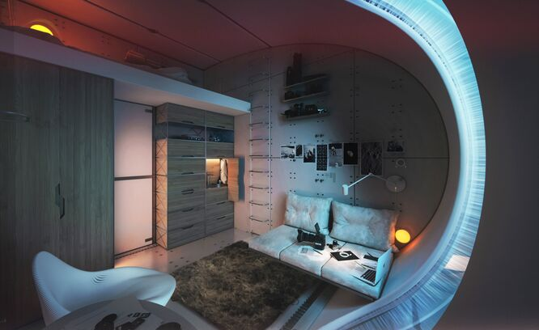
Bedroom
Image: SOM/ESA
Image: Hassell/ESA
Notes:
Teacher Notes (see page 43 in the Teacher Handbook for more details)
Item prompts in Student Workbook: Sleeping bag/covers, mattress, pillows, bed frame, storage space (for clothes, personal items, and other things), sleeping masks and earplugs

Slide 33
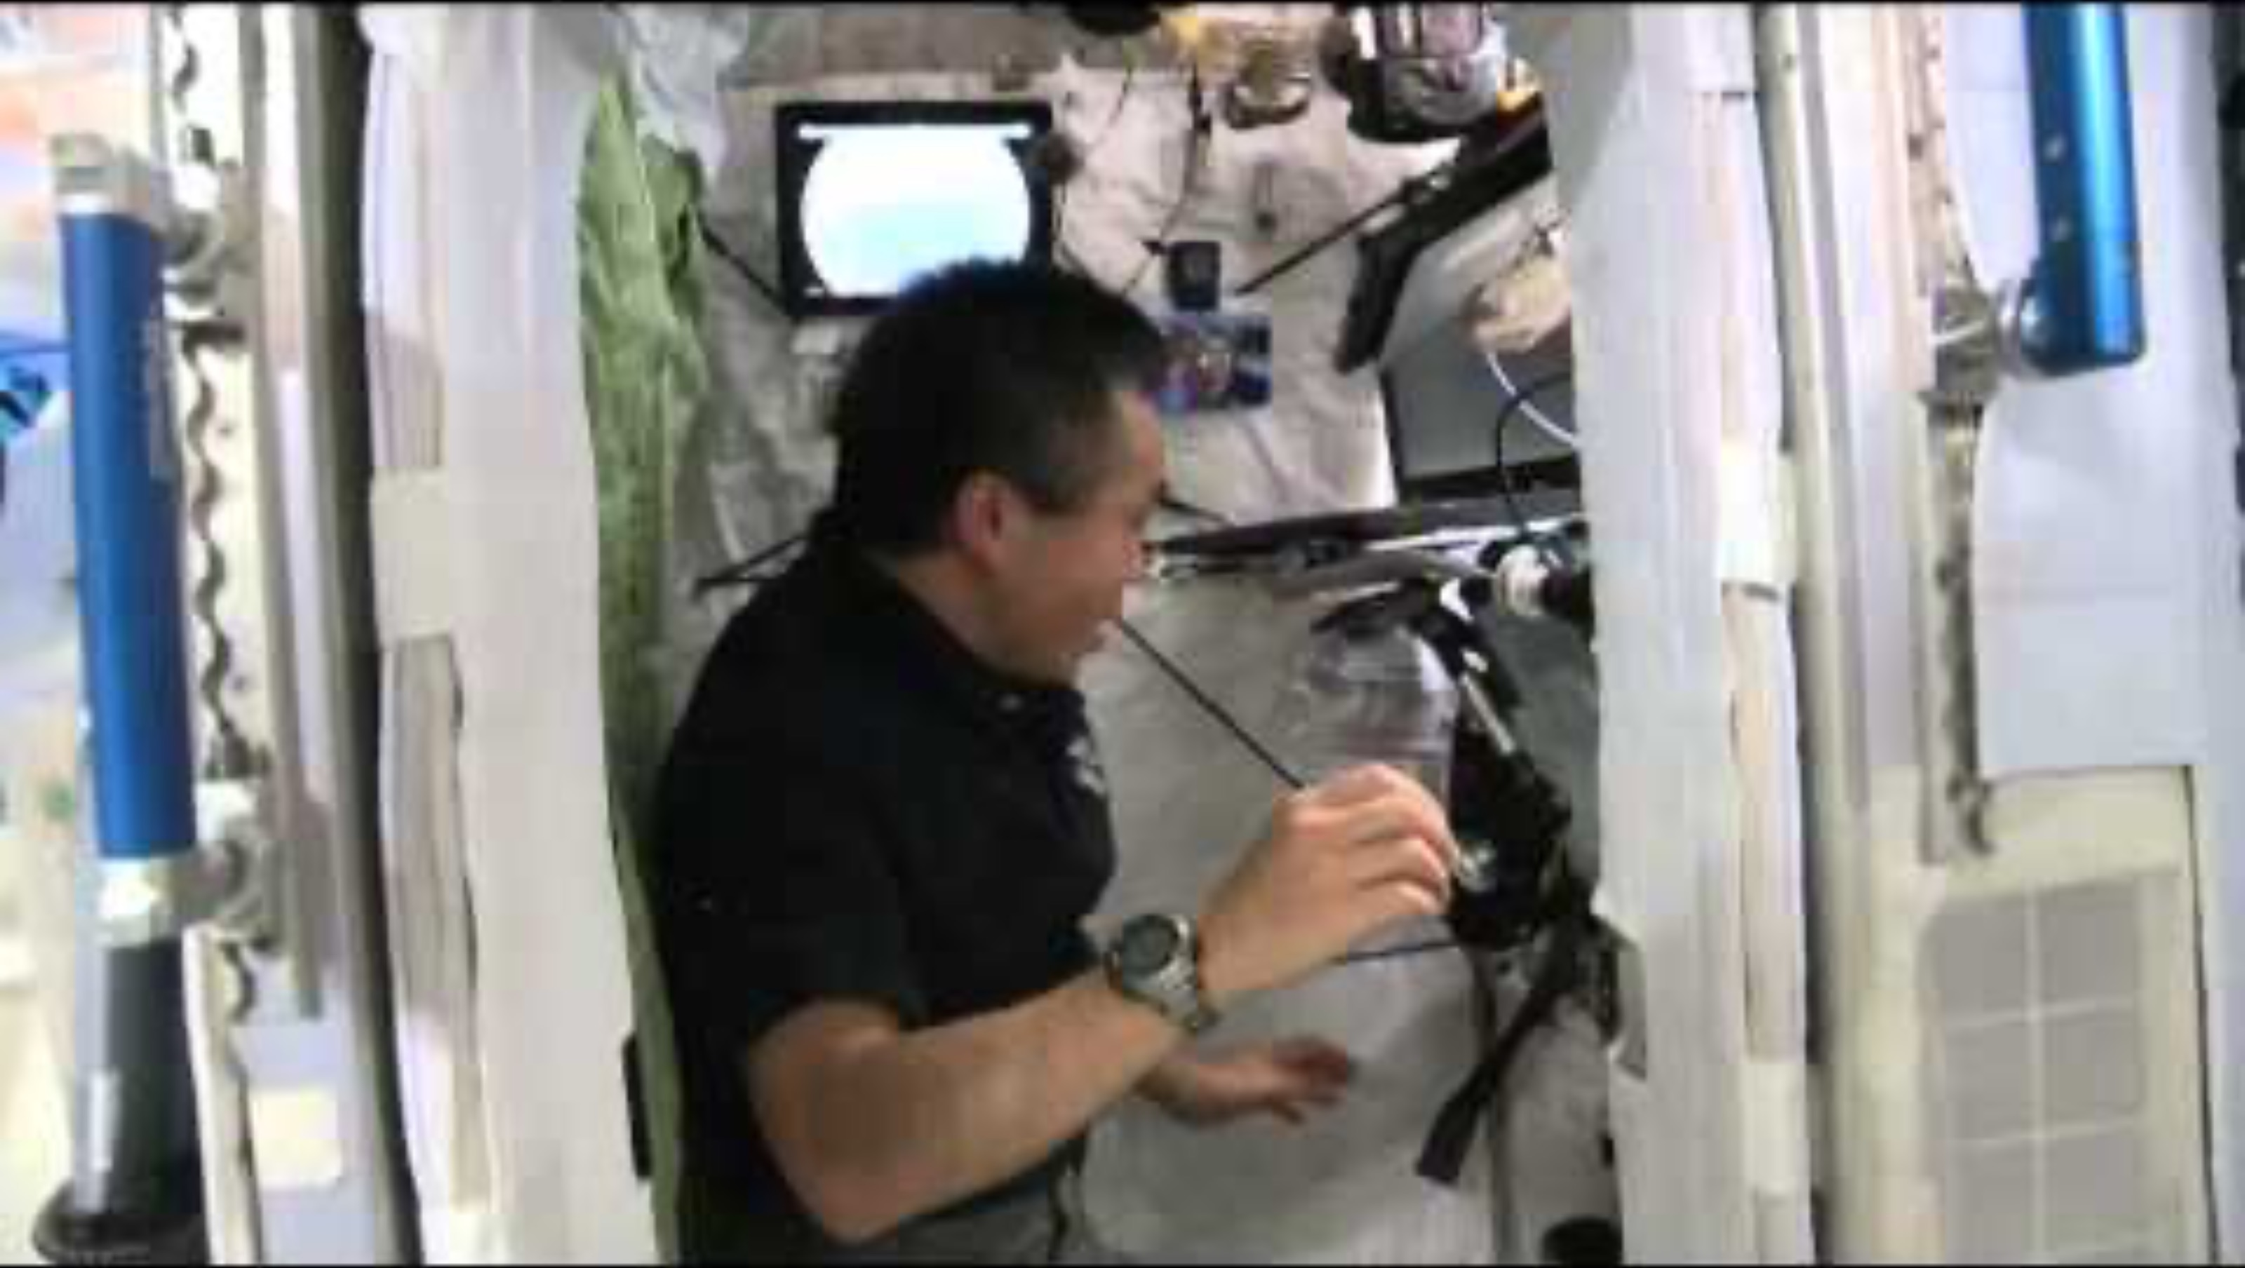
Bedroom on the ISS

Slide 34
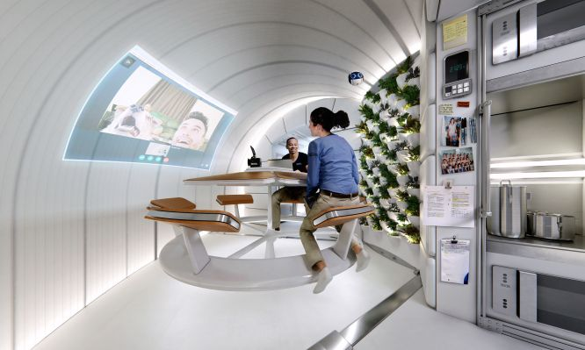
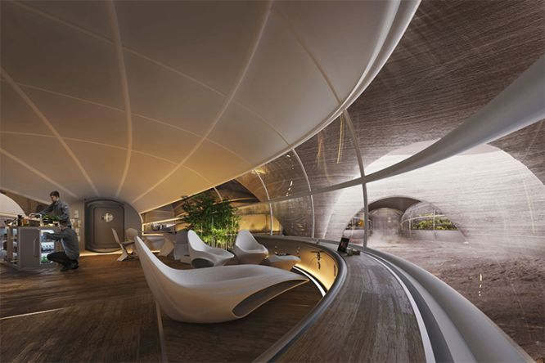
Living Quarters with Kitchen
Images: Hassell/ESA
Notes:
Teacher Notes (see page 43 in the Teacher Handbook for more details)
Item prompts in Student Workbook: Kitchen appliances (like an oven or microwave), kitchen items (like pans, utensils, cutlery, plates, or bowls), tables and chairs, items for entertainment (like TV screens and books)

Slide 35
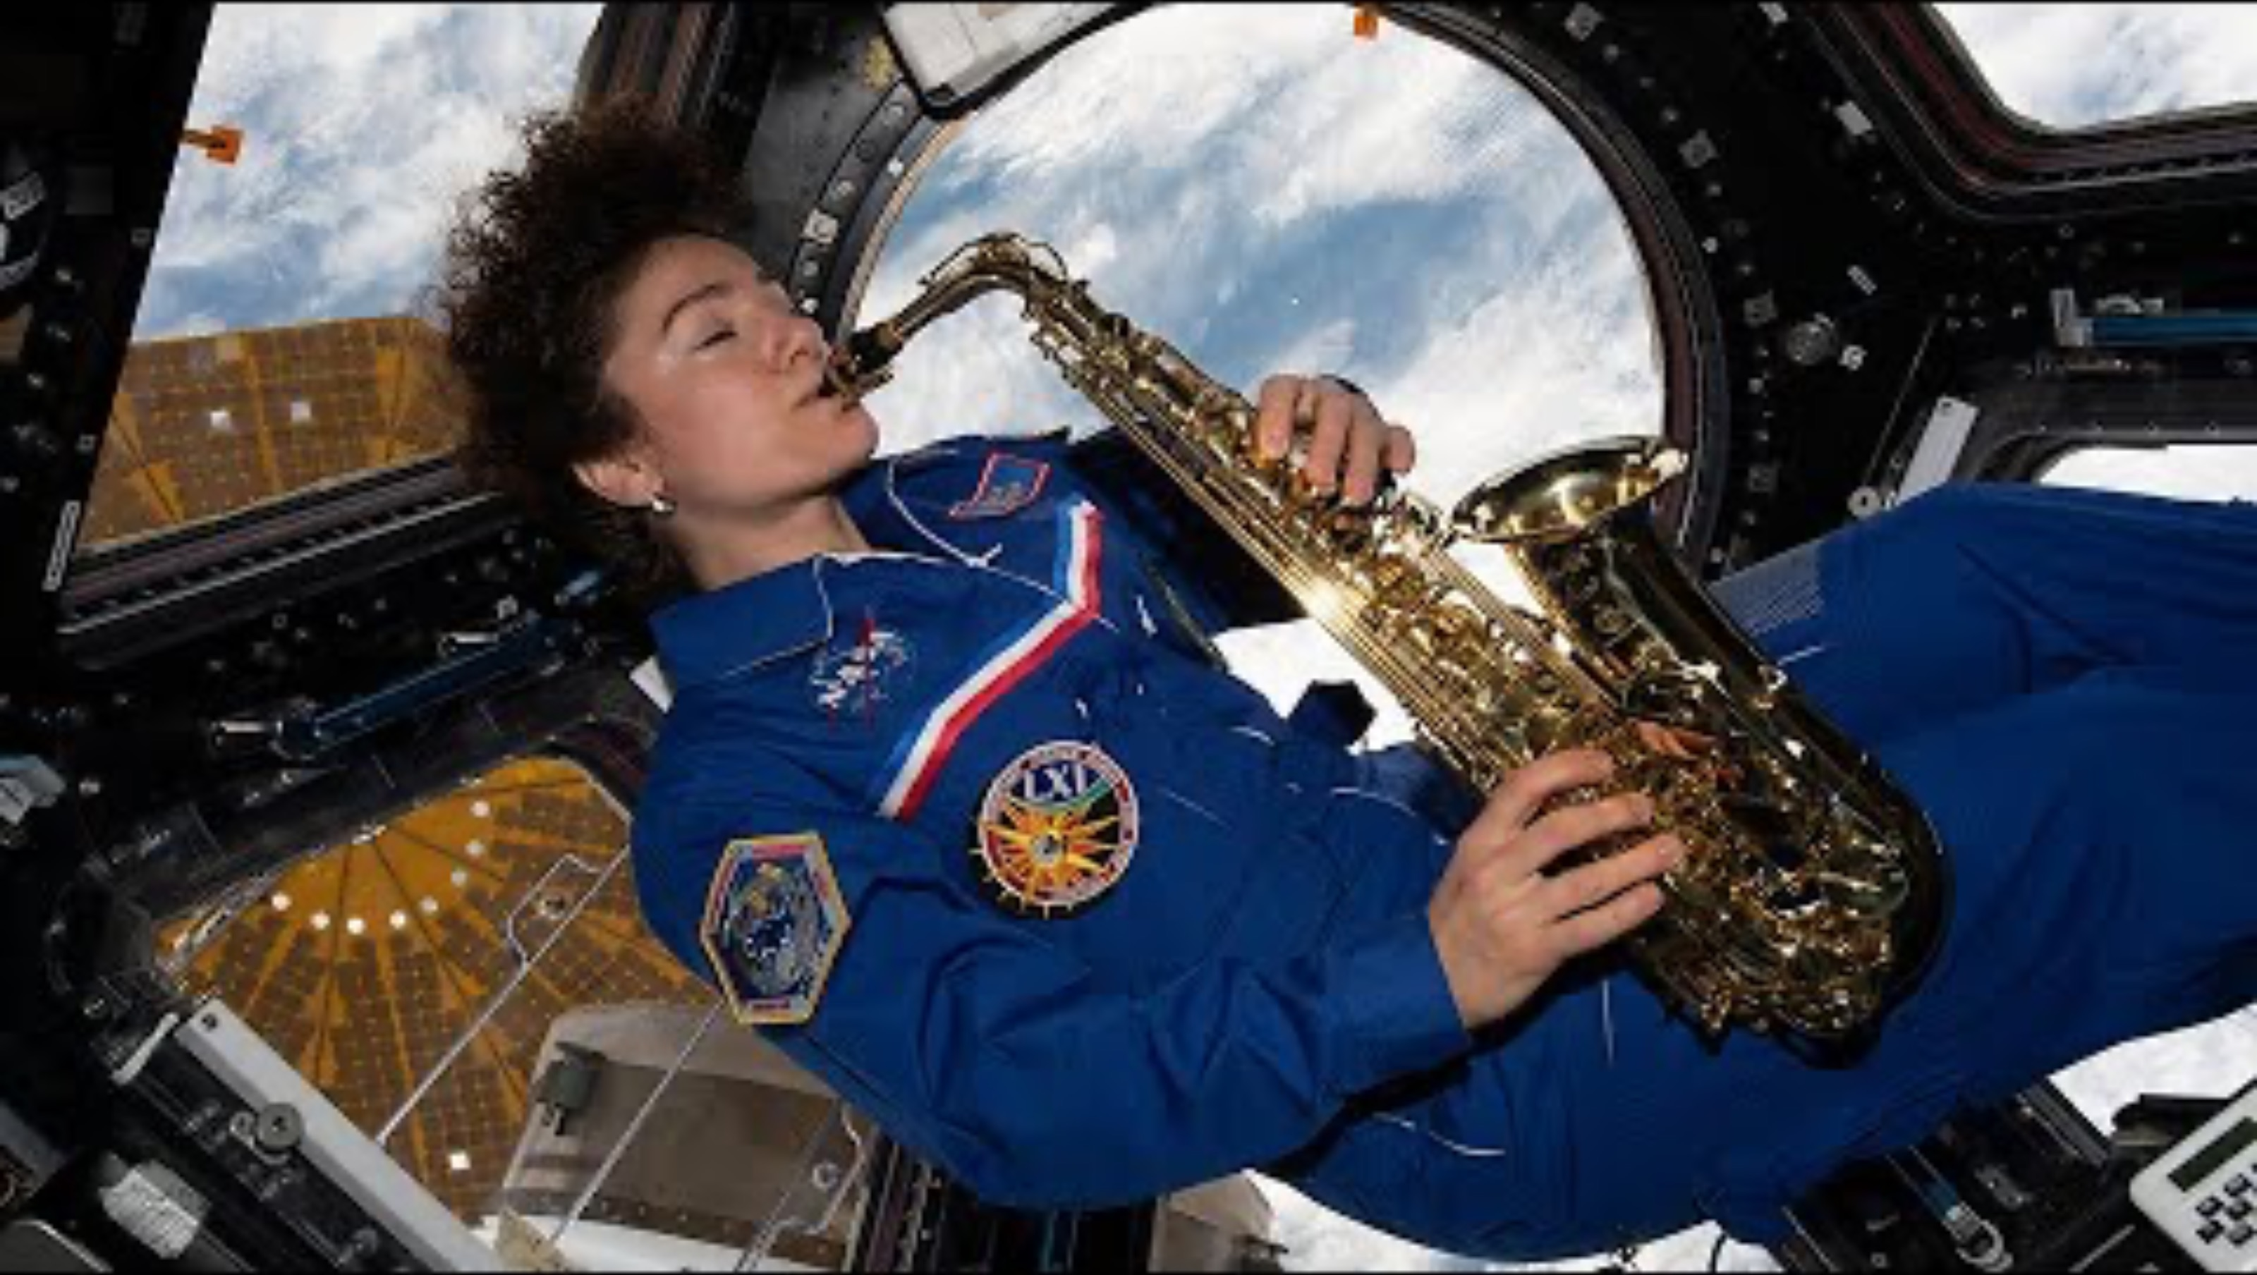
How Do Astronauts Unwind in Space?

Slide 36
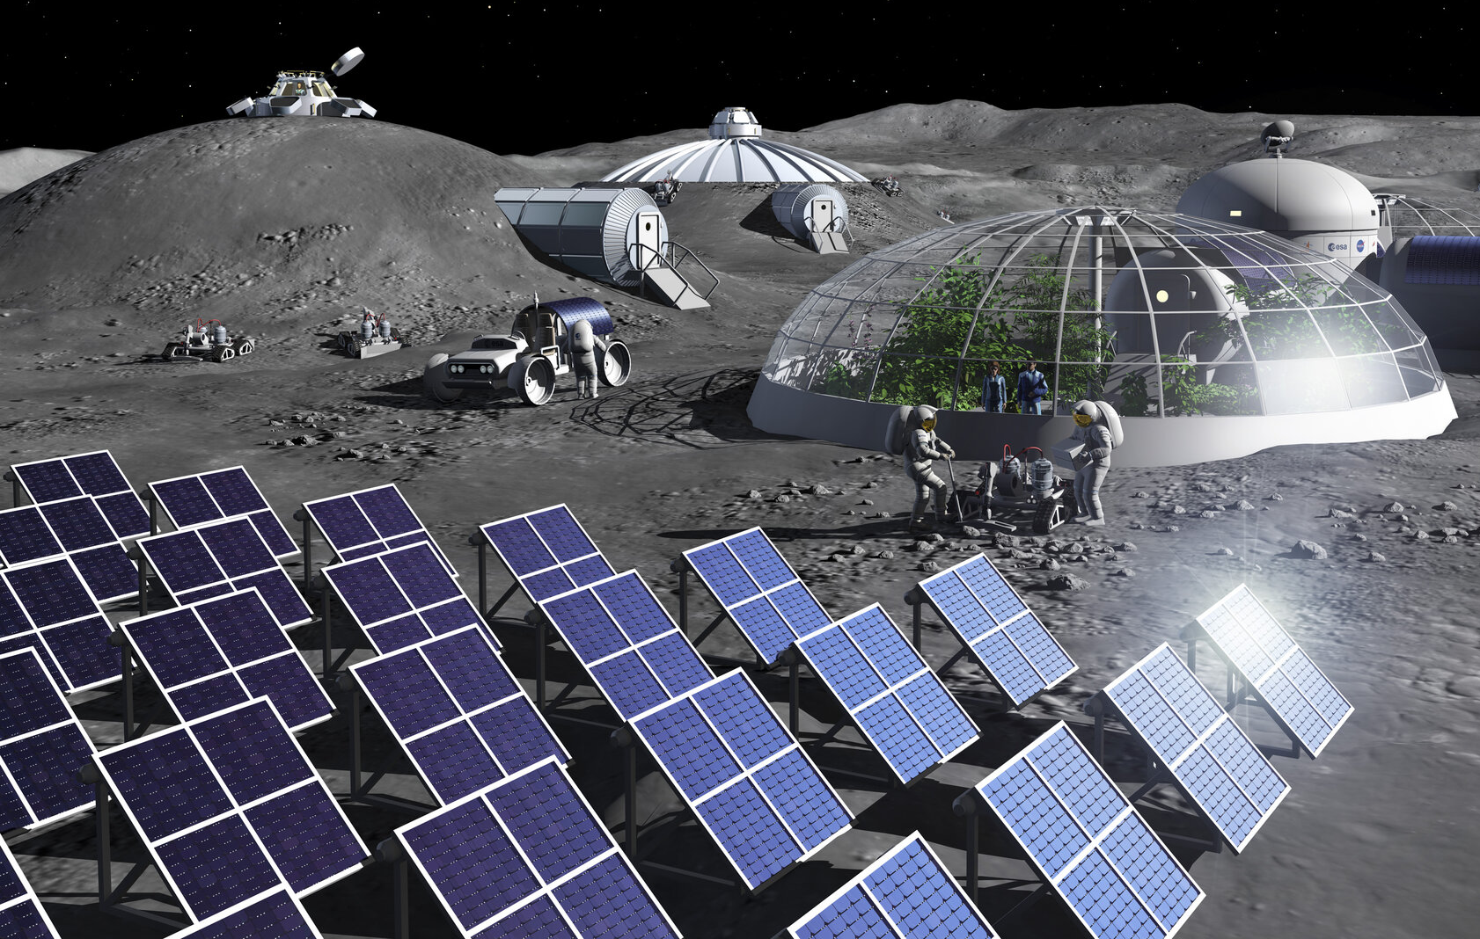
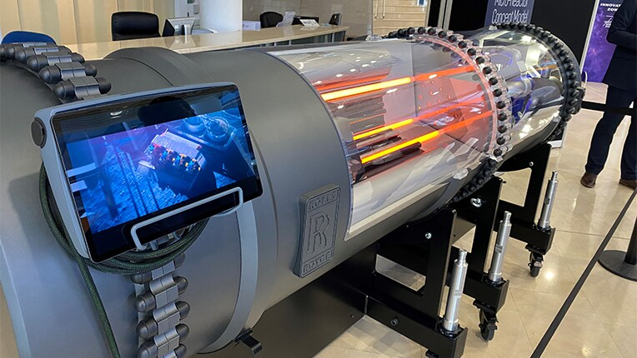
Electricity/Power Supply Room
Image: ESA - P. Carril
Image: Rolls-Royce
Lots of solar panels to generate electricity!
Rolls-Royce are developing a small nuclear reactor that could generate electricity in space!
Notes:
Teacher Notes (see page 44 in the Teacher Handbook for more details)
Item prompts in Student Workbook: Fuel cells/batteries (to store extra electricity), electrical circuits with wires/cables (to transport electricity), solar panels (on the outside of the room), nuclear reactor

Slide 37
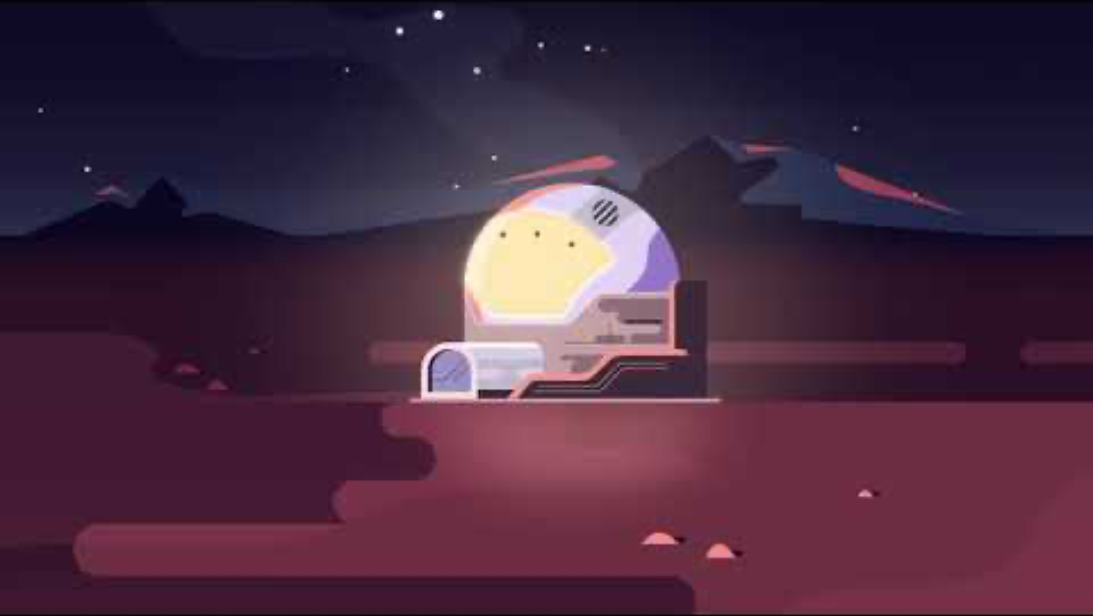
Powering a Moon Base

Slide 38
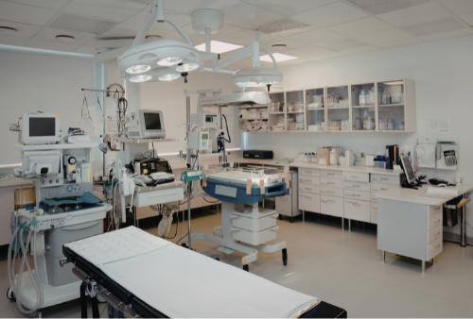
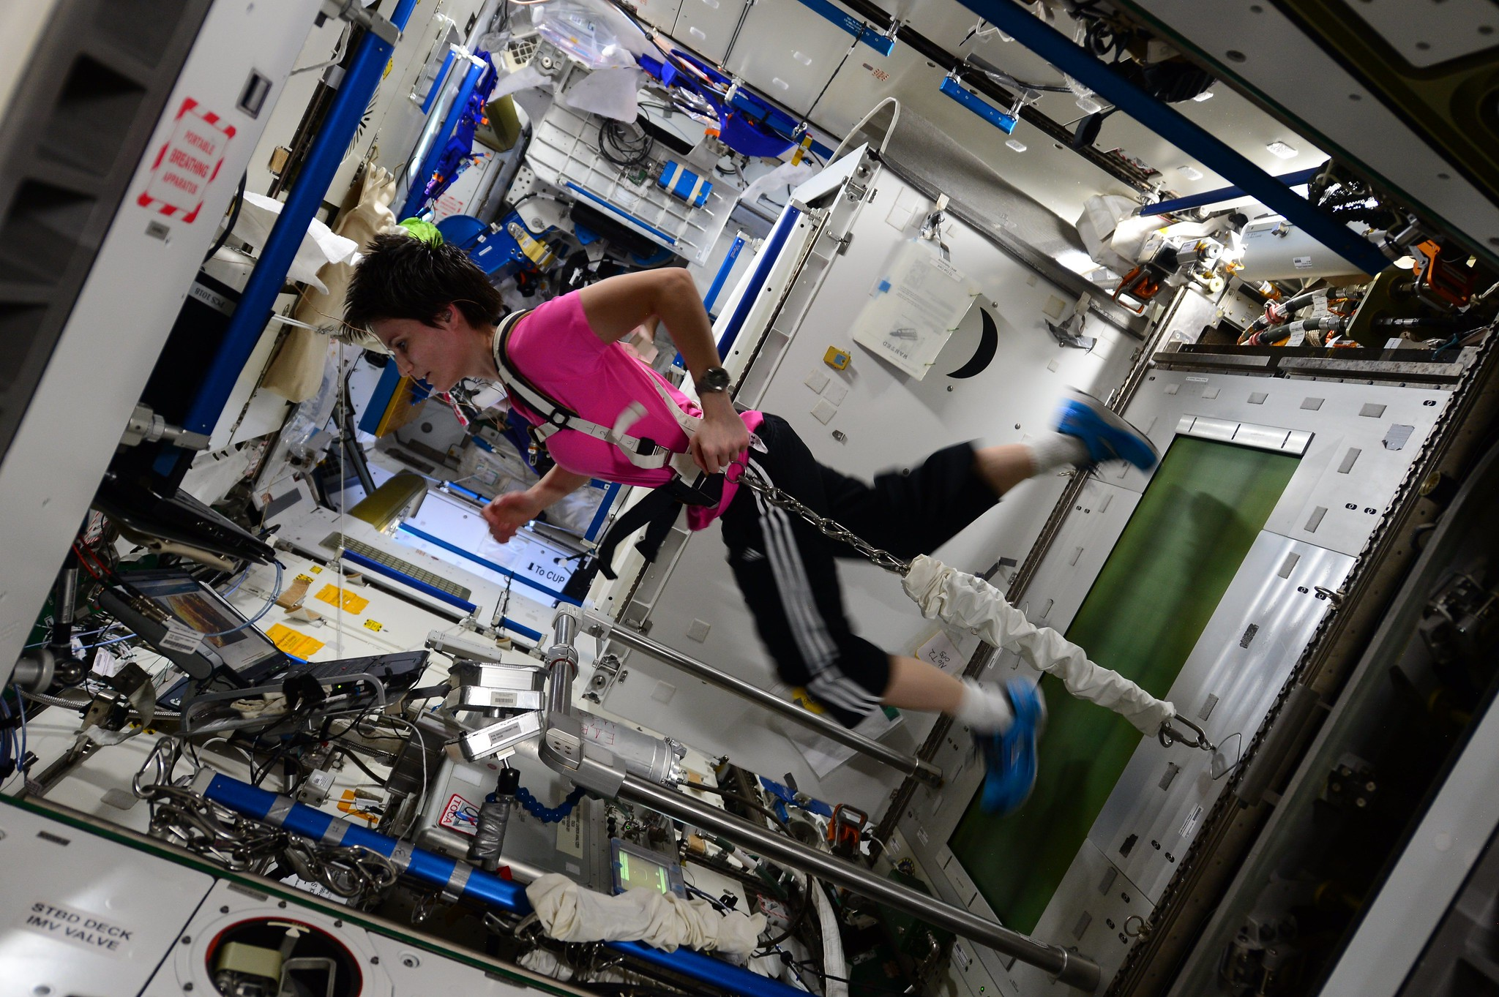
Medical Room with Gym
Image: ESA/NASA
Notes:
Teacher Notes (see page 44 in the Teacher Handbook for more details)
Item prompts in Student Workbook: Medical equipment (like an ultrasound scanner or X-ray machine), medical items (like bandages, gloves, needles, or thermometers), medicines (like painkillers or antibiotics), exercise equipment (like treadmills, weights, or rowing machines)

Slide 39
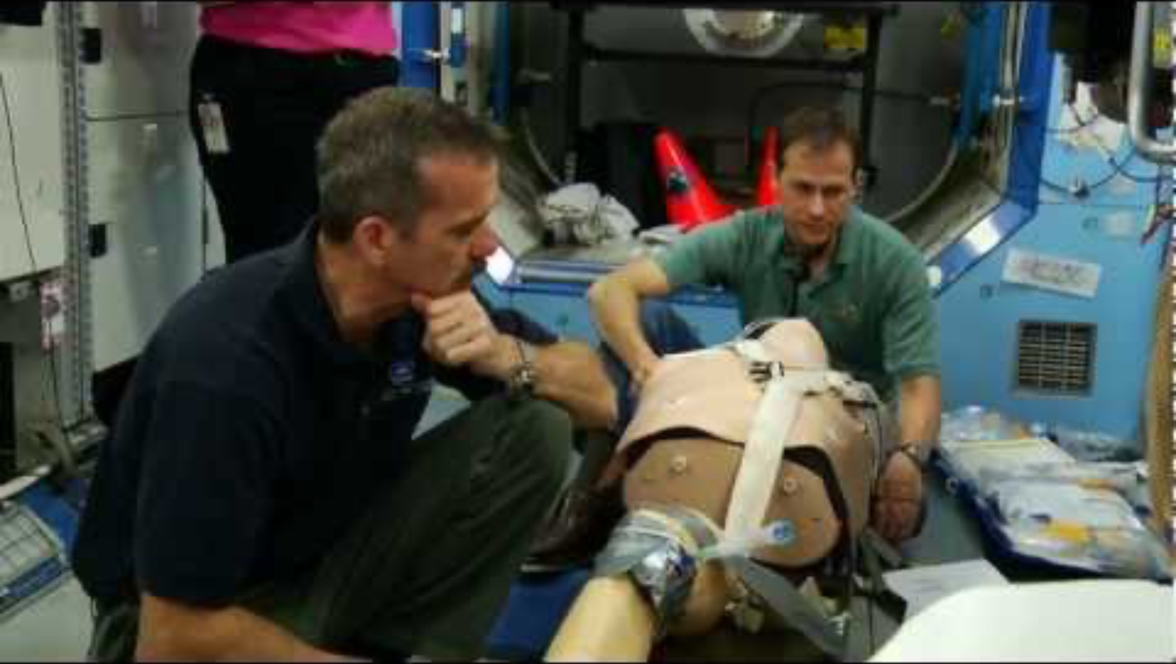
Training for Medical Emergencies

Slide 40
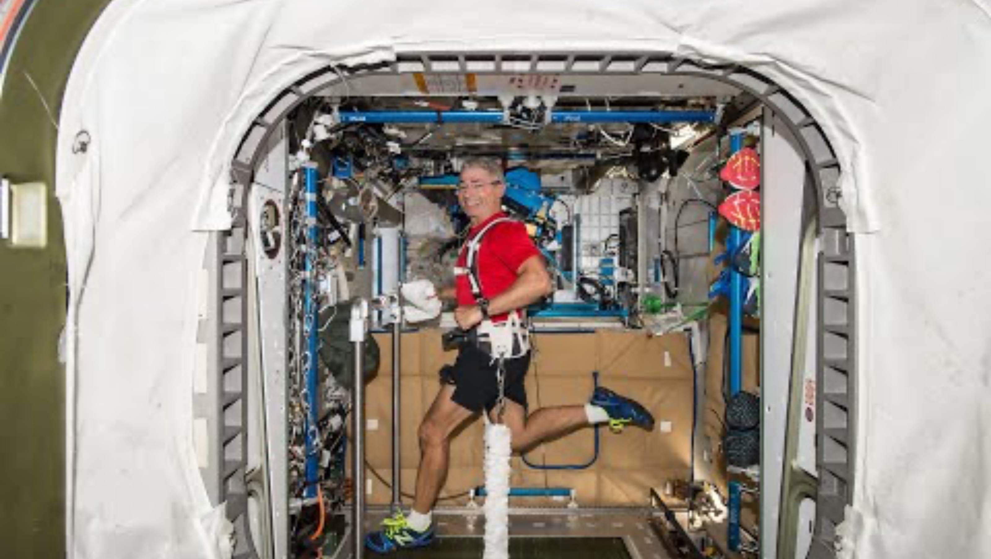
How Do Astronauts Exercise in Space?

Slide 41
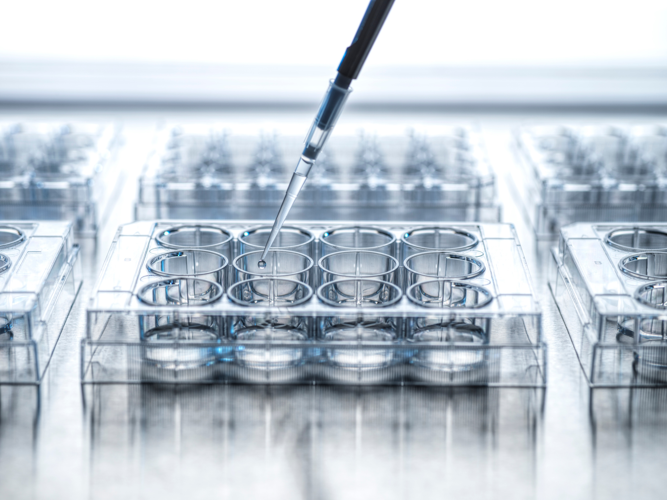
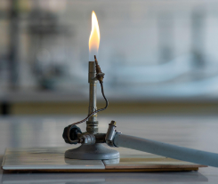
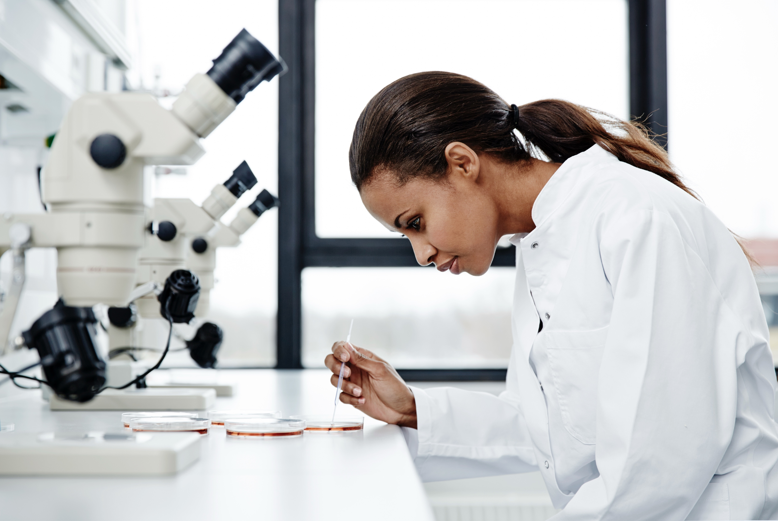

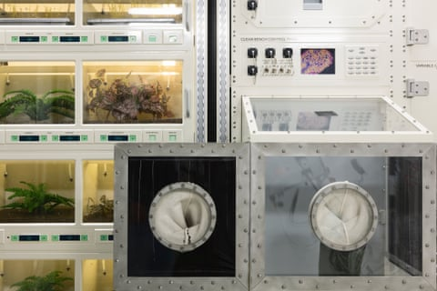
Science Lab
Image: NASA/ASI
Notes:
Teacher Notes (see page 45 in the Teacher Handbook for more details)
Item prompts in Student Workbook: Microscope, glassware (like beakers, flasks, and test tubes), glass slides (for looking at samples under a microscope), measuring cylinders, funnels, Bunsen burner, safety goggles and gloves, tweezers or forceps, droppers or pipettes, mixing rods, thermometers, stopwatches or timers, scales for measuring mass, notebooks for recording information/data

Slide 42
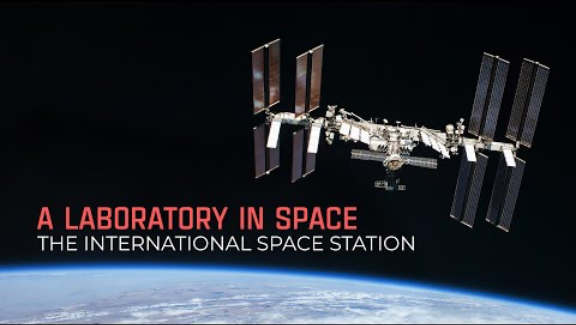
A Laboratory in Space

Slide 43
What next?
Now you know what resources humans need to survive and how we can get these in space! This means we can survive travelling to Mars and staying on the planet.
In the next investigation, you’ll learn how we can use robot rovers to help us explore the surface of Mars!

