Slide 1

Investigation 5
Why does Mars change size?
Career Link:
Astronomer

Slide 2
Introduction to your Mission
Now that we know how to stay healthy in space, and how we can live and work on the surface of Mars, we need to work out how to get there!
In this mission, you will be an astronomer. Your job is to explore our Solar System and find out why Mars appears to change size in the sky when we look at it from Earth.
First, we need to understand where Mars sits in the Solar System…
Notes:
STEM Professional Notes (see pages in the STEM Professional Handbook for more details)
Link to previous investigation: Students learned how the human body reacts in environments different to Earth and how to mitigate negative changes. This will enable them to keep healthy during when travelling to Mars and when they live on the planet. Now, this investigation will explore the movements of planets in our Solar System and help us understand why this is important when considering our journey to Mars.
Link to overall Mars project: Students have learned how they can live and work in environments off-Earth. We now need to think about our journey to Mars. Mars appears to change size in the sky when we look at it from Earth. Understanding why these changes happen is crucial to our mission – it could affect our plans of getting to the planet.

Slide 3
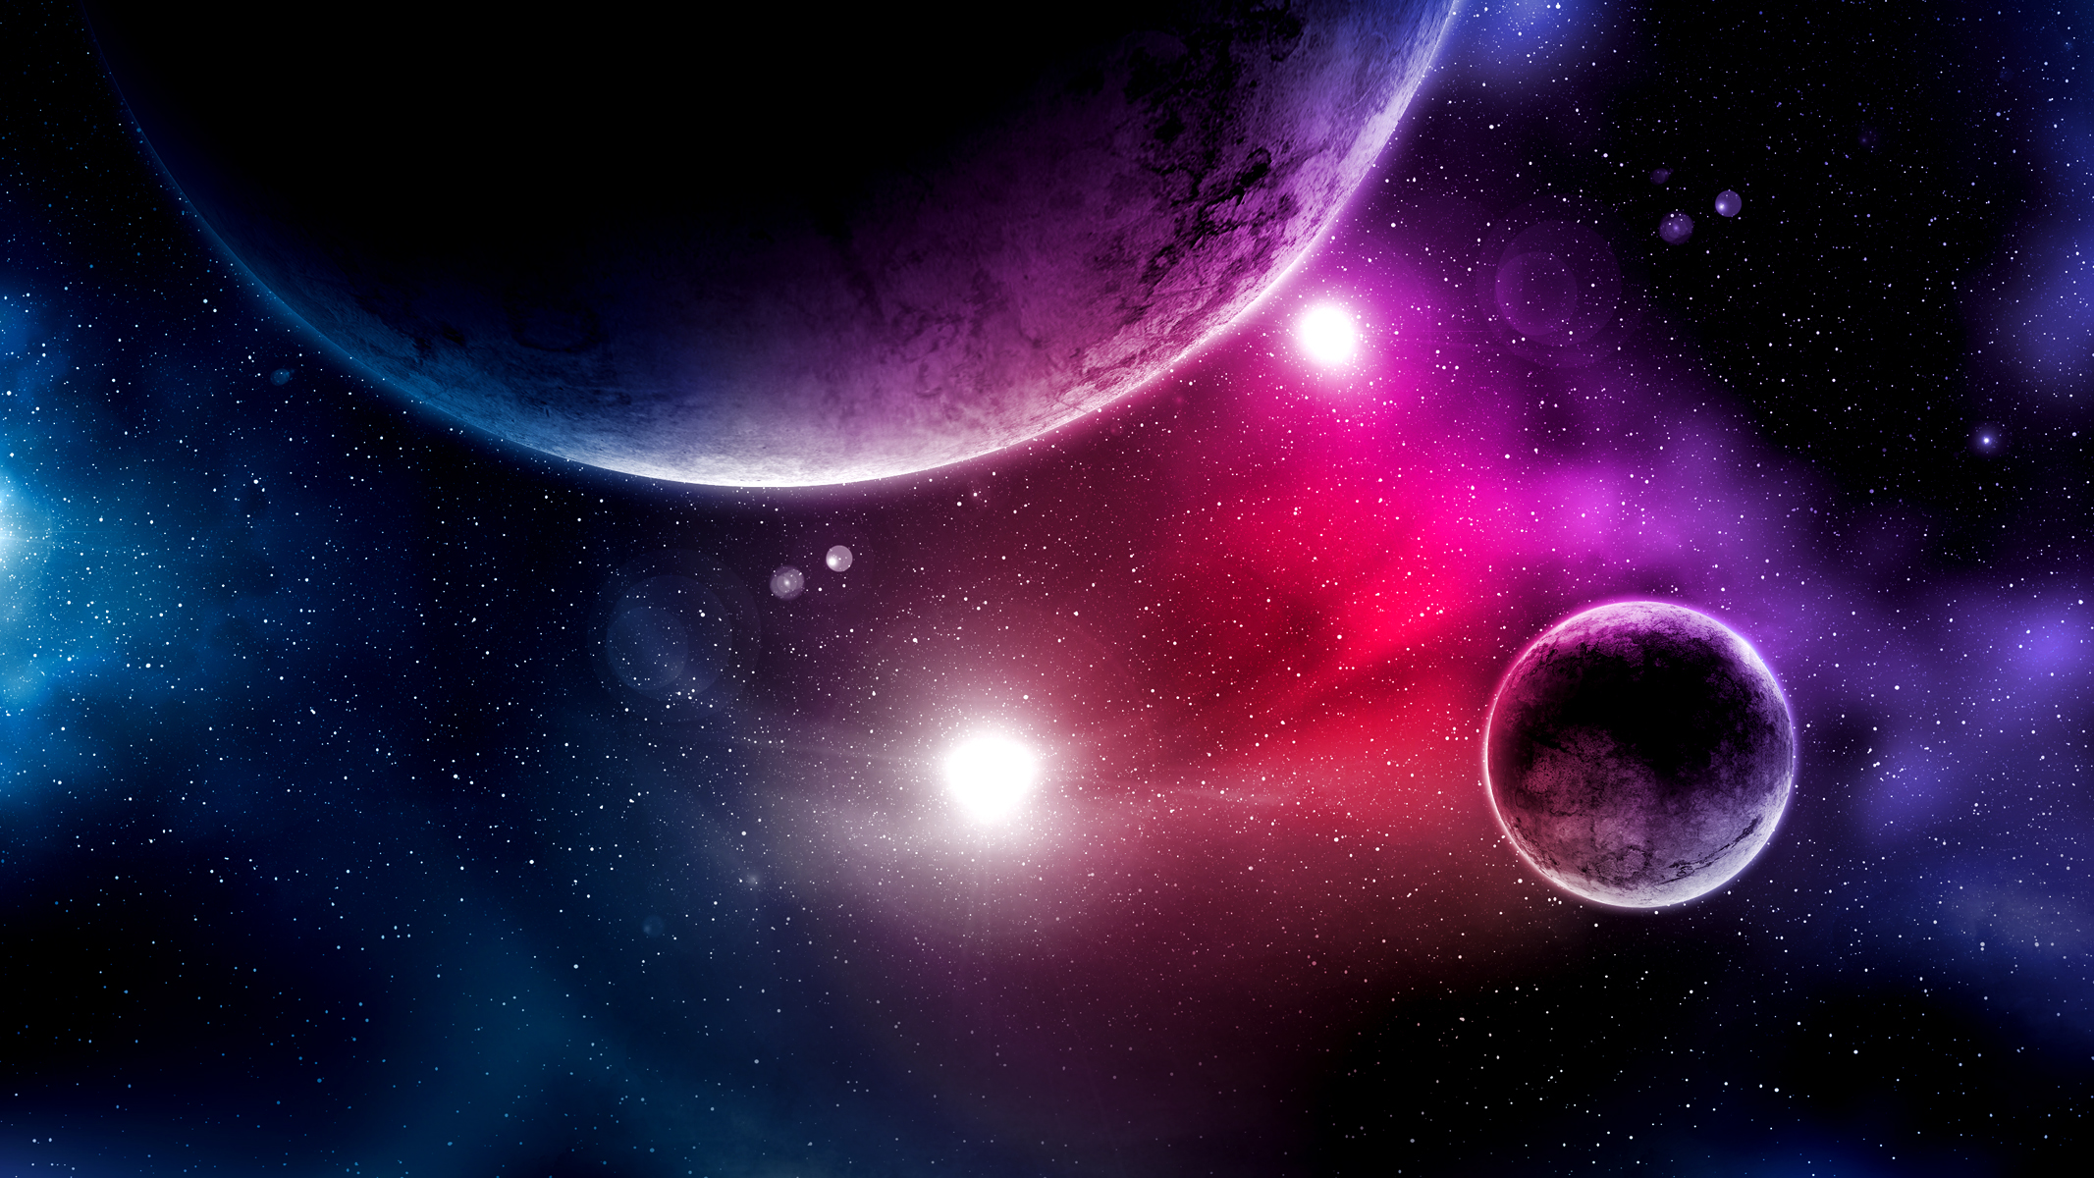
Activity 1: Order the Planets

Slide 4
Order the Planets
The planets are large, spherical objects that move around the Sun. But they are all positioned at different distances from it.
Name the planets in order of distance (near to far) from the Sun:
1. Mercury
2. Venus
3. Earth
4. Mars
5. Jupiter
6. Saturn
7. Uranus
8. Neptune
Student Workbook: page 54
Notes:
STEM Professional Notes (see pages in the STEM Professional Handbook for more details)
Ask students if they know the names of any planets in the Solar System. Select some to share their answers.
Students then need to write the order of the planets in their workbooks.
Click through the animations to show the correct order. Mention that beyond Neptune there are also some dwarf planets, including Pluto.
Note: there is also a dwarf planet in the asteroid belt called Ceres – but only mention this if a students does. For the sake of the next activity, we will just have ‘Dwarf Planets’ listed at the orbit of Pluto.

Slide 5
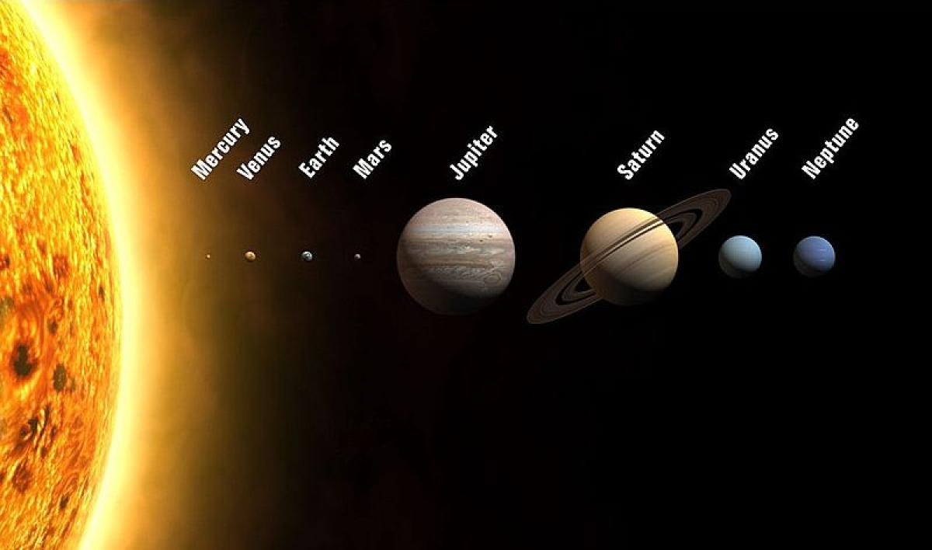
Our Solar System
Notes:
STEM Professional Notes (see pages in the STEM Professional Handbook for more details)
You could show this image and discuss the size of the planets in comparison to each other, especially if some students have talked about which planets are larger than others.

Slide 6
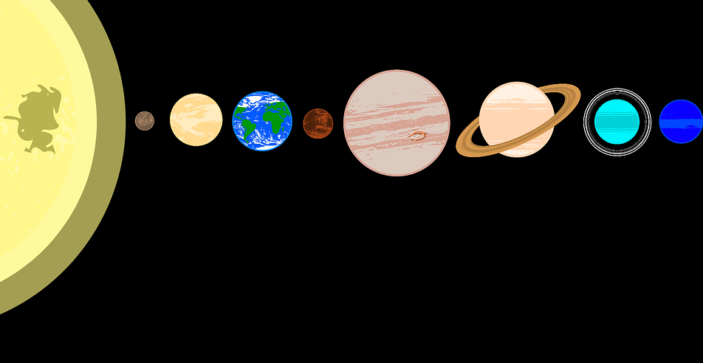
Activity 2: Map the Solar System
Notes:
STEM Professional Notes (see pages in the STEM Professional Handbook for more details)
The steps for this activity are given on slides 7 – 14 along with reference images. Students might find these useful to refer to as they work through the activity.
If any students lack confidence with writing or spelling (ask your class teacher about this), give them the planet stickers to use instead.

Slide 7
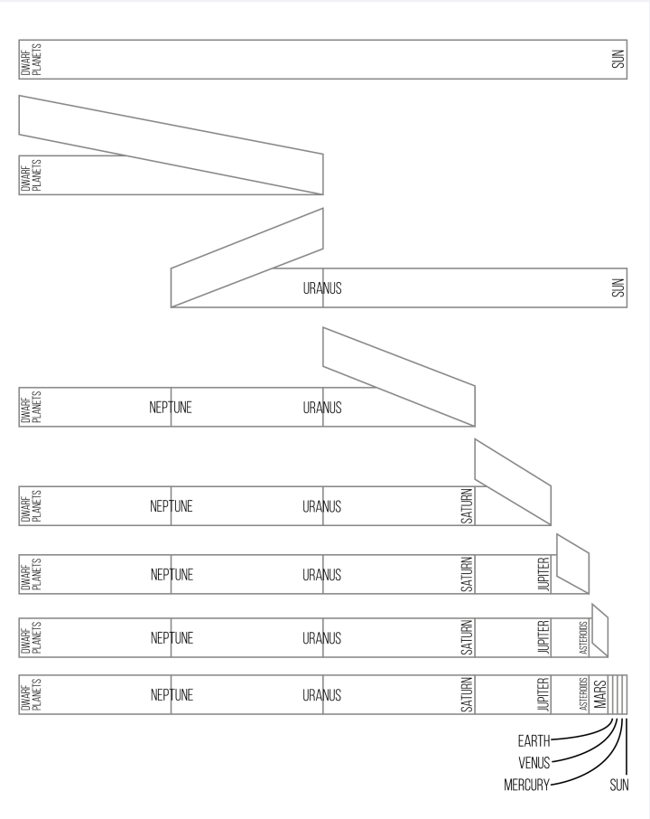
Map the Solar System
Step 1: Hold the paper out with the Dwarf Planets end on the left and the Sun on the right.

Slide 8
Step 2: Fold the paper in half and write Uranus on the crease.
URANUS

Slide 9
Step 3: Fold the paper from Dwarf Planets up to Uranus. Write Neptune on the crease.
NEPTUNE
URANUS

Slide 10
Step 4: Fold the paper from the Sun up to Uranus. Write Saturn on the crease.
NEPTUNE
URANUS
SATURN

Slide 11
Step 5: Fold the paper from the Sun up to Saturn. Write Jupiter on the crease.
NEPTUNE
URANUS
SATURN
JUPITER

Slide 12
Step 6: Fold the paper from the Sun up to Jupiter. Write Asteroid Belt on the crease.
NEPTUNE
URANUS
SATURN
JUPITER
ASTEROID BELT

Slide 13
Step 7: Fold the paper from the Sun up to the Asteroid Belt. Write Mars on the crease.
MARS
NEPTUNE
URANUS
SATURN
JUPITER
ASTEROID BELT

Slide 14
Step 8: Write Mercury, Venus, and Earth evenly in the space between the Sun and Mars. Write them in the correct order with Mercury closest to the Sun.

Slide 15

Your scale
Scale means…
…the relationship between a distance on a map and the matching distance in real life.
Note the scale size of your Solar System map:
Student Workbook: page 55
1 mm = 10 Million km
10 Million
Notes:
STEM Professional Notes (see pages in the STEM Professional Handbook for more details)
The scale is approximate and each students will be slightly different, but for the representation of this map an approximate value is fine.

Slide 16
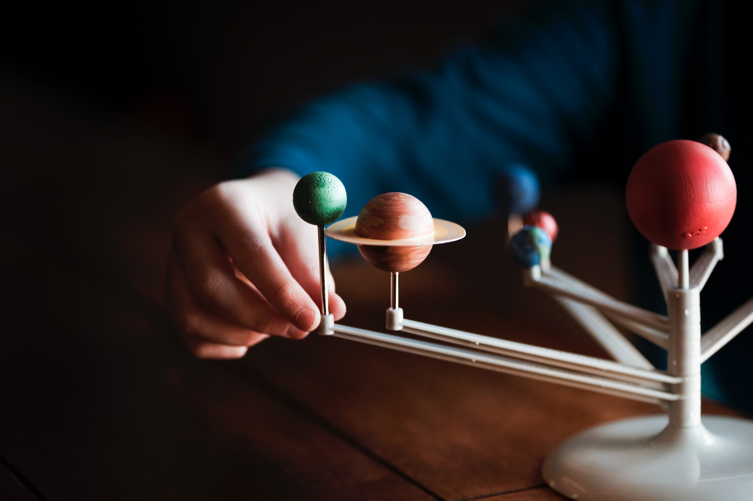
Activity 3: Planetary Motion

Slide 17

Orbits
All of the planets orbit around the Sun which lies at the centre of the Solar System
Our map shows them in a straight line to the distances between the orbits
But planets do not stay in a straight line as they move around the Sun…
Notes:
STEM Professional Notes (see pages in the STEM Professional Handbook for more details)
Explain that while pictures of the Solar System - and the map we’ve created - show the planets in a straight line, this isn’t how things look in real life.
Each planet moves around the Sun repeatedly in a path. This is called an orbit. As the planets orbit, they don’t stay lined up.

Slide 18
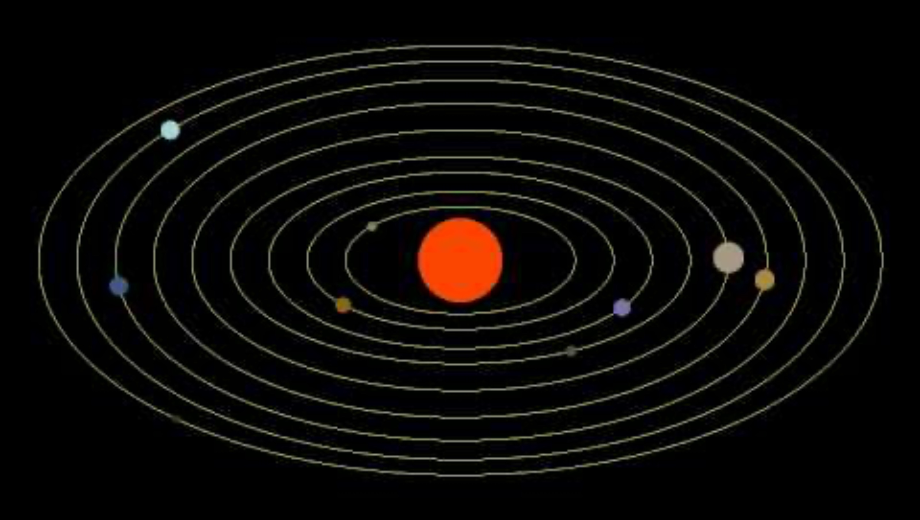
Notes:
STEM Professional Notes (see pages in the STEM Professional Handbook for more details)
This is a video showing how much the planets move over 4 years – you can see that the outer planets barely seem to move at all, whilst the inner planets make multiple orbits during this time.
If we were to speed this up and extend it for more time, the movement of the outer planets would be more obvious, but the inner ones would be moving so quickly that it would be hard to keep up!
The orbits are also oval shaped. This means the distance between a planet and the Sun constantly changes during its orbit, though these differences may be smaller for some planets (with less oval shaped orbits) compared to others.

Slide 19
Complete the sentences using the words in the box:
An ___________ is a regular, repeating path that one object takes around another. The ________ is at the centre of our Solar System, and the ___________ orbit around it. The paths of the planets are ________ shaped.
Student Workbook: page 55
planets
orbit
oval
Sun

Slide 20
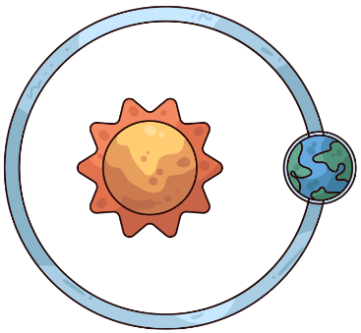
Earth’s Orbit
Earth’s orbit is almost a perfect circle
This means its distance from the Sun doesn’t change much
Earth is around 149 million km from the Sun
Notes:
STEM Professional Notes (see pages in the STEM Professional Handbook for more details)
Because Earth’s orbit is much less oval shaped than Mars’s orbit, the distance between the Sun and Earth’s orbit doesn’t change very much. This is why only 1 distance (149 million km) is given.

Slide 21
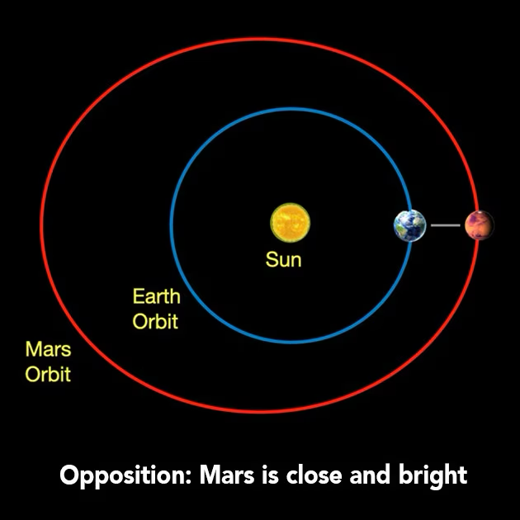
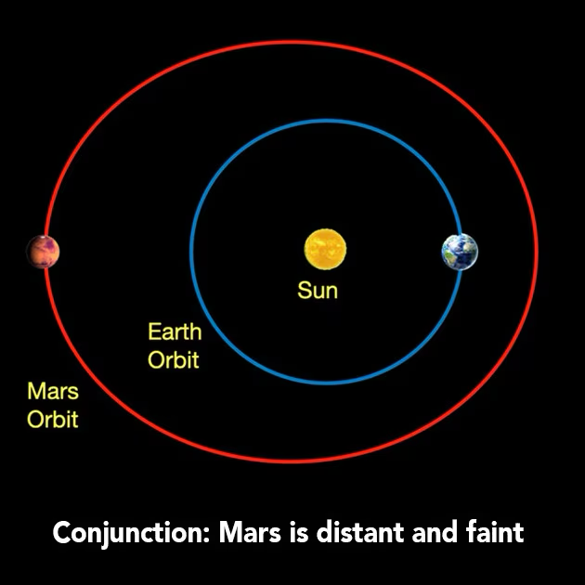
Mars’s Orbit
Mars’s orbit is oval shaped
This means its distance from the Sun (and Earth) changes a lot
Mars can be around 204 million km to 247 million km from the Sun
Images: NASA
Notes:
STEM Professional Notes (see pages in the STEM Professional Handbook for more details)
Mars’s orbit is much more oval shaped, so the distance between the Sun and Mars’s orbit changes a lot. This is why 2 distances (204 million km and 247 million km) are given – the closest and furthest points of the orbit.
The distance between Earth and Mars changes due to their orbits. The first image shows the planets on the same side of the Sun. They have lined up in their orbits and are close to each other.
Click to show the second image. At this point in their orbits, the planets are on opposite sides of the Sun, so are further away from each other.
However, even if Earth was on the same side as Mars, the distance between them is still larger than the distance in the previous example (first image).
This is due to the shape of Mars’s orbit.

Slide 22
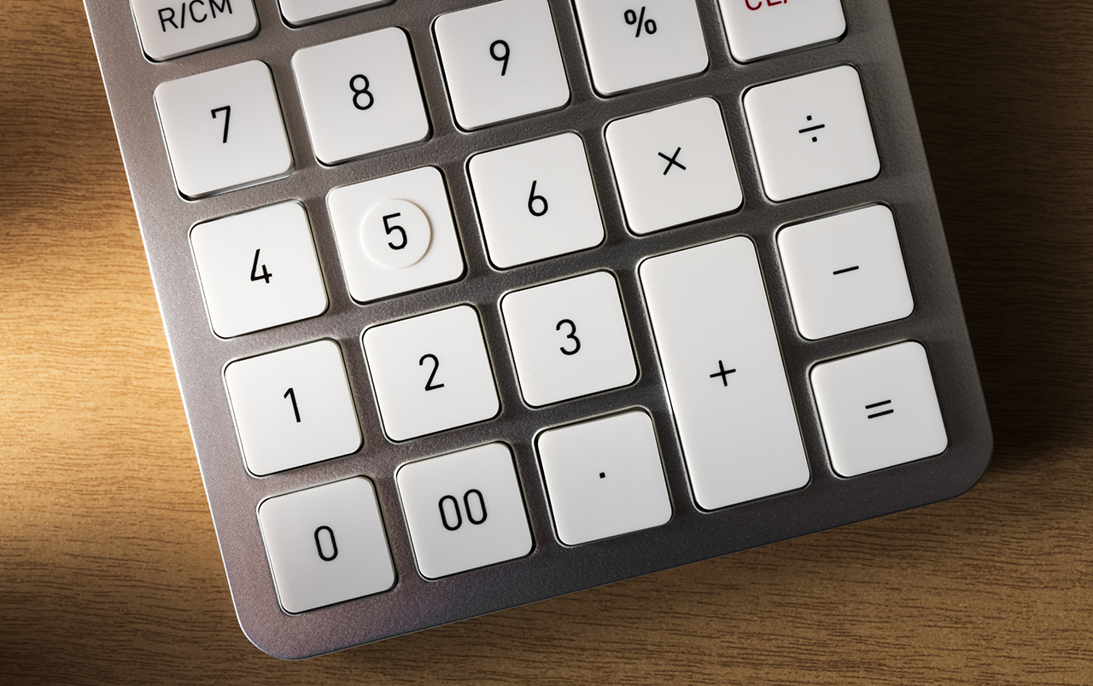
Activity 4: Orbit Maths

Slide 23
Orbit Maths
Student Workbook: page 56 – 57
Distance from the Sun to:
Earth’s orbit – 149 million km
Mars’s orbit (closest) – 204 million km
Mars’s orbit (furthest) – 247 million km
Complete the questions in your workbooks!

Slide 24
Calculate the shortest distance between Earth and Mars.
Mars’s closest orbit – Earth’s orbit = Shortest distance
(million km) (million km) (million km)
204
149
55
–
=
Student Workbook: page 56
55 million km
=

Slide 25
Calculate the longest distance between Earth and Mars.
Mars’s furthest orbit + Earth’s orbit = Longest distance
(million km) (million km) (million km)
247
149
396
+
=
Student Workbook: page 56
396 million km
=

Slide 26
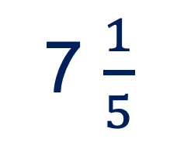
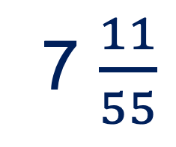
Calculate how much further away Mars is at its longest distance from Earth compared to its shortest distance. Give your answer as a decimal.
Longest distance ÷ Shortest distance = How many times further away
(million km) (million km)
7 $\frac{11}{55}$
396
÷
55
=
Student Workbook: page 57
7 $\frac{1}{5}$
=
=
7.2

Slide 27
Lastly, round your answer to the nearest whole number.
7.2
7
Student Workbook: page 57

Slide 28

Still very far away!
55 million km = 34 million miles
The same as…
…travelling to the Moon over 70 times!
…walking around the whole of the Earth 1372 times!
…travelling to Australia and back around 1900 times!
Notes:
STEM Professional Notes (see pages in the STEM Professional Handbook for more details)
Highlight the difference between the longest and shortest distances. It would take longer to reach Mars if it was further away from us. This is why we need to consider where each planet is in its orbit when planning our trip to Mars. Students will explore this further in the next investigation.
Remind students of the Solar System map they made earlier. Earth and Mars are some of the closest planets in the Solar System, but even at the closest point in their orbits, the distance (55 million km) is still vast.

Slide 29
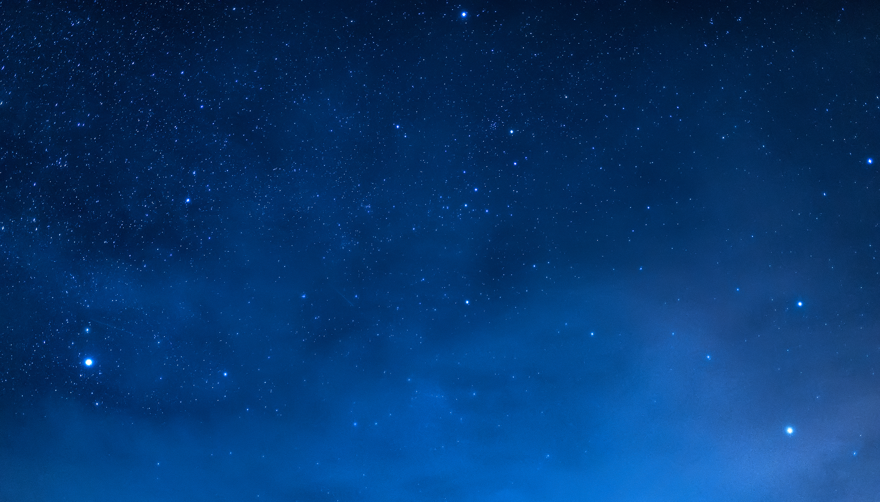
Activity 5: Measure Mars

Slide 30
Measure Mars
The next few pages in your Student Workbooks have images taken of Mars from the Liverpool Telescope – the telescope you used to look at the Moon!
It lives on La Palma, one of the Canary Islands of Spain.
The same telescope took all these images of Mars from the same place. We are showing you the images zoomed in to the same amount.
Can you work out why they look different?
Notes:
STEM Professional Notes (see pages in the STEM Professional Handbook for more details)
Students have 8 images of Mars in their workbooks. They are all zoomed in to the same amount, so any differences in size are not to do with the images themselves.
Students will investigate these differences in this activity.

Slide 31
Step 1: Record the Data
Use your ruler to measure the size of Mars in centimetres (cm).
You need to measure across Mars, from left to right, at the widest point.
Record the data in your table to 1 decimal place.
If you have time, remeasure the size of Mars from top to bottom and diagonally.
Student Workbook: page 60 – 62
Notes:
STEM Professional Notes (see pages in the STEM Professional Handbook for more details)
Emphasise completing a full set of measurements in one direction before measuring in a different direction.
Students might struggle to know where the ‘edge’ is to take their measurement from. This is often the case when measuring things in astronomy – just tell them that their best guess is okay.

Slide 32
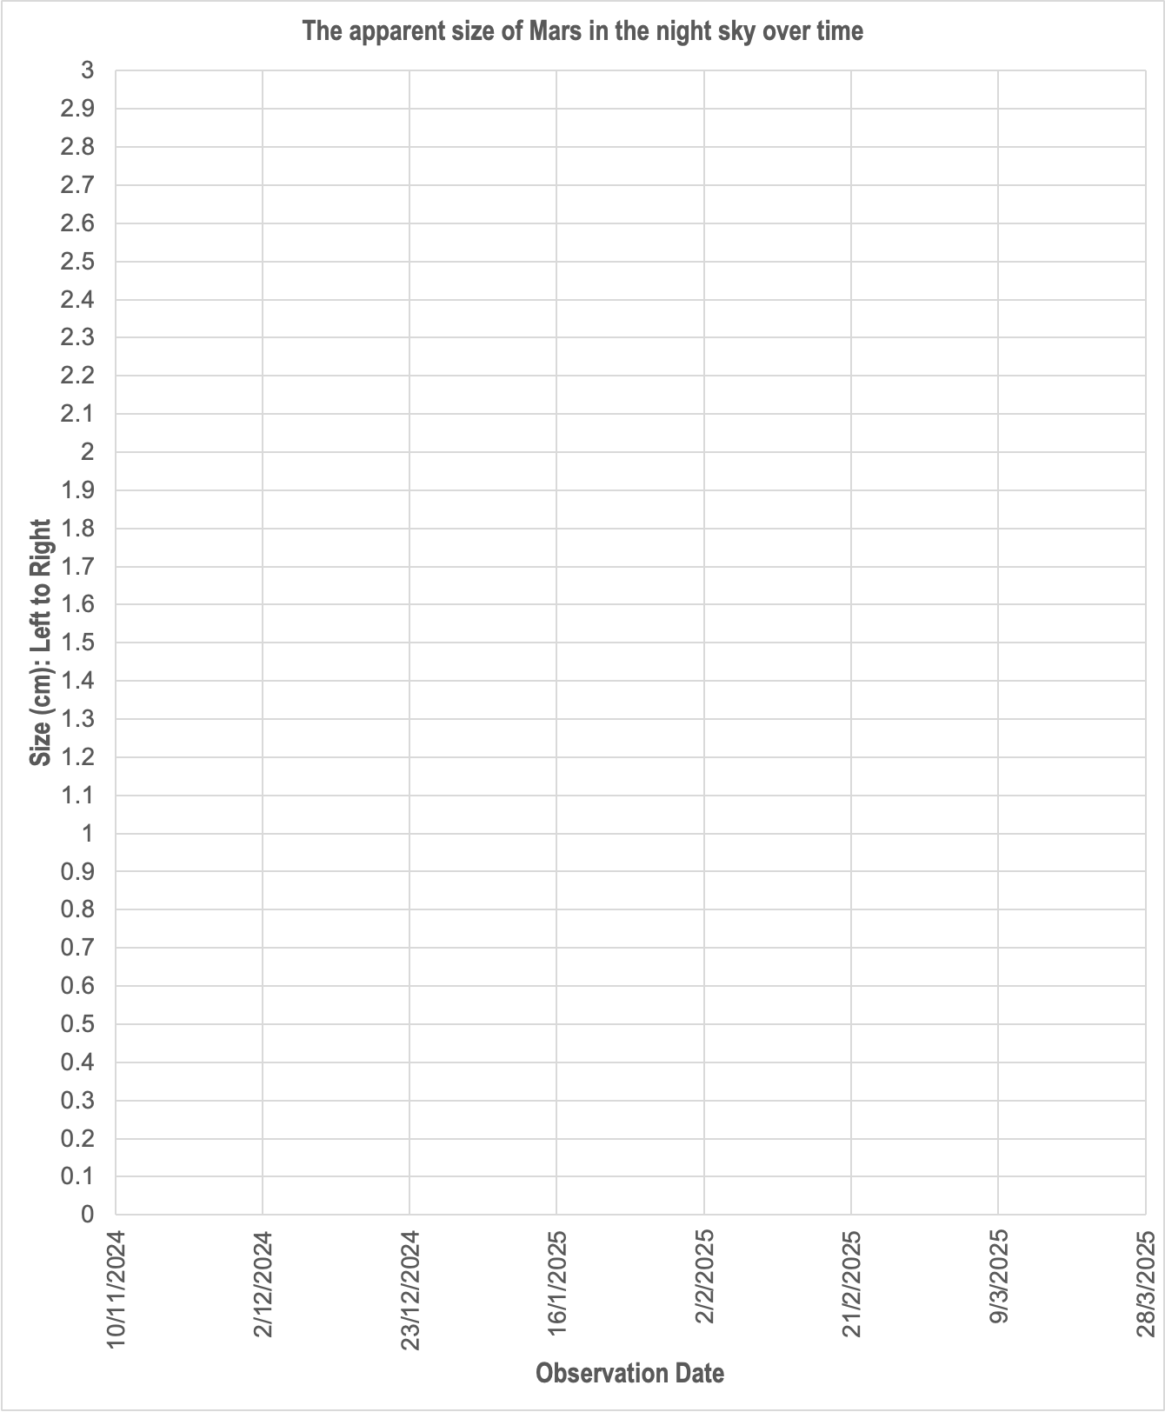
Step 2: Plot the Data
How to plot data on a graph
Data point:
10/11/2024
1.0 cm
Data point:
2/12/2024
1.4 cm
x
x

Slide 33
Things to Remember!
Use your data for the size of Mars measured from left to right.
Use a sharp pencil to plot your data.
Plot each point with a small ‘x’.
Student Workbook: page 63
Notes:
STEM Professional Notes (see pages in the STEM Professional Handbook for more details)
Students should use a sharp pencil and plot using a cross (x) rather than a dot (•) – it’s easier to see the centre of the cross, so results can be plotted precisely.

Slide 34
Step 3: Analyse the Results
Complete the questions in your workbooks.
Student Workbook: page 64
Notes:
STEM Professional Notes (see pages in the STEM Professional Handbook for more details)
Students have a range of prompts and sentence starts in their workbooks to help them answer the questions.

Slide 35
Describe how the apparent size of Mars changes over time.
At the start of the observations…
The date that Mars reaches its largest apparent size is
After this date, the size of Mars appears to…
Mars appears to get bigger in the night sky.
16/1/2025
get smaller in the night sky.

Slide 36
Explain why the size of Mars appears to change.
The planets orbit the Sun at different distances and speeds.
Earths orbits the Sun than Mars.
When Earth moves towards Mars, Mars appears to get bigger because…
When Earth moves past Mars, Mars appears to get smaller because…
slower / faster
the planets are getting closer together (the distance between them decreases).
the planets are getting further apart (the distance between them increases).

Slide 37

Now you know how the planets move in the Solar System and why Mars looks like it changes size from here on Earth.
It doesn’t really change size – it just gets further away!
You’ll need to consider this in the final investigation, where we will plan our launch date to Mars!
Notes:
STEM Professional Notes (see pages in the STEM Professional Handbook for more details)
In the next investigation, students will use an online tool to analyse the movement of the planets and plan a launch date.

