Slide 1

Investigation 6
When should we launch to Mars?
Career Link:
Mathematician

Slide 2

Introduction to your Mission
This is our final investigation of the project…
We need to plan our launch date!
In this mission, you will be be a mathematician. Your job is to analyse the movement of the planets and calculate a launch date for our mission to Mars.
Notes:
STEM Professional Notes (see pages in the STEM Professional Handbook for more details)
Link to previous investigation: Students learned about the orbits of the planets and how this affects the distance between them. Now, this investigation will involve applying that knowledge to select a launch date based on when the distance between Earth and Mars is small.
Link to overall Mars project: Students have learned how they can live and work in environments off-Earth. They also understand how the distance between Earth and Mars changes. Now, we need to apply that understanding to planning our journey.

Slide 3
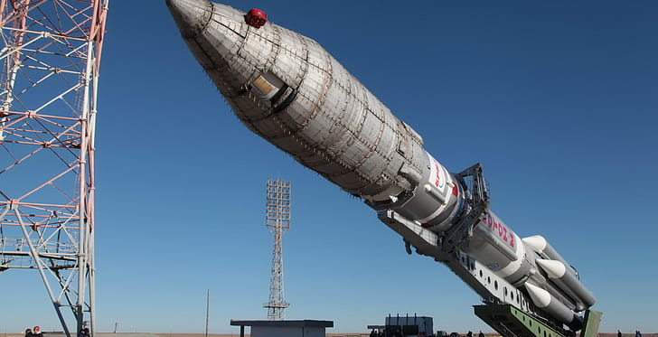
Activity 1: Travelling to Mars

Slide 4
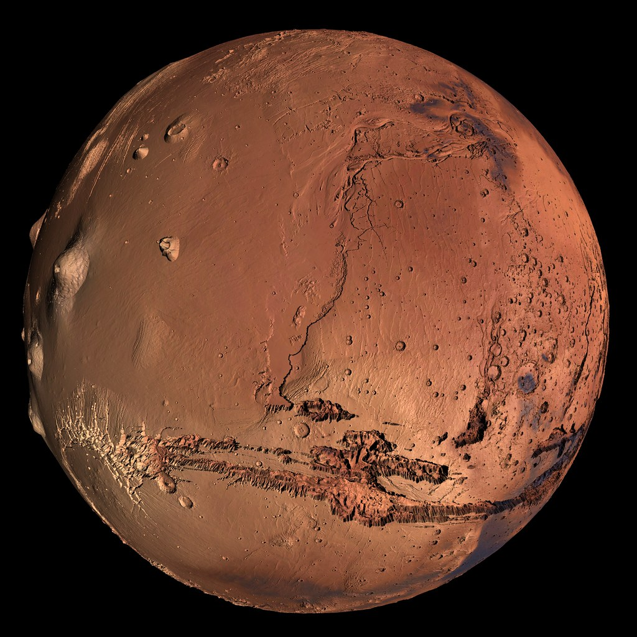
Travelling to Mars
Even at its closest approach, Mars is still about 55 million km from Earth.
Spacecraft carrying people to Mars also need to carry enough food, water, oxygen and other supplies to keep the crew alive!
Notes:
STEM Professional Notes (see pages in the STEM Professional Handbook for more details)
Reemphasise the distances involved here = 55 million km is equivalent to going to the Moon and back more than 70 times.
It’s important to pick the right launch window so that we know the astronauts will have enough supplies to last the journey – and to make sure the journey is as short as possible.

Slide 5
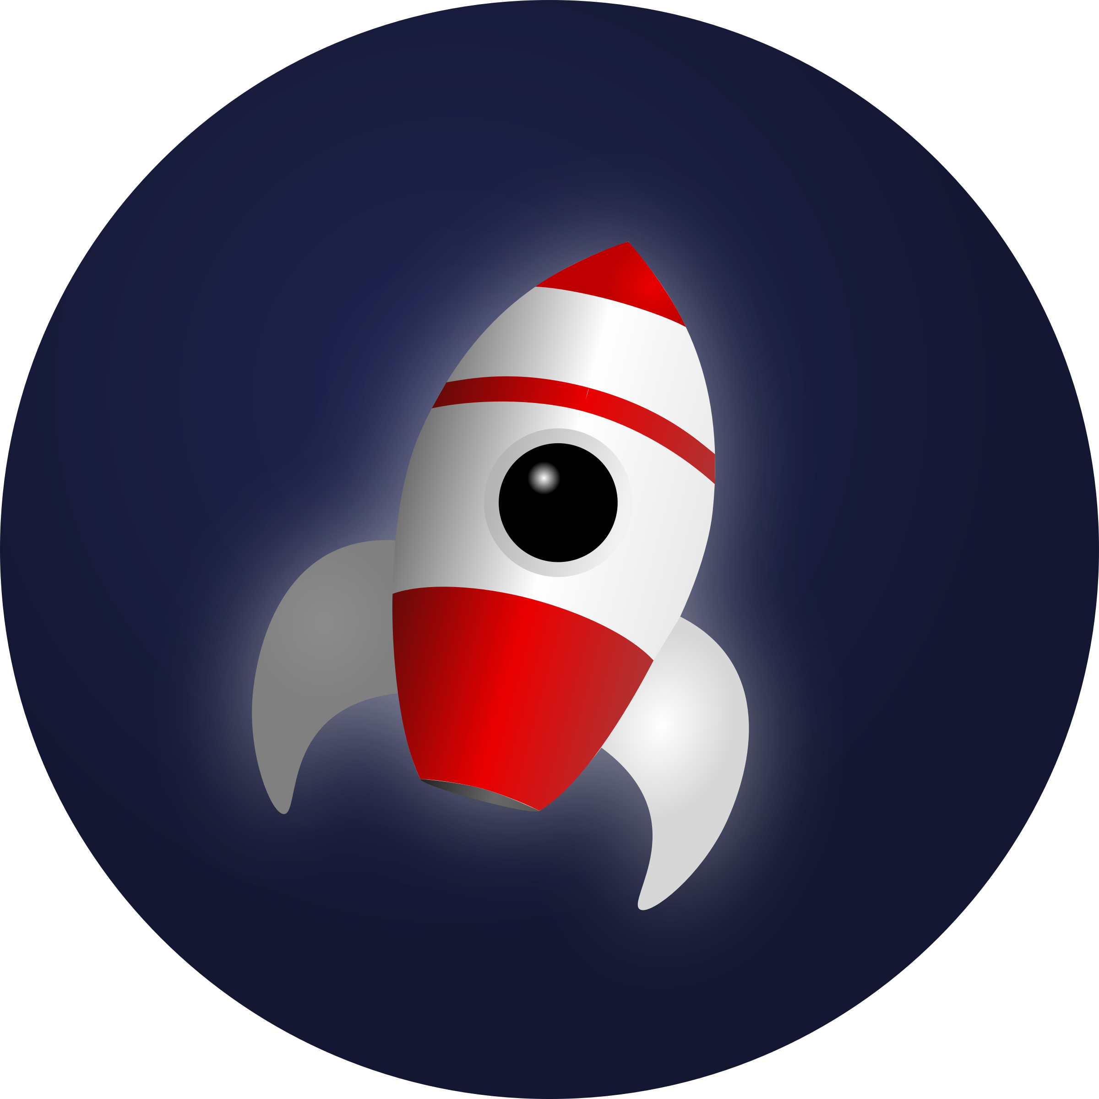
Travelling to Mars
How long would it take to get to Mars in a spacecraft?
Write your guess in your workbooks.
Student Workbook: page 68
Notes:
STEM Professional Notes (see pages in the STEM Professional Handbook for more details)
Remind the students that in the last investigation, they learnt that even though Mars is next to us in the Solar System, it is still really far away.
Get them to write in their workbooks how long they think it would take to get to Mars by spacecraft – even if it was at its closest to us. Take a selection of their answers – you can play higher/lower for this – have they gone for days/weeks/months/years.

Slide 6
Travelling to Mars
Travelling to Mars really takes
Write the value in your workbooks.
Complete the calculations.
250 days
Student Workbook: page 68
Notes:
STEM Professional Notes (see pages in the STEM Professional Handbook for more details)
Get the students to write down in their workbooks the answer of 250 days (this is a rough estimate – values typically span 210-270 days with the most fuel-efficient path and a good launch window.

Slide 7
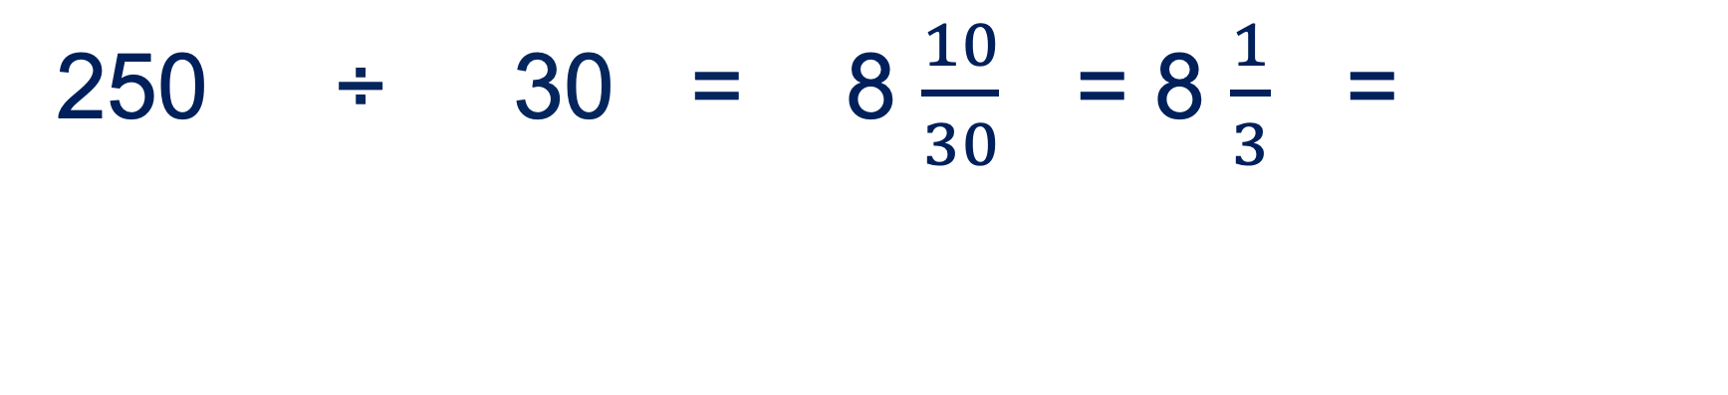
Calculate this in months – assume 30 days in each month. Give your answer to 1 decimal place.
8.3
250 ÷ 30 = 8 $\frac{10}{30}$ = 8 $\frac{1}{3}$ =
Student Workbook: page 68

Slide 8
Lastly, round your answer to the nearest whole number.
7.3
8
Student Workbook: page 68

Slide 9
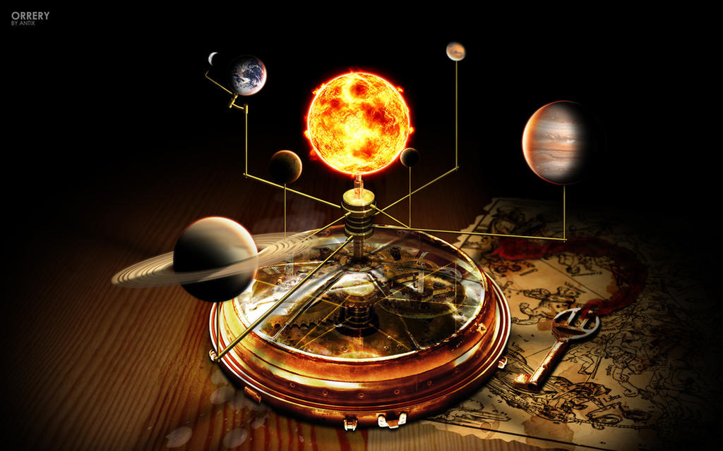
Activity 2: Electric Orrery
This Photo by Unknown Author is licensed under CC BY-NC-ND

Slide 10
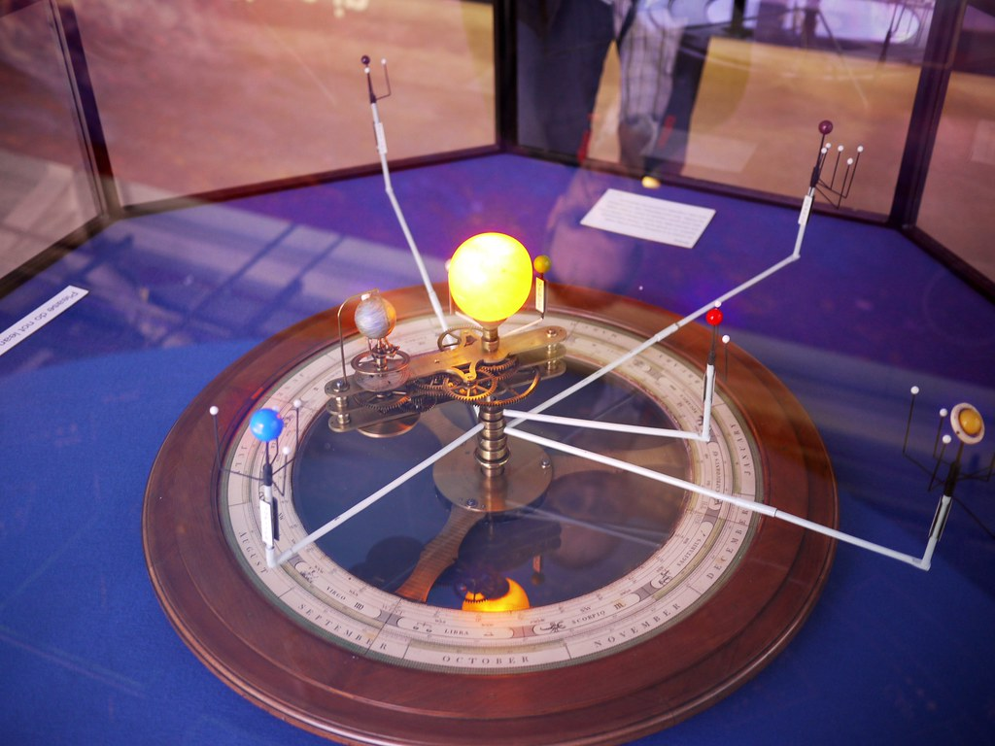
Orrery
We are going to carefully plan our launch date by using an orrery.
An orrery is a model of the Solar System which shows where the planets are at any point in time.
They have been made for hundreds of years using clock mechanisms.
Notes:
STEM Professional Notes (see pages in the STEM Professional Handbook for more details)
Give the students a quick definition of what an orrery is – models of the Solar System which map the actual positions of all of the planets in our Solar System, including the speed of their movement and their positions relative to each other at an exact time.

Slide 11
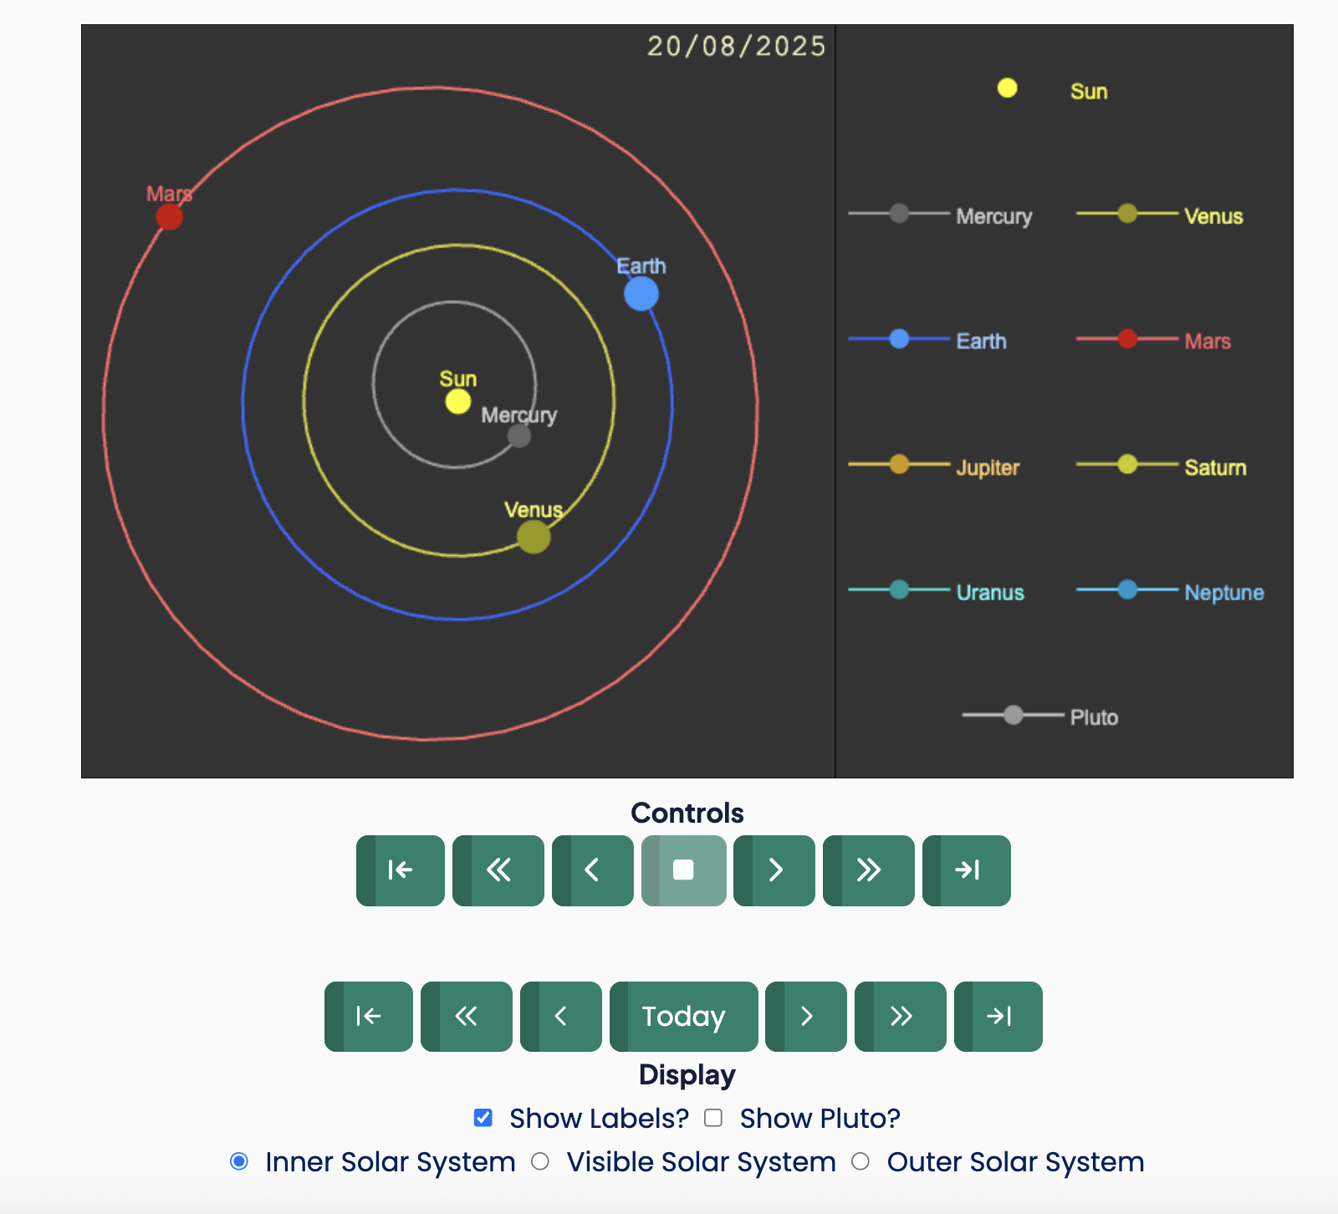
Electric Orrery
Go to: www.schoolsobservatory.org
Open the search box
Type in “orrery” and click on Electric Orrery
Scroll down the page to the section called Start Exploring!
Notes:
STEM Professional Notes (see pages in the STEM Professional Handbook for more details)
Get the students on to their computers/tablets/devices working in pairs and get them to go to The Schools’ Observatory website.
Follow the steps above, but on a browser screen to get the students to the right place – you don’t need to be logged in for this.
Demonstrate on the browser how to play the orrery in timestamps of a day, month or year using the top Controls
Then show how they can move the orrery step by step by coming back to today on the bottom controls and using the arrows there to move forward by a day, month or year without it playing as an animation.
Make sure on the display that they only show the inner Solar System – you can show them the visible (what we can see with our eyes) or outer Solar System, and even include Pluto – but if they do that, they won’t be able to see Mars and Earth.

Slide 12
When are Mars and Earth next close together?
Start from 1/1/2035 and fill in the table in your workbook.
Check month by month – don’t forget to write the date!
When Earth and Mars look close together, check different days in the month.
Find the date of closest approach.
You might add notes about:
If the planets are on the same or opposite sides of the Sun.
How the distance between Earth and Mars changes.
Anything else that seems interesting!
Student Workbook: page 69
Notes:
STEM Professional Notes (see pages in the STEM Professional Handbook for more details)
Get the students to work in their pairs, moving through month-by-month to work out the next time of closest approach. Get them to fill in the table in their workbooks.
If they have time, they can move day by day to get a more exact answer.
They should get a date in early September 2035 (e.g. 5/9/2035) – hopefully, they get something close to this – it doesn't matter if they get the exact answer.

Slide 13
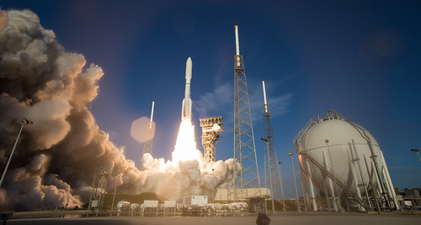
Activity 3: The Launch Date

Slide 14
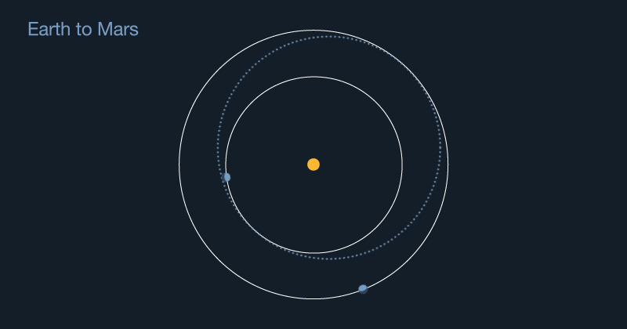
The Launch Date
The planets are constantly moving.
We must leave Earth months earlier and travel towards where we know Mars will be on a specific date.
Credit: NASA
Notes:
STEM Professional Notes (see pages in the STEM Professional Handbook for more details)
Because it takes a long time to travel within the Solar System, we need to carefully plan the launch date to ensure the planet (or other object) is in the right position when we arrive!
Essentially, we need to leave Earth and travel towards where we know Mars will be on a specific date (e.g. the date of closest approach). And must factor travel time into our planning of the launch date.

Slide 15
The Launch Date
Work out your launch month
Choose a launch day
Pick a launch time
Student Workbook: page 70

Slide 16
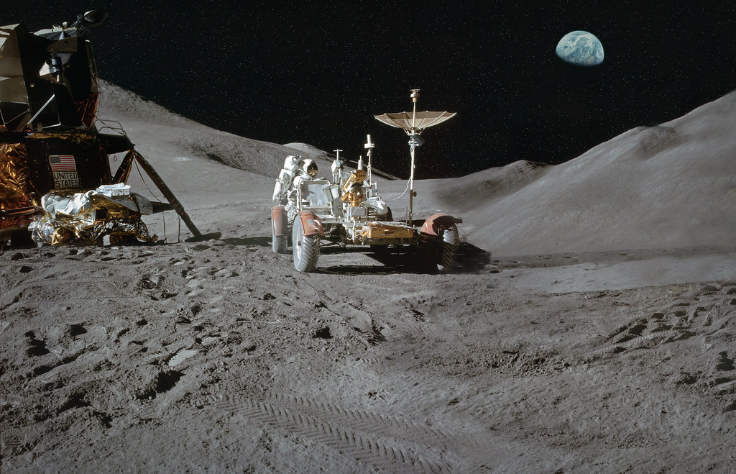
Activity 4: First Words

Slide 17
First Words
When the first person set foot on the Moon (Neil Armstrong in 1969), he had carefully planned his first words.
Around 650 million people tuned into the TV to watch the Moon landings live.
Even more people might watch the future Mars landing…
Notes:
STEM Professional Notes (see pages in the STEM Professional Handbook for more details)
Talk briefly about the importance of the first words spoken from the Moon’s surface.
Around 650 million people watched live the Moon landing live. Even more people might watch the future Mars landing – the population is bigger, and more people have access to technology. The words spoken on Mars will be just as important as those said on the Moon.

Slide 18
First Words
What would your first words be when you first set foot on Mars?
You might want to talk about:
People who are important to you
Your favourite quote from a book, song, film, or similar
The work you or others did to reach Mars
Why you think it’s important for humans to explore space
Student Workbook: page 71

Slide 19
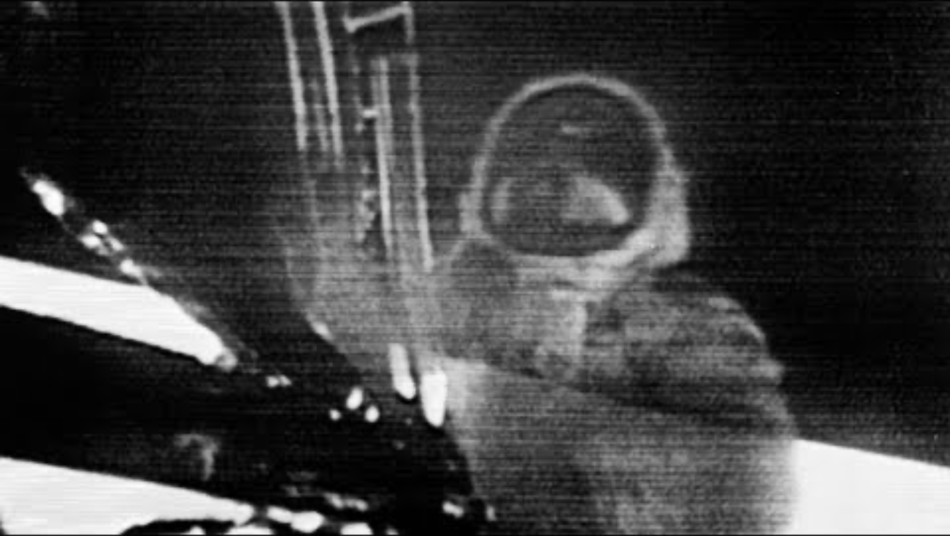
First words are important and last the test of time…
Notes:
STEM Professional Notes (see pages in the STEM Professional Handbook for more details)
Play the video (sound on).

Slide 20

Activity 5: Postcards
Notes:
STEM Professional Notes (see pages in the STEM Professional Handbook for more details)
Hand out the evaluation postcards to the class, with one per person. Ask them to spend 10 minutes quietly filling in the postcard with how they’ve found the project overall. Collect these back in at the end of the session.

Slide 21
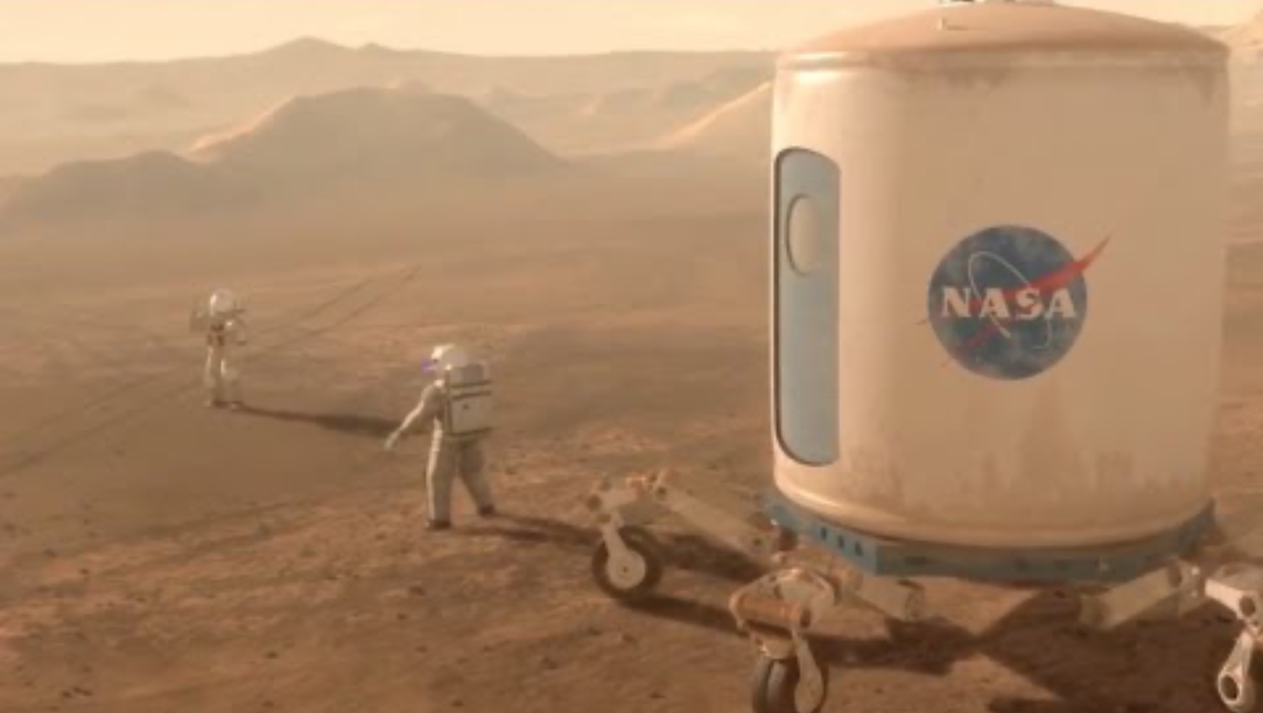
In your lifetime
Notes:
STEM Professional Notes (see pages in the STEM Professional Handbook for more details)
Spend the last part of the session expressing how you’ve found working with the class.
ENSURE THE VIDEO IS ON MUTE
Show the video and explain that future Missions to Mars are already being planned to launch as early as the 2030s. Advanced missions to land back on the Moon are planned for 2027.
These will happen during the students' lifetime – might they be part of one? Get the students to put their hands up if they’d like to be a part of a Mission to Mars – whether that’s as an astronaut or part of the ground crew.

