Slide 1
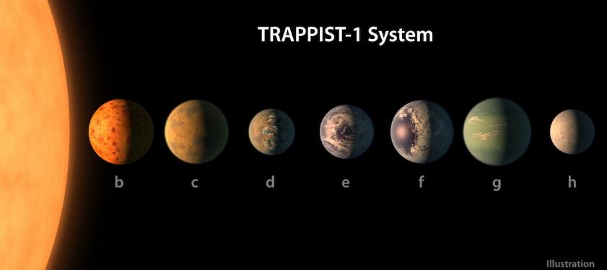
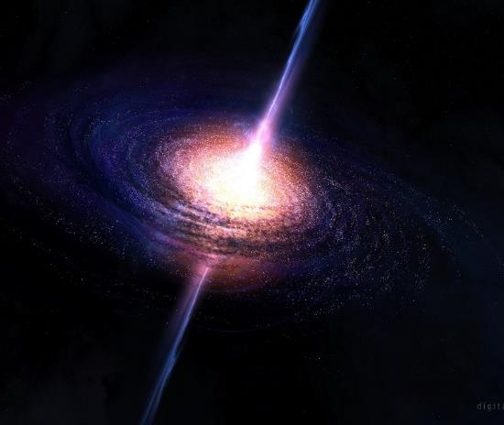
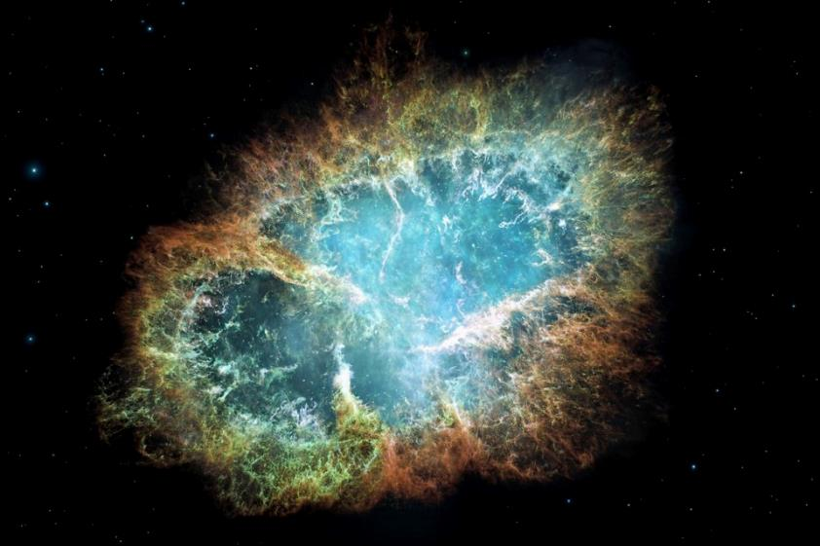


WORK EXPERIENCE WEEK 2026
Welcome to LJMU & The Astrophysics Research Institute
Notes:
Important info, overview of the week, today’s timetable
Introduce university and people you’ll be working with
Briefly describe what we do here
But first….

Slide 2

You have been selected from a pool of 110 applicants to be this year’s
Wex Week Class of 26!

Slide 3
In this talk...
Important Info
Today's timetable
Meet the Team
Astrophysics at LJMU
Telescopes at LJMU
The Schools' Observatory

Slide 4
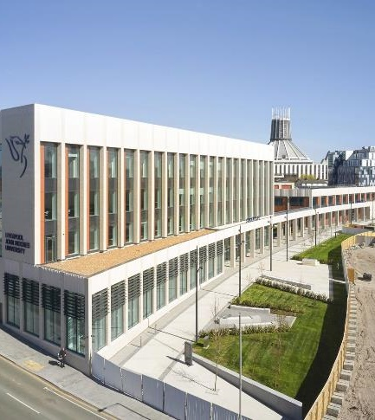
Important Information
Student Life Building (SLB)
We'll be in SLB for most of the week - please arrive on time each day (start at 9:30).
You need your ID card to get in
Please let us know if you leave the building
There are no fire alarms scheduled today.
Georgia is a first aider, there are others on the reception desk (ground floor).
Toilets are around the corner from the lifts (all single cubical unisex).
Water stations are also near the lifts.
You can connect to LJMU_Guest wifi.
Please keep in mind that you agreed to a code of conduct when you accepted your place.
Just a friendly reminder that lunch will only be provided for today.

Slide 5


Slide 6
During the Week
Talks
Skills workshops
Do research
Present your work
University & Careers
Team-work
Use data from telescopes
Work with professionals
Meet university students

Slide 7
Today’s timetable
When? | What? | Where?
MONDAY 13th JULY
09:30 | Welcome | SLB UG15 (you are here!)
10:00 | Icebreakers | SLB UG15
11:00 | Introduction to Astrophysics (talk) | SLB UG15
12:00 | Lunch (Provided by the ARI) | ARI
13:15 | Planetarium | Sports Building Studio
14:15 | Break
14:30 | Robotic Telescopes (talk) | SLB UG15
15:30 | Design a Telescope (workshop) | SLB UG15

Slide 8
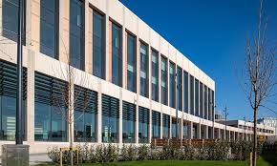
Liverpool John Moores University
Home to 25,000 students and 2,500 staff
Research and teaching are organised into 2 big faculties
Notes:
home to 25,000 students and 2,500 staff
Research and teaching are organised into faculties
Guess where astrophysics sits?

Slide 9
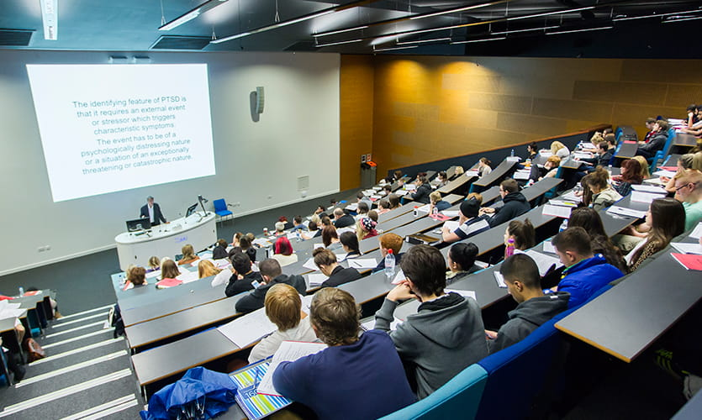
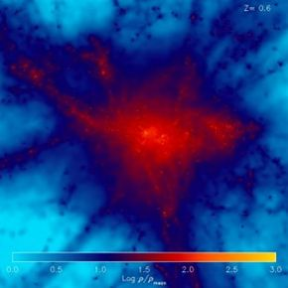
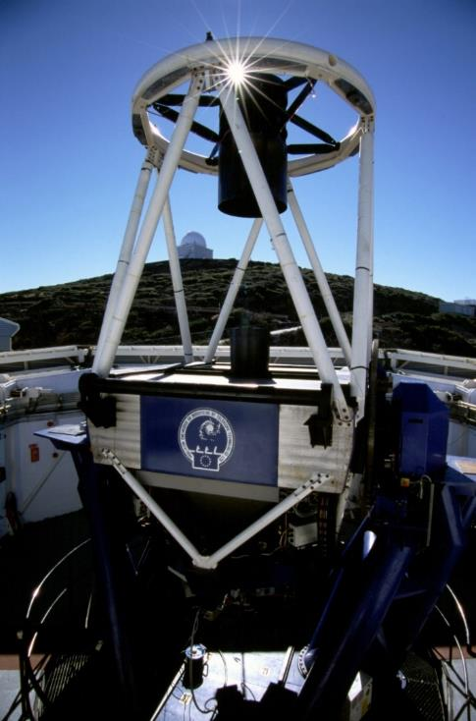
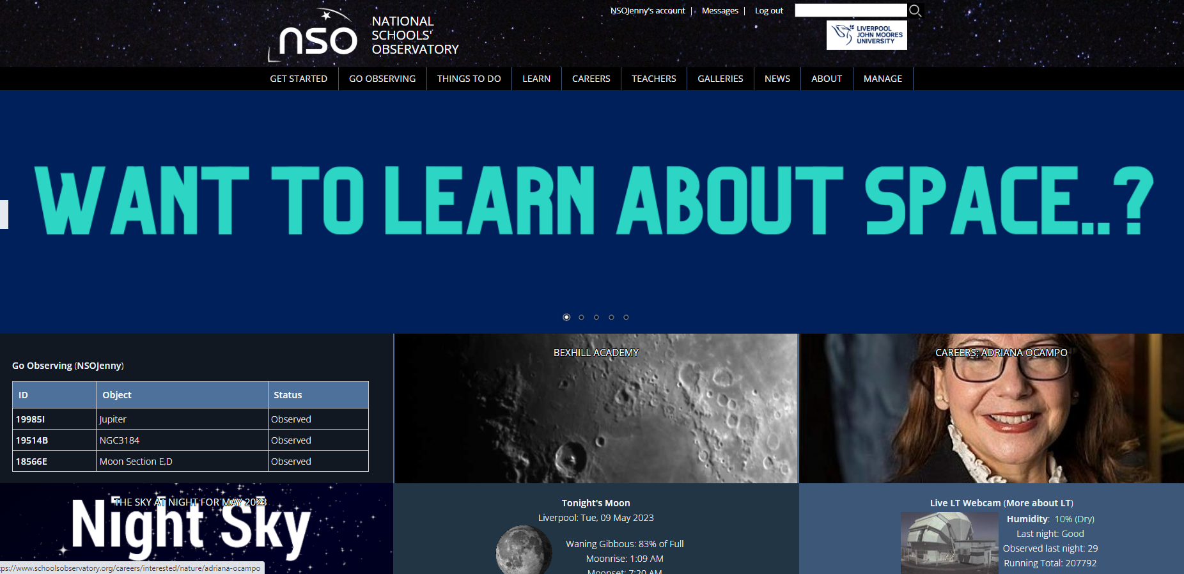
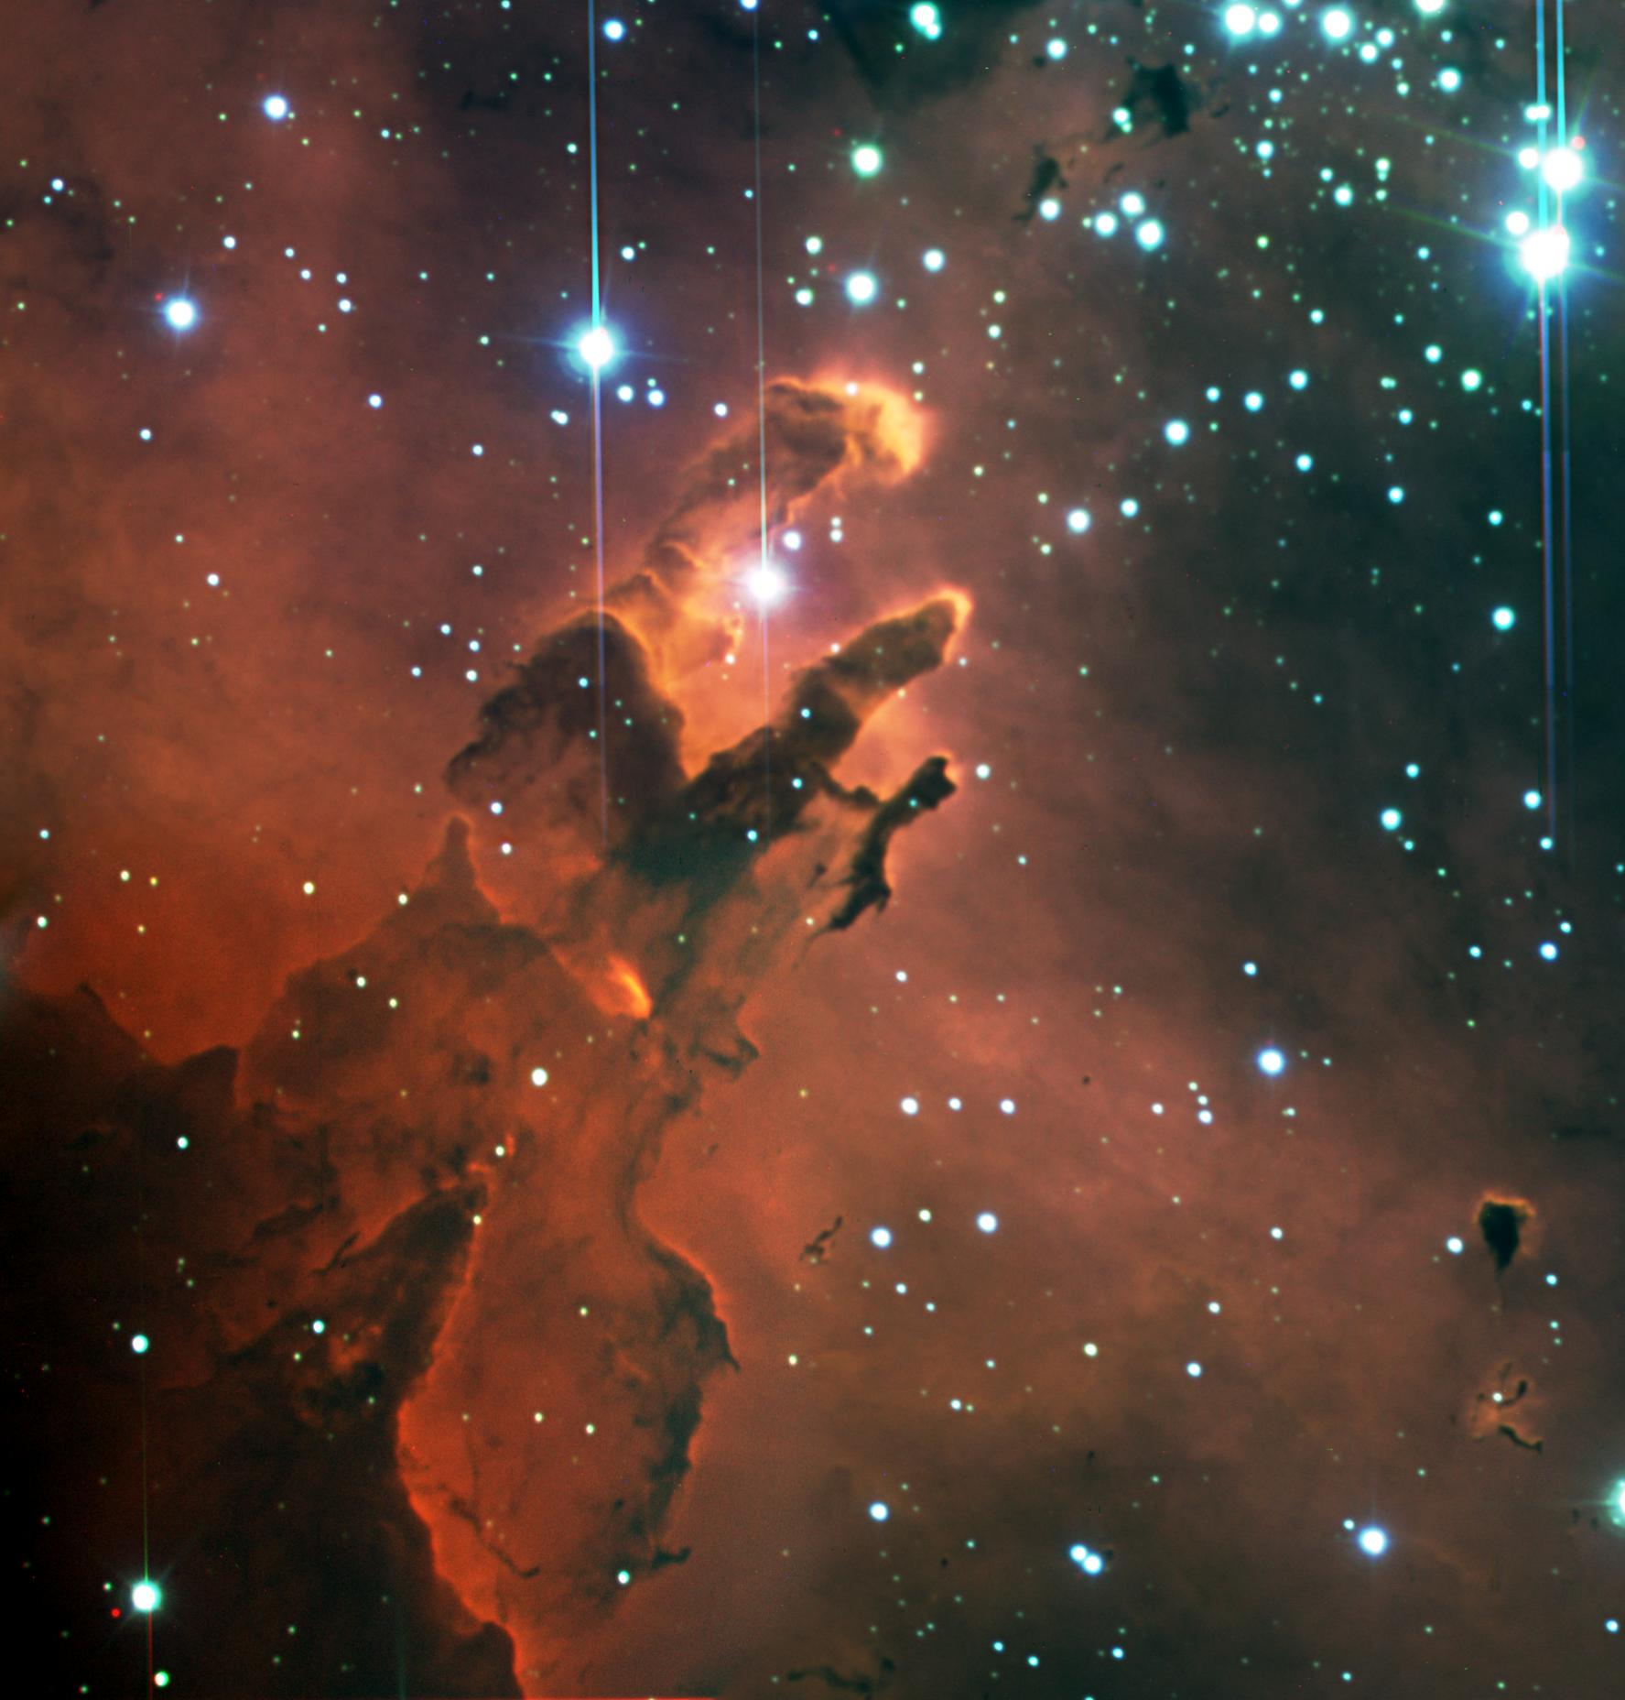
Astrophysics Research Institute
Teaching
Research
Robotic Telescopes
The Schools’ Observatory
Notes:
Image credits: LJMU, ARI, LT, NSO

Slide 10
Astrophysics Research
Staff have different research interests.
They work together in teams called research groups.
ARI staff investigate topics like:
  Cosmology
  Gamma Ray Bursts
  Star formation
  Supernovae
  Active Galaxies
Notes:
Can anyone explain any of these space terms?

Slide 11
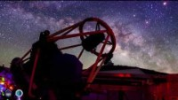

Robotic Telescopes
Liverpool Telescope (LT)
Fully robotic and autonomous.
Has a 2-metre-wide mirror.
Whole thing is 8.5m high, 6.5m wide and weighs 24 tonnes.
Clamshell enclosure protects it from the elements.
Designed to investigate how the Universe changes and to react quickly to sudden bursts of energy in space.
Not in Liverpool!
Video credit: Daniel López - IAC

Slide 12

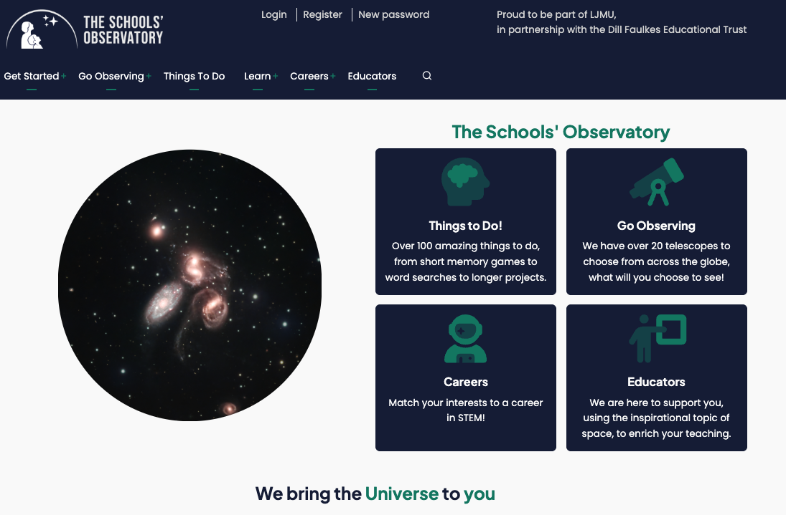
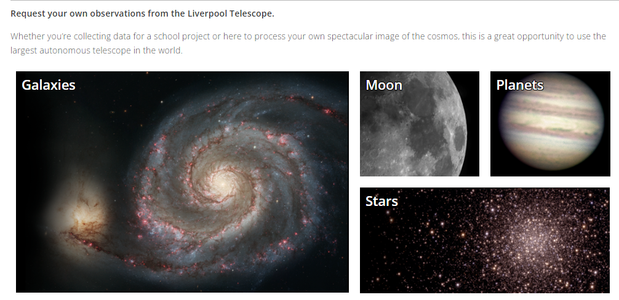
The Schools’ Observatory
www.schoolsobservatory.org
Provide free access to the wonders of the Universe through 26 robotic telescopes.
Support teachers and inspire students during their journey in STEM.
Over the last 15+ years, we have enabled tens of thousands of students to take over 250,000 images of space.
An extensive website provides access to accurate information and engaging resources that encourage exploration and curiosity.

Slide 13
Any questions so far?
?
?
?
Notes:
Questions so far…
Will continue to cover who we are and what we do

Slide 14
Some information for us….
Please spend 5 mins filling in the pre-week information sheet

Slide 15
So now you know who we are…
Let’s get to know you!

