Slide 1
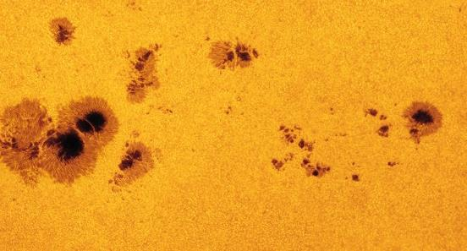
PREDICT THE
SOLAR CYCLE
Notes:
Image credit: NSO

Slide 2
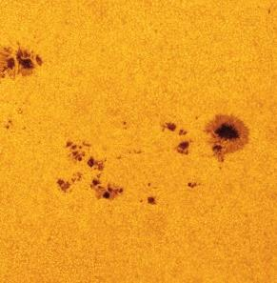
Can we predict space weather?
The Sun is the centre of our Solar System and our only source of heat and light.
But the Sun is not a stable place. It has ‘weather’ of its own. And when it’s windy on the Sun – it impacts us here on Earth too!
So – can we predict the weather on the Sun to help protect ourselves here on Earth?
Notes:
Image credit: NSO
Teacher notes:

Slide 3
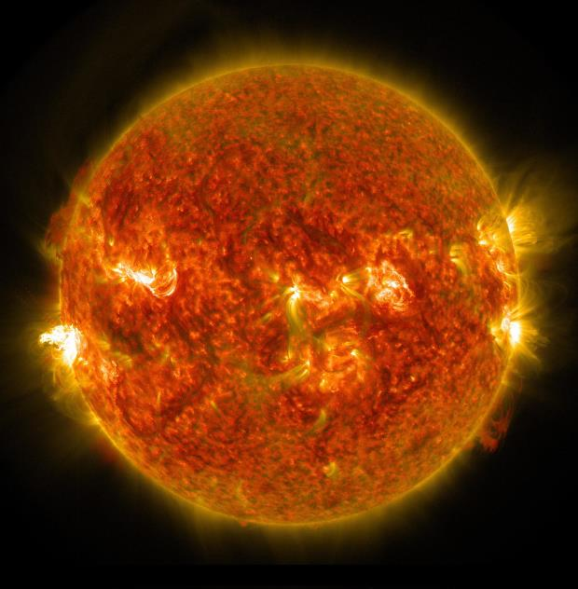
Objectives
Investigate observations from the Solar Dynamics Observatory to count the number of sunspots on the surface and compare different periods in time.
Analyse sunspot counts for a year, and a century, to look for patterns in the data.
Use the results to predict the next period of high solar activity.
Notes:
Image credit: NSO

Slide 4
Notes:
Teacher notes:
The data the students use comes from a range of telescopes all over Earth. This video shows some examples of solar flares leaving the Sun.
The video has background music and is about 2 mins long.
Click to play the video.
The video is embedded from YouTube. You will need to be connected to the internet and have enabled content to view this video as part of the slides.
It is also available at this link - https://www.youtube.com/watch?v=GrnGi-q6iWc

Slide 5
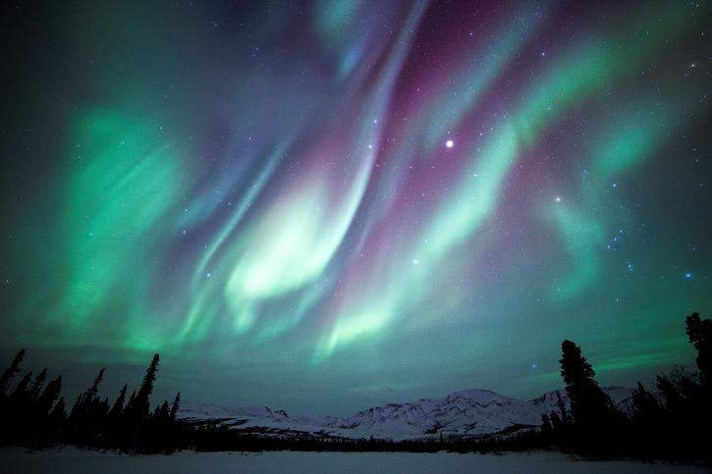
Solar Flares
Flares can extend out into space ejecting material
(particles) from the Sun.
We call these Coronal Mass Ejections (CMEs).
When the material reaches Earth it interacts with our atmosphere – we see the Aurorae.
It also interacts with satellites, space probes and astronauts outside of the atmosphere:
Disrupting radio communications
Limit GPS accuracy
Affect power
Harm the human body if not protected.
Notes:
Teacher notes:

Slide 6
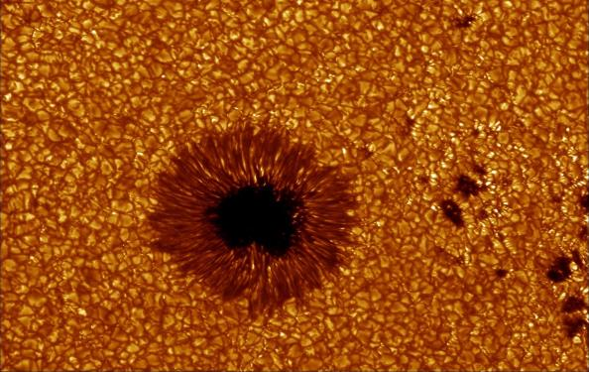
Sunspots
CMEs come more frequently when there are sunspots
(dark patches) on the surface of the Sun.
Sunspots are regions on the surface of the Sun where the
temperature is lower than the surroundings.
The sunspots appear where the magnetic field of the Sun has been twisted.
Sunspots typically last from hours to days.
The average number of sunspots visible on the surface changes over time.
Notes:
Teacher notes:

Slide 7
Your task
Use data from solar observations to find patterns in the solar cycle.
Use these to predict the next solar maximum so that we can prepare for what might happen!
Notes:
Teacher notes:

Slide 8
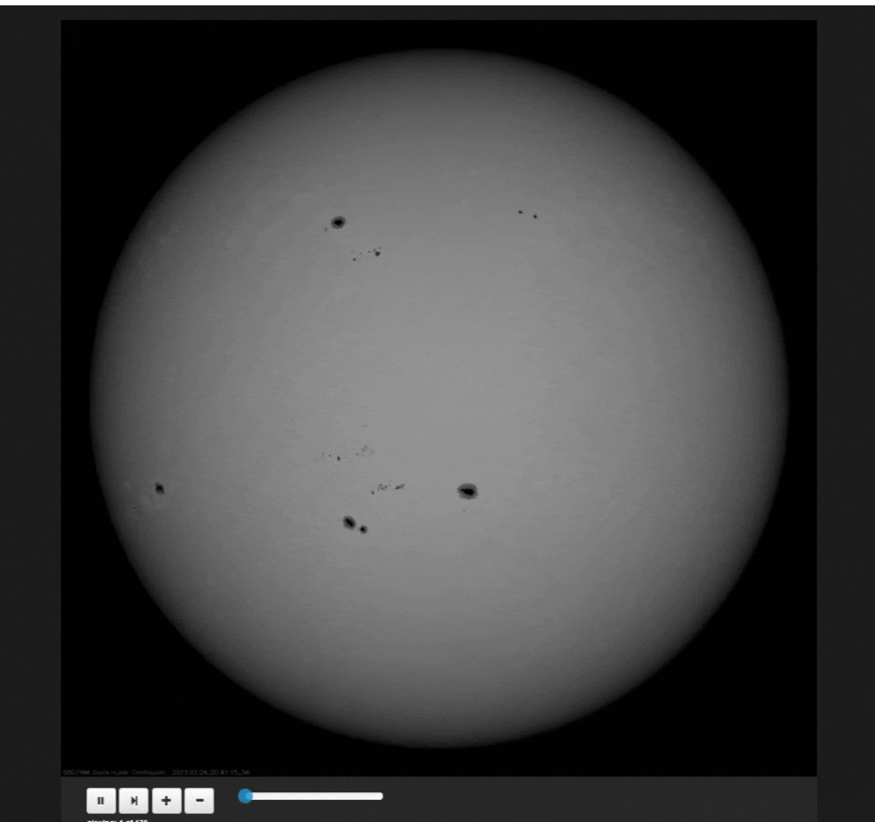
Observing sunspots
The Solar Dynamics Observatory has been watching the Sun for more than 10 years taking constant images.
You are going to look at some of the images taken by the observatory of the Sun.
These have been taken in different years.
Notes:
Image credit: NSO/SDO
Teacher notes:
Students will need the 2 jpg images from the resource page on the website: SDO images from April 2014 and February 2018

Slide 9
Task 1: Look at an SDO observation from 2014 and 2018
Record the number of sunspots visible on the surface during each period in:
April 2014.
February 2018
Does the Sun look the same in each period?.
Compare the results and think about why there might be changes.
Notes:
Teacher notes:
In 2018 the Sun was experiencing a period of low activity – this is recorded by a small number of visible sunspots
In 2014 the Sun was experiencing a period of high activity – this is recorded by a high number of visible sunspots
By measuring the changes in the number of sunspots with time, patterns can start to emerge – this is explored in the next task

Slide 10
Task 2: Measure the number of sunspots visible in 1 year
Use a spreadsheet to plot a graph of the number of sunspots visible on the Sun each day over the course of a year (1997 and/or 2003) using the data provided.
Note down any dates where there is a maxima in each data set (largest number of sunspots).
Note down any dates where there is a minima in each data set (smallest number of sunspots).
Calculate the average number of sunspots visible each day on the years provided.
How do these compare?
Notes:
Teacher notes:
Use the data file sunspot_cycle.xls and open in excel (or equivalent) – each year (1997 and 2003) is given in a different tab of the spreadsheet.
Plot the number of sunspots visible each day over the course of a year using the tools available in the spreadsheet – number of sunspots on the y-axis and the date on the x-axis.
The dates are given in fractions of a year where 2003.006 is 0.6% of the way through the year and 2003.975 is 97.5% of the way through the year.
Compare the data in both tabs – one is near a solar minima (when the Sun is least active) and one near a solar maxima (when the Sun is most active)

Slide 11
Task 3: Estimate the solar cycle
By looking at data over a longer period patterns start to emerge.
On the 100-years tab of your spreadsheet plot the number of sunspots visible each month over the whole dataset.
Note down each maxima.
Note down each minima.
Calculate the average difference between each maximum.
Convert this into an average number of years.
Notes:
Teacher notes:
Use the data file sunspot_cycle.xls and open in excel (or equivalent) – move to the tab: 100-years and plot the number of sunspots visible each month over the course of a year
Work out the average difference in time between each maximum in the data
Convert this into a number of years

Slide 12
Task 4: Predict the next solar maximum
Use the average length of time you have calculated from this data to predict when the next solar maximum will be.
Consider the following:
How accurate is your prediction?
Why might your result differ from the true value?
What period are we currently in?
When will the next solar minimum be?
Notes:
Teacher notes

Slide 13
The Solar Cycle
The activity on the Sun has cycles of 11 years – during this time, the magnetic field lines move from being straight like a bar magnet, to being very twisted, then straightening out again.
Solar maxima occur mid way through this cycle.
At the end of each 11-year period the north and south poles of the Sun flip around and the cycle starts again.
Sun Spot Number
Days
Notes:
Teacher notes

Slide 14
The Solar Cycle
To learn more about the Solar Cycle and why it happens watch our video:
Notes:
Teacher Notes –
For more information on the Sun and its structure and weather you might want to watch the associated video “What can we see on the Sun?” - https://www.schoolsobservatory.org/things-to-do/what-can-we-see-sun it is approximately 8 minutes long.

