Slide 1
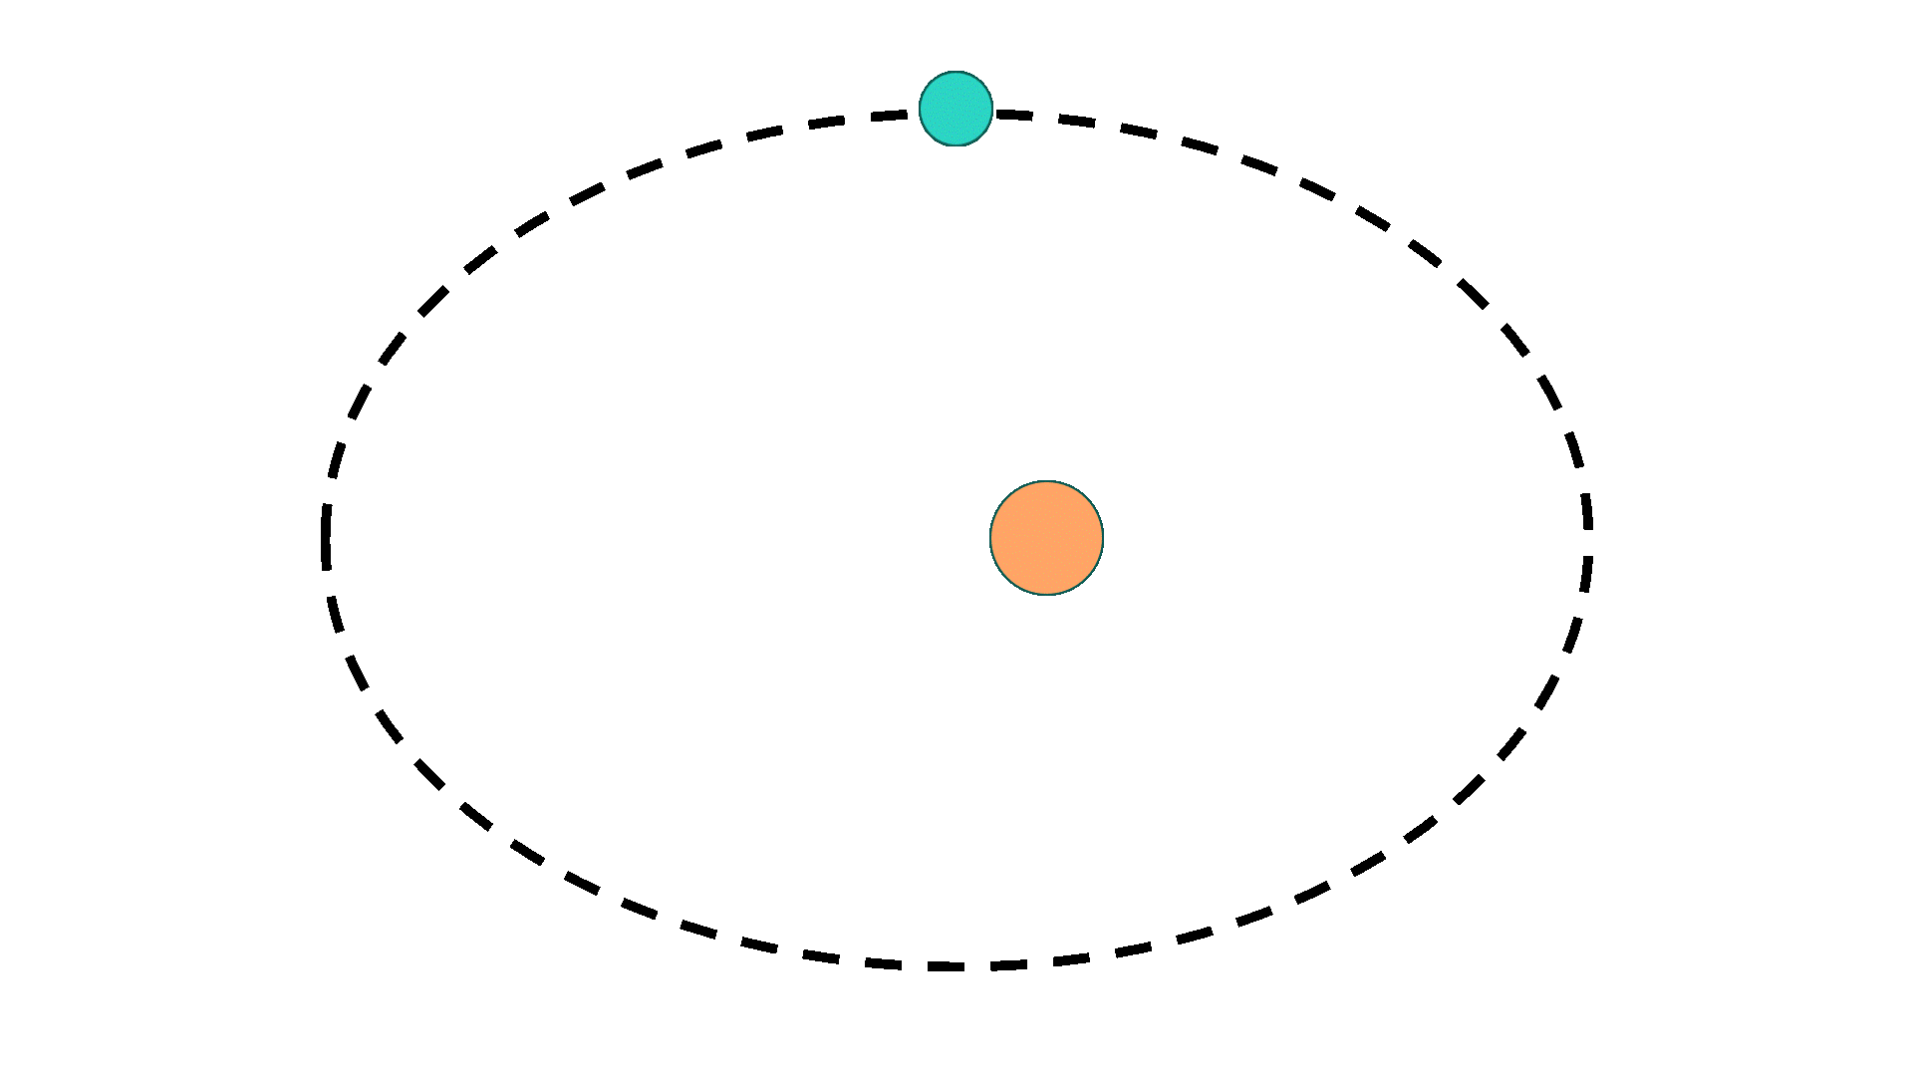
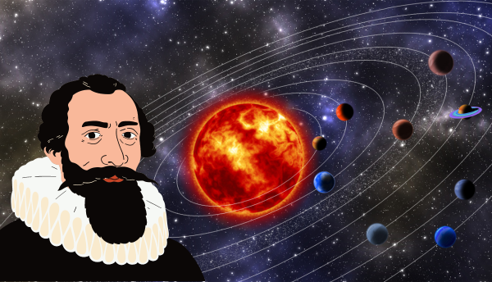
Kepler's Laws: FIND THE MASS OF THE SUN
Notes:
This presentation can be used to deliver the activity, Kepler’s Laws: Find the Mass of the Sun
You can access additional information and the worksheets on this webpage: https://www.schoolsobservatory.org/things-to-do/keplers-laws-find-mass-sun

Slide 2
OBJECTIVES
Know the fundamental principles of Kepler’s Laws.
Know the properties of an ellipse.
Be able to use Kepler’s 3rd Law to find the mass of the Sun.

Slide 3
KEPLER’S 1ST LAW: THE LAW OF ORBITS
Kepler’s 1st law: All planets in our Solar System orbit the Sun in an elliptical shape with the Sun at one focus.
Notes:
Click on the video to open it on The Schools’ Observatory’s YouTube channel. The video explains Kepler’s 1st Law and is 2 minutes long.
The video is also available on The Schools’ Observatory’s website using this link: https://www.schoolsobservatory.org/things-to-do/keplers-first-law
The examples shown use an ellipse with high eccentricity to illustrate the concept.

Slide 4
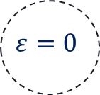
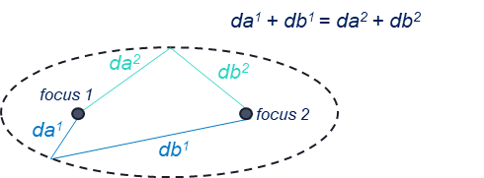
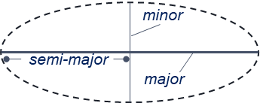
PROPERTIES OF AN ELLIPSE
An ellipse has 2 special points called foci. If you measure the distances from any point on the ellipse to the 2 foci, the total distance is always the same.
The intensity of the elliptical shape is denoted by eccentricity ($ε$).
$ε=0$ is a circular orbit and $ε=1$ is a parabolic orbit.
An ellipse has 2 axes. The longer one is called the major axis, and the shorter one is called the minor axis. Half of the major axis is called the semi-major axis.

Slide 5
PLANETARY DATA
 | Mercury | Venus | Earth | Mars | Jupiter | Saturn | Uranus | Neptune
Semi-major axis (AU) | 0.387 | 0.723 | 1.0 | 1.52 | 5.20 | 9.57 | 19.17 | 30.18
Eccentricity ($ε$) | 0.206 | 0.007 | 0.017 | 0.093 | 0.049 | 0.056 | 0.047 | 0.009
Radius (km) | 2,440 | 6,054 | 6,378 | 3,397 | 71,492 | 60,268 | 25,559 | 24,746
Mass (Earth Masses) | 0.055 | 0.82 | 1.0 | 0.11 | 318 | 95.2 | 14.5 | 17.1
Orbital period (Earth days) | 88 | 225 | 365.25 | 687 | 4346 | 10756 | 30681 | 60193
Day Length (Earth Days) | 176 | 117 | 1.0 | 1.03 | 0.41 | 0.43 | 0.75 | 0.67
Surface Gravity (g) | 0.38 | 0.91 | 1.0 | 0.38 | 2.34 | 0.93 | 0.92 | 1.12
1 AU (or Astronomical Unit) = 149,600,000 km and is the mean distance from the Earth to the Sun.
1 Earth Mass = 5,980,000,000,000,000,000,000,000 kg.
1 g = 9.8 m/s2 - this is the acceleration due to gravity on Earth.
Day lengths are sidereal days (time taken to rotate once) except for Mercury and Venus which are solar days (time from midnight to midnight).
Notes:
The eccentricity for each planet is given in the table. Students do not need to use this in their calculations.
Students only need to use the semi-major axis and orbital period data to complete the activity. Students should note the units for both.
The notes tell students how large 1 Astronomer Unit is in km. They will need to use this for the conversion to metres.

Slide 6
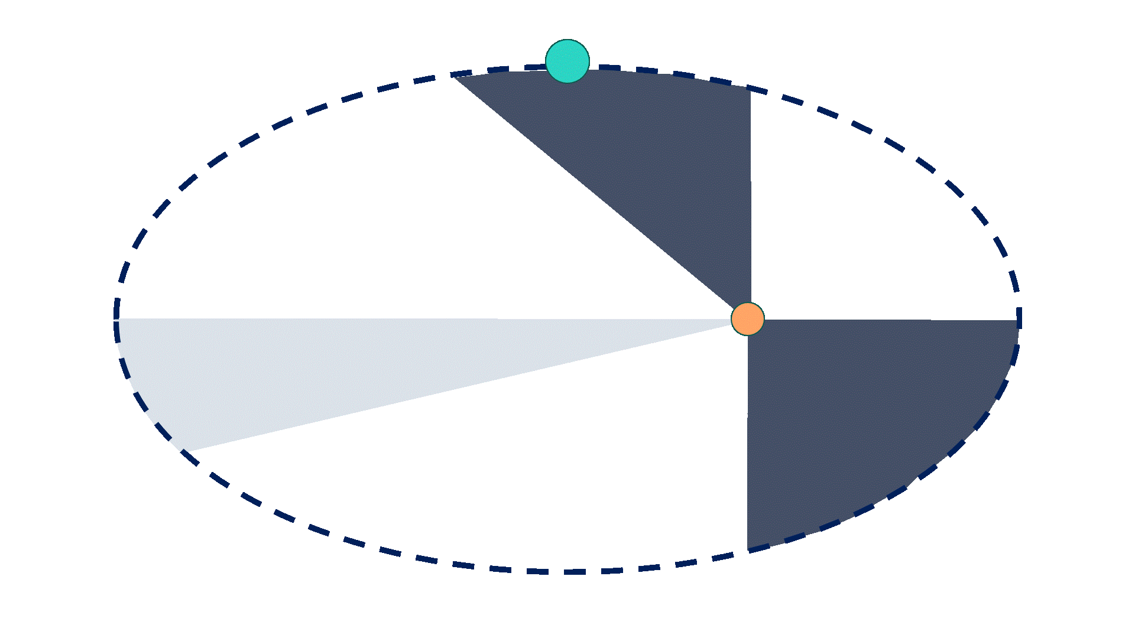
KEPLER’S 2ND LAW: THE LAW OF AREAS
Kepler’s 2nd law: A line drawn from the centre of the Sun to the centre of an orbiting body will sweep out equal areas in equal intervals of time
Notes:
Click on the video to open it on The Schools’ Observatory’s YouTube channel. The video explains Kepler’s 2nd Law and is 2 minutes long.
The video is also available on The Schools’ Observatory’s website using this link: https://www.schoolsobservatory.org/things-to-do/keplers-second-law
The examples shown use an ellipse with high eccentricity to illustrate the concept.

Slide 7
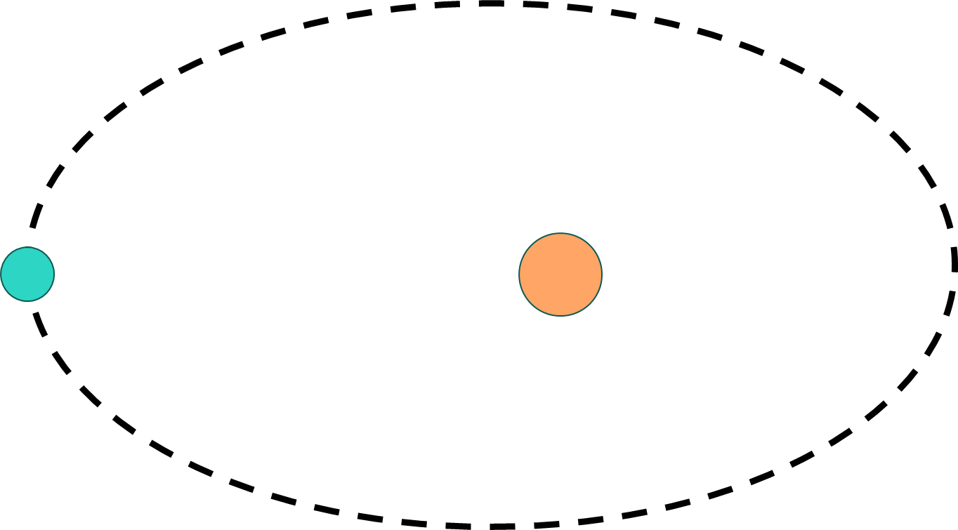
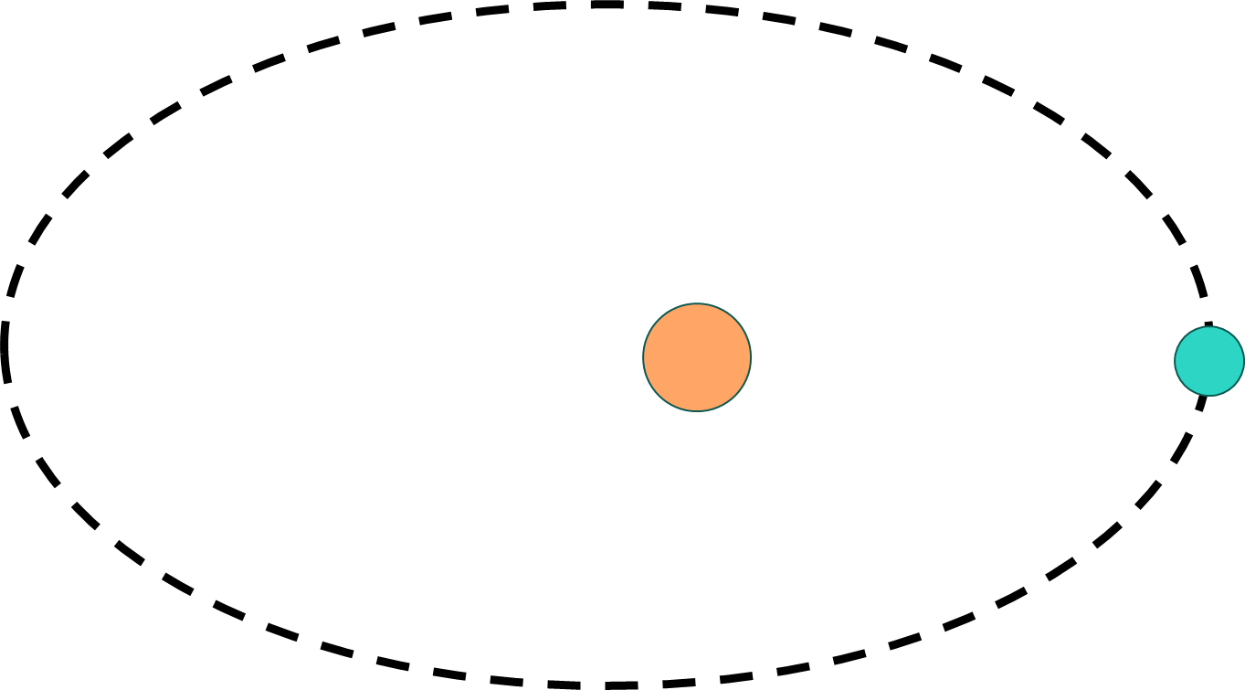
SPEED OF THE PLANETS
As an orbiting object moves closer to the centre of mass it is orbiting, it speeds up.
This means a planet is at its slowest when it is furthest from the Sun (a point called aphelion).
It is at its fastest and will travel a larger distance when it is at its closest point to the Sun (a point called perihelion).
Notes:
The diagram shown uses an ellipse with high eccentricity to illustrate the concept.

Slide 8
KEPLER’S 3RD LAW: THE LAW OF PERIODS
Kepler’s 3rd law: The ratio of the squares of the periods of any two planets is equal to the ratio of the cubes of their semi-major axis (a) of their elliptical orbit.
$$T^{2 } a^{3}$$
∝
(a)
Planetary Data Table
Notes:
Click on the video to open it on The Schools’ Observatory’s YouTube channel. The video explains Kepler’s 3rd Law and is 4 minutes long.
The video is also available on The Schools’ Observatory’s website using this link: https://www.schoolsobservatory.org/things-to-do/keplers-third-law
The examples shown use an ellipse with high eccentricity to illustrate the concept.
Clicking on the ‘Planetary Data Table’ will take you to the data on slide 5.

Slide 9
APPLYING NEWTON’S LAW OF GRAVITY
mass of object 1
mass of object 2
semi-major axis
force of gravity
orbital period
$$F=G\frac{m^{1}m^{2}}{r^{2}}$$
$$T^{2}=\frac{4π^{2}}{GM}a^{3}$$
Gravitational Constant
6.67x10⁻¹¹ m³ kg⁻¹ s⁻²
distance between objects
Gravitational Constant
6.67x10⁻¹¹ m³ kg⁻¹ s⁻²
mass of the Sun
Notes:
Note: It is not necessary for students to understand the derivation – just appreciate that later work by Newton allows us to see how the orbital period squared is proportional to the semi-major axis cubed.
Also note, planets do also have a gravitational effect on other planets, but it is negligible because the Sun contains more than 98% of the mass of the Solar System. When investigating gravitational effects between the Sun and a planet the scenario can be treated as 2 point-source masses.

Slide 10
TASKS
Complete the worksheet to do the following:
Plot a graph that shows orbital period squared (T²) on the y-axis and semi-major axis cubed (a³) on the x-axis for each planet in the Solar System. What does your graph tell you?
Work out the mass of the Sun based on the orbital period and semi-major axis of each of the 8 planets in the Solar System.
Compare your results to the true mass of the Sun.
Planetary Data Table
Notes:
Notes:
Clicking on the ‘Planetary Data Table’ will take you to the data on slide 5.
Task 1: Students will find it easier to plot the graph if you use logarithmic scales on both axes. Alternatively, you could ask students to create a graph using a spreadsheet application like MS Excel or Google Sheets. A model answer is shown on slide 12.
Task 2: Students will need to rearrange the equation to make the mass of the Sun (M) the subject of the equation. A walkthrough of this process is given on slide 13. Students will need to make sure their units are consistent with those of the Gravitational Constant and convert Astronomical Units to metres, and days to seconds. Students should express their results for M using scientific notation to 3 significant figures.
Task 3: You can ask students to look up the true mass of the Sun and use it to compare their results, or you can give them the true value (shown on slide 14).

Slide 11
ANSWERS
The following slides contain the answers to each task
Task 1 Answers
Task 2 Answers
Task 3 Answers
Notes:
If you click on one of the buttons, it will take you to the slide containing those answers.

Slide 12
TASK 1: ANSWERS
The data points plot in a straight line.
The line of best fit has an R² value of 1. This tells us there is a strong relationship between the 2 variables.
The squares of the orbital periods are directly proportional to the cubes of the semi-major axis.

Slide 13
TASK 2: ANSWERS
Rearrange the equation to make M the subject:
Step 1
Step 2
Step 3
$$\left(\frac{T^{2}}{a3}\right)$$
Divide both sides by a³
Multiply both sides by M
Divide both sides by
$$T^{2}=\frac{4π^{2}}{GM}a^{3}$$
$$\frac{T2}{a^{3}}=\frac{4π^{2}}{GM}$$
$$M\left(\frac{T^{2}}{a3}\right)=\frac{4π^{2}}{G}$$
$$\frac{4π^{2}a^{3}}{G{T^{2}}}$$
$$M=$$
 | Mercury | Venus | Earth | Mars | Jupiter | Saturn | Uranus | Neptune
Calculated value of M (kg) | 1.99x10³⁰ | 1.98x10³⁰ | 1.99x10³⁰ | 1.98x10³⁰ | 1.98x10³⁰ | 2.01x10³⁰ | 1.99x10³⁰ | 2.01x10³⁰

Slide 14
TASK 3: ANSWERS
The true mass of the Sun is $1.989×{10}^{30} kg$
All your values for M should be relatively similar and close to this value

