Slide 1
Notes:
Image credit: NSO

Slide 2
If you have not already learned about the topic of day and night, we suggest you watch this short video first.
Quick Quiz!
Notes:
Image credit: NSO
Teacher notes:
If students are new to the topic of day and night, we suggest they watch the Why do we have day and night? video before starting the activity
The video has sound and is about 2 mins long.
Click to play the video.
You will need to be connected to the internet to view this YouTube video.
The video is also available at www.schoolsobservatory.org/things-to-do and at this link - https://youtu.be/k23rP1mTIvc

Slide 3
Quick Quiz!
Question 1/3
Where does day-light come from?
The Sun
The Moon
The Earth
Notes:
Image credit: NSO
Teacher notes:
Click to reveal the answer on the next slide

Slide 4
Quick Quiz!
Question 1/3
Where does day-light come from?
The Sun
The Moon
The Earth
Notes:
Image credit: NSO

Slide 5
Quick Quiz!
Question 2/3
Does the Sun move around the Earth?
Yes
No
Notes:
Image credit: canva
Teacher notes:
Click to reveal the answer on the next slide

Slide 6
Quick Quiz!
Question 2/3
Does the Sun move around the Earth?
Yes
No
Notes:
Image credit: canva
Teacher notes:
Click to reveal the answer on the next slide

Slide 7
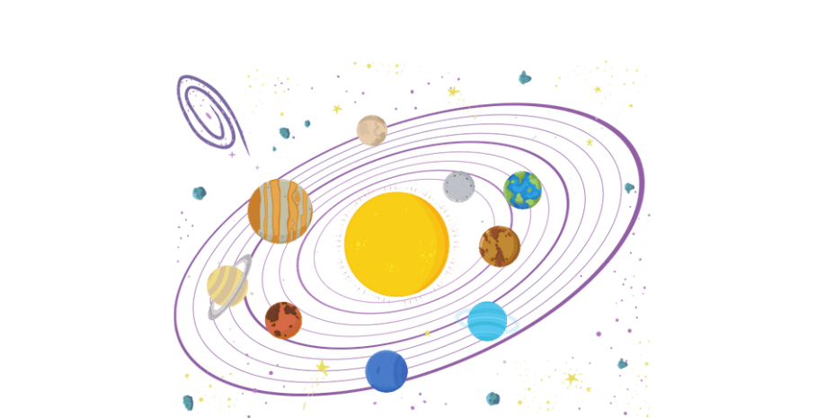
The Sun stays in the centre of the Solar System.
Notes:
Image credit: canva
Teacher notes:
The Sun does in fact rotate around its own axis. It also orbits the galaxy. The important thing is that children do not think that we see it moving across the sky because it is moving around in space.

Slide 8
Quick Quiz!
Question 3/3
Does the Earth move?
Yes
No
Notes:
Image credit: canva
Teacher notes:
Click to reveal the answer on the next slide

Slide 9
Quick Quiz!
Question 3/3
Does the Earth move?
Yes
No
Notes:
Image credit: canva

Slide 10
The Earth orbits the Sun. The Earth also rotates around its own axis.
Sun
axis
Notes:
Image credit: NSO
Teacher notes:
The Earth takes 1 year to orbit the Sun
The Earth takes 1 day to rotate around its axid
The axis runs from North to South
The axis is tilted with respect to the Earth’s orbit by about 23 degrees

Slide 11
Why is it light in the day-time and dark at night-time? Let's investigate!
Notes:
Image credit: NSO

Slide 12
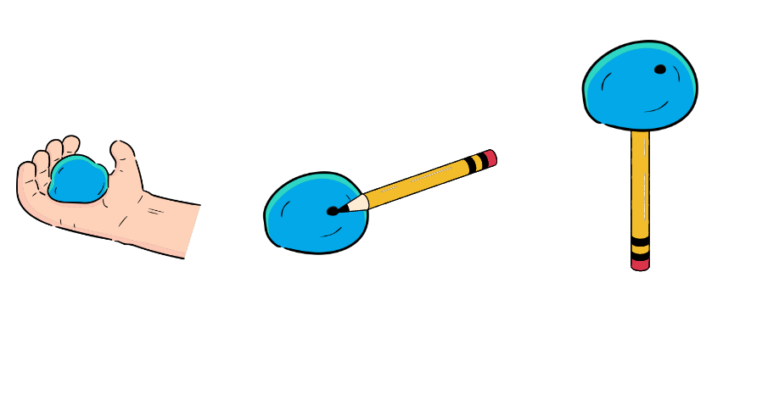
Set Up Your Investigation!
1. Roll the play-doh into a ball - this represents planet Earth.
2. Use a pencil to put a mark on the ball - this represents where you are on Earth.
3. Push the pencil into the ball of play-doh so that the ball stays securely attached to the pencil when you hold the pencil up - the pencil represents the axis that the Earth rotates around.
Notes:
Image credit: NSO

Slide 13
Method
One person holds the pencil
The other person holds the torch
Turn on the torch and shine it on the Earth
Spin the pencil so that the play-doh Earth rotates
Carefully watch the mark you made on the Earth
Notes:
Image credit: NSO

Slide 14
Investigate
Carefully watch the mark you made on the play-doh Earth as it rotates.
Imagine you are standing on the mark. Can you work out when you would have each of the following:
Sunrise
Day-time
Sunset
Night-time
Draw and label a diagram of the play-doh Earth, the mark, and the Sun (torch) at each of those times.
Notes:
Teacher notes:
The next slide shows what the diagrams should look like

Slide 15
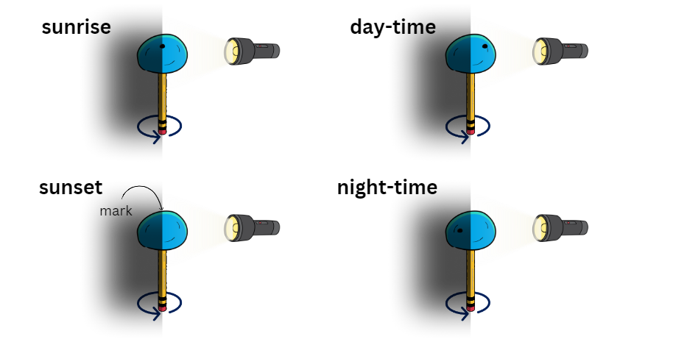

Slide 16
Show What You Know!
Choose where each word should go:
The imaginary line that the Earth rotates around is called its *axis*. Earth *rotates* once every 24 hours.
When our part of Earth is facing the Sun, it is *day-time*. When our part of Earth is facing *away from* the Sun, it is night-time.
away from
axis
day-time
rotates
Notes:
Teacher notes:
The next slide shows what the diagrams should look like

Slide 17
Show What You Know!
Choose where each word should go:
The imaginary line that the Earth rotates around is called its *axis*. Earth *rotates* once every 24 hours.
When our part of Earth is facing the Sun, it is *day-time*. When our part of Earth is facing *away from* the Sun, it is night-time.
axis
rotates
day-time
away from

