Slide 1
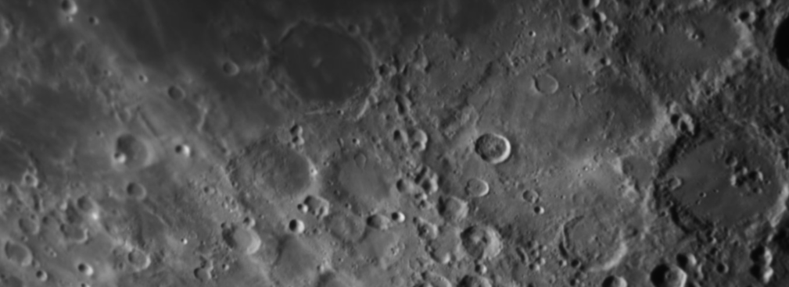
HOW TALL ARE MOUNTAINS ON THE MOON?
Notes:
Image credit: LR/ARI/NSO/LJMU

Slide 2
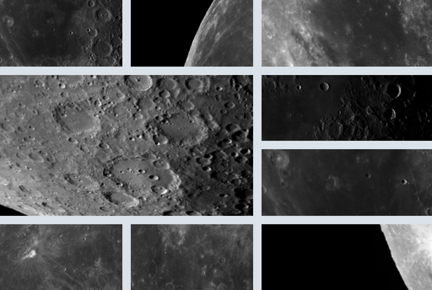
Investigate
The Moon is our nearest neighbour in space.
From Earth, it may look smooth and featureless. But if you look more closely, you will soon see that the lunar surface is not smooth.
It is made up of a variety of dark and bright regions, mountain ranges and thousands upon thousands of craters.
But how tall are the mountains on the Moon? Complete this investigation to find out.
Notes:
Image credit: LT/ARI/NSO/LJMU

Slide 3
Watch this video before you start the investigation. If you have already watched it, you can skip this slide.
Notes:
Note: You must enable content to play this video. It is also available on the NSO website and on the NSO YouTube channel:
https://www.schoolsobservatory.org/things-to-do/what-makes-shadows-moon
https://youtu.be/ErUH1z--RnA

Slide 4
Quick quiz
Q1. The terminator is…?
The most northerly point of the Moon
The line around the centre of the Moon (equator)
The line that separates the light and dark sides of the Moon
Notes:
Answer revealed on the next slide

Slide 5
Quick quiz
Q1. The terminator is…?
The most northerly point of the Moon
The line around the centre of the Moon (equator)
The line that separates the light and dark sides of the Moon
Notes:
Answer revealed on the next slide

Slide 6
Quick quiz
Q2. The best time to look for shadows on the Moon is at…?
Full Moon
First Quarter or Last Quarter
New Moon
Notes:
Answer revealed on the next slide

Slide 7
Quick quiz
Q2. The best time to look for shadows on the Moon is at…?
Full Moon
First Quarter or Last Quarter
New Moon
Notes:
Answer revealed on the next slide

Slide 8
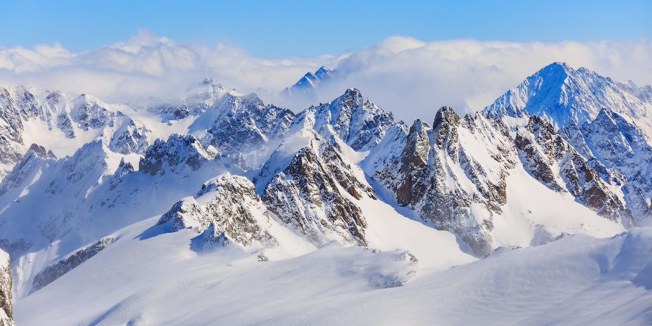
Background information
There are mountains on the Earth and on the Moon.
Mountains on the Earth range in height from 1 km to 8 km high.
They formed through active volcanism and tectonic plate activity. Neither of these processes have been present on the Moon for billions of years.
Mountains on the Moon formed through massive asteroid impacts. These left behind deep craters and high crater walls.
Notes:
Image credit: Canva

Slide 9
Quick quiz
Fill in the blanks using the words below.
“The gravity on the is lower than the gravity on the .
Mountains on the Earth are by wind and rain.
These erosion processes can only take place when there is an .”
eroded
Moon
atmosphere
Earth
Notes:
Answer revealed on the next slide

Slide 10
Quick quiz
Fill in the blanks using the words below.
“The gravity on the is lower than the gravity on the .
Mountains on the Earth are by wind and rain.
These erosion processes can only take place when there is an .”
Moon
Earth
eroded
atmosphere
Notes:
Answer revealed on the next slide

Slide 11
Make a prediction
Which are taller?
Mountains on the Moon?
Mountains on Earth?
Make a note of your prediction.
Notes:
Top image credit: LT/ARI/NSO/LJMU
Bottom image credit: Canva

Slide 12
Method
If we know the height of an object and the length of its shadow, we can use the information to estimate the height of a second object just by measuring the length of the second object's shadow.
The method relies on:
The Sun remaining at the same angle during both measurements.
The application of a bit of geometry, known as ‘similar triangles’.
Notes:
Image credit: NSO

Slide 13
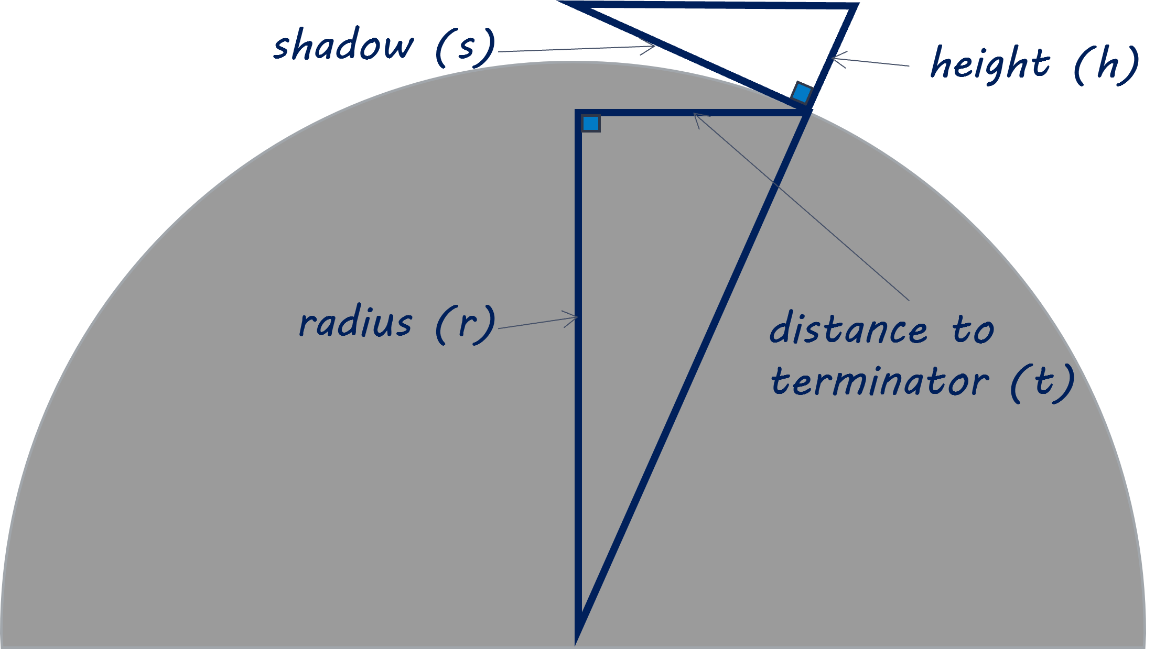
Method
You will measure 2 triangles:
One created by the height and shadow of the mountain.
One created by the distance of the mountain to the terminator and to the centre of the Moon.

Slide 14
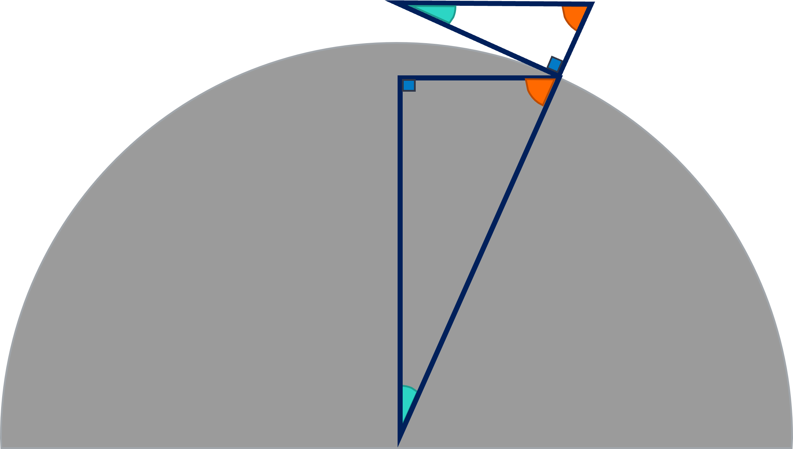
Method
Two triangles are similar if:
The angles are the same size.
Or the corresponding sides are in the same ratio.
You can tell your two triangles are similar because:
The top lines of each are parallel.
They both contain a right-angle.
Notes:
Note: Students do not need to use rules of similar triangles or have knowledge of corresponding angles to complete the investigation. This is for information and demonstrating the applications of geometry.

Slide 15
Method
If the 2 triangles are similar, the following formula is true:
$$\frac{h}{s}=\frac{t}{r}$$
The formula can also be expressed as:
$$h=\frac{(s×t)}{r}$$

Slide 16
Assemble the Moonsaic
From the video on slide 3, we know that it is easier to see shadows at the Moon when the Moon is close to first or last quarter phase.
Download and print all the files of the Last Quarter – Moonsaic
Once printed, match and stick the pieces together like a jigsaw puzzle. Each image overlaps slightly so that you can glue the edges together securely.
Notes:
Link to Moonsaic files
https://www.schoolsobservatory.org/things-to-do/moonsaic

Slide 17
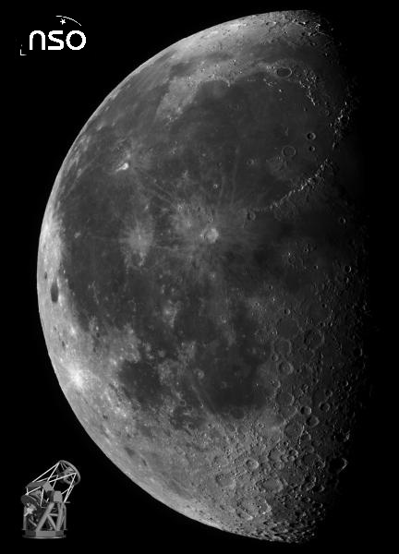
Your finished Moonsaic should look like this!
Notes:
Image credit: LT/ARI/NSO/LJMU

Slide 18
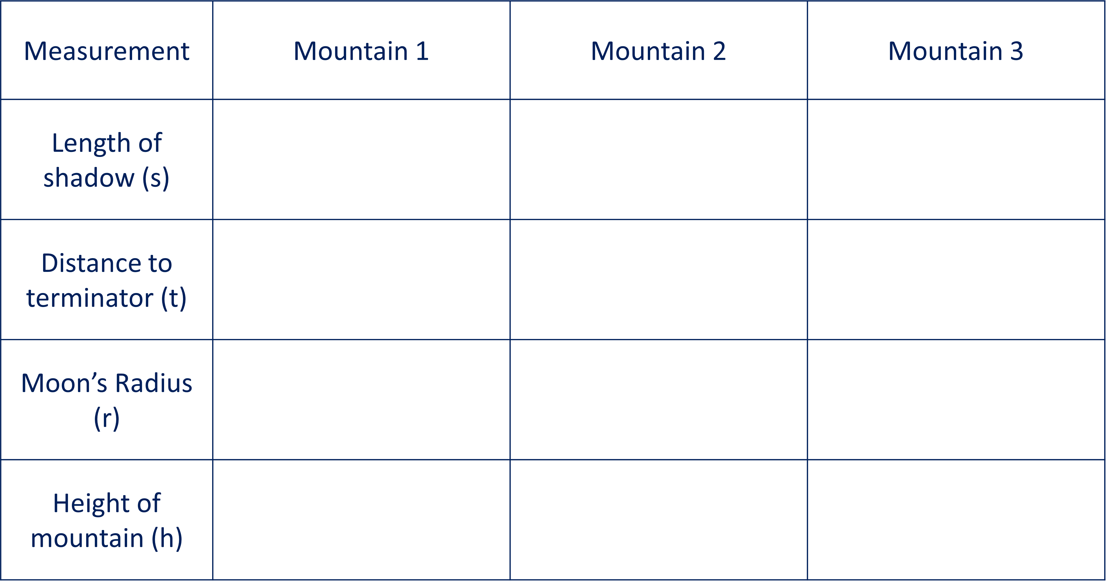
Collect your data
Pick 2 or 3 mountains on the Moonsaic that are:
near the centre of the Moon
fairly close to the terminator
Use a ruler to measure the following distances:
length of shadow (s)
distance of the mountain to the terminator (t)
Also, measure the radius of the Moon (r) on your printed Moonsaic - you only need to do this once.
Tip! Record your measurements in a table like this.

Slide 19
Calculate the height
Use the formula to work out the height (h) of each mountain.
h = measured height of the mountain
s = length of the shadow
t = distance to the Moon's terminator
r = measured radius of the Moon on your print-out
Record the heights in your table.
$$h= \frac{(s×t)}{r}$$
Tip! Make sure you have used the same units for all measurements!

Slide 20
Calibrate your results
You have worked out the heights of your lunar mountains, but they are probably only a few centimetres tall. Is that realistic?
Your results are scaled down because you have measured small images of shadows, rather than the shadows themselves.
You need to calibrate (scale up) your results so that you can present your answer in terms of the true height of the mountains on the Moon.
Notes:
Reveal the next slide to show how to rearrange the formula

Slide 21
$$\frac{True height of mountain, H}{Radius of the Moon, R} \left(in km\right)=\frac{Measured height of mountain, h}{Radius of Moon on poster, r}(in cm)$$
1. This is the same formula, but it is written out using only the symbols
$$\frac{H}{R} =\frac{h}{r}$$
2. You want to find out H, so you need to make H the subject of the formula and isolate it from the other variables
$$\frac{H}{R} =\frac{h}{r}$$
$$\frac{H}{R}×R =\frac{h}{r}×R$$
3. H is being divided by R. To isolate H, multiply both sides of the formula by R
$$H =\frac{h}{r}×R$$
4. H is now isolated, so H is the subject of the formula
Notes:
Click to reveal each step

Slide 22
Assess your results
Check whether the true heights (H) you have calculated seem reasonable.
Consider the following and decide if your results make sense:
The radius of the Moon is less than 2000 km. So, any answers greater than that cannot be right.
It is impossible to measure a height of 0.002 km (20 m) with the method you just used.
The highest mountain on the visible side of the Moon is around 4.7 km (4700 metres) tall.

Slide 23
Conclusions
Try to answer the following questions:
Do your results help you answer the question "How tall are mountains on the Moon?“
How do your results compare to the height of mountains on Earth?
Was your prediction correct?
What can you conclude from your investigation?
Go back to slide 8 to check the heights of mountains on Earth

Slide 24
Recommendations
Finally, think about the following:
Can you think of any parts of the investigation where you made an assumption?
Can you think of any parts of the investigation where errors may have been included in your results?
If you did the investigation again, would you change anything to make it more accurate or reliable?
If you had unlimited resources, how would you measure the height of mountains on the Moon?

Slide 25
Notes:
Image credit: Canva

