Slide 1
Space Jobs
Notes:
Notes for teachers –
This resource has been created by the National Schools’ Observatory.

Slide 2
Can you think of any jobs for people interested in space science?
Notes:
Notes for teachers – ask class for ideas

Slide 3
Who wants a space job when they are older?
Notes:
Notes for teachers – ask class for ideas

Slide 4
What is a stereotype?
Notes:
Notes for teachers – ask class for ideas

Slide 5
What is a stereotype?
A stereotype is a fixed belief about a particular group of people.
Here are some examples of stereotypes:
Girls are better at cooking than boys
Children don’t like healthy food
Boys are messy

Slide 6
Space for Everyone Quiz True or False…
Notes:
Notes for teachers –
Quiz statements and further information for discussion can be found in the resource ‘Space Jobs Quiz’

Slide 7
Girls and boys can go to space
Notes:
Notes for teachers –
Ask the class to vote on each statement before you go to the next slide.
The next slide reveals the answer.
Quiz statements and discussion prompts can be found in the resource ‘Space for Everyone Quiz’

Slide 8
Mae Jemison is a former NASA Astronaut
TRUE!
501 men and 65 women have been to space.
Helen Sharman was the UK’s first astronaut!
Notes:
https://www.schoolsobservatory.org/careers/interested/spaceflight/mae-Jemison
Image credit: NASA
Numbers correct January 2021

Slide 9
All scientists are boys
Notes:
Notes for teachers –
Ask the class to vote on each statement before you go to the next slide.
The next slide reveals the answer.
Quiz statements and discussion prompts can be found in the resource ‘Space for Everyone Quiz’

Slide 10
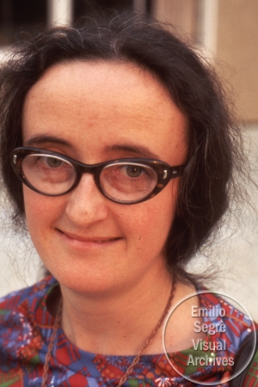
Beatrice Tinsley was an Astronomer
FALSE
Astronomers are scientists who study objects in space.
Notes:
https://www.schoolsobservatory.org/careers/interested/stargazing/beatrice-tinsley
Image Credit: AIP Emilio Segrè Visual Archives, John Irwin Slide Collection Low res image used with permission

Slide 11
The best science shows are presented by men
Notes:
Notes for teachers –
Ask the class to vote on each statement before you go to the next slide.
The next slide reveals the answer.
Quiz statements and discussion prompts can be found in the resource ‘Space for Everyone Quiz’

Slide 12
FALSE
Lots of men and women present great science shows on TV and YouTube.
Maggie Aderin-Pocock is a TV presenter and a space scientist
Notes:
https://www.schoolsobservatory.org/careers/interested/explaining/maggie-aderin-Pocock
Credit: Science and Technology Facilities Council

Slide 13
Most of the first computer programmers were girls
Notes:
Notes for teachers –
Ask the class to vote on each statement before you go to the next slide.
The next slide reveals the answer.
Quiz statements and discussion prompts can be found in the resource ‘Space for Everyone Quiz’
’

Slide 14
TRUE!
Many black, women wrote computer code for NASA in the 1950s.
Dorothy Vaughan was a NASA computer programmer
Notes:
https://www.schoolsobservatory.org/careers/interested/computers/dorothy-Vaughan
Credit: Unknown author

Slide 15
Girls can be engineers
Notes:
Notes for teachers –
Ask the class to vote on each statement before you go to the next slide.
The next slide reveals the answer.
Quiz statements and discussion prompts can be found in the resource ‘Space for Everyone Quiz’

Slide 16
TRUE!
Engineers like Mimi, design robots that are sent to explore other planets for us!
Mimi Aung is a Space Engineer
Notes:
https://www.schoolsobservatory.org/careers/interested/making/mimi-aung
Credit: NASA/JPL

Slide 17
Boys don’t care about plants and animals
Notes:
Notes for teachers –
Ask the class to vote on each statement before you go to the next slide.
The next slide reveals the answer.
Quiz statements and discussion prompts can be found in the resource ‘Space for Everyone Quiz’
’

Slide 18
Piers Sellers, NASA astronaut and climate change scientist
FALSE
Men like Piers want everyone to work together to help look after our beautiful planet, Earth.
Notes:
https://www.schoolsobservatory.org/careers/interested/nature/piers-sellers
Credit: NASA

Slide 19
Girls are better at writing than boys
Notes:
Notes for teachers –
Ask the class to vote on each statement before you go to the next slide.
The next slide reveals the answer.
Quiz statements and discussion prompts can be found in the resource ‘Space for Everyone Quiz’

Slide 20
Anthony Aveni is an astronomer and author of many books, including some children’s books
FALSE
Authors say that reading lots of book can help you to become a better writer.
Notes:
https://www.schoolsobservatory.org/careers/interested/history/anthony-aveni
Credit: All rights reserved. Used by permission.

Slide 21
Boys are braver than girls
Notes:
Notes for teachers –
Ask the class to vote on each statement before you go to the next slide.
The next slide reveals the answer.
Quiz statements and discussion prompts can be found in the resource ‘Space for Everyone Quiz’

Slide 22
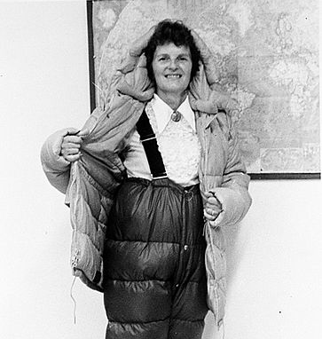
Ursula Marvin was an Explorer. She travelled to Antarctica to study meteorites found there.
FALSE
Men and women have braved flying to space, sailing around the world, and trekking to the South Pole.
Notes:
https://www.schoolsobservatory.org/careers/interested/exploring/ursula-marvin
Credit: Charles Hanson

Slide 23
Girls can be maths experts
Notes:
Notes for teachers –
Ask the class to vote on each statement before you go to the next slide.
The next slide reveals the answer.
Quiz statements and discussion prompts can be found in the resource ‘Space for Everyone Quiz’
’

Slide 24
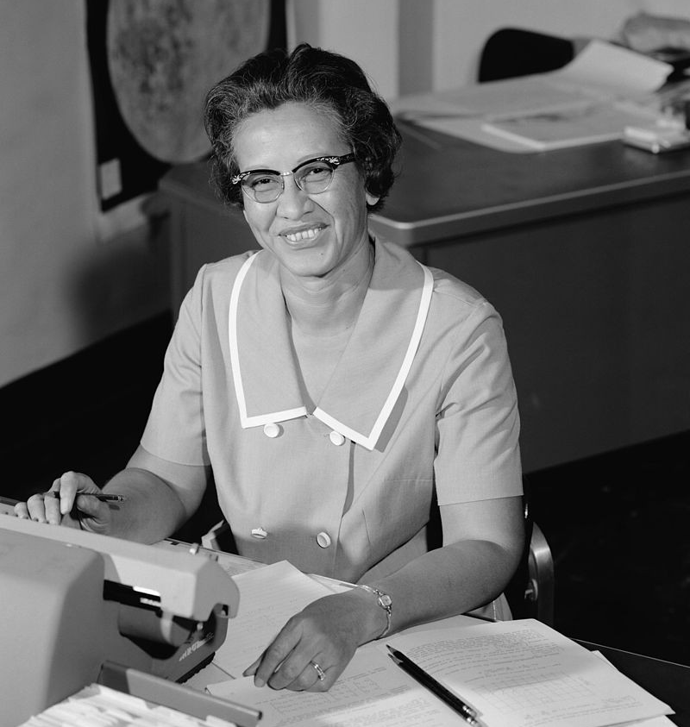
Katherine Johnson was a NASA mathematician
TRUE!
Most jobs need you to use maths in some way. Katherine used maths to help send astronauts to the Moon!
Notes:
https://www.schoolsobservatory.org/careers/interested/numbers/katherine-johnson
Credit: NASA

Slide 25
Boys are better leaders than girls
Notes:
Notes for teachers –
Ask the class to vote on each statement before you go to the next slide.
The next slide reveals the answer.
Quiz statements and discussion prompts can be found in the resource ‘Space for Everyone Quiz’

Slide 26
Alice Bunn is a Leader at the UK Space Agency
FALSE
Women have led countries including the UK, New Zealand, Germany, Bangldesh, and Barbados.
Notes:
https://www.schoolsobservatory.org/careers/interested/influencing/alice-bunn
Credit: UK Gov

Slide 27
Space Job Game Stand up…
Notes:
Notes for teachers –
Don’t show the next slide until you’ve read out the five statements
Game rules:
Ask everyone to stand up and teacher reads out list of statements relating to a particular job one at a time
If a statement doesn’t apply to an individual, they sit down
All pupils remaining standing when all statements have been read out have some of the skills and qualities needed to do that job
Game statements can be found in the resource ‘Stand Up Space Jobs Game’.
Reinforce that interests, skills, qualities are more important when choosing a career than gender or skin colour.

Slide 28
Astronaut!
Notes:
Notes for teachers –
Reveal this slide after all 5 statements have been read out
Don’t show the next slide until you’ve read out the five statements

Slide 29
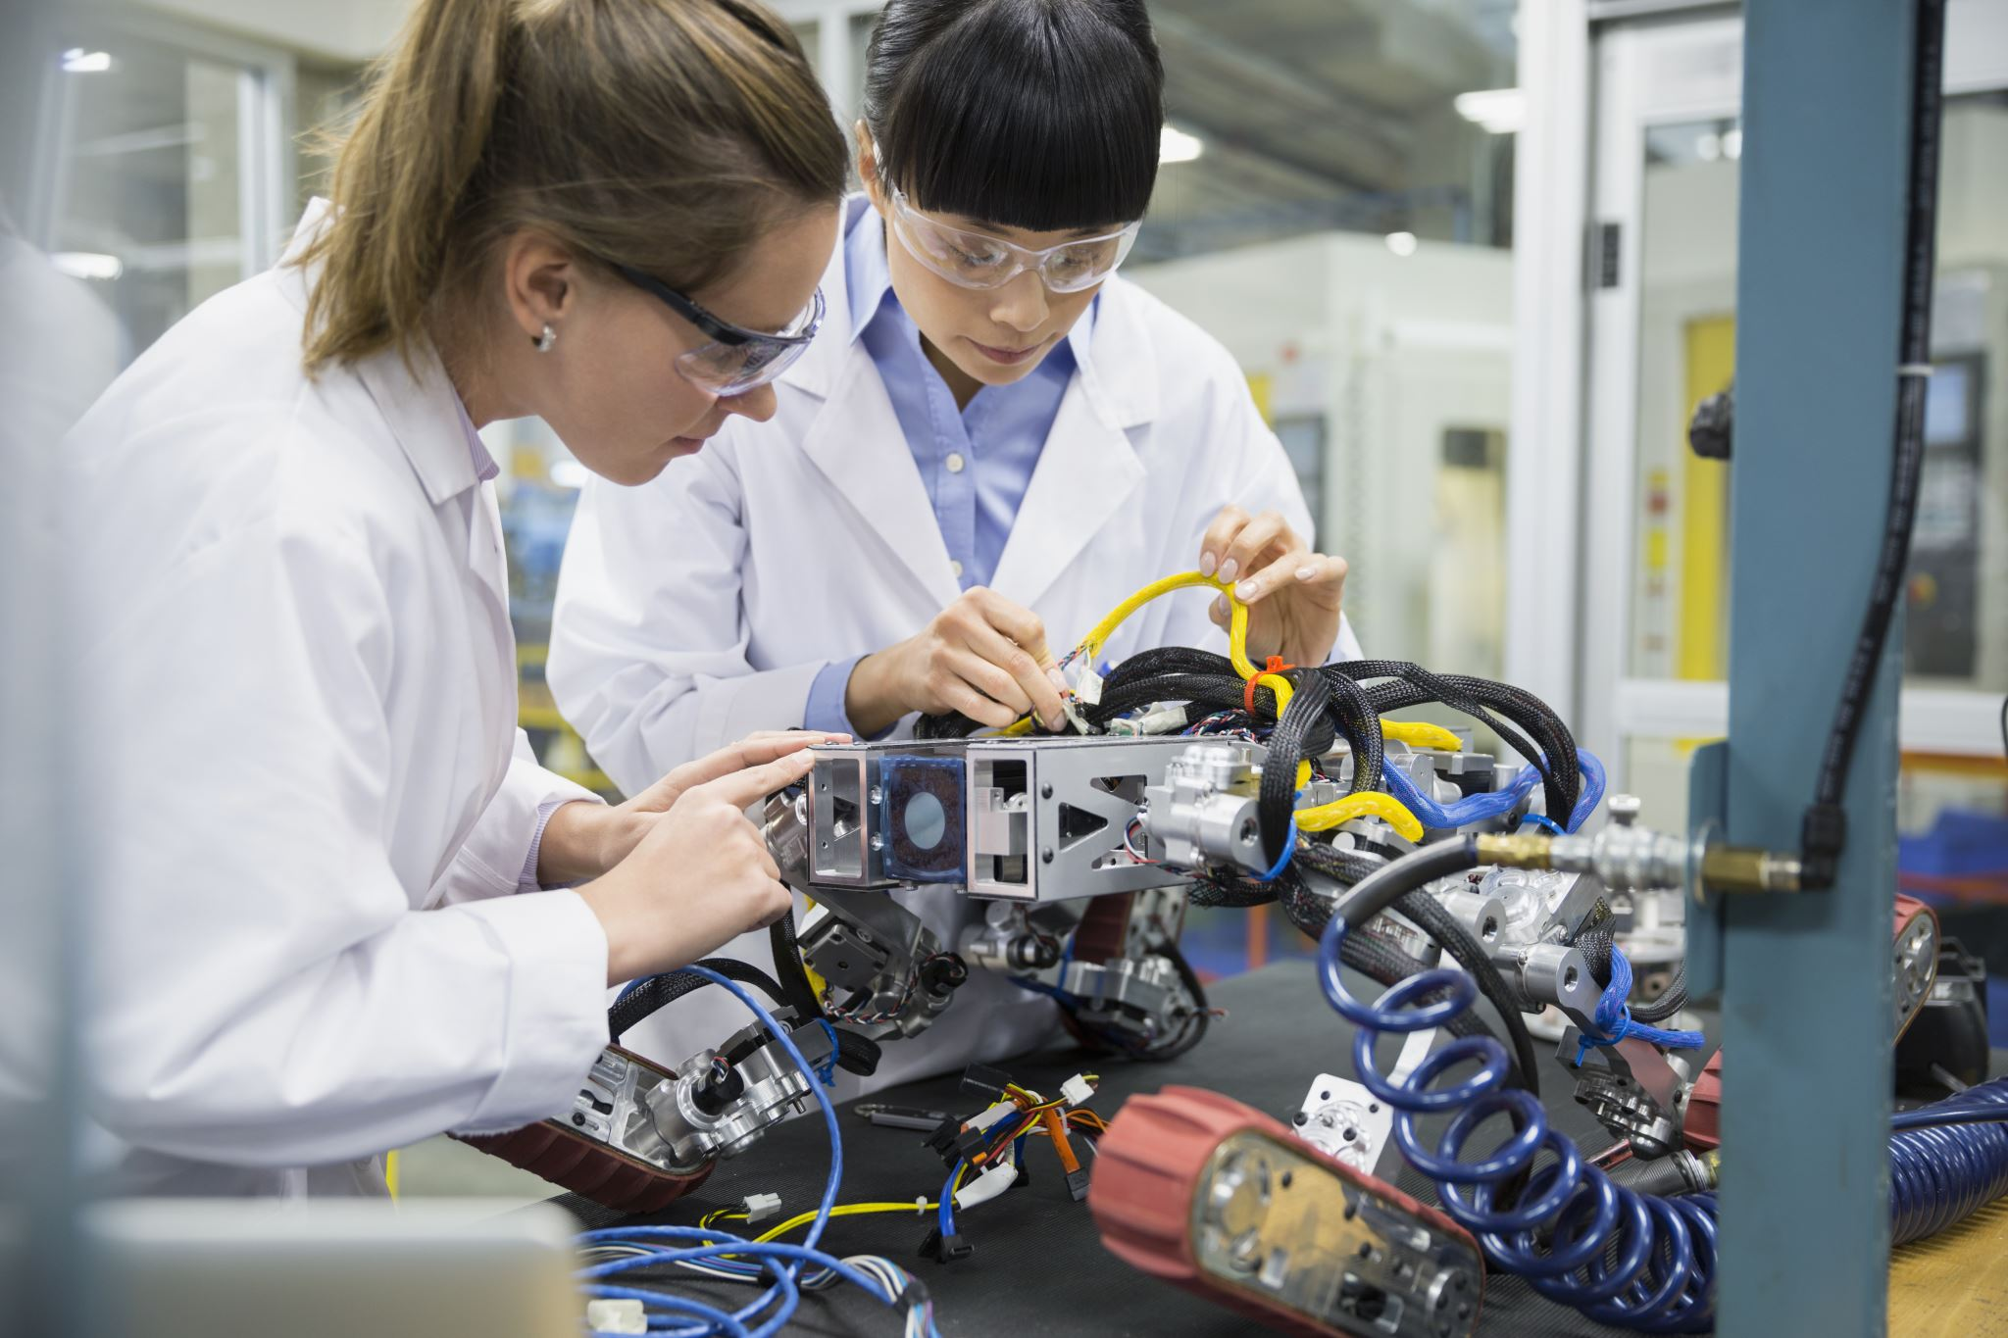
Engineer!
Notes:
Notes for teachers –
Reveal this slide after all 5 statements have been read out
Don’t show the next slide until you’ve read out the five statements

Slide 30
Scientist!
Notes:
Notes for teachers –
Reveal this slide after all 5 statements have been read out
Don’t show the next slide until you’ve read out the five statements

Slide 31
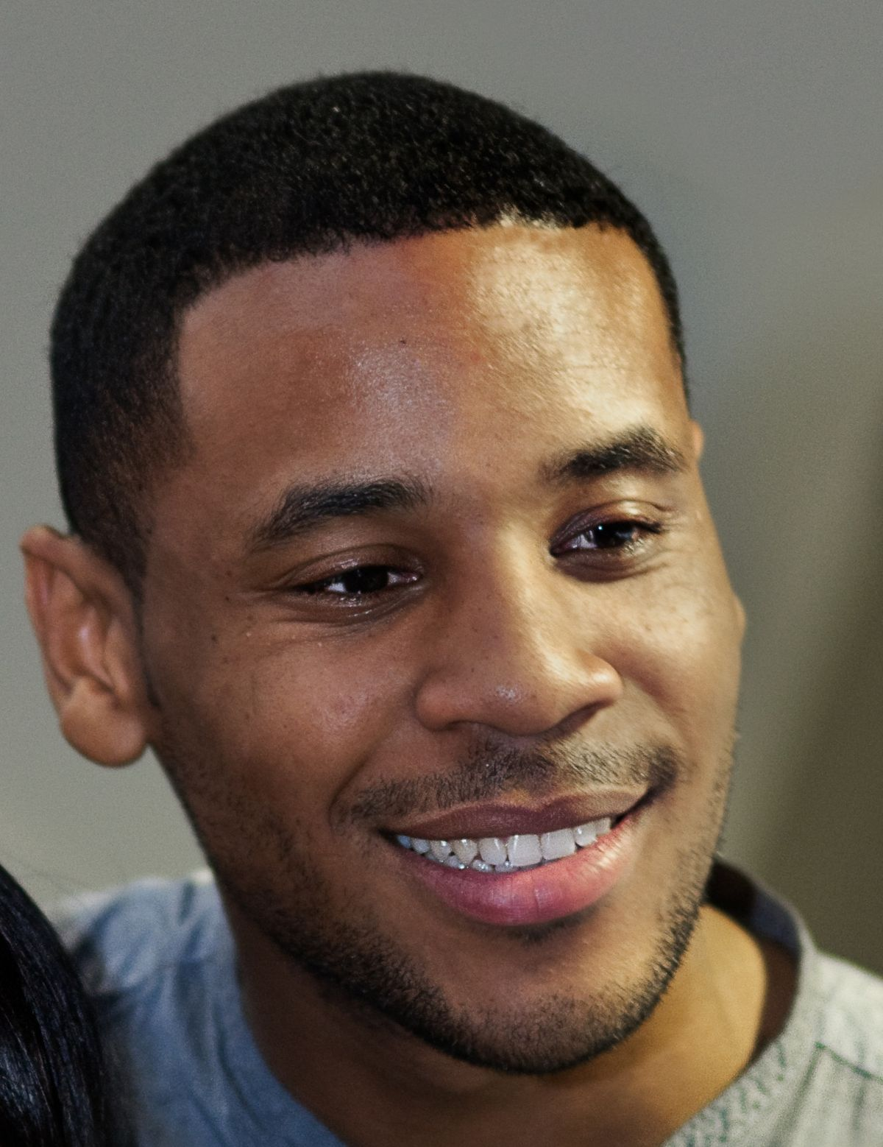
TV presenter!
This Photo by Unknown Author is licensed under CC BY-SA
Notes:
Notes for teachers –
Reveal this slide after all 5 statements have been read out
Don’t show the next slide until you’ve read out the five statements

Slide 32
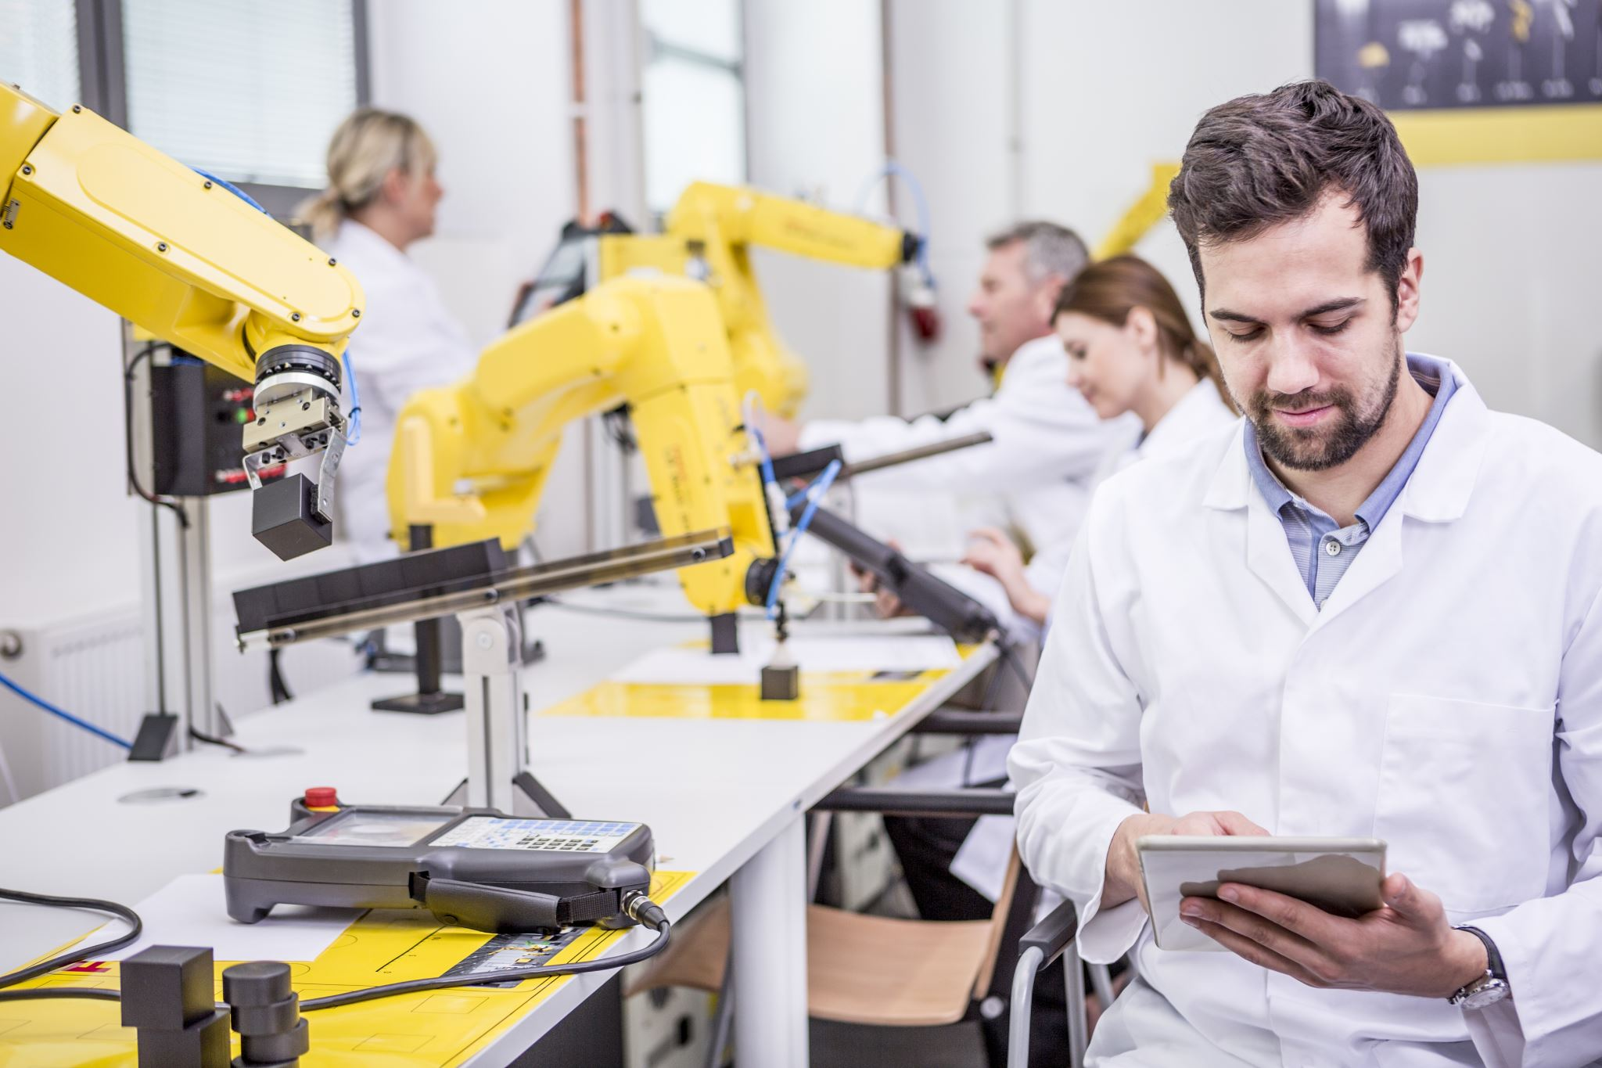
Computer programmer!
Notes:
Notes for teachers –
Reveal this slide after all 5 statements have been read out
Don’t show the next slide until you’ve read out the five statements

Slide 33
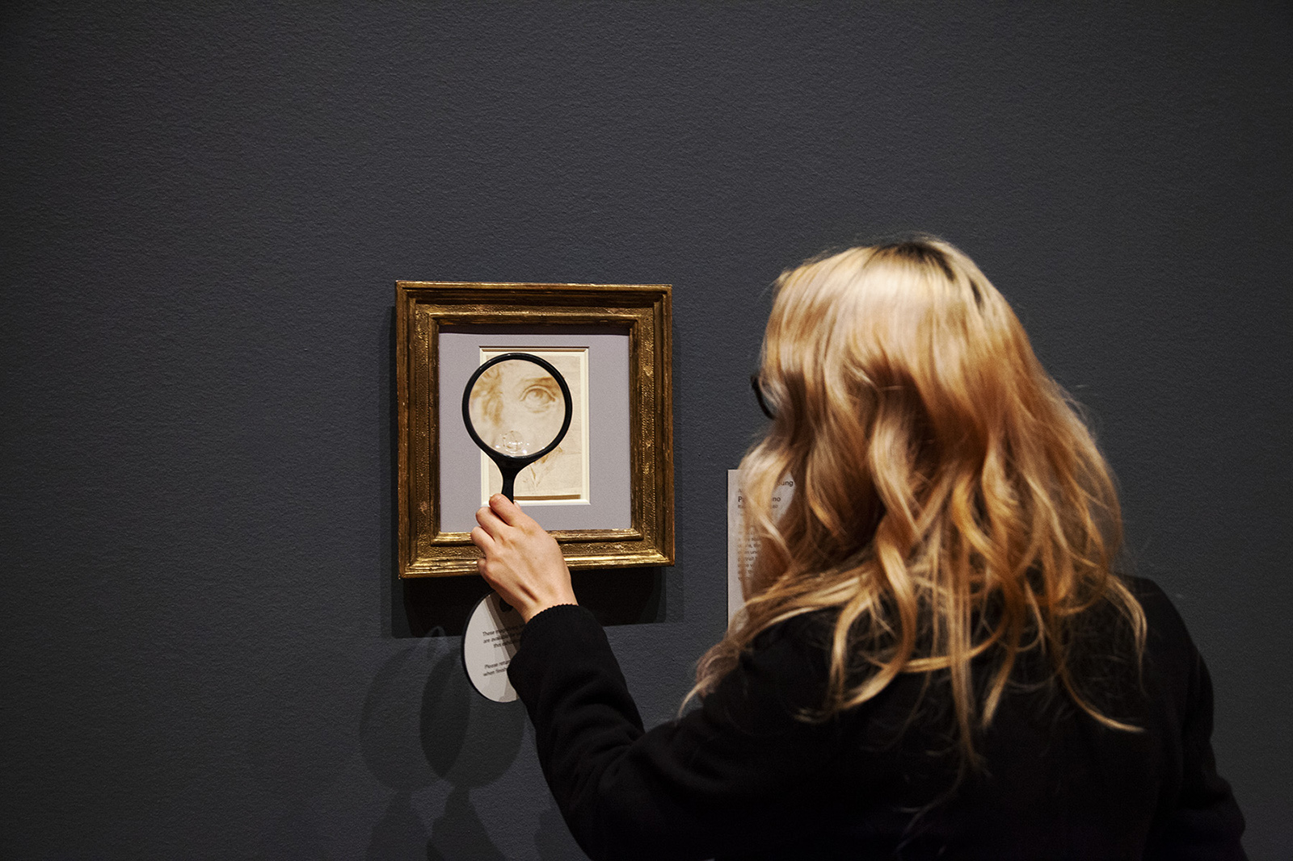
Museum curator!
This Photo by Unknown Author is licensed under CC BY
Notes:
Notes for teachers –
Reveal this slide after all 5 statements have been read out

Slide 34
Who wants a space job when they are older?
Notes:
Notes for teachers –
Discuss if/why anyone has changed their mind from the beginning of the lesson, following the quiz and game.

