Slide 1
Space Art Examples

Slide 2
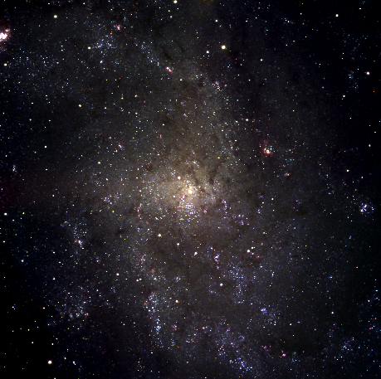
Triangulum Galaxy

Slide 3
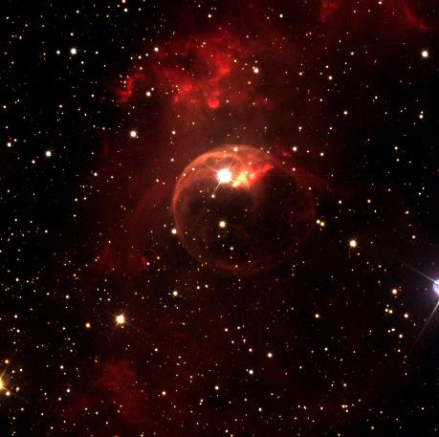
Bubble Nebula

Slide 4
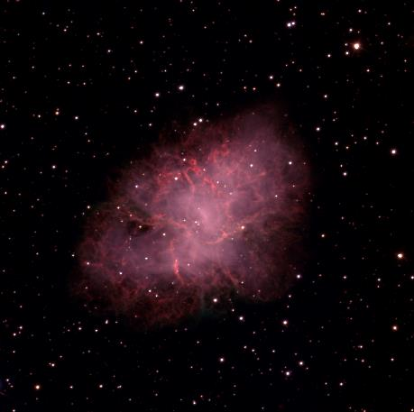
Crab Nebula

Slide 5
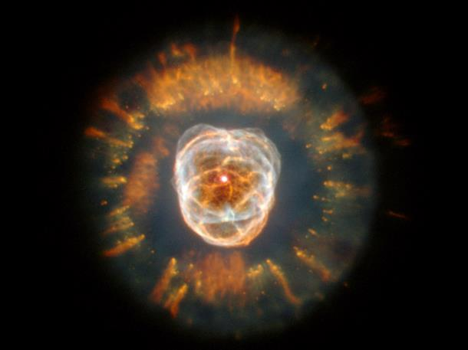
NGC 2392 Nebula

Slide 6
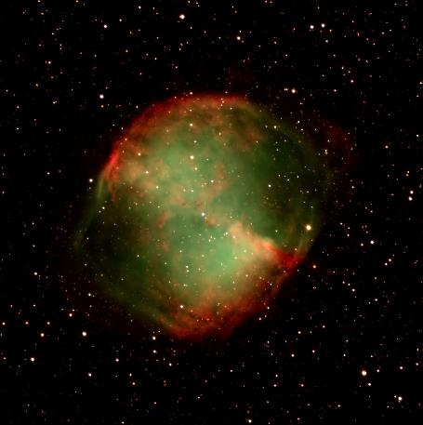
Dumbbell Nebula

Slide 7
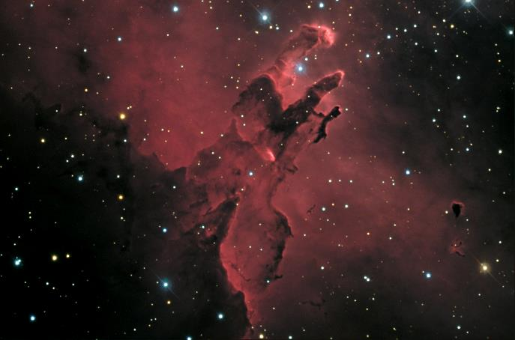
Eagle Nebula

