Slide 1
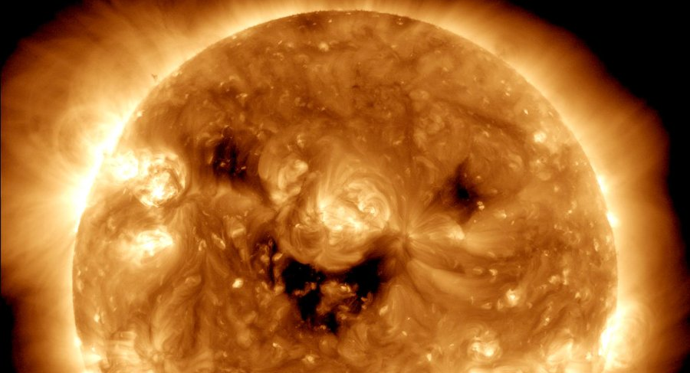
The Sun Quiz
Notes:
Image credit: ultraviolet image of the Sun taken by NASA’s Solar Dynamics Observatory.
The dark patches on the Sun are known as coronal holes and are regions where fast solar wind gushes out into space.

Slide 2
The sun was formed from a cloud of gas and dust, pulled together by which force?
Gravity
Tension
Electrostatic
Notes:
Click to reveal correct answer

Slide 3
What stage of its lifecycle is the Sun currently in?
Red giant
White dwarf
Main sequence
Notes:
Click to reveal correct answer

Slide 4
What type of reactions take place within the Sun?
Combustion
Nuclear fission
Nuclear fusion
Notes:
Click to reveal correct answer

Slide 5
What are the dark areas on the Sun called?
Sunspots
Sunpimples
Solar freckles
Notes:
Click to reveal correct answer

Slide 6
The Sun contains what percentage of the entire mass of the Solar System
9.86%
90.86%
99.86%
Notes:
Click to reveal correct answer

Slide 7
Approximately how hot is the Sun's core?
15,000,000 °C
15,000 °C
5,000 °C
Notes:
Click to reveal correct answer

Slide 8
Which one of these is not one of the layers in the Sun?
Conductive Zone
Convective Zone
Radiative Zone
Notes:
Click to reveal correct answer

Slide 9
What form of matter is the Sun?
Gas
Plasma
Solid
Notes:
Click to reveal correct answer

Slide 10
What are large explosions from the Sun's surface called?
Solar splashes
Solar flashes
Solar flares
Notes:
Click to reveal correct answer

Slide 11
Charged particles escape from the Sun's surface and blow out into space. What is this called?
Aurora
Solar wind
Corona
Notes:
Click to reveal correct answer

